Slide 1
Welcome

Slide 2
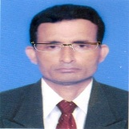
Introduction
Manik Chandra Majumder
Senior Teacher
Gazirhat High School
Senbag, Noakhali.
Contact No: o1717155169
E-mail:manikmajumder01@gmail.com
Class : Nine-Ten
Subject : English 1st paper
Time: 50 Minutes
Date : 00/00/2017

Slide 3
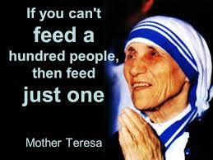
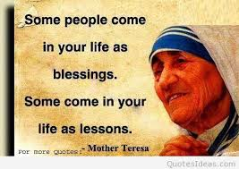
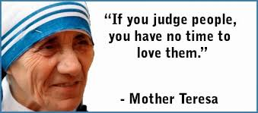
Look & read at the quotes

Slide 4
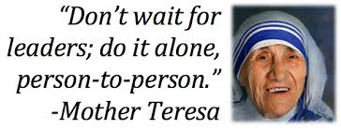
Who said these?

Slide 5
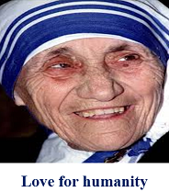
So dear, let’s know something more about----------
Mother Teresa,
a messenger of peace
Unit : Seven
lesson : Six
page : 94

Slide 6
Learning outcomes
After we have studied this lesson, we will be able to ----
a) Listen to the text for specific information,
b) ask and answer questions,
c) read and understand texts through silent
reading,
d) describe a person.

Slide 7
Observe the video attentively

Slide 8
Individual work
a) About what is the video ?
b) What has Mother Teresa taught us?

Slide 9
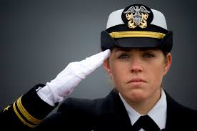
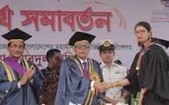
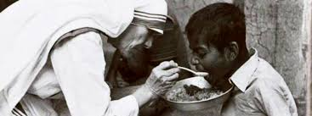
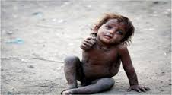
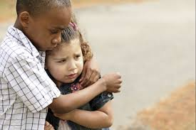
Click word
Word meaning and sentence making
Meaning : Identity, Acknowledged
Meaning : Exist, Stay alive
Meaning : Poor , Needy,lacking necessities of life
Meaning : Kindness, Sympathy, Empathy
Meaning : Greet , Welcome, sign of respect
Destitute (adj)
Survive (V)
Recognise (V)
Salute (V)
Compassion (N)
Sentence : Bangladesh showed a great compassion
for the Rohinga Refugee.
Sentence : Mother Teresa’s work is recognized all
over the world.
Sentence : The world salutes Mother Teresa’s love
and humanity.
Sentence : Missionaries of Charity would give job
the lepers those who survive from leprosy.
Sentence : Mother Teresa founded a home for the dying and destitute.

Slide 10
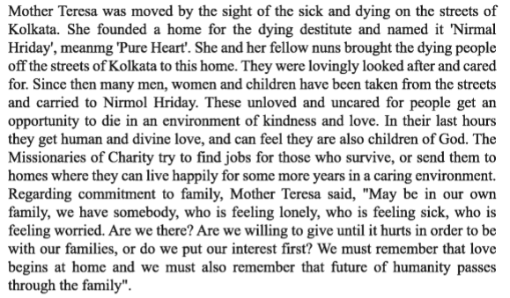
Students will read the passage silently/loudly.

Slide 11
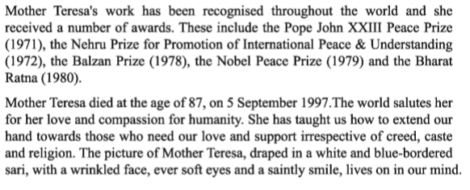

Slide 12
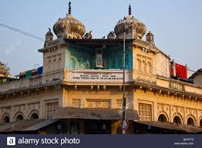
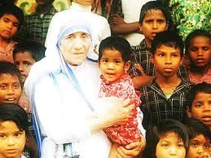
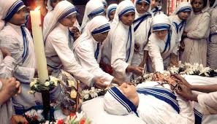
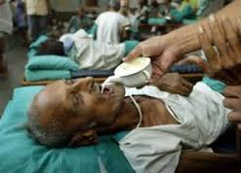
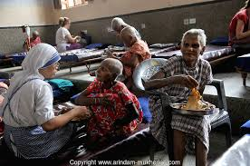
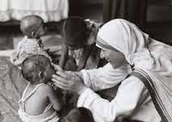
Now we will see some text related pictures.
Mother Teresa died at the age of 87, on 5 Sept.1997. The world salutes her for her love and compassion for humanity.
She gave shelter the dying and destitute in ‘Nirmal Hridoy’.
Mother Teresa founded the home for the dying and destitute and named it ‘Nirmal Hridoy’.
She gathered the rootless and orphan children.
She loved the unloved.
She fed the unfed.

Slide 13
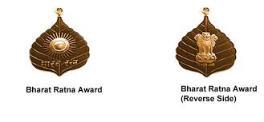
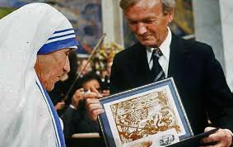
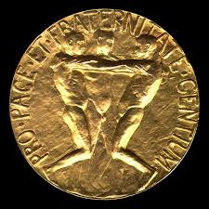
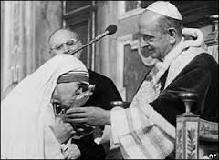
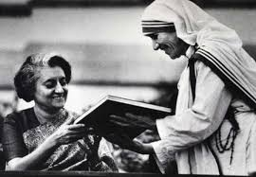
Observe some other text related pictures.
Mother Teresa’s work has been recognised throughout the world and she received a number of awards.
The Nobel Peace Prize (1979)
The Nehru Prize for promotion of International peace & understanding (1972)
The Balzan Prize (1978)
The Bharat Ratna ( 1980)
The Pope John XXIII Peace prize (1971)

Slide 14
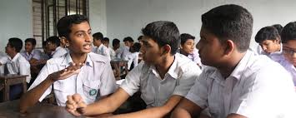
Group work-1
Make a list of Mother Teresa’s awards mantioning years.

Slide 15
Group work-2
Fill in the gaps with appropriate words
MotherTeresa a)…...Nirmal ‘Hridoy’for the dying b)….. who were left in the streets of kolkata.She and her fellow nuns c)……these people d)….. the Nirmal Hridoy and e) …..after them lovingly.These unloved and uncared people got an f )…… to g)…….in an environment of h) ……and love. Her work has been i)…….throughout the world and she received number of j) …….including noble prize.

Slide 16
Match your answer
Mother Teresa a) founded ‘Normal Hridoy’for the dying b) patients who were left in the streets of kolkata. She and her fellow nuns c) gathered these people d) in the Nirmal Hridoy and e) looked after them lovingly. These unloved and uncared people got an f ) opportunity to g) die in an environment of h) kindness and love. Her work has been i) recognized throughout the world and she received number of j) awards including noble prize.

Slide 17
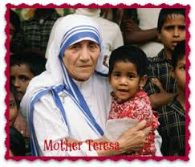
Look at the picture and work in pairs orally.
What do you think about the picture?
Mother Teresa is taking…..........
Who are the children?
They are rootless or orphan…..

Slide 18
Where did she collect them?
She collected them from the……............
Where did she shelter them?
SShe sheltered in Nirmal……..
Really she is a great lady. She is worthy for Nobel Prize.
Exactly.

Slide 19
Evaluation
Choose the best answer from the alternatives
Q: a) Mother Teresa has taught us how to extend our
hand to the…... .
Ans:
ii) powerful
Ans:
i) rich
iii) needy
iv) thieves
iii) needy
Q: b) Mother Teresa Founded a home for the destitute
named…... .
Ans:
Ans:
i) ‘Nirmal Hridoy’
i) ‘Nirmal Hridoy’
ii) ‘The Destitutes’
iii) ‘Divine Love’
iv) ‘Christian Missionary’

Slide 20
Q: c) According to Mother Teresa, love begins at….. .
Ans:
i)Family
Ans:
ii) home
ii) home
iii) School
iv) hospital
Q: d) Mother Teresa died in the……..century.
Ans:
iii) 20th
Ans:
i) 18th
ii) 19th
iii) 20th
iv) 21th
Q: e) Mother Teresa got Nobel Prize in …… .
Ans:
i) peace
ii) literature
iii) economics
iv) physics
Ans:
i) peace

Slide 21
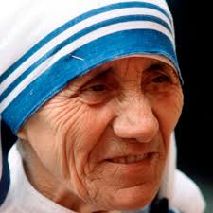
Home work
Write a paragraph about Mother Teresa.

Slide 22
GOOD BYE

