Slide 1
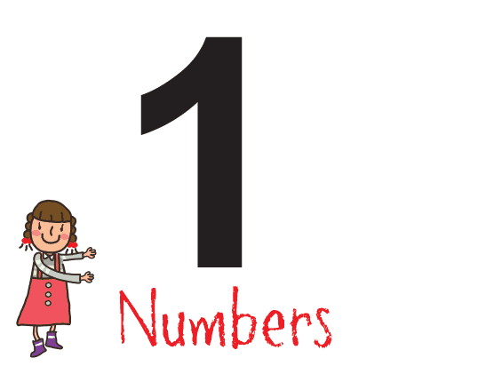
WELCOME
TO DAY’S CLASS

Slide 2
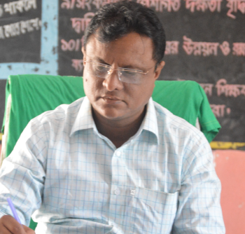
IDENTITY
LESSON
K.M.ABDUL BARI
SUBJECT: ENGLISH
AMOIN GPS
CLASS: Three
SHERPUR,BOGURA
LESSON: Number
bari64515@gmail.com
TIME: 35 MIN

Slide 3
watch and say what they are .

Slide 4
Lesson declaration
Our today’s lesson
Number .
1 2 3 4 5

Slide 5
LEARNING
OUTCOMES
Speaking
1.1.1 to repeat after the teacher and say words,phrases and sentences with proper sounds ,stress and intonation.
1.1.2 Say words,phrases and sentences with proper sounds ,stress .
Reading
2.1.1 recognize and read cardinal number up to 100.
writing
2.1.1 write cardinal numbers up to 100 in figures.

Slide 6
Individual work
Count 1, 2, 3, 4, 5 with the help of real object( book, pen , leaf,strick)

Slide 7
Teacher’s model reading(wcw)
Open the page 8
First time only I say the number then you will say after me.

Slide 8
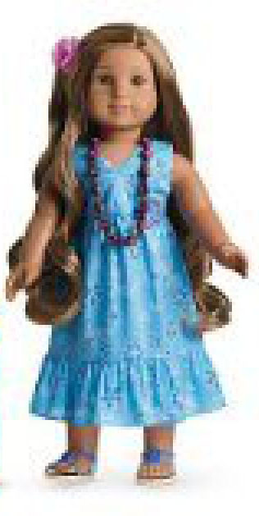
What is this?
How many doll ?
What is this?
1
How many pens ?
4

Slide 9
Look at the picture carefully.
How many caps there in the picture?
How many elephant there in the picture?
How many oranges there in the picture?
How many bags there in the picture?
What is this?
What is this?
What is this?
What is this?
What is this?
How many pencils there in the picture?

Slide 10
Open at page 8 .
Say, count and write the number beside the box .
2
4
1
3
5

Slide 11
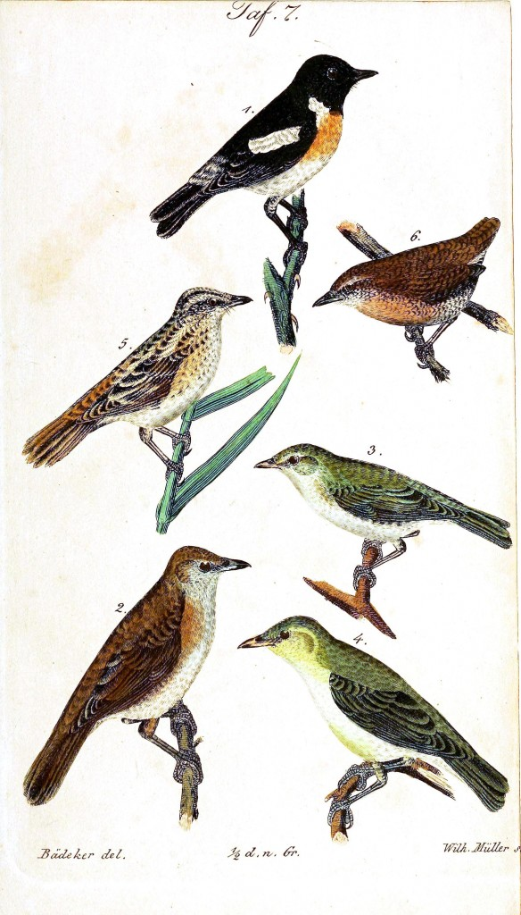
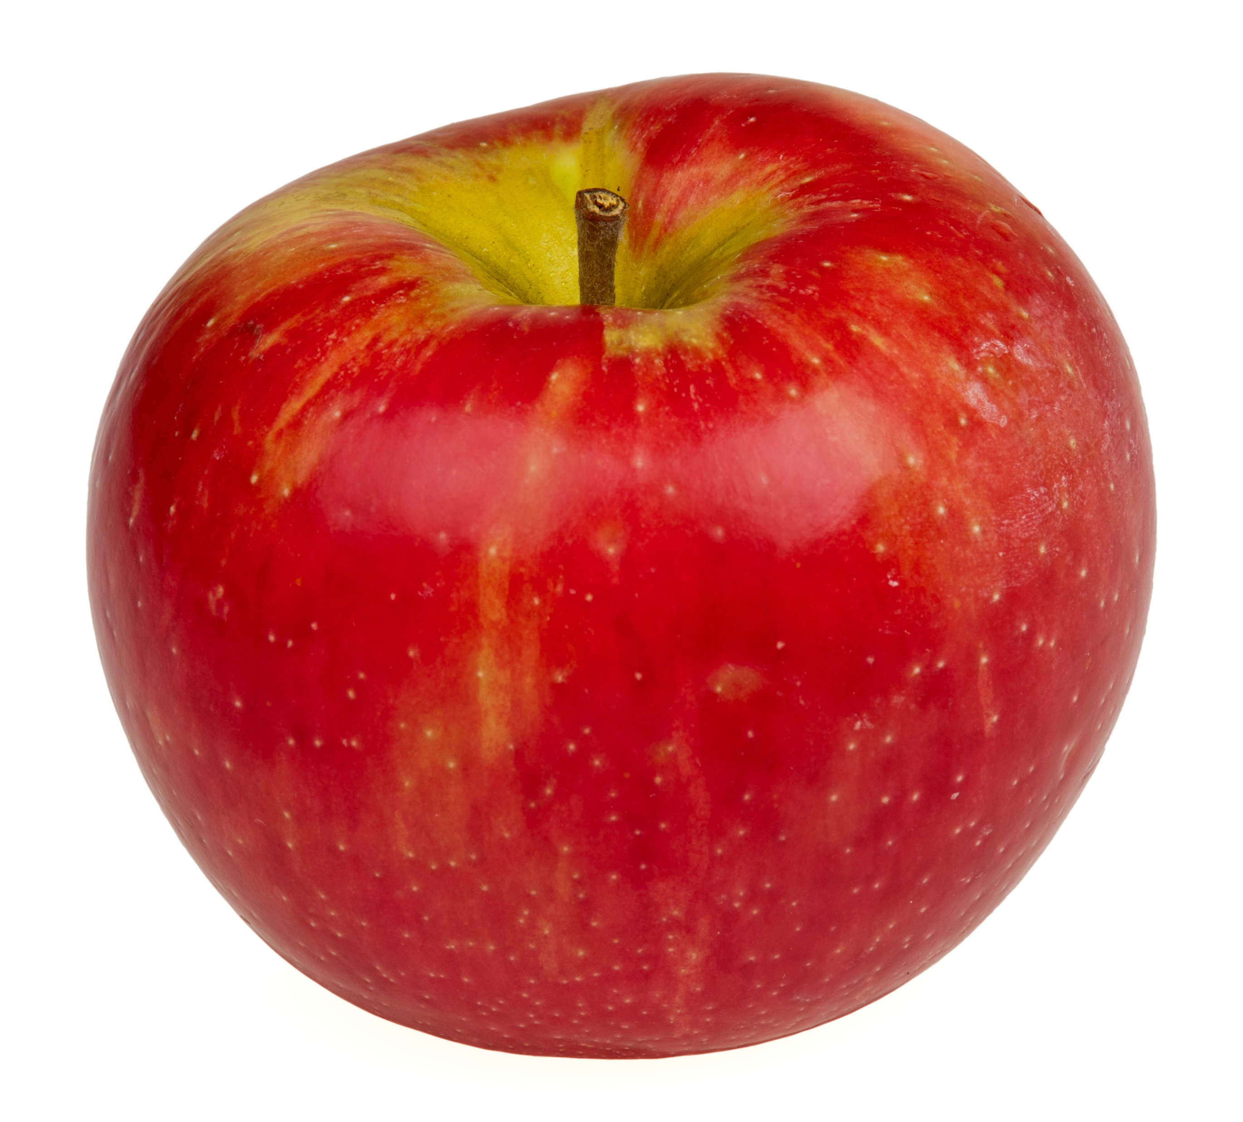
Count and say.
How many birds?
How many flowers?
How many apple?
5
3
1

Slide 12
Say the number.
2
5
4

Slide 13
Write the missing number.
2
4
5
1
3

Slide 14
Home work
Tomorrow you will bring home to write from 1 to 5 by colouring nicely .

Slide 15
H
A
N
K
S
T
t o a l l

