Slide 1
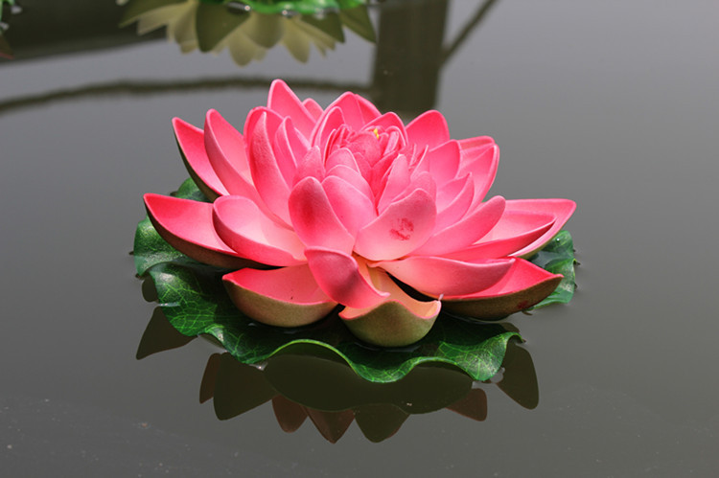
WEL COME

Slide 2
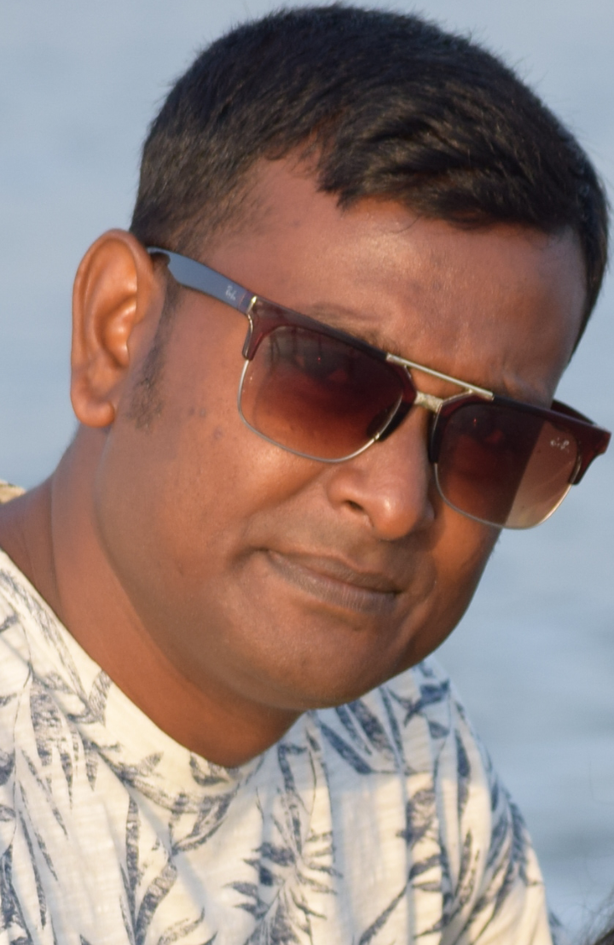
PRESENTED BY
Shahinur Rahman
Assistant Teacher of
Shibpur G.P. School
Birampur, Dinajpur
shahinurrahmanshibpur@gmail.com
017188243411

Slide 3
Class:Three
Sub:English
Unit : 7
Lesson:1 (I’m a. . . .food.)

Slide 4
Learning Outcomes
Students will be able to. . . . . . .
Read the passage with acceptable pronunciation.
Use new words.
Answer some questions .
Write five sentences about ‘A Crow’.

Slide 5
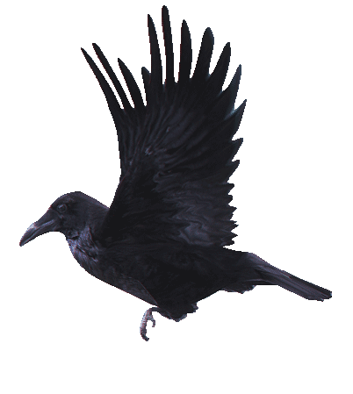
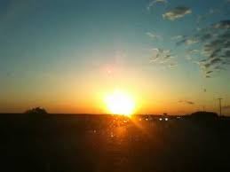
Look at the picture
Which birds can you see in this picture ?

Slide 6
Lesson Declaration
The crow

Slide 7
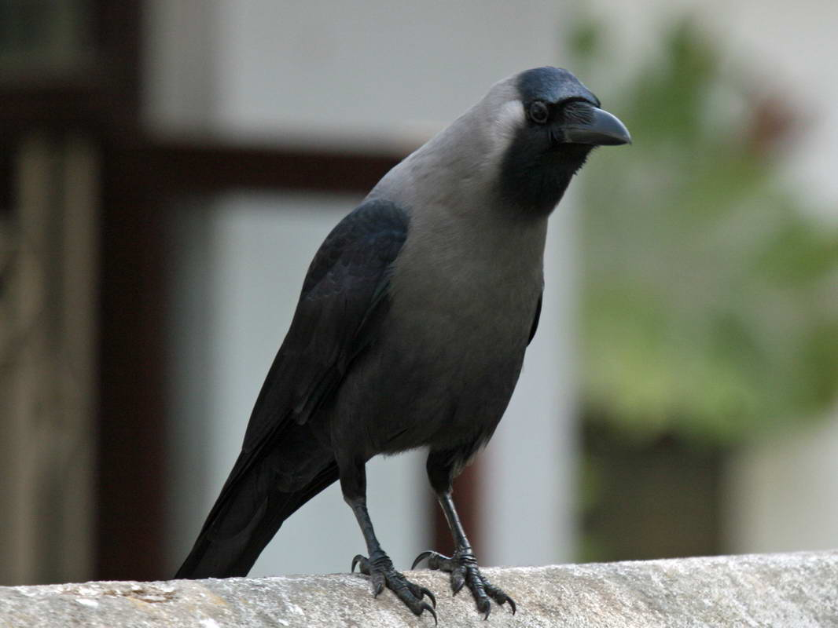
I’m a crow.

Slide 8
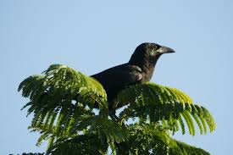
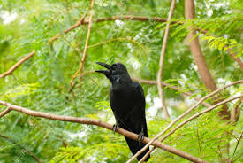
I live in a tree.

Slide 9
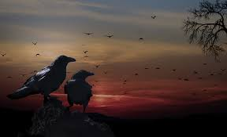
I get up early in the morning.

Slide 10
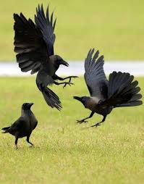
I’m active all day.

Slide 11
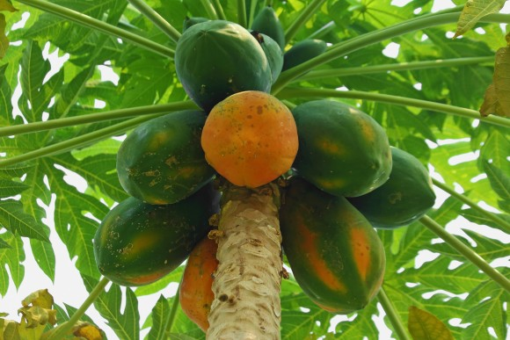
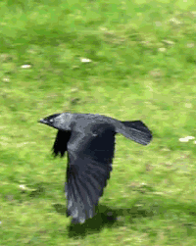
I fly in the sky and look for food.

Slide 12
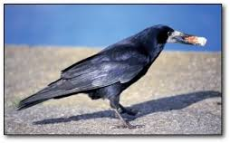
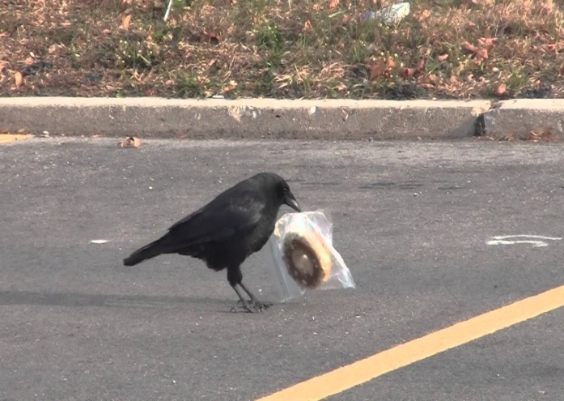
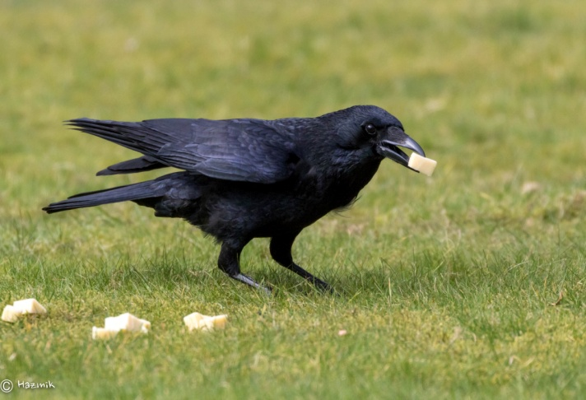
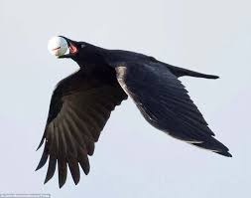
Sometime I take food from people.

Slide 13
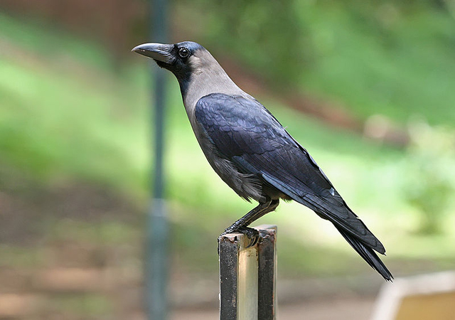
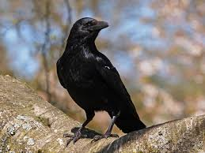
I’m very quick.

Slide 14
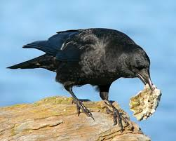
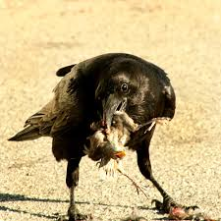
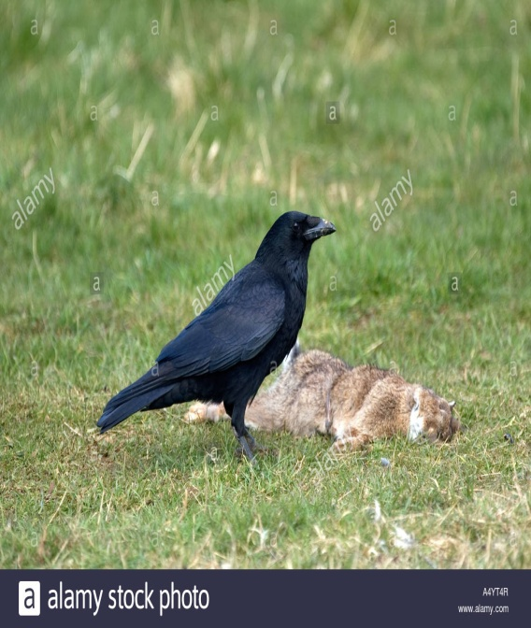
Sometimes I eat dirty things.

Slide 15
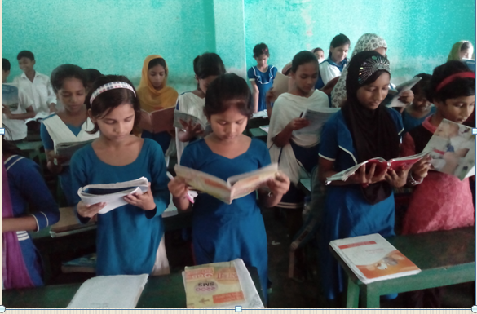
Reading Loudly
I’m a crow. I live in a tree. I get up early in the morning. I’m active all day. I fly in the sky and look for food. Sometime I take food from people. I’m very
quick. Sometimes I eat dirty things.

Slide 16
Some new words
Word | Word meaning
Crow | One kind of bird
Tree | Plant
Morning | First time of the day
Sky | The heavens
Food | Etables

Slide 17
Fill in the blanks
lazy | sky | crow | very
tree | late | get | active
1. I’m a …….
2. I live in…….
3. I’m …... all day.
4. I fly in the…..
5. I’m ……. quick.

Slide 18
Matching
Crow | hurry
Tree | first time of the day
Morning | plant
Quick | now and then
Sometime | a small black bird

Slide 19
EVALUATION
1. What kind of bird is the crow?
2. When does it get up?
Answer these questions
1.The crow is a common bird.
2.It gets up early in the morning.

Slide 20
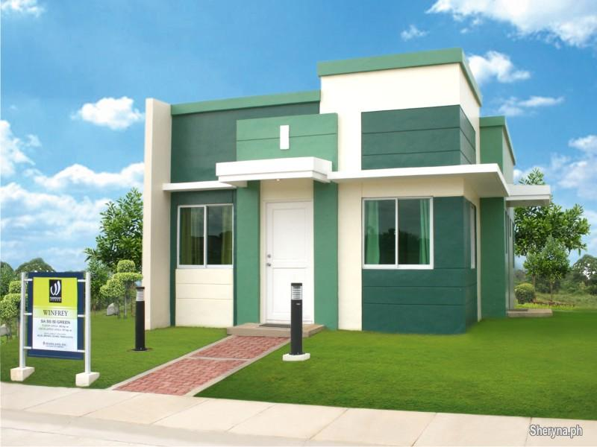
Home task
Write five sentences about
‘A Crow’.

Slide 21
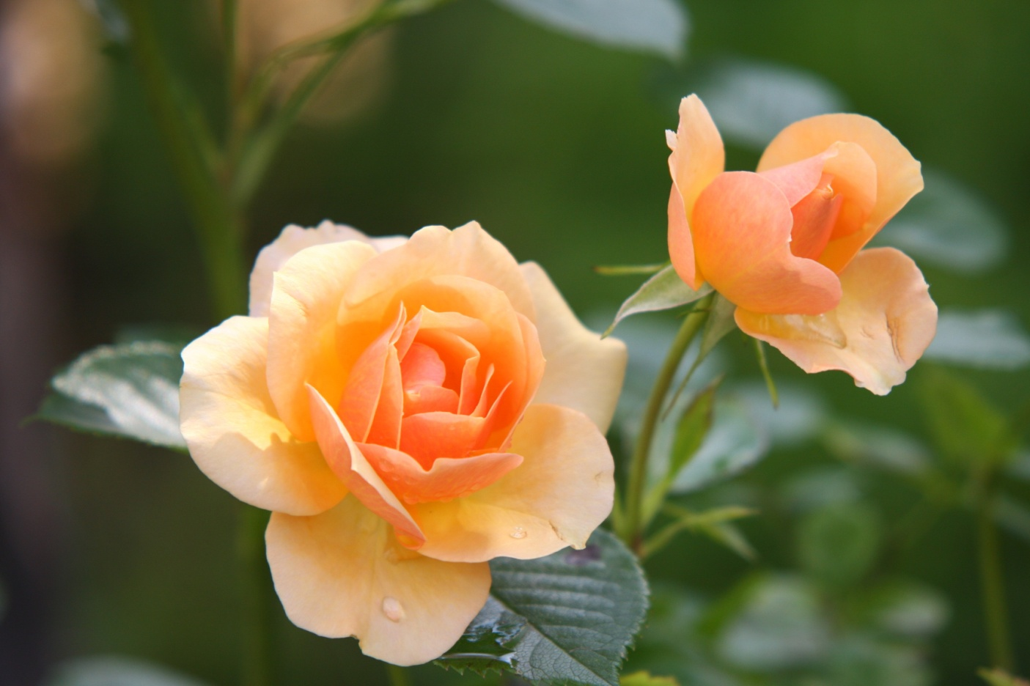
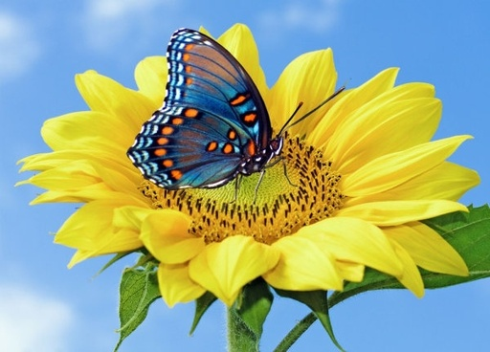
THANKS
TO
ALL

