Slide 1
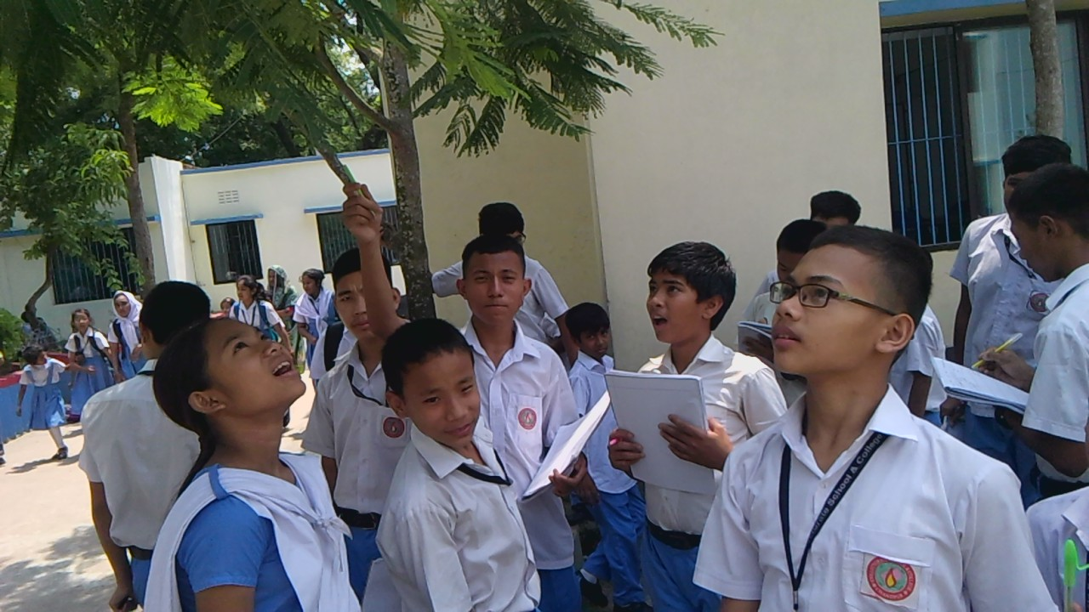
Welcome!

Slide 2
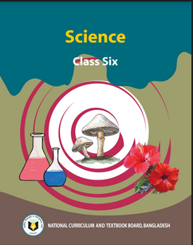
Introduction
Muhammad Waliullah
Senior Teacher
Collectorate School And College Chandpur
Mob: 01723924300
write2waliuullah@gmail.com
Chapter : Four
Morphology Of Plants
Notes:
Please enjoy this Lesson .

Slide 3
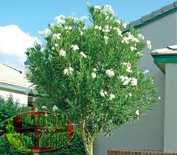
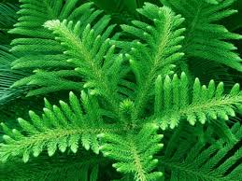
What differences do you observe here?
What do you call the plants
those bear flowers and fruits?

Slide 4
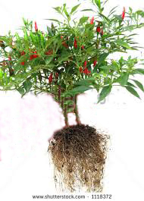
External Features of an Ideal Flowering Plant

Slide 5
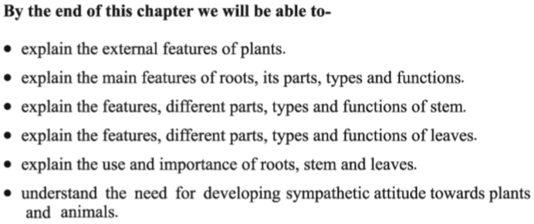
Learning Goal:

Slide 6
External Features of a Chilly Plant
Fruit
Flower
Leaf
Stem
Tap root
Notes:
You can collect a plant and relate it with the picture.

Slide 7
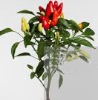
Some Parts of a typical Flowering Plant
Stem
Inter Node
Root

Slide 8
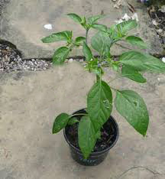
Leaves
What is the function of a leaf ?
Leaves prepare food by the process of Photosynthesis.
Notes:
বাস্তব উপকরণের মাধ্যমে শ্রেণিকক্ষে মরিচ গাছের পাতা দেখাতে পারেন। সালোক সংশ্লেষন প্রক্রিয়াটি শিক্ষার্থীদেরকে জানাতে পারেন ।

Slide 9
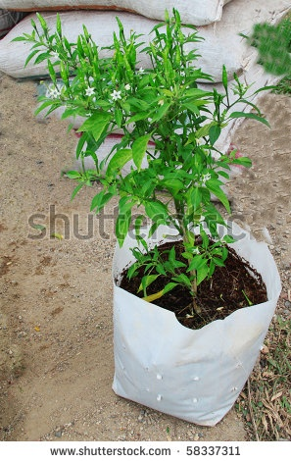
What is produced from flower?
?
Flower
?
Fruit
Notes:
বাস্তব উপকরণের মাধ্যমে শ্রেণিকক্ষে মরিচ গাছের ফুল ও ফল দেখাতে পারেন।

Slide 10
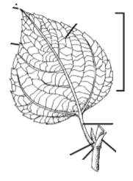
Different Parts of a Leaf
Level the picture
Leaf apex
Vein
Leaf
LAMINA
Petiole
Axillary bud
Stipule
Leaf base
Notes:
Level these.

Slide 11
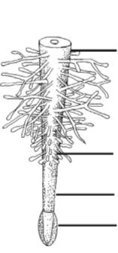
Different Parts of Typical Root---Level the picture
Learn: Types and Function of root (Page 35 of your Text book)

Slide 12
Feedback
What are the parts of a Flowering Plant ?
What is the function of a Stem ?
What is the function of leaves ?
What is the function of a Root ?

Slide 13
Vocabularies
Primary root
Tap root
Adventitious root
Root cap
Root hair
Leaf base
Compound leaf
Inter node
Sapling
Petiole
Vein
Lamina
Notes:
Write meaning/synonyms of these vocabularies in your CT exercise book and submit it in the CSCC page.

Slide 14
Home Work
Stem, Root, Leave and Flower
Which two are very important you think?
Explain in five sentences.
Notes:
Complete Your Home Work in Your HW book and submit in CSCC page. Show these at School when we meet

Slide 15
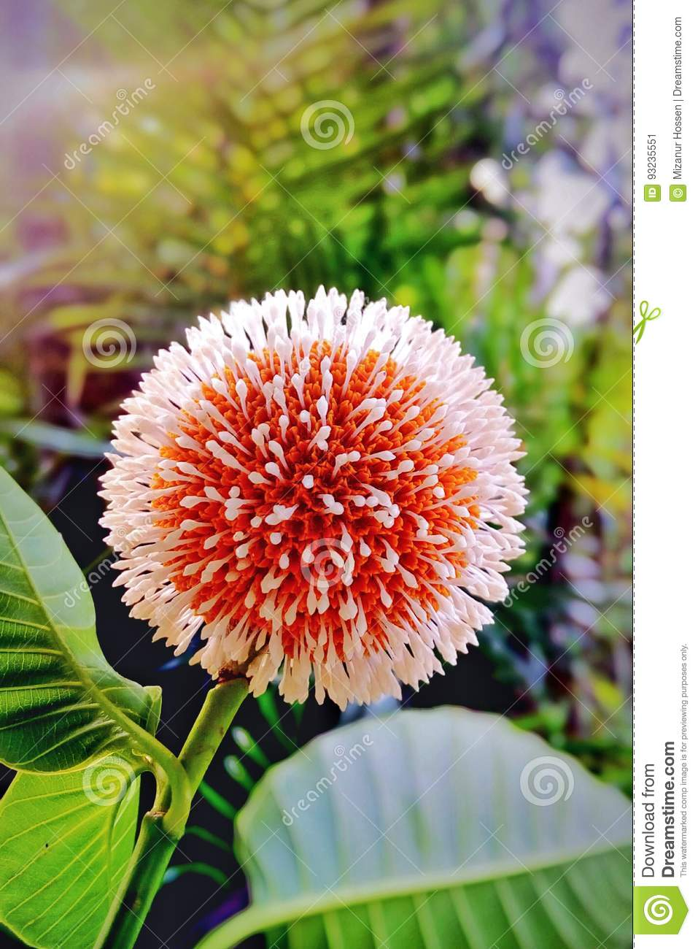
Thank You
Notes:
.

