Slide 2
Introduce
Teacher name
Kamal pasa
Boroutoli Govt Primary School
Class -5
Subject- English
Time -45 Minit
Date -1-1-2016

Slide 3
3.31-understand guestion about objects around them Speaking 3.11 Ask and answer Wh question 1.6.1. Reading Recognize and statmentments commands greetings question and answar. 8.1.1 Make sentences using words and phrases gives in the text book.
Lerning outcome:

Slide 4
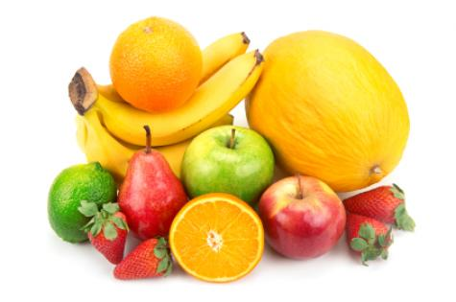
Showing picture

Slide 5
carrot
Mango
Orange
Potato

Slide 6
Group work
Word meaning:
Food .Happy .Face

Slide 7
Make Sentence
Individual work

Slide 8
Evaluation
Which foods can keep you helthy.

Slide 9
Thanks

