Slide 1
Welcome

Slide 2
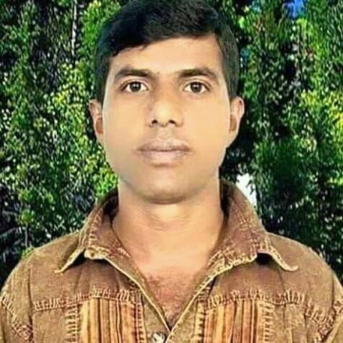
Teacher’s
Introduce
Lesson’s
Introduce
Kalyan Brata Biswas
Assistant Teacher
Kayesthorail Govt. Primary School
Dakshin Surma, Sylhet.
Email: kalyanbratabiswas1979@gmail.com
Unit: 4 ( Numbers )
Lessons: 1 – 3
Parts of lesson: Activity-A
(Look and say)
Subject: English
Class: Two
Time: 45 minutes.

Slide 3
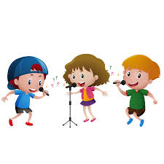
Safety environment by greetings song.
Hello! Hello!
How are you?
I’m very well, thank you. Thank you.
And how are you?
I’m very well , too.
Thank you , thank you.

Slide 4
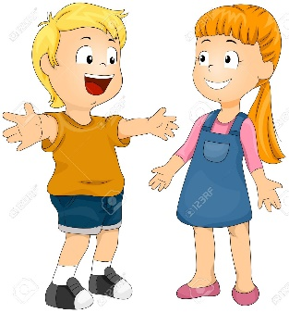
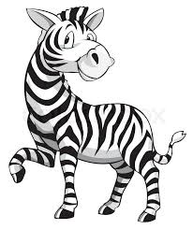
Checking homework and justify the previous lesson by the following ways:-
How many children are reading book?
How many children are talking?
How many zebras are dancing?
Answering the questions I will declaration today’s lesson.

Slide 5
Today’s our lesson is
Unit-4(Numbers)
Lessons:(1-3)
Activity - A

Slide 6
LEARNING OUTCOMES
By end of the lesson students will be able to---
Listening: 1.1.1 become familiar with English sounds by listening to common English words.
Speaking: 1.1.1 repeat after the teacher simple words and phrases with proper sounds and stress.
1.1.2 say simple words and phrases with proper sounds and stress.
Reading: 1.2.1 recognize and read cardinal numbers up to 30.

Slide 7
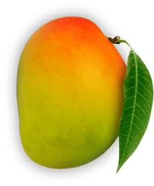
Look and say.
What are these?
How many mangoes?
How many mangoes?
How many mangoes?

Slide 8
Look and say.
How many balls are there?
What is this?
f
v
e
5
i
6
s
i
x
7
s
e
v
e
n
Notes:
Repeat 2/3/4

Slide 9
Dear students, now let’s see a counting video song .

Slide 10
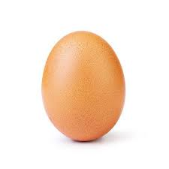
Now open your book at page 8 and see the activity- A( Look and say).
How many eggs?
5
6
7
five
seven
six
Repeat after me.
Spell out the words.
Techniques: SGW

Slide 11
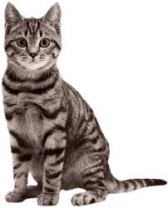
Pair work.
How many cats in the pictures?
One more.

Slide 12
Dear students look and say.
How many hens are there in your English book at page no-8?
2. How many fans are in your class room?
3. How many windows are in your class room?
4.How many books are in your bag?

Slide 13
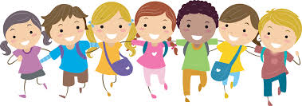
Now look at the picture and say how many
students are dancing?
5
6
7

Slide 14
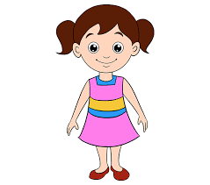
Look at the picture and say how many dolls in the picture?
5
6
7

Slide 15
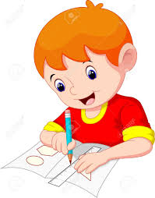
Count and say how many boys are drawing?
.
6
7
5
6

Slide 16
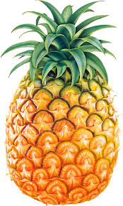
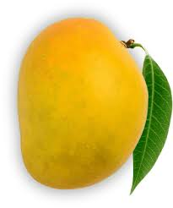
Count and say
Let’s see the right answer.
5
6
7

Slide 17
Read and say.
five
seven
six
six
five
seven
seven
six
five
Marking weak students and taking to care.

Slide 18
One Day One Word
How many balls in the picture?
পাঁচ।
five
Spell out the word - SGW

Slide 19
Find out the letters which are made by a word.
s
e
u
e
m
v
k
n
i
The right word is -------------.
senev
sveen
seven
seevn

Slide 20
Say the missing letter.
s- x
si-
-ix
six
ছয়।
Write the word in your exercise book.

Slide 21
Dear students look at the below picture and re-arrange the following letters which will be make a meaningful word.
e
i
v
f
The meaningful word is………………

Slide 22
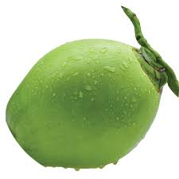
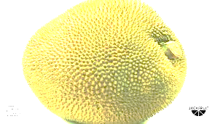
Evaluation
Q. How many coconuts in the picture?
Q. How many jackfruits in the picture?

Slide 23
Home work
Page no-8 activity-A will be well reading practice.

Slide 24
That’s all for today.
Thanks.
See to tomorrow.
Bye.

