Slide 2
Personal Information
Asim Kumar Talukder
Lecturer in English
Fenchuganj Govt. College
Fenchuganj, Sylhet
Phone No.: 01716348110
E-mail id: aktalukder@gmail.com

Slide 3
Introducing of Lesson
Class-Eleven
Subject-English First Paper
Unit- 8, Lesson- 5
Time: 01 Hour
Students: 120

Slide 4
Objectives
By the end of the lesson, Students will be able to:
* describe the scenic beauty of Kuakata

Slide 5
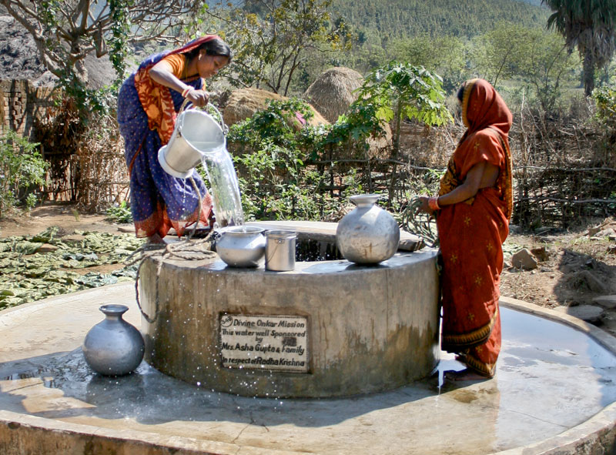
Look at the Picture

Slide 6
Now, let’s enjoy the video

Slide 7
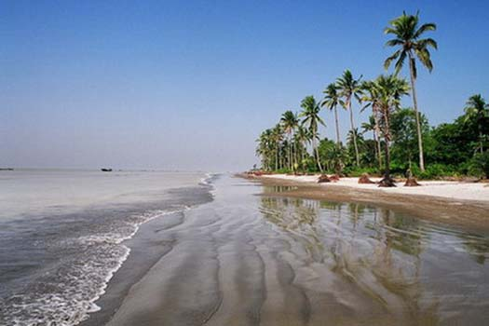
Declaration of Lesson
There is a similarity between the picture and the last viewed picture and video
Kuakata: Daughter of the sea

Slide 8
Look at the picture
What can you understand about Kuakata by the picture?
Kuakata is an excellent combination of the of the picturesque natural beauty, sandy beaches, blue sky and the shimmering expanse of water of the Bay of Bengal and evergreen forest which attracts the tourist most.

Slide 9
Kuakata
Suitable place for swimming and diving
Able to enjoy sunrise and sunset
World’s most attractive beaches
Long and wide beach

Slide 10
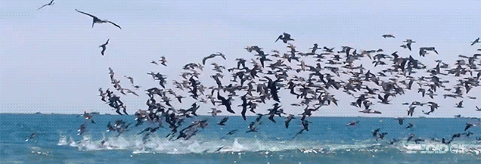
Kuakata is truly a virgin beach and a sanctuary for migratory birds in winter

Slide 11
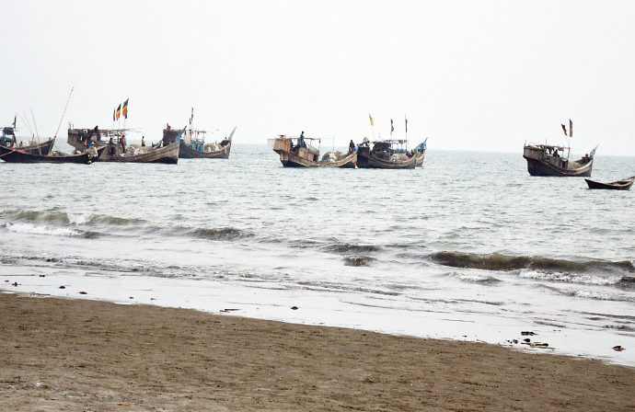
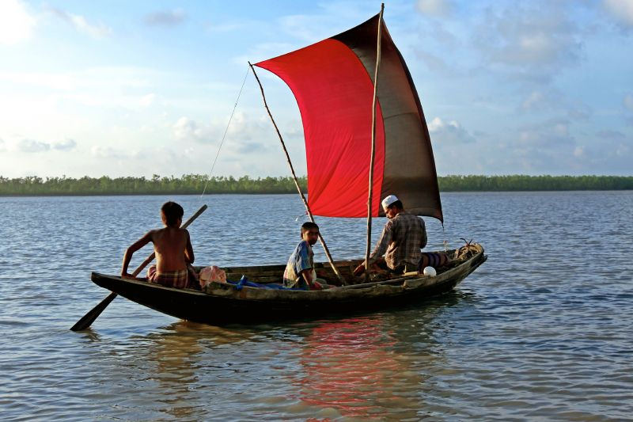
Fishing boats plying in the Bay Of Bengal with colorful sails.

Slide 12
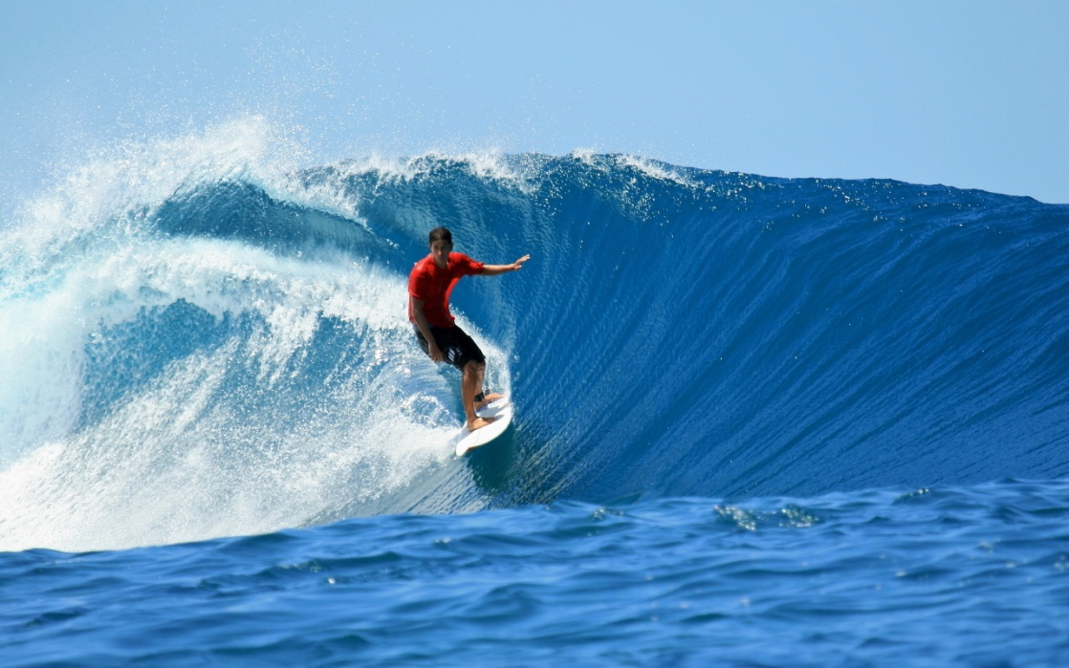
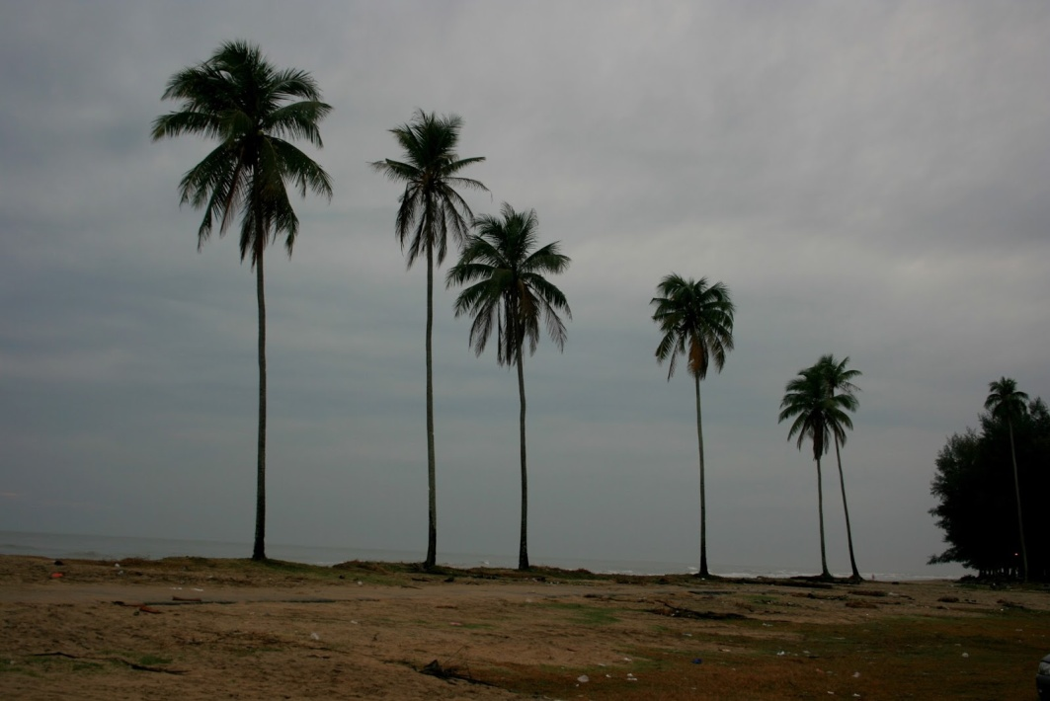
Surfing waves, and the lines of coconut trees add to it vibrant colors.

Slide 13
Evolution
Pair Work
1. Would you like to visit Kuakata? Make a list of things that you’d like to do while in Kuakata

Slide 14
Home Task
# White a short paragraph on “The Scenic Beauty of Kuakata”.

Slide 15
Thank You

Slide 16
Flash Back
Welcome
Introduction
Intr. Of lesson
Objectives
Warm up
Warm up
Declare of lesson
L. Outcome
L. Outcome
L. Outcome
L. Outcome
L. Outcome
Evalution
Homework
Thanks

