Slide 1
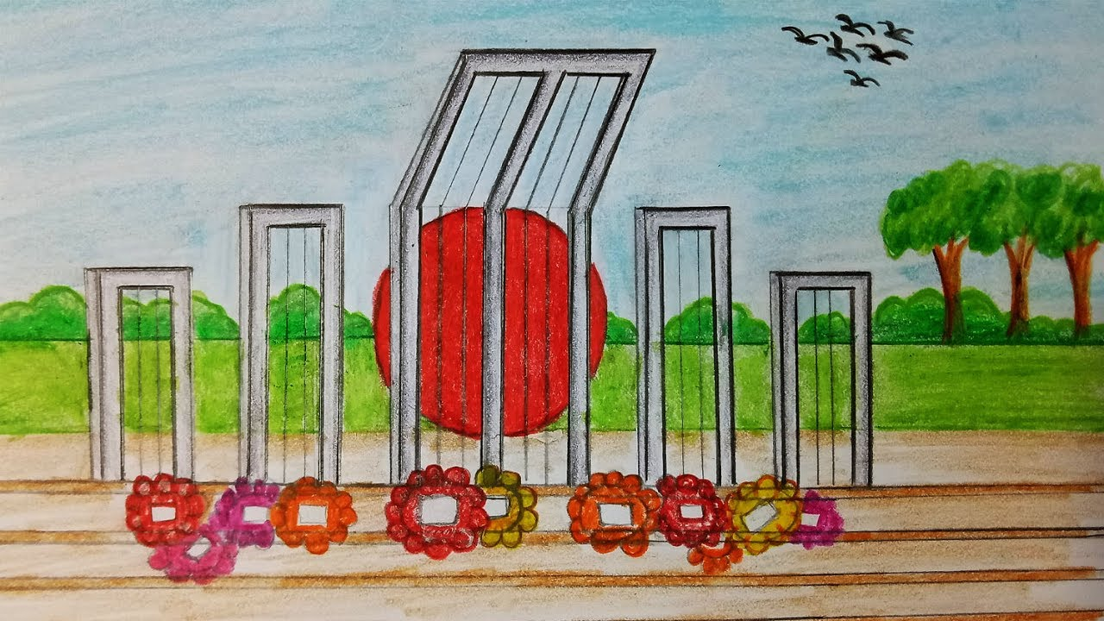

Slide 2
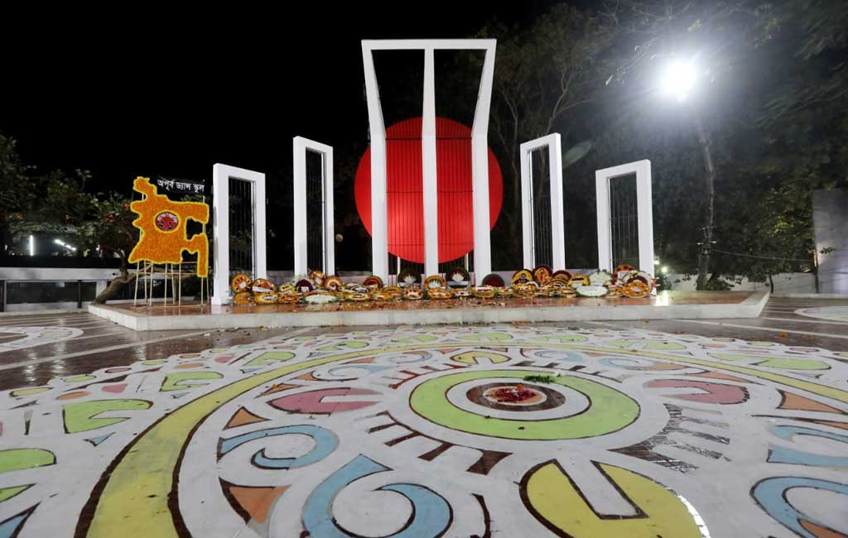
Welcome to all.

Slide 3
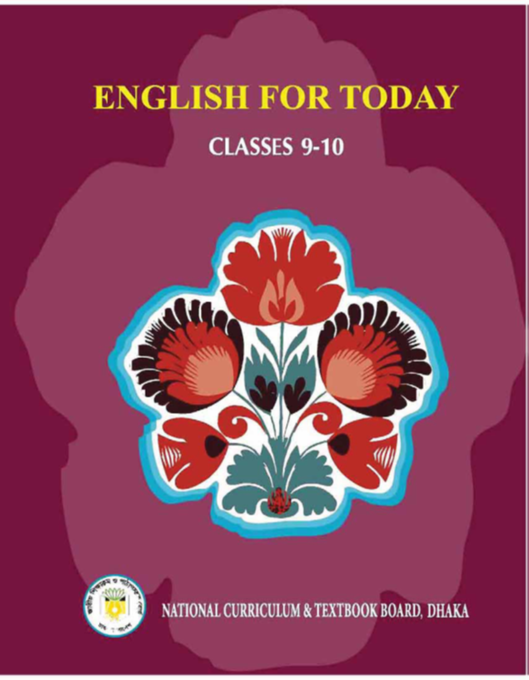

Slide 4
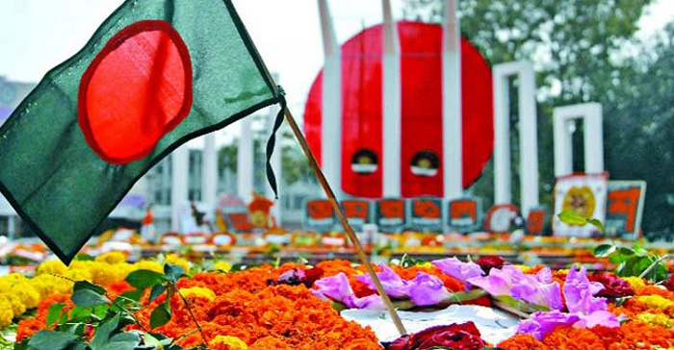
A: Look at the following picture.

Slide 5
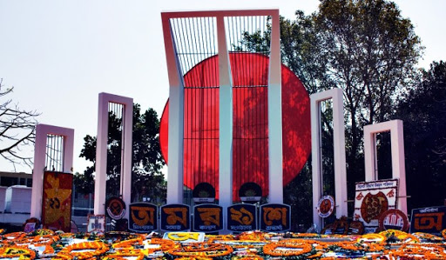

Slide 6
Let us watch the video.
Please click here to go to internet for watching Video.
Now try to give the answer of the following questions.
1. When does the International Mother Language Day celebration begin?
2. What does the abbreviation UNESCO stand for?
3. What is the other name of 21 February?

Slide 7
Today’s topic of the class is----
International Mother Language Day-2
Unit : III
[Events and Festivals]
Lesson : 4

Slide 8
Learning outcomes
After the students have studied the lesson, they will be able to --- ---
talk about events and festivals,
ask and answer questions and give opinions in a logical sequence,
infer meanings from the context.

Slide 9
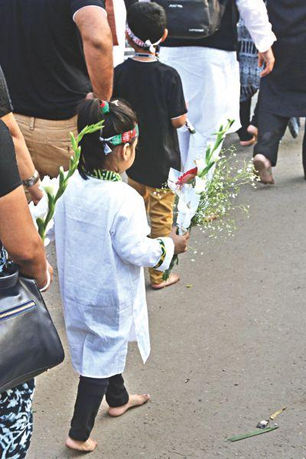
New Word
Bare-footed
Without shoes on
Syn.: unshod

Slide 10
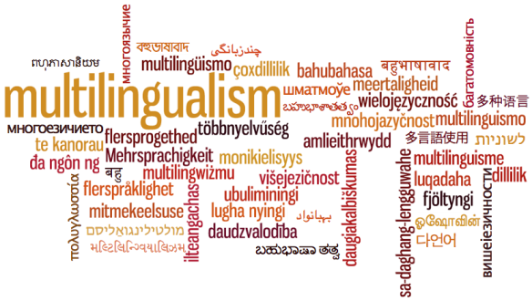
Multilingualism
Use of many languages
Adj.: multilingual

Slide 11
B: Open at page no. 41 from the text and read it to answer the questions that follow.
10 Minutes
21 February has been observed as Shaheed Dibosh every year throughout the country in remembrance of the martyrs of language movement of 1952. ---- ----- --- --- --- --- --- --- --- --- --- --- --- --- --- --- --- --- --- --- --- --- --- --- --- --- --- --- --- --- The day is now annually observed worldwide to promote awareness of linguistic and cultural diversity and multilingualism.
TEXT

Slide 12
21 February has been observed as Shaheed Dibosh every year throughout the country in remembrance of the martyrs of language movement of 1952. The occasion begins at the early hours of the day with mourning songs that recall the supreme sacrifices of our language martyrs. People wear black badges and go to the Shaheed Minar barefoot in procession, singing mourning songs. They place wreaths at the Minar. Many of them visit the graves of the martyrs at Azimpur graveyard and pray for them. They also attend various programmes organised in remembrance of the language martyrs.
The UNESCO (United Nations Educational, Scientific and Cultural Organisation) on 17 November in 1999 proclaimed February 21 as the International Mother Language Day in recognition of the sacrifices of the martyrs for the rightful place of Bangla. The day is now annually observed worldwide to promote awareness of linguistic and cultural diversity and multilingualism.
BACK

Slide 13
C: Match the words/phrases in the table with their meanings.
Words/phrases | Meanings
wreath
in remembrance of
proclaim
promote
diversity
multilingualism
in recognition of
An arrangement of flowers in the shape of a circle
in memory of
declare
encourage
variety
practice of using several languages
in appreciation of

Slide 14
D: Read the text in B again and answer these questions.
Why is 21 February called Shaheed Dibosh?
Why do people go to the Shaheed Minar? How do they go there?
3. Why is 21 February now observed throughout the world every year?

Slide 15
E: Complete the passage with suitable words.
blood
On 21 February 1952 _______ was shed at a place between Dhaka Medical College and Dhaka University _______ to establish Bangla as a state ______ of Pakistan.
All subsequent movements _______ the struggles for independence had their origin from the historic language _________. Shaheed Minar is the ______ of the supreme sacrifice _______ the mother tongue.
area
language
including
movement
symbol
for

Slide 16
E: Answer the following questions in 5 Groups serially.
Why is 21 February observed as ‘Shaheed Dibosh’?
Why do we go to the Shaheed Minar bare-footed?
What do you understand by the phrase ‘the rightful place of Bangla?
What is the other name of 21 February?
‘People place wreaths at the Minar.’ --- What do wreaths symbolize?
EVALUATION

Slide 17
HOME WORK
Write briefly how you observed this year’s 21 February at your school.

Slide 18
Thank you all.

