Slide 1
Welcome the students

Slide 2
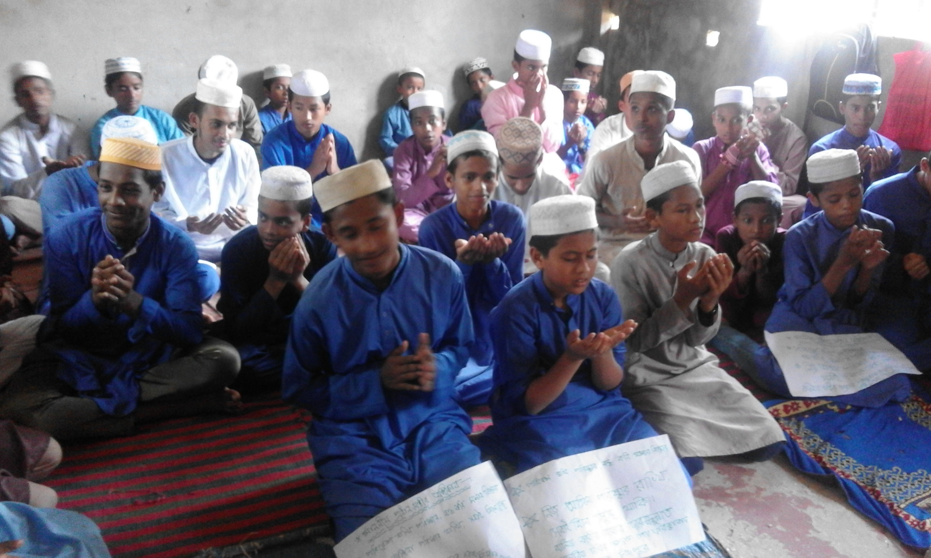

Slide 3
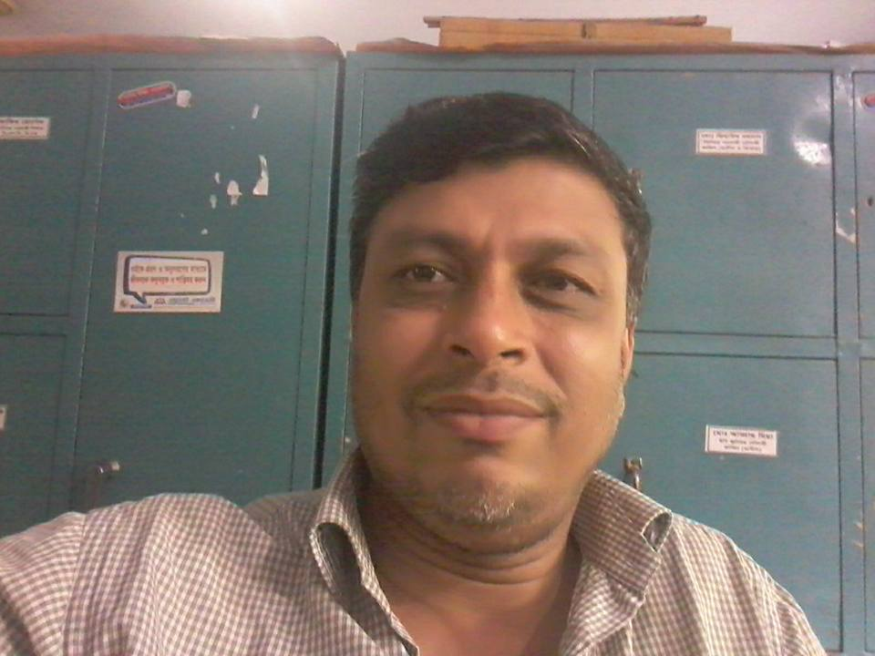
Sultan Ahmed Miazi
Astt. Teacher
Balia K.B.D.N. Dakhil Madrasah
Chamdpur Sadar, Chandpur.
01817106106

Slide 4
Class IX/X
Subject : English 2nd Paper
(English Grammar And Composition)
Time: 45 Minutes

Slide 5
Learning Outcomes:
By the end of the lesson the students will be able to-
find out relative pronouns as connectors.
make sentences using the connectors.
apply the linking words/connectors
filling the gaps.
solve the problems using the connectors.

Slide 6
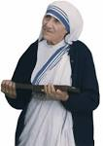
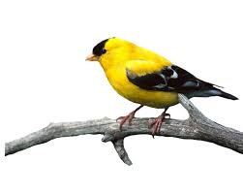
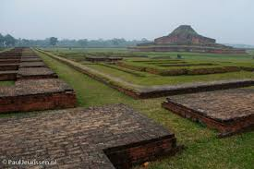
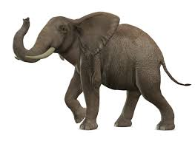
who, which, what, when, how, where, whom, whose, why, that
What do you understand by the photos and text?

Slide 7
Relative pronoun
Our today’s lesson is-
Sentence
connectors
Class : IX/X, Subject: English
Paper:II, U-9, L-7 Time: 45 Minutes

Slide 8
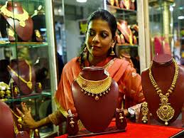
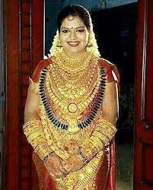
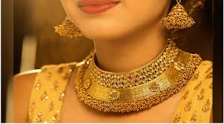
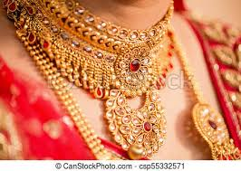
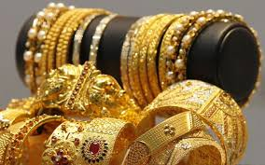
who
This is the girl.
She likes ornament.
This is the girl who likes ornament.

Slide 9
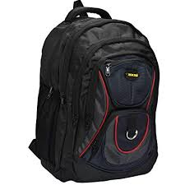
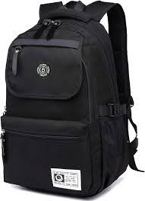
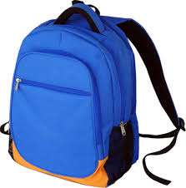
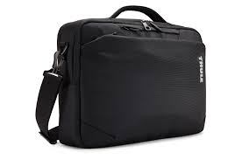
which
connector
I bought a bag.
It was lost.
I bought a bag which was lost.

Slide 10
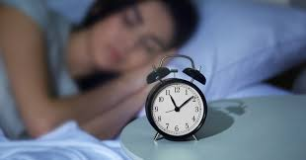
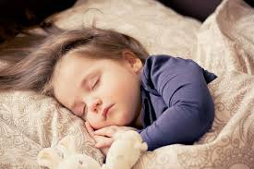
What time is it now?
What are they doing?
10 pm is the time
when
we go to bed.
10 pm is the time when we go to bed.

Slide 11
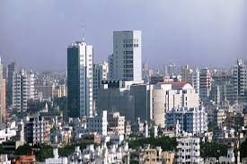
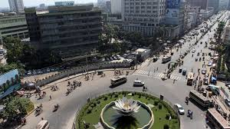
Dhaka is a city
where
My father works.
Dhaka is a city where my father works.

Slide 12
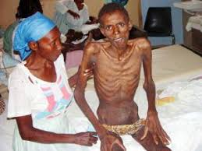
how
Tell me
I can help you.
Tell me how I can help you.

Slide 13
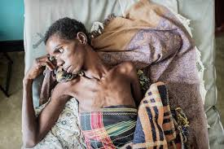
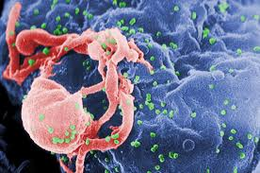
That/
which
AIDS
HIV.
AIDS is a disease that/which is caused by HIV.

Slide 14
Click

Slide 15
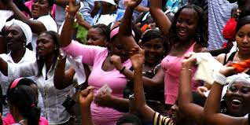
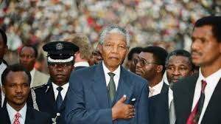
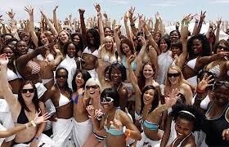
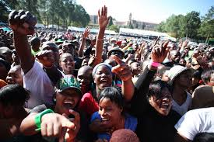
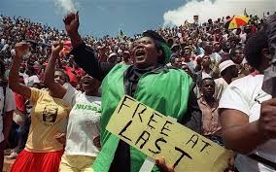
That/
who
The black
neglected
They were the black who/that were neglected in their own mother land.

Slide 16
whom
whose
Who
Obj.
possessive
sub
I like him who is honest. That is the man whom I was looking for. I offered him a bag whose bag was stolen.

Slide 18
Viva-voce
Now do these
Time:05 Minutes
Fill in the gaps with appropriate connectors:
which
Rina bought a story book (a)________ was very interesting. She presented the book to a person (b)______ she loved very much. The man (c) _______ got the book read again and again. He thanked her (d) _______ gift was very interesting and educative. Rina went to a book fair (e) _____ she found that book in a book stall.
whom
who
whose
where
Click me to get answer

Slide 19
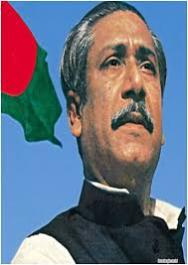
Group Work
08 Minutes
1
2
3
4
Every group will make 5 sentences
using connectors basis on the photos.

Slide 20
Let’s Try
ourselves
Time: 2 minutes

Slide 21
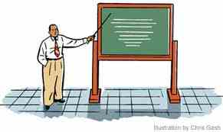
Evaluation
(a) This is Eric___ is the first boy in the class.
(b) I read a novel___ was very tragic.
(c) 1971 is the year___ Bangladesh became free.
(d) Covid-19 is a disease___ is not incurable.
(e) Be serious ___ you can save your family.

Slide 22
Home Work
Write a text of five sentences using who, which, what, when and where:

Slide 23
Thanks

