Slide 2
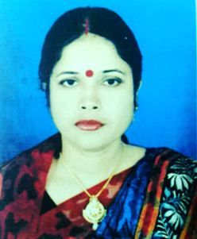
Teacher’s Introduce
Lesson’s Introduce
Sabita Rani Das
Assistant Teacher
Chandai Govt. Primary School
Dakshin Surma ,Sylhet.
Email: sabitaranidas21605@gmail.com
Unit: 5 ( How old…..? )
Lessons: Alphabet(4-6)
Parts of lesson: Activity- B
( Read and say .Trace and write.)
Subject: English.
Class: Two
Time: 45 minutes

Slide 3
Safety environment by greetings song.
Hello! Hello!
How are you?
I’m good,
I’m great!
How about you?
Na na nana na na na,
Hei, na na nana na na na!

Slide 4
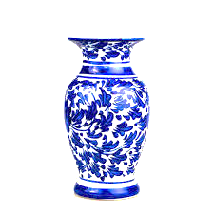
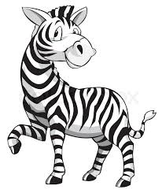
Dear students look at the below pictures and say the pictures name.
What’s this ?
Answering the questions I will declaration today’s lesson.

Slide 5
Today’s our lesson is....
Unit:5(How old…..?)
Lessons:4-6
Alphabet (u to z)
Activity: B
Read and say. Trace and write

Slide 6
LEARNING OUTCOMES
By end of the lesson students will be able to-------
Speaking: 1.1.1 repeat after the teacher simple words and phrases with proper sounds and stress.
1.1.2 say simple words and phrases with proper sounds and stress.
Reading: 1.3.1 recognize and read the names of objects having the same initial and final sounds.
Writing: 1.2.1 write non-cursive small letters.

Slide 7
Dear students now say the word for each letter which we learned in the previous class.
Spell out the words.
Now repeat after me.
U u
umbrella
V v
vase
W w
window
X x
x-ray
Y y
yo-yo
Z z
zebra

Slide 8
Open your English book at page no - 11 and see the Activity- B
Read and say. Trace and write.
umbrella
vase
window
x-ray
yo-yo
zebra
Exchange your book with other and check the text of other.
Let’s practice on the board.

Slide 9
Dear students now we will practice writing the words in the air in our exercise book.
Techniques: WCW

Slide 10
Read and say…..
vase
window
x-ray
yo-yo
zebra
umbrella
window
x-ray
yo-yo
zebra
umbrella
vase
x-ray
yo-yo
zebra
umbrella
vase
window
yo-yo
zebra
umbrella
vase
window
x-ray
Marking weak students and taking to care.
Techniques: SGW.

Slide 11
One day one word
Look at the picture attentively.
What’s this?
vase
ফুলদানি
Spell out the word - SGW

Slide 12
Select the suitable letters and find out the right word.
b
c
z
x
r
a
o
e
z
w
The right word is
zabre
zebra
zebar
zaber

Slide 13
Say the missing letter.
windo--
wind--w
win--ow
wi--dow
w--ndow
--indow
Write the word to your exercise book.
window
জানালা

Slide 14
Dear students look at the below picture and re-arrange the following letters which will be make a meaningful word.
l
r
m
u
b
e
l
a
The meaningful word is……….........................

Slide 15
Evaluation
Write the following words in your English handwriting exercise book.
uniform
violin
well
xylography
yoke
zero

Slide 16
Home work
Page no – 11 activity-B will well read and write.

Slide 17
Thank you,that’s all
for today.
Goodbye.

