Slide 1
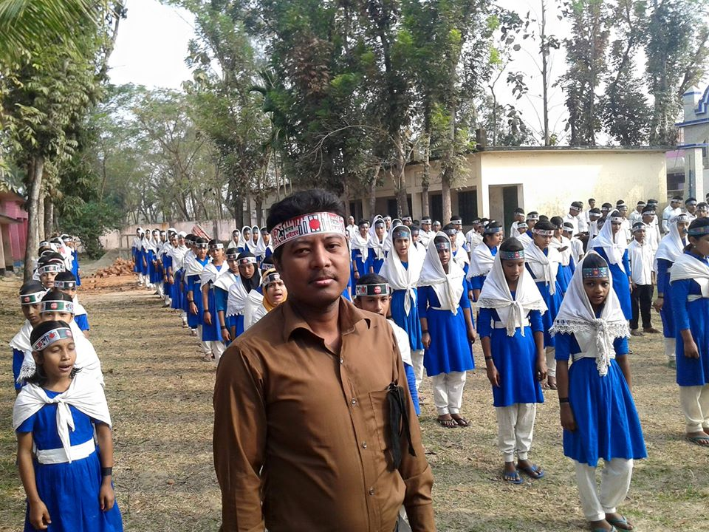
Teacher ID
Sumon Barua
Assist. Teacher
Guzra Shyamacharan High School
P. K. Sen Hat. Mogdai, Raozan, Chattogram,
email: sumonbarua8626@gmail.com

Slide 2
ENGLISH SECOND PAPER
CLASS-SIX
Time: 40Minutes

Slide 3
At the end of the lesson, student will be able
Defination of syllable
Kinds of syllable
Defination of every kinds of syllable

Slide 4
Cat

Slide 5
Student

Slide 6
Umbrella

Slide 7
Harbard University

Slide 8
Syllable
(শব্দাংশ)
Page-8

Slide 9
Cat, Pen,Look, Everyday, Food, Work, Admition, Student,Happy, Morning, Stomach, Working, Computer, Chittagong, happy,Day, Examination, University,Agriculture
What are these?

Slide 10
Cat, Pen,Look, Food,Work
Poly Syllable

Slide 11
Student,Happy,Morning,Stomach,Working
Mono-Syllable

Slide 12
Computer, Chittagong, Everyday, Unhappy
Di-Syllable

Slide 13
Examination,University,Agriculture
Tri-Syllable

Slide 14
pen,dog,cat,man,Leg.
Poly Syllable
যে word এ একটি মাত্র syllable(শব্দাংশ)রয়েছে তাকে
Poly syllableবলে।

Slide 15
Mor+ning=Morning Stu+dent=Student
Far+mer=Farmer Tea+cher=Teacher
Mono-Syllable
যে word এদু’টি মাত্র syllable(শব্দাংশ)রয়েছে তাকেMono- syllableবলে।

Slide 16
Eve-ri-day Chi-tta-gong
Umb-re-lla Fa-mi-ly
Di-Syllable
যে word এ তিনটি syllable(শব্দাংশ)রয়েছে তাকেDi- syllableবলে।

Slide 17
Ag-ri-cul-ture App-li-ca-tion
Pre-po-si-tion Exa-mi-na-tion
Tri-Syllable
যে word এ চারটি syllable(শব্দাংশ)রয়েছে তাকে
Tri- syllableবলে।

Slide 18
Group Work
Syllable কত প্রকার ও কি কি? প্রত্যেক প্রকারের দু’টি করে উদাহরণ দাও।

Slide 19
Home Work
1.নিচের word গুলি থেকে বাচাই করে কোনটি কোন Syllable নির্ণয় কর।
Understanding, Everyday, Student, Tiger, Kind, Dhaka, Danger, Admition, Stomach, Hungry,
Morning, Elephant, Happy.

Slide 20
Sumon Barua
Assist. Teacher
Guzra Shyamacharan High School
P. K. Sen Hat. Mogdai, Raozan, Chattogram,
email: sumonbarua8626@gmail.com

