Slide 1


Slide 2

W
E
L
C
O
M
E

Slide 3
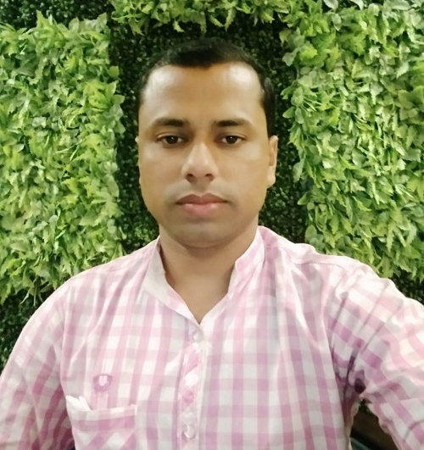

Identity
Khalidur Rahman Manik
Assistant Teacher
Khasgaon GPS
Chhatak, Sunamganj
Sub:English
Class:5
Unit:8
Lesson:4-5
Activity:D&E

Slide 4
Good morning students.
How are you today?
Let’s sing the good morning song together.

Slide 5

Recalling previous lesson
Dear students, can you remember what
we had learnt in our previous class?
Yes, we had learnt about the disease Flu

Slide 6
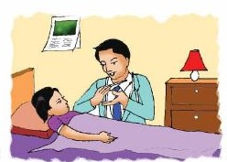
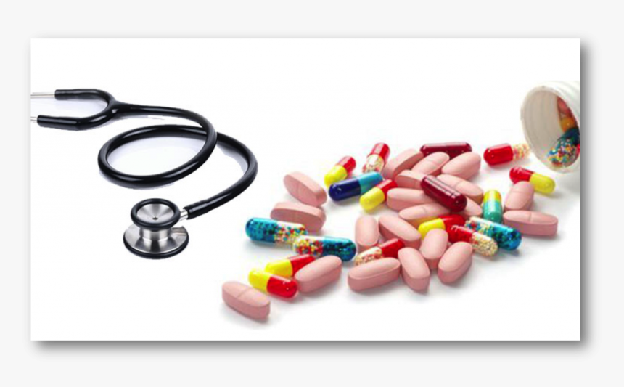
Let’s see some pictures.
Doctor and patient.
Some medicine.
Can you guess what is our today’s lesson?
What do you see in these pictures?

Slide 7


Our today’s lesson is…
Write to me soon!
Activity: D&E

Slide 8
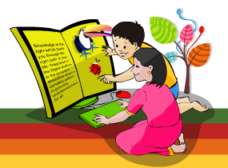
Learning outcomes
Students will be able to…
understand statements made by the teacher and students;
say sentences with proper intonation;
read silently with understanding paragraph;
make sentences using words and phrases given in the text.

Slide 9
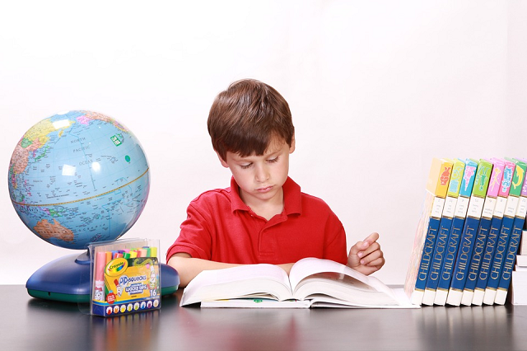
Recalling previous lesson
Answer the following questions
Why Sima didn’t go to school?
Ans: Sima didn’t go to school because she is ill.
What is Sima’s illness?
Ans: Sima is suffering from Flu.
Where should Sima stay?
Ans: Sima should stay at home.

Slide 10
Open at page 30 and read activity: A silently.

Slide 11

Now listen to the audio of Activity:A
Listen to the audio again and repeat after it.

Slide 12
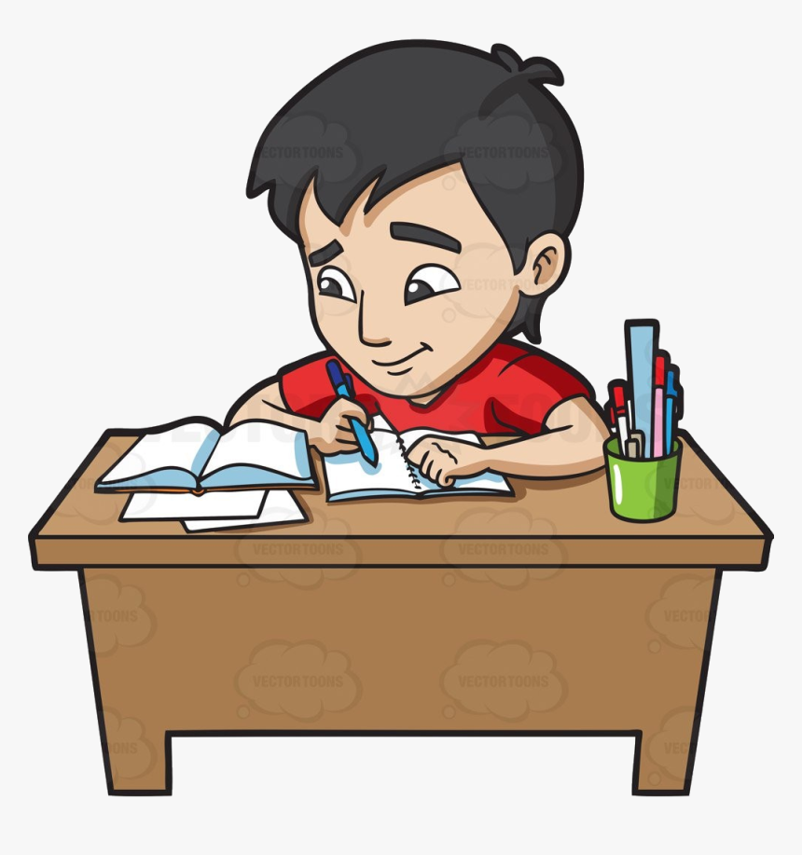
Individual Work
Read the text again. Complete the sentences.
1. Sima didn’t go to school because…
a. she went to the doctor’s office.
b. she has the flu.
c. she is hungry
d. she is on holiday.
Ans: (b) she has the flu.
Which one will be appropriate to complete the sentence?

Slide 13
Individual Work
2. The doctor told Sima to…
a. use her own plate and cup.
b. cough into her hand.
c. go to school.
d. wash her face regularly
Ans: (a) use her own plate and cup.
Which one will be appropriate to complete the sentence?

Slide 14
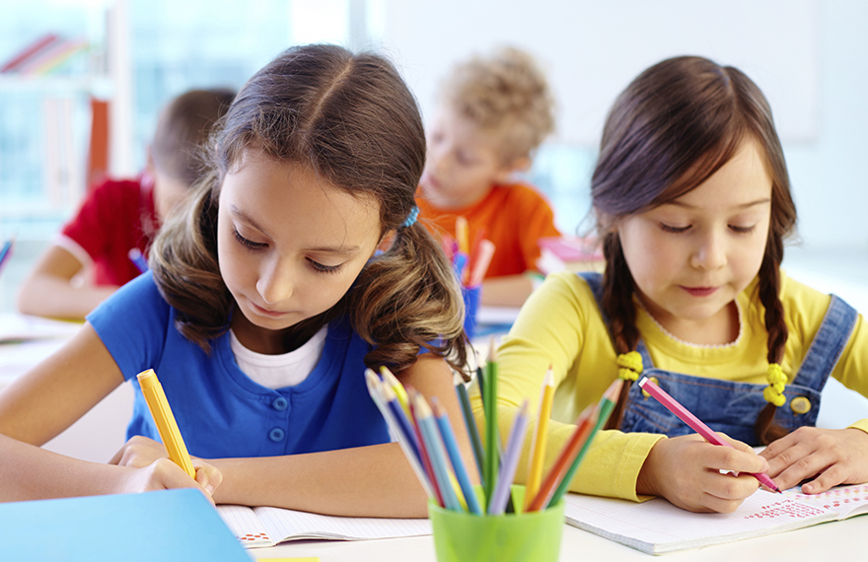
Pair Work
Read the doctor’s advice again. Say the advice.
Use should or shouldn’t.
Example: Ear food that gives your body energy.
You should eat food that gives your
body energy.
(1) Try to eat, even if you aren’t hungry.
You should try to eat, even if you aren’t hungry.

Slide 15
Pair Work
(2) Stay at home.
You should stay at home.
(3) Don’t go to school or work.
You shouldn’t go to school or work.
(4) Drink a lot of water or juice.
You should drink a lot of water or juice.
(5) Cover your mouth and nose.
You should cover your mouth and nose.

Slide 16
Pair Work
(6) Wash your hands regularly.
You should wash your hands regularly.
(7) Use your own plate, glass and cup.
You should use your own plate, glass and cup.

Slide 17
Checking Learning
Dear students, what have you learnt from today’s lesson?
We have learnt today…
How to stay healthy.
How to keep others healthy.

Slide 18
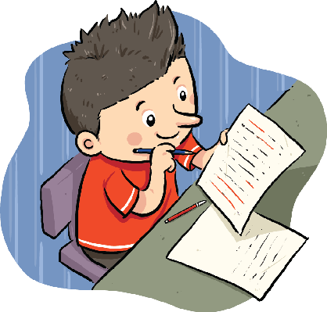
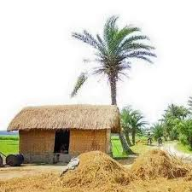
Homework
Suppose, you are Adi/Diya. Your friend is Wadi/Riya.
Now write a letter to your friend advising him/her
what to do if he/she is affected by Flu.

Slide 19


Thank you

