Slide 1
Welcome

Slide 2
Jahangir Alam Bhuiyan Assistant Teacher Guara Patherkandi Gps Raytuty, Itna, Kishoregonj email:jahangiratict@gmail.com
Class: Two
Subject:English For Today
_ Unit:18,a/an
Lesson:4_5

Slide 3
Learning outcomes
Students will be able to
3.1.2 Understand simple question and statements about familiar object.
1.4.1 read words and phrases with the help visual clue and simple sentences.

Slide 4
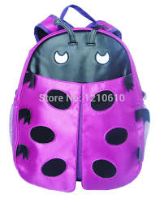
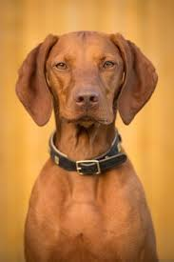
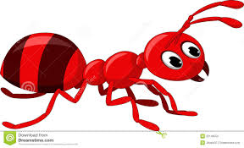
See the pictures

Slide 5
See the pictures
Ant
Bag
Hut
Dog

Slide 6
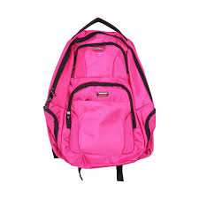
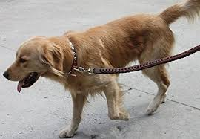
a/an
an ant
a bag
a hut
a dog

Slide 7
Read and say
It’s an ant.
It’s a bag
It’s a hut
It’s a dog

Slide 8
Four colours
red
violet
yellow
brown

Slide 9
The ant is red.
The bag is violet
The hut is yellow
The dog is brown

Slide 10
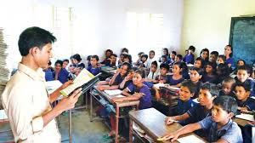
Connection of the lesson Pages_37

Slide 11
Evaluation
1.What is this?
2.What is this?
3.This is __ant?
4.This is__a dog?

Slide 12
Good bye

