Slide 1
WELCOME

Slide 2
IDENTITY
MD.Jahangir alam
Assistent Teacher
Vedvedi Govt.Primari School,
Rangamati, sadar.

Slide 3
LESSONS IDENTITY
Subject: English
Class:Two
Unit: 20
Lessons: 4-6
Title: Mr.Shape

Slide 4
Greeting
Good morning/ Good afternoon/Greeting song

Slide 5
Learning Outcomes:
(By the eand of the lesson students will be able………..)
Speaking:
1.1.2 Say simple words and phrases with proper sound and stress.
Reading:
1.4.1 Read words and phrases with the help of visual clues and simple sentences.
Writing :
4.1.2 Write numbers up to 10 in figures and in words.

Slide 6
TEACHING AIDS:
Shapes Picture, Shape model.

Slide 7
Showing picture:
(Say about the picture)
INPUT
circle
triangle
square
rectangle

Slide 8
Let’s see, how do we drow the shaps.
INPUT
circle

Slide 9
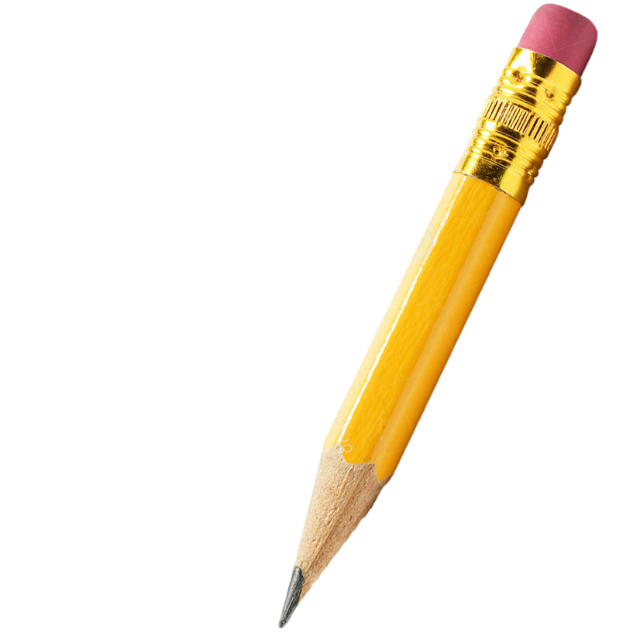
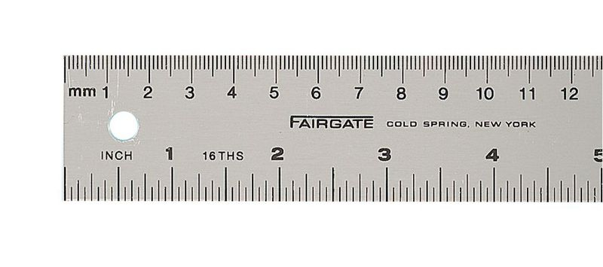
Let’s see, how do we drow the shaps.
INPUT
triangle

Slide 10
Let’s see, how do we drow the shaps.
INPUT
square

Slide 11
Let’s see, how do we drow the shaps.
INPUT
rectangle

Slide 12
Look,listen and say.
How many squires are there in the picture?
How many triangles are there in the picture?
How many circles are there in the picture?
How many rectangles are there in the picture?
PRACTICE
_5_ circles.
_3_triangles.
_4_ rectangles.
_3_ squires.
Mr.Shape

Slide 13
Look,listen and say.
How many circles are there in the picture?
How many triangles are there in the picture?
How many rectangles are there in the picture?
How many squires are there in the picture?
PRACTICE
_14_ circles.
_21_triangles.
_8_ rectangles.
_19_ squires.

Slide 14
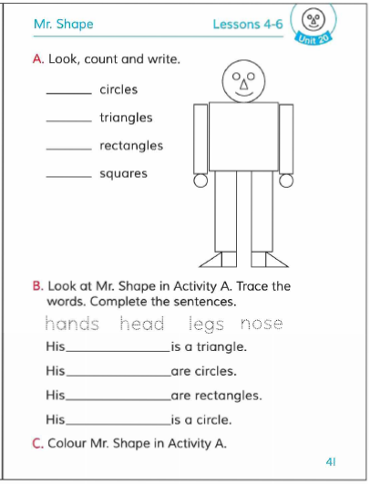
Open your Book at page-41

Slide 15
CHEEKING LEARNING
TASK
How many circles are there in the picture?
Ans: 4-circles.
How many triangles are there in the picture?
Ans: 11-triangles.
How many rectangle are there in the picture?
Ans: 4-rectangles.
How many squires are there in the picture?
Ans: 3-squires.
Mis.Shape

Slide 16
Let’s we sing a goodbye song.

Slide 17
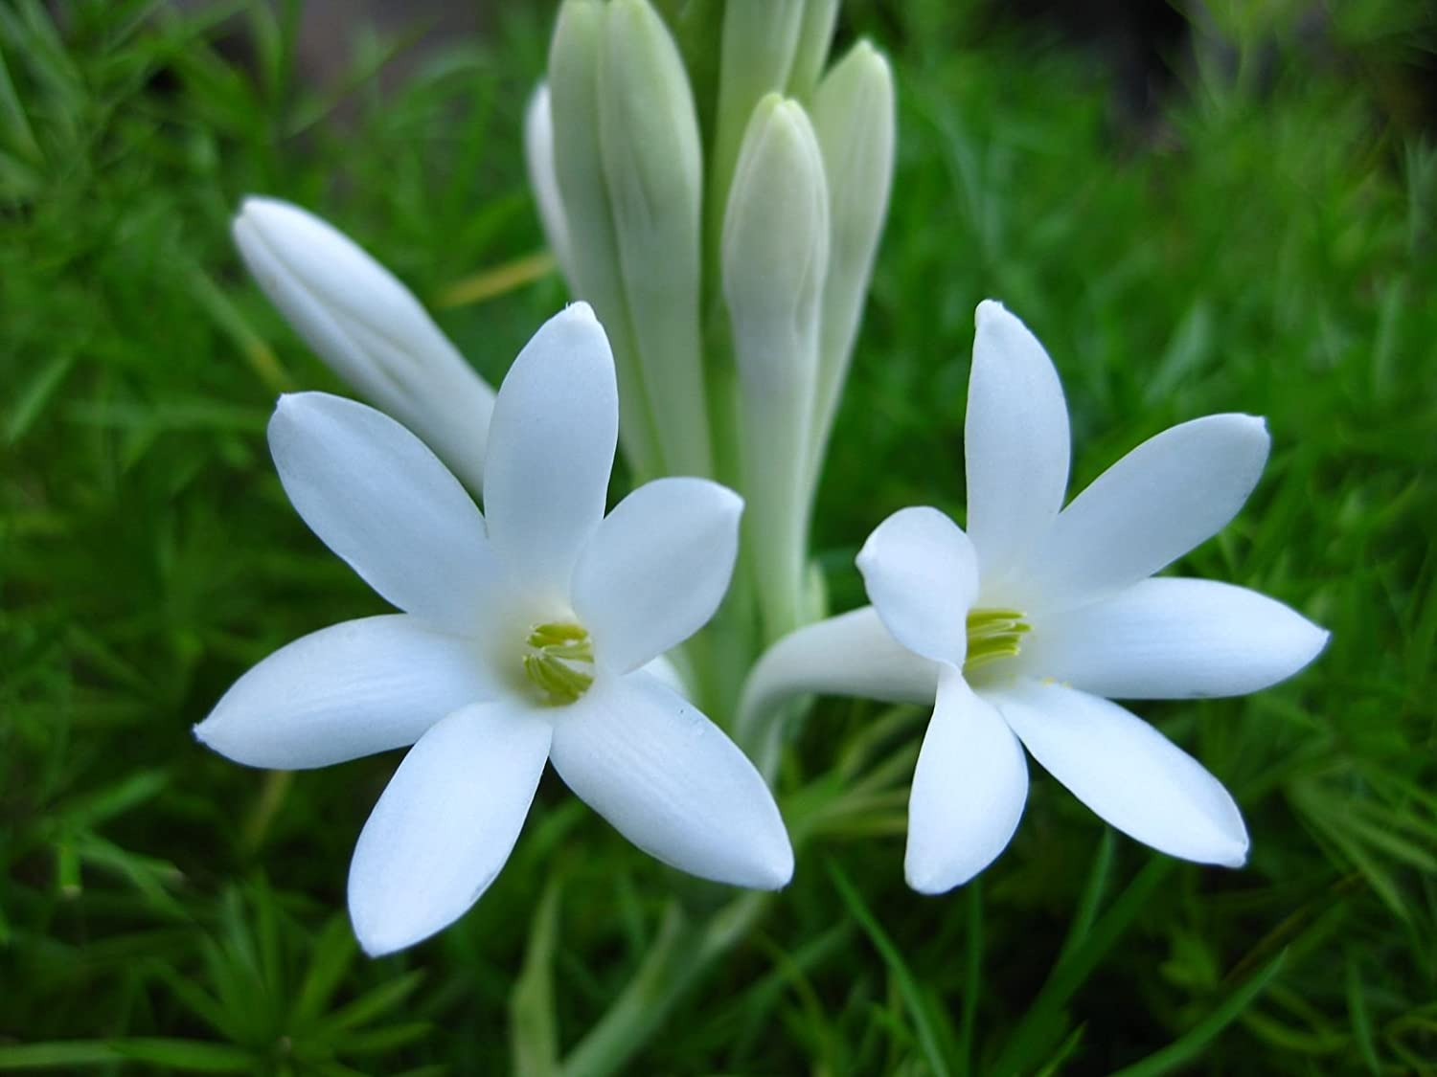
THANK YOU

