Slide 1

Welcome
everybody
Easy To Learn
powered by saju sir
Visit : www.sajusir34.blogspot.com

Slide 2
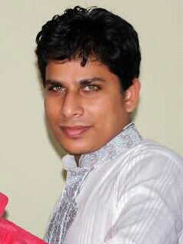
Teacher’s Information
Md Rabiul Mowla
Assistant Teacher
Govt. Primary School
Easy To Learn
powered by saju sir
Visit : www.sajusir34.blogspot.com

Slide 3
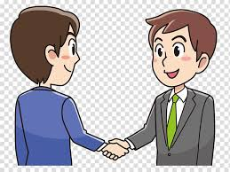
Can you see the picture?
Hello
Can you guess what are they saying each other?
Easy To Learn
powered by saju sir
Visit : www.sajusir34.blogspot.com

Slide 4

Today’s Lesson
Unit-1
Lesson-(1-3)
Easy To Learn
powered by saju sir
Visit : www.sajusir34.blogspot.com

Slide 5
Vocabulary
New word | Meaning
Introduce | পরিচিত
Myself | নিজে
Holiday | ছুটির দিন
Journey | ভ্রমণ
Fun | মজা
Meet | সাক্ষাত
Easy To Learn
powered by saju sir
Visit : www.sajusir34.blogspot.com

Slide 6
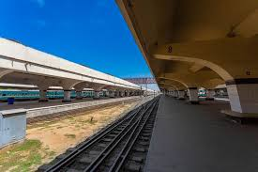
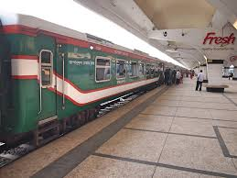
What do you see in the picture ?
Railway Station
Easy To Learn
powered by saju sir
Visit : www.sajusir34.blogspot.com

Slide 7
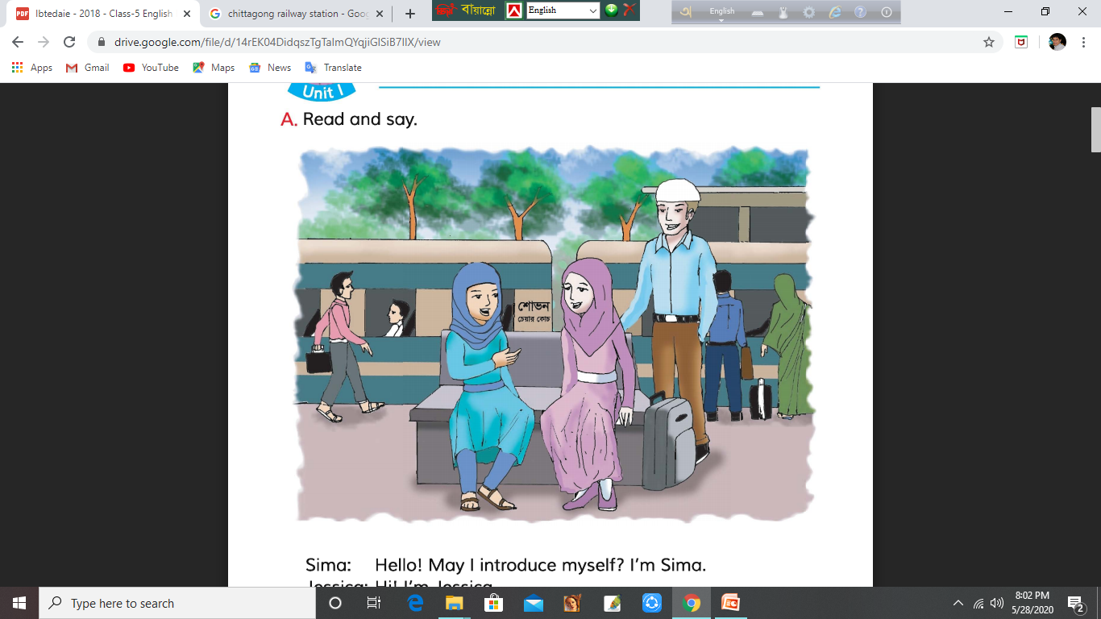
Now talk about the picture
We see two girls are sitting on the bench at the
Railway Station. They are also talking with one another .
Easy To Learn
powered by saju sir
Visit : www.sajusir34.blogspot.com

Slide 8
Let’s see the conversation between two girls……….
Easy To Learn
powered by saju sir
Visit : www.sajusir34.blogspot.com

Slide 9
Hello! May I introduce myself ? I’m Sima.
Hi !I’m Jessica.
Sima
Jessica
Easy To Learn
powered by saju sir
Visit : www.sajusir34.blogspot.com

Slide 10
Where are you going , Jessica?
I’m going to Chattogram. I’m on holiday with my father.
Sima
Jessica
Easy To Learn
powered by saju sir
Visit : www.sajusir34.blogspot.com

Slide 11
Really ? Where are you from ?
I’m from the United Kingdom. Are you from Dhaka?
Sima
Jessica
Easy To Learn
powered by saju sir
Visit : www.sajusir34.blogspot.com

Slide 12
No, I’m from Sylhet. That’s where we’re going. Our train is leaving in 10 minutes.
Have a good journey .
Sima
Jessica
Easy To Learn
powered by saju sir
Visit : www.sajusir34.blogspot.com

Slide 13
Thank you. Nice meeting you , Jessica. Have fun in Chattogram
Thanks. Nice meeting you, too, Sima.
Sima
Jessica
Easy To Learn
powered by saju sir
Visit : www.sajusir34.blogspot.com

Slide 14
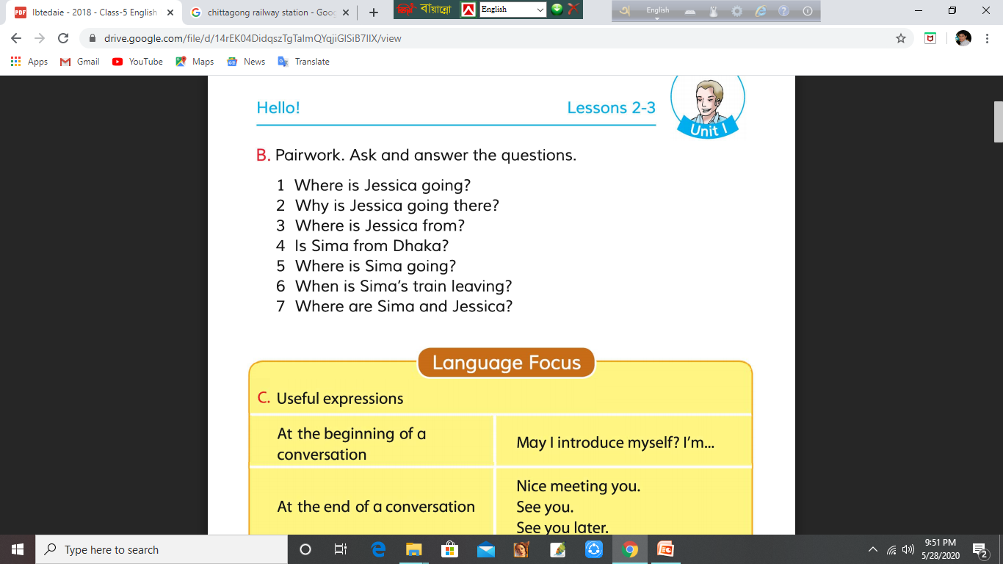
Pair Work
Easy To Learn
powered by saju sir
Visit : www.sajusir34.blogspot.com

Slide 15
Language Focus
At the beginning of the conversation | Hello ! Hi ! May I introduce myself ? Excuse me ?
At the end of the conversation | Nice meeting you. See you. See you later/again. Bye.
Easy To Learn
powered by saju sir
Visit : www.sajusir34.blogspot.com

Slide 16
Pair Work
Introduce yourself and
use the useful expressions.
Easy To Learn
powered by saju sir
Visit : www.sajusir34.blogspot.com

Slide 17
Thank you all
Easy To Learn
powered by saju sir
Visit : www.sajusir34.blogspot.com

