Slide 1
Notes:
This is just a welcome slide.

Slide 2
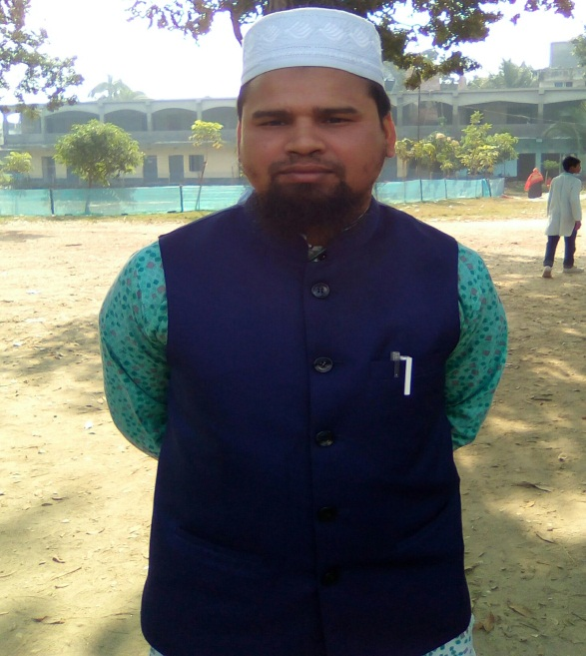
Identity
Teacher
Class & Subject
Md. Farid Uddin Assistant Teacher(English)
Dupchanchia D.S Fazil Madrasah
English 2nd paper
Grammar Item
Class IX & X
Notes:
Identity of the teacher & class as well as subject

Slide 3
The sweet sound of nature makes us charming.
As/Since it is the sweet sound of nature, it makes us charming.
What kind of change have you followed?
Simple to Complex
Let us discuss about it in our today’s class
We will conduct simple to complex with coordinating words today.
Notes:
This is a slide for suspension and to involve the students’ attention to the class.

Slide 4
Learning outcomes
At the end of the lesson, we will be able to—
be introduced with coordinating words.
transfer from simple to complex with coordinating words
Notes:
Only two outcomes will be achieved.

Slide 5
Coordinating words
Though, Although, Since/ As, If, that, so that,
‘So + adjective +that’, because, etc. are normally
used to mention condition.
Notes:
We will discuss only the function of coordinating words in our today’s class as we have finished ‘wh’ word function in the previous class.

Slide 6
Simple to complex with Though/Although
No one bought the hen despite the reduced price.
No one bought the hen though it was the reduced price.
In spite of poverty, he is honest.
Although he is poor, he is honest.
Note: Though /Although is used in stead of ‘in spite of/despite’
Notes:
Subject teacher will make it clear to the students.

Slide 7
Activities
Change the sentences from simple to complex
In spite of his shortness he made the best performance.
I love him despite his faults.
We had a great time in spite of the rain.
Despite our efforts, we failed after all.
He enjoys his job in spite of the low salary.
Check your answer.
Though he was short, he made the best performance.
I love him though he has some faults.
We had a great time though it was rain.
Although we adopted/showed/applied our efforts, we failed after all.
He enjoys his job though there is low salary.
Notes:
Evaluation and feed back.

Slide 8
Simple to complex with As/Since
She could not go to school for illness.
As she was ill, she could not go to school.
Important notes
Illness, boldness, sickness and such types of nouns will be
turned into adjectives, ‘hard work’ will be ‘work hard’
Notes:
Sample of As/Since

Slide 9
Activities
Change the sentences from simple to complex
He obtained golden A+ for hard study.
Achieving Scholarship he went to London.
Truth is beauty.
A mother’s love is divine.
He will succeed in life because of hard work.
Check your answer.
He obtained golden A+ as he studied hard.
As/Since he achieved scholarship, he went to London.
As/Since it is truth, it is beauty.
As it is a mother’s love, it is divine.
He will succeed in life as he works hard.
Notes:
Feed back in the class.

Slide 10
Simple to complex with ‘If’(1)
If there is by + gerund, follow the structure
Simple in affirmative
By reading attentively you
can make a good result.
If you read attentively, you
can make a good result.
Structure: If +subject + verb +ext. word + principal clause’
Notes:
‘Ext. word’ means বাকী শব্দ।

Slide 11
Simple to complex with ‘If’(2)
Simple in negative
Without working hard
you cannot succeed in life.
If you do not work hard,
you cannot succeed in life.
If there is without + gerund,
follow the structure
Structure: If +subject +do not+ verb +ext. word + principal clause
Notes:
Use of without + gerund shown here.

Slide 12
Simple to complex with ‘That’
We know him the legend of Bangla.
We know that he is the legend of Bangla.
That he is the legend of Bangla we know.
If there is object + adjective, follow the structure
Structure: Principal clause +that+ subject + verb +extension.
Notes:
Details mentioned in the slide.

Slide 13
Simple to complex with ‘ so that’
We eat to live.
We eat so that we can live.
Farmers go to the field to grow crops.
Make it a complex sentence.
If there is an infinitive (to +verb) in the sentence, changing structure will be--
Structure: Principal clause +so that+ subject + can/could +verb+ex.
Notes:
May/might also may be used.

Slide 14
Simple to complex with ‘ so + adjective + that’
If the simple sentence is-
“Subject + verb + too + adjective+ to + verb,”
complex will be --
Subject + verb + so + adjective+ that
+ subject + cannot/could not + verb.
He is too weak to walk.
He is so weak that he cannot walk.
Notes:
Normal rules to change simple to complex with ‘too+…+to’

Slide 15
Class work
Change the sentences from simple to complex
By working hard you can shine in life.
You cannot make a good result without reading well.
I know him very well.
We eat good food to keep us fit for work.
He is too little to cross the canal.
Check your answer.
If you work hard, you can shine in life.
You cannot make a good result if you do not read well.
I know that he is very well.
We eat good food so that we can/may keep us fit for work.
He is so little that he cannot cross the canal.
Notes:
Evaluation option.

Slide 16
Use of ‘because/before/after’ to change from simple to complex
If the simple sentence is with--
1. Because of + possessive + noun
2. Before/After+ v₄ (verb + ing )+ extension,
Changing form will be--
Principal clause+ because/before/after+ subject + verb + extension
Notes:
How to change simple into complex with ‘because/before/after shown here.

Slide 17
THANK YOU ALL

