Slide 1
WELCOME

Slide 2
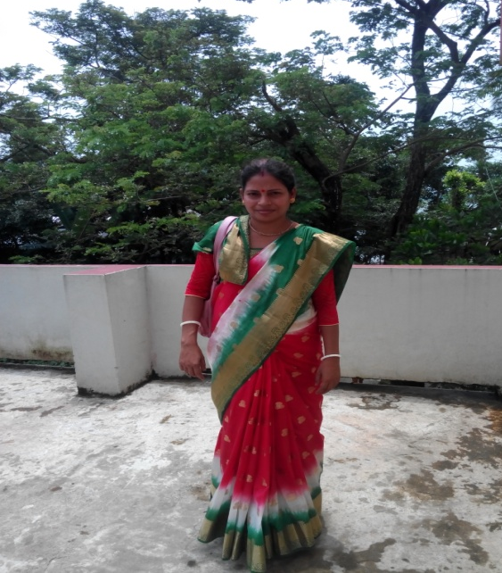
Teacher Identification
Bipula Rani Deb
Assistant Teacher
Kharia Govt. Primary Schol
Nabiganj, Habiganj.

Slide 3
Subject Introduction
Class – 2
Subject – English
Heading – The Golden Goose
Lessons(4-6)
Unit- 29.Page-59.
Part of the lesson – Look and Listen.A Poor farmer-------------the egg.
Time-40 Minutes.

Slide 5
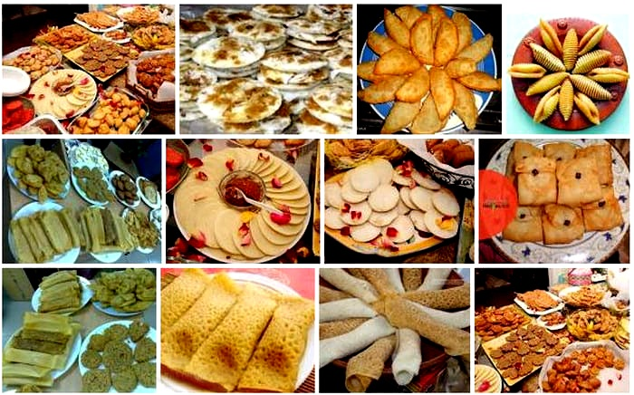
Creat safety environment
Good morning students. How are you?
Warmup activity- By showing a picture.

Slide 6
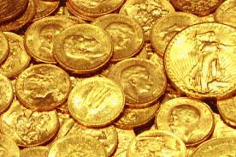
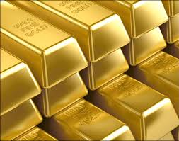
Do you know ,what is the valuable things?
Gold

Slide 7
Todays We are going to start a new lesson
The Golden Goose

Slide 8
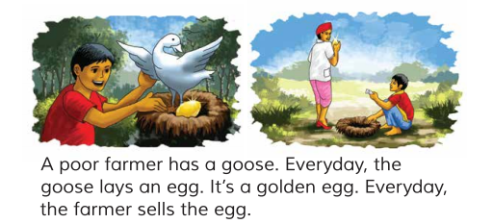
Do you thing in this pictures?

Slide 9
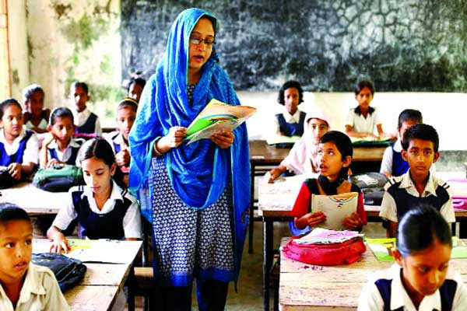
Teachers Lesson

Slide 10
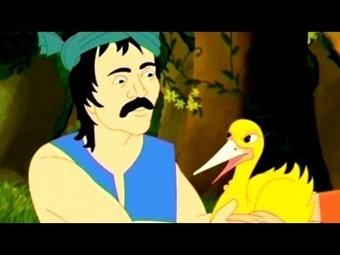
A poor farmer has a goose.

Slide 11
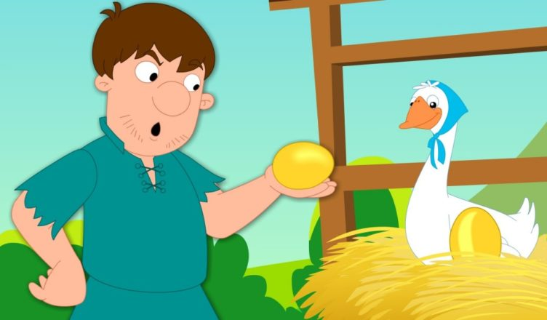
Everyday ,the goose lays an egg . It’s a golden egg.

Slide 12
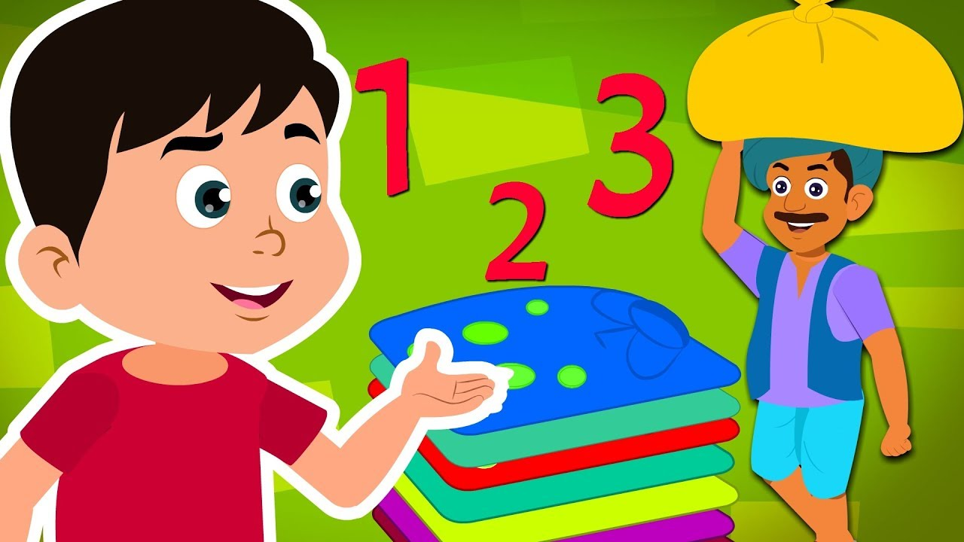
Everyday the farmer sells the egg.

Slide 13
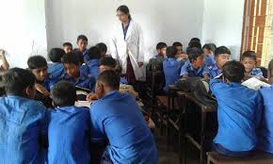
Group Work
Following Say this words- Poor , Farmer ,Golden , Egg .

Slide 14
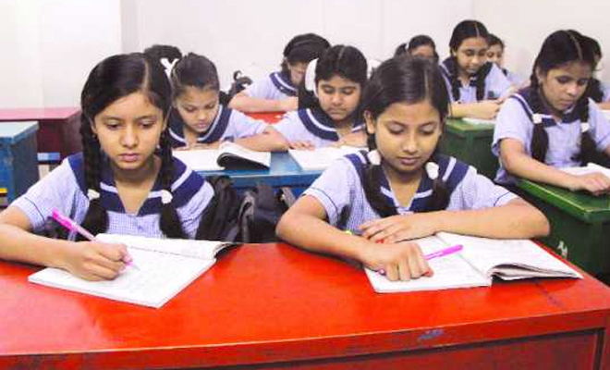
Individual Work

Slide 15
Evaluation
Say this word meaning -----Poor ,Farmer , Golden , Egg .

Slide 16
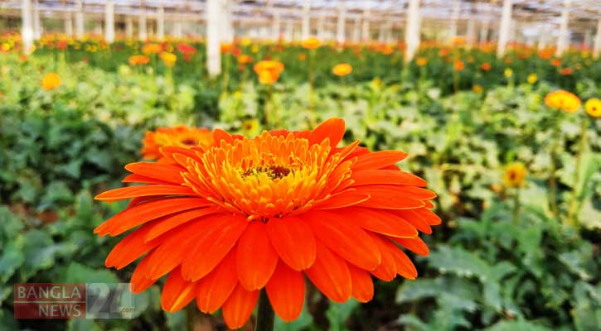
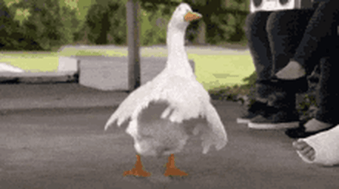
Goodbye Students

