Slide 1
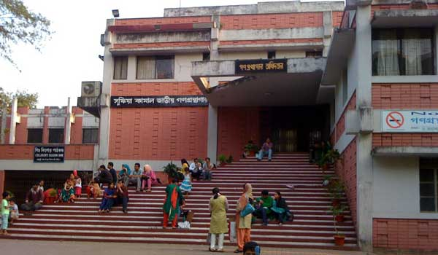
Welcome to English Class

Slide 2
Identity
Manik Chandra Majumder
Senior Teacher
Gazirhat High School
Senbag, Noakhali.
Contact No: o1717155169
E-mail:manikmajumder01@gmail.com
Class : Nine-Ten
Subject : English 1st paper
Time: 50 Minutes
Date : 00/00/2017

Slide 3
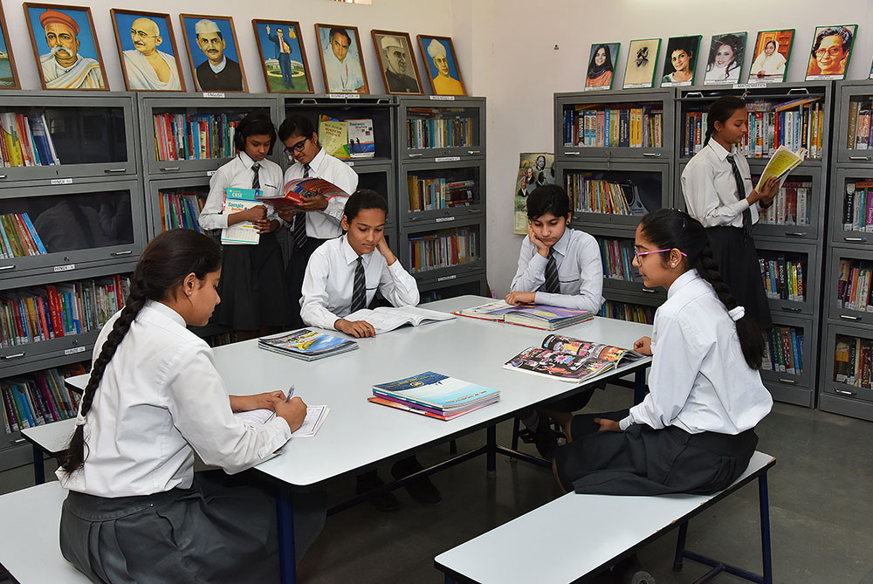
Have you any library at your school?
Are you familiar with it?
What is this?
A school Library
Yes, we are familiar.
Yes, we have.

Slide 4
But what our today’s lesson is----
It is a paragraph.
“ A School Library”
Writing Part

Slide 5
Learning Outcomes :
After the end of the lesson, learners will be able to :
a) tell about school library,
b) ask and answer questions,
c) practise speaking and describing familiar topic,
d) write short paragraph.

Slide 6
Before writing this paragraph you have to think over the following questions.
What is a Library? And what is a school library?
Where and how is your school library housed and decorated?
How many books are there in your library and how arranged?
Is there any internet facility in your school library?
What do the students do in the library?
Who conducts the library? And how ?
What environment does prevail in your library?
What is your feeling about the library?

Slide 7
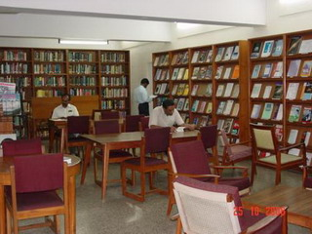
What is a Library?
Library is a place where varied collection books are preserved for readers.

Slide 8
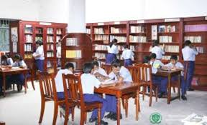
What is a school library?
Hence a school library is a place where both students and teachers go to quench their thirst of knowledge .It plays immense contribution to make an educated nation with intellect.

Slide 9
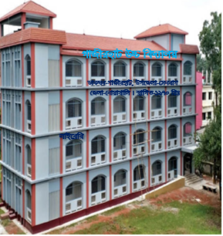
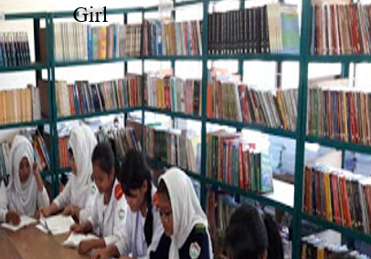
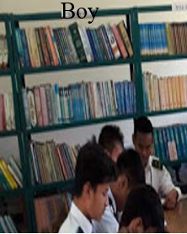
Have you any library in your school?
Where is your school library housed?
We have an enriched library in our school. It is housed in the second floor of the school building. There are three big rooms in it. The two rooms are use for reading purpose. Boys and girls have separate rooms. The other room is used as office room.

Slide 10
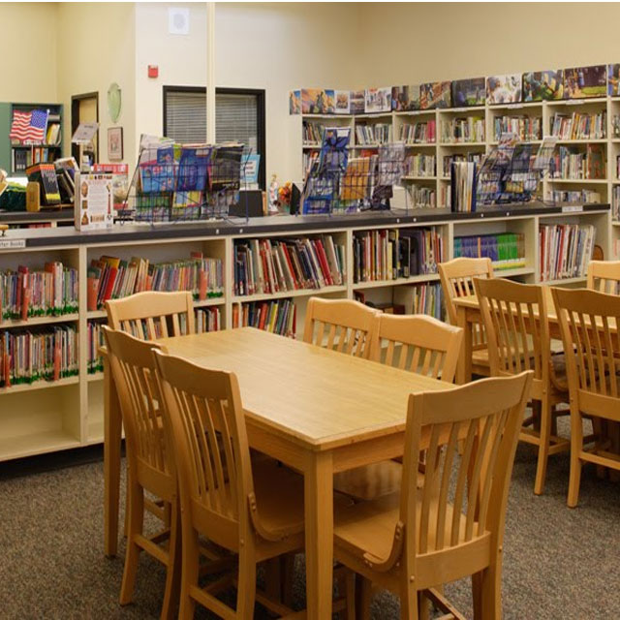
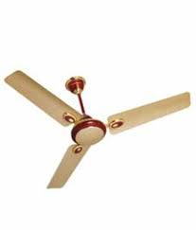
How is it decorated?
It is well decorated and ventilated with lights, fans and ventilators. There is a good sitting arrangement in it.

Slide 11
Is there any internet facility in your school library?
There are two computers, a projector and modern internet facilities
in our school library.

Slide 12
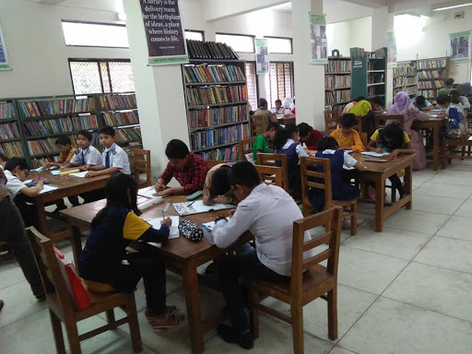
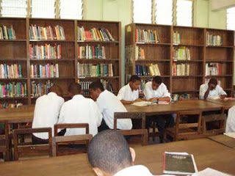
How many books are there in your library and how arranged?
There are about 5000 books in our library including many rare collection of books on history and culture .

Slide 13
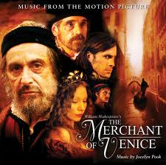
The books are arranged according to different categories like------
text books, story books. poetry books, science fictions, ghost books, children books, dramas, stories, novels reference books etc.

Slide 14
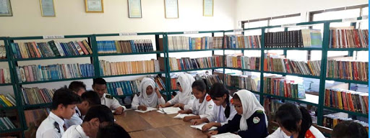
What do the students do in the library?
Only the students and teachers can read books, make notes and gather reference in the library in their off periods. Thus they enrich their knowledge.

Slide 15
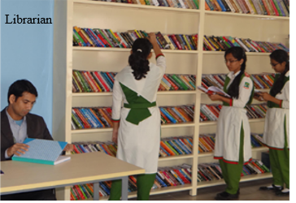
Who conducts the library? And how ?
A librarian is appointed to conduct the library. He helps the students to deliver the books at home maintaining a register. A student can borrow 2 or 3 books at a time and keep home for a week or two. But in the reading room he can read as many books he can .

Slide 16
When does it remain open?
What environment does prevail in your library?
It remains open from9 a.m.to 5 p.m. except holidays . A pin-drop silence prevails in the library when it continues.
What is your feeling about the library?
A pin-drop silence prevails in the library. Our school library is a great attraction for us. We are really proud of it .

Slide 17
What items are mentioned as decoration, book arrangement, electronic facilities, book lists and so on. Make a logical assemble with all the things in the library to write a paragraph on “A school Library.”

Slide 18
Work in pair. Ask the following questions to your partners.
What is a Library? And what is a school library?
Where and how is your school library housed and decorated?
How many books are there in your library and how arranged?
Is there any internet facility in your school library?
What do the students do in the library?
Who conducts the library? And how ?
What environment does prevail in your library?
What is your feeling about the library?

Slide 19
Evaluation
What do you mean by a school library?
What things are needed to make a school library?
How should be the arrangement of a school library?
Why is it necessary for a school?
Who are benefited the the library?
Why is it called the store house of knowledge?
Who conduct the school library?

Slide 20
Home work
Write in a paragraph on your School library.

Slide 21
GOOD BYE

Slide 22
Just have a look on whole paragraph
Library is a place where varied collection books are preserved for readers. Hence a school library is a place where both students and teachers go to quench their thirst of knowledge .It plays immense contribution to make an educated nation with intellect. We have an enriched library in our school. It is housed in the second floor of the school building. There are three big rooms in it. The two rooms are use for reading purpose. Boys and girls have separate rooms. The other room is used as office room. It is well decorated and ventilated with lights, fans and ventilators. There is a good sitting arrangement in it. There are two computers, a projector and modern internet facilities in our school library. There are about 5000 books in our library including many rare collection of books on history and culture . The books are arranged according to different categories like text books, story books. poetry books, science fictions, ghost books, children books, dramas, stories, novels reference books etc. Only the students and teachers can read books, make notes and gather reference in the library in their off periods. Thus they enrich their knowledge. A librarian is appointed to conduct the library. He helps the students to deliver the books at home maintaining a register. A student can borrow 2 or 3 books at a time and keep home for a week or two. But in the reading room he can read as many books he can . It remains open from9 a.m.to 5 p.m. except holidays . A pin-drop silence prevails in the library when it continues. A pin-drop silence prevails in the library. Our school library is a great attraction for us. We are really proud of it .

