Slide 2
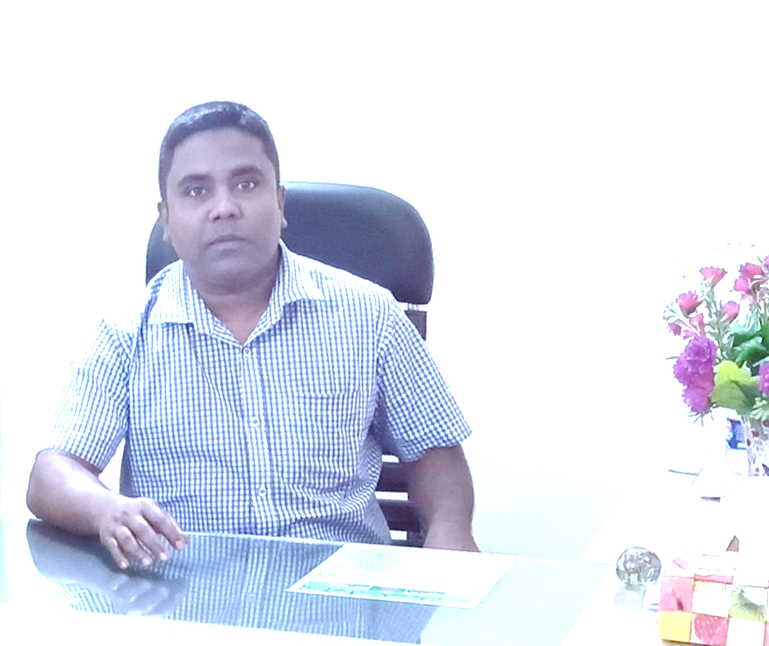
Sub: English
Class: Two
Lesson : Numbers-17,18,19
Parts of the lesson: Activity-A
Page No-24
Md. Mushfikur Rahman
ASISSTANT TEACHER
PARGOBINDOPUR GOVT. PRIMARY SCHOOL
BIRAMPUR,DINAJPUR.

Slide 3
Safety environment by greetings song.
WE SHALL OVERCOME
WE SHALL OVERCOME
WE SHALL OVERCOME, SOME DAYS.
OH, DEEP IN MY HEART
I DO BELIVE THAT
WE SHALL OVERCOME, SOME DAYS.

Slide 4
Dear students- Count and say.
Now try to say-
What can be the topic of our today’s lesson?

Slide 5
Our today’s lesson is--
Numbers-17,18,19
Activity-A

Slide 6
LEARNING OUTCOMES
By end of the lesson students will be able to-------
Listening: 1.1.1 become familiar with English sounds by listening to
common English words
Speaking: 1.1.1 repeat after the teacher simple words and phrases with
proper sounds and stress.
1.1.2 say simple words and phrases with proper sounds and stress.
Reading: 2.1.1 recognize and read cardinal numbers up to 30.

Slide 7
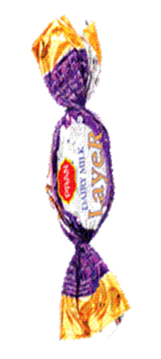
Look, listen and say.
What are these?
How many chaklets are there?
How many candles are there?
How many ice-creams are there?
17
18
19

Slide 8
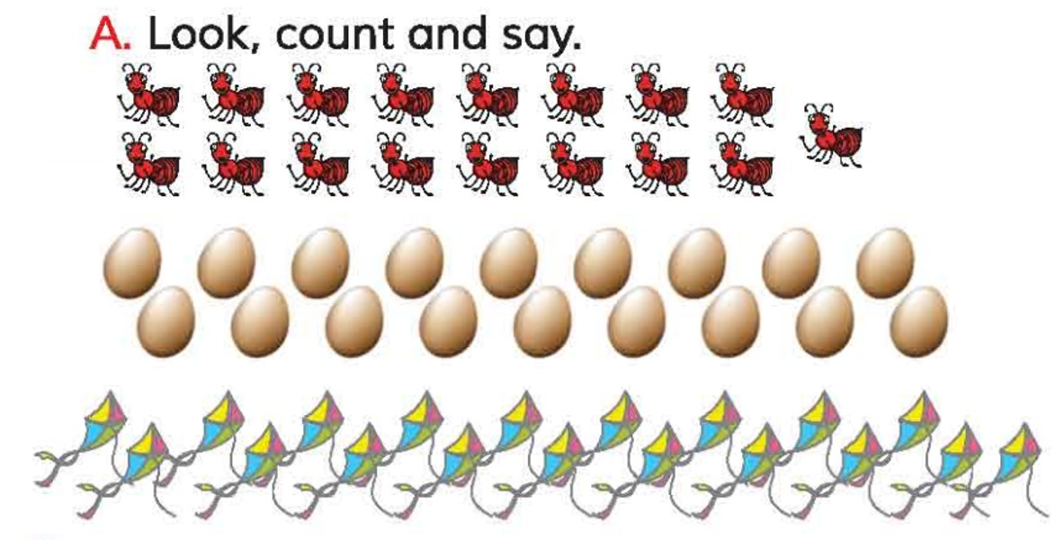
Open your English book at page-24 and see the Activity-A
17
18
19
How many ants are there?
How many eggs are there?
How many kites are there?

Slide 9
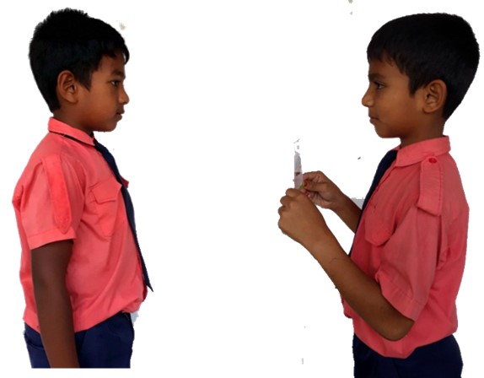
How many -----------?
One more

Slide 10
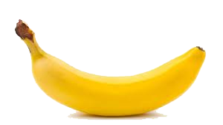
Count and say.
18
17
19

Slide 11
Read and say.
18
12
16
6
2
4
9
17
10
15
1
7
14
5
8
11
19
3
13

Slide 12
One day one word
Read and say.
touch
স্পর্শ করা

Slide 13
Find out the letters that are made by the word--------.
t
n
o
u
c
e
c
k
h
d
Find out the correct word-------.
toch
touch
tauch
teuch

Slide 14
Say the missing letter.
tou-h
t-uch
to-ch
touc-
Write the word to your notebook.
touch
টাচ
স্পর্শ করা

Slide 15
Home work
Page 5 will be well read and written.

Slide 16
That’s all for today. Goodbye. See you tomorrow.

