Slide 1
`
O
E
L
W
M
C
E
Mithu kumar Roy.
Assistant Teacher, Tularampur Gov’t Primary School. Narail.
ICT4E District Ambassador.
Cell no: 01714670007, E-mail: mithuroy0007@gmail.com

Slide 2
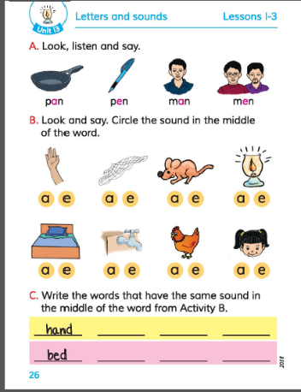
Today’s Lesson: Letters And Sounds.
English For Today
Class:3
Unit:13, Lesson: 1-3
Activity: C , Page: 26
Time: 50 minutes.

Slide 3
Dear students,
How are you?
Do you want to listen to a rhyme?
First, Listen to the rhyme,
then recite the rhyme with action.
PLEASE CLICK

Slide 4
Learning Outcomes:
By the end of the lesson, Students will be able to -
Writing :
3.1.2 write words, phrases and sentences using non-cursive small letters.

Slide 5
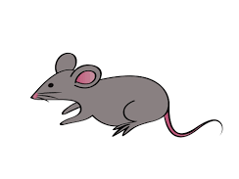
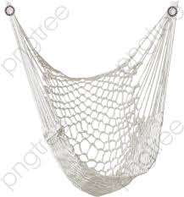
Look at the picture and say the words
Rat
Net

Slide 6
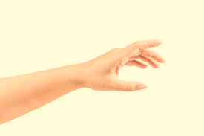
Look at the picture and say the words
Hand
Head

Slide 7
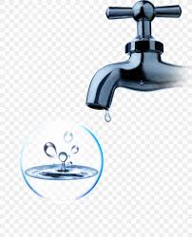
Look at the picture and say the words
Tap
Lamp

Slide 8
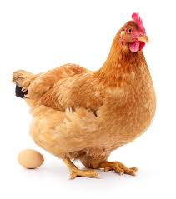
Look at the picture and say the words
Hen
Bed

Slide 9
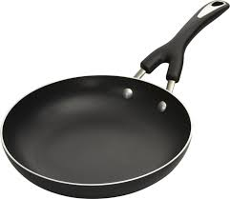
Look at the picture and say the words
Pan
Pen

Slide 10
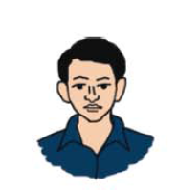
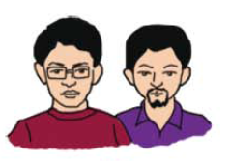
Look at the picture and say the words
Man
Men

Slide 11
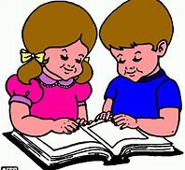
Read the words with peer.
Pair work
Tap
Man
Bed
Lamp
Net
Hand
Rat
Pan
Hen
Men
Pen
Head

Slide 12
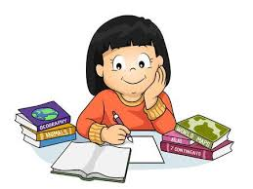
Who can say the sound in the middle of the words.
Yes, the sound is ‘a’ and ‘e’.
Now put the words in to the right place.
Think alone
Rat
Net
a
e

Slide 13
Now put the words in to the right place.
Rat
Net
Rat
Net
a
e

Slide 14
Now open your English Book at page no 26.
Do the work in Small Group
Look at the picture of Activity A and B.
Find out the words that have the same sound in the middle of the word.

Slide 15
Now write the words that have the same sound in the middle of the word.
Look ! One is done for you .
Do the activity in Small Group
Bed
Lamp
Bed
Net
Hand
Rat
Hen
Rat
Head
Tap
a
e

Slide 16
Let us see.
Bed
Lamp
Net
Hand
Lamp
Net
Hand
Tap
Rat
Hen
Tap
Hen
Head
Head
Rat
a
e
Bed

Slide 17
Dear students, Say the words and say the sound that are in the middle of the words.
Tap
Hen
Man
Hand
Head
Lamp
Evaluation

Slide 18
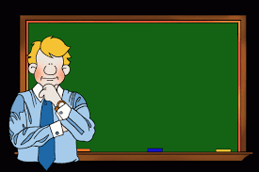
Dear students,
What have we learnt today?
Summerising
Who can say?
Raise your hand.

Slide 19
Dear students,
Summerising
Now We can say the sound ‘a’ and ‘e’.
Now We can read and write the following words- Head, hand, tap, men, pan, rat, net, man, pen. Lamp, bed, hen.

Slide 20
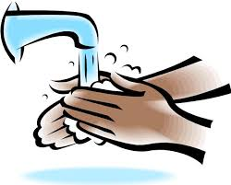
Dear students, that’s all for today.
Thank you everybody.
Stay at home, Stay safe.

