Slide 1
WELCOME

Slide 2
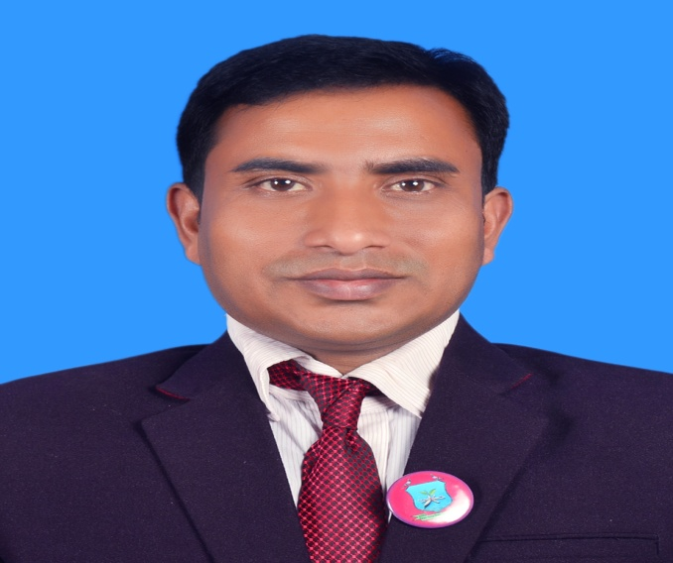
INTRODUCTION
Suranjit Talukder
( BA, B-Ed; MSS, M-Ed; C-in-Ed )
Assistant teacher
Voishber Govt. Primary School.
Sunamgonj Sadar , Sunamgonj.
Class: Five
Subject: English
Unit:7,Lesson: 1-2.
Date:
Time:40 Minutes

Slide 3
CREATING EMOTION
Good morning , students.
Good morning , teacher.
How are you?
Fine . And you?
I’m also fine. But you are looking pale .(By showing a student)
Have you any problem?
No/Yes , Sir.
Let’s sing a song …

Slide 4
We eat to live . Everyday we eat different kinds of foods . Every foods are not delicious. Some foods are delicious but unhealthy.
Please tell me the names of some foods which are tasty but unhealthy.
Burger , Chips , Loly pop , Ice-cream , Sandwich,
Different Soft drinks etc.
Why should we eat healthy foods and take regular exercise?
To be healthy.
Really! We should eat healthy foods and take regular exercise.
Today’s topic is “Be Healthy ” .

Slide 5
LEARNING OUTCOMES
Students will be able to………
Understand statements made by the teacher and students.
Say words, phrases and sentences with proper sound stress and intonation .
To read silently with understanding paragraph, stories,
Dialogues, personal letters and others texts materials.
write short dialogue on familiar objects, people, places and events.

Slide 6
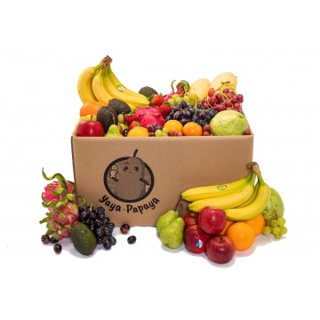
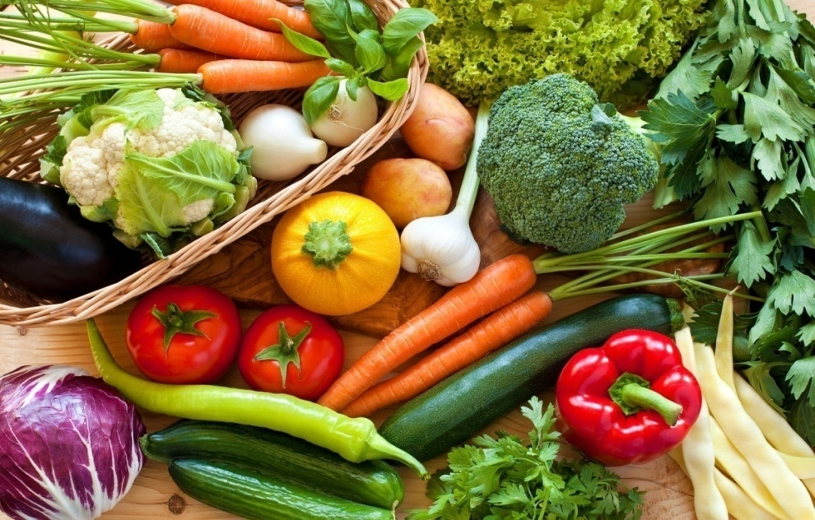
Please think about this picture and discuss in pairs.
What do you see in the picture?
Different kinds of fruits and vegetables.
To be healthy we should eat these foods regularly.

Slide 7
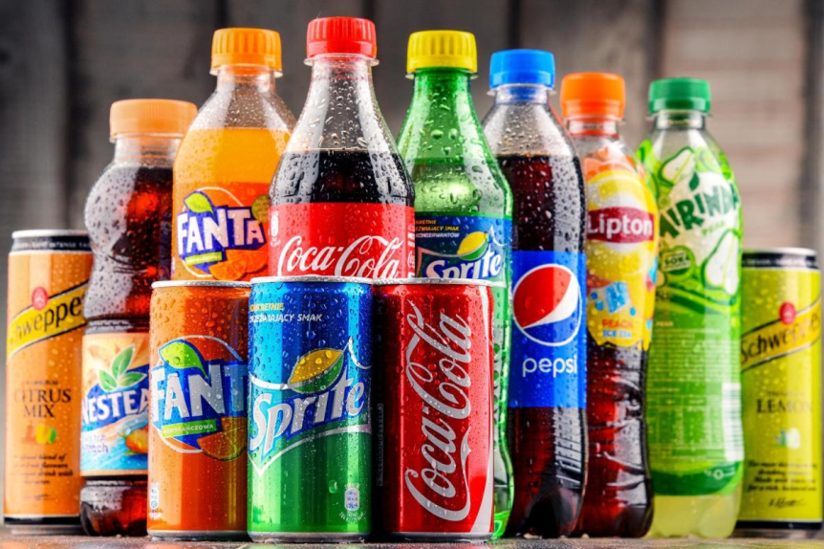
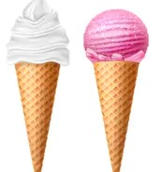
Please think about this picture and discuss in pairs.
What do you see in the picture?
Chocolate, ice cream and different kinds of cold drinks.
To keep our body fit we should avoid these foods because these foods are harmful for our health.

Slide 8
NEW WORDS MEANINGS
Chocolate:
Delicious :Pleasant, Testy

Slide 9
NEW WORDS MEANINGS
Ice cream: A soft frozen food made with sweetened and flavored milk , fat.
Delicious :Pleasant, Testy

Slide 10
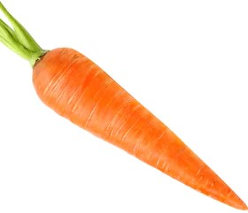
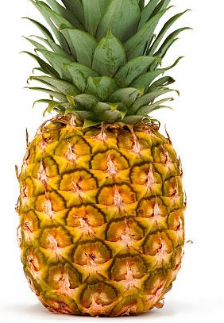
NEW WORDS MEANINGS
Carrot
Pineapple

Slide 11
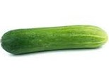
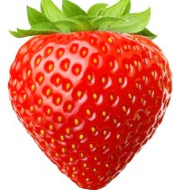
NEW WORDS MEANINGS
Cucumber
Strawberry

Slide 12
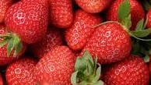
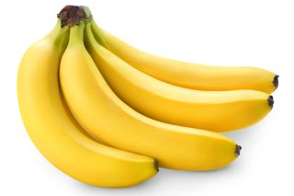
NEW WORDS MEANINGS
Strawberry
Banana

Slide 13
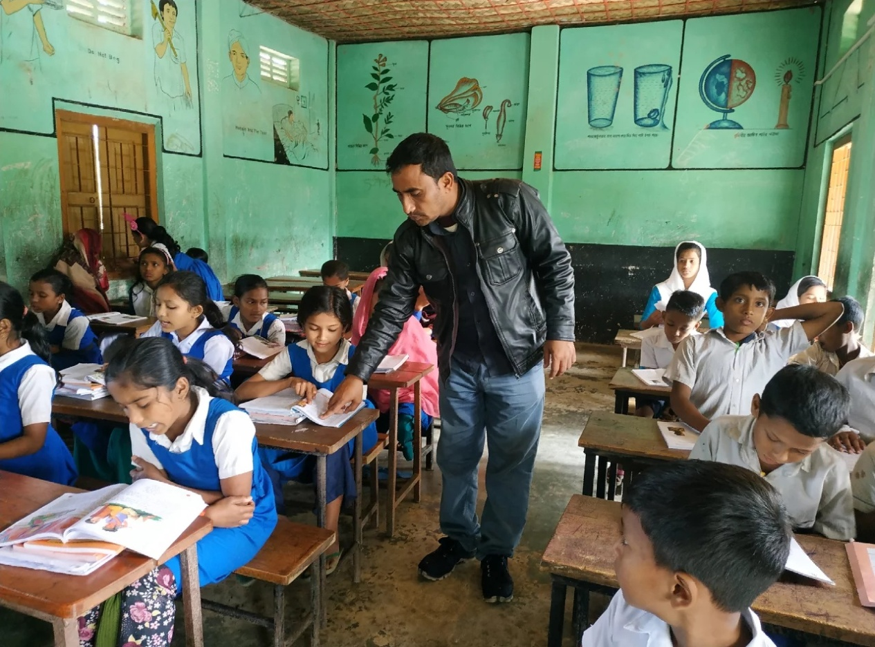
Listen to the text with me and put your finger under the line.
Now read loudly after me.

Slide 14
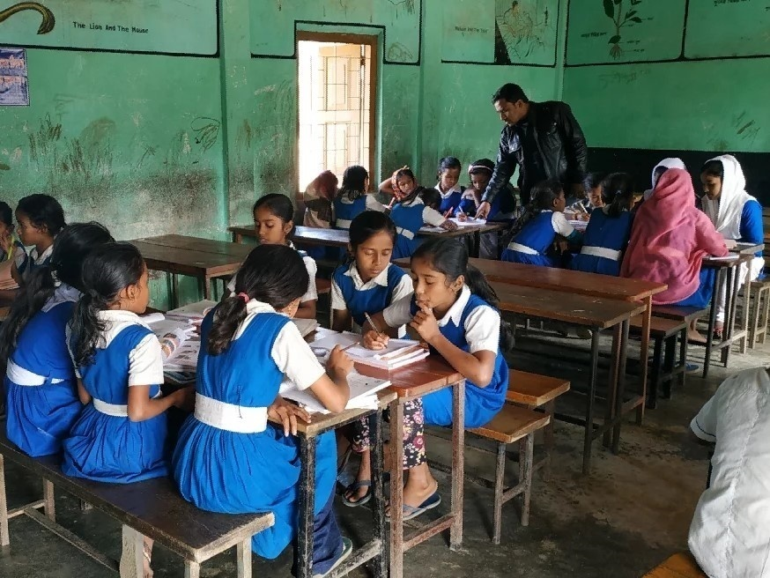
Now read the text in groups.

Slide 15
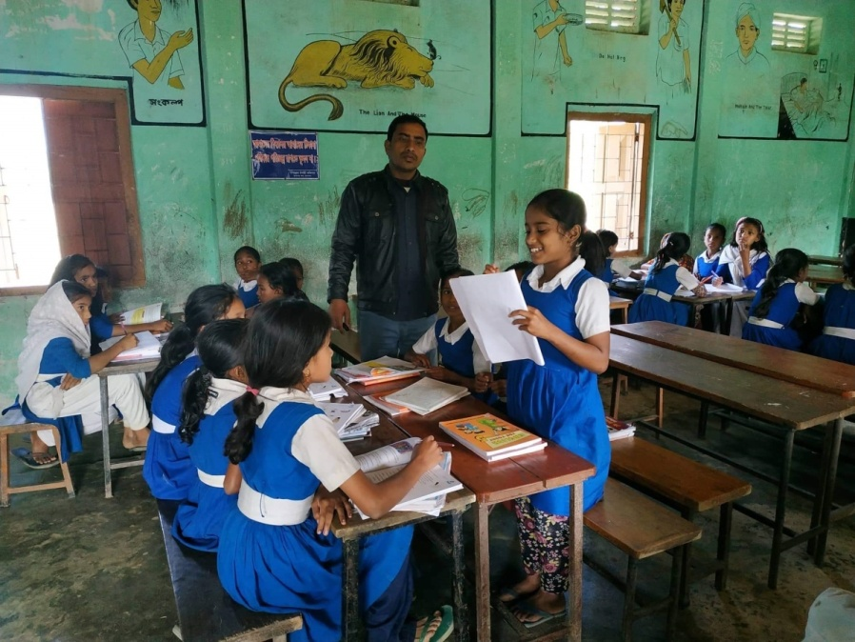
A student will be selected from every group to present their group work.

Slide 16
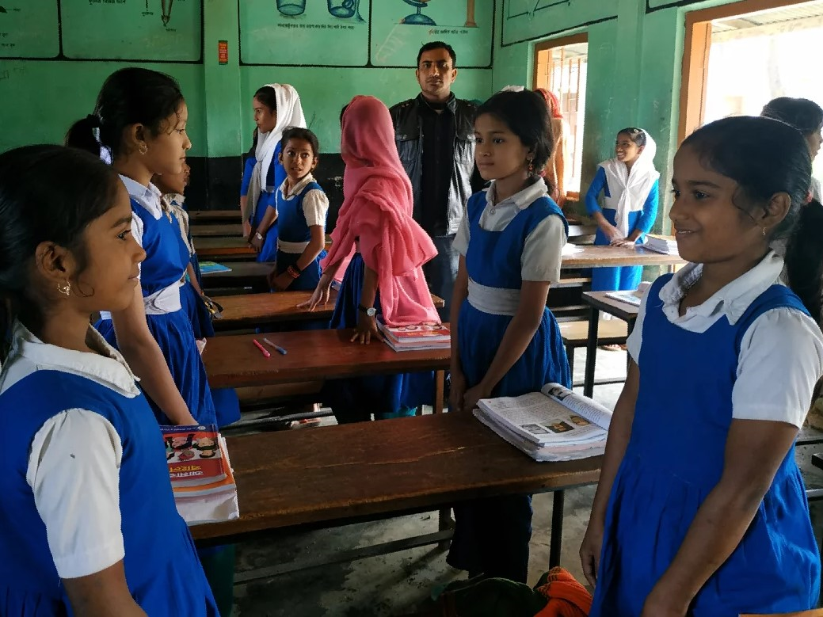
Now act in pair.

Slide 17
Pair work . Ask and answer the questions.
1.What is Nasreen putting chocolate on?
2. Why doesn’t Nasreen eat chocolate regularly?
3.What does Nasreen say about chocolate and icecream?
4.What are Nasreen’s favorite foods? Are these healthy foods?
5.What are Sima’s favorite foods? Are these healthy foods?

Slide 18
INDIVISUAL WORK
Write a short composition about a healthy meal you ate. Use the following words:
vegetables | lentils | fruit | healthy | dairy | unhealthy | oil

Slide 19
Homework
Write a dialogue between you and your friend about healthy and unhealthy foods.

Slide 20
GOODBYE

