Slide 1
WELCOME

Slide 2
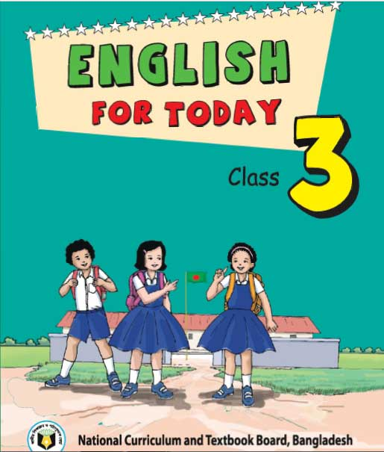
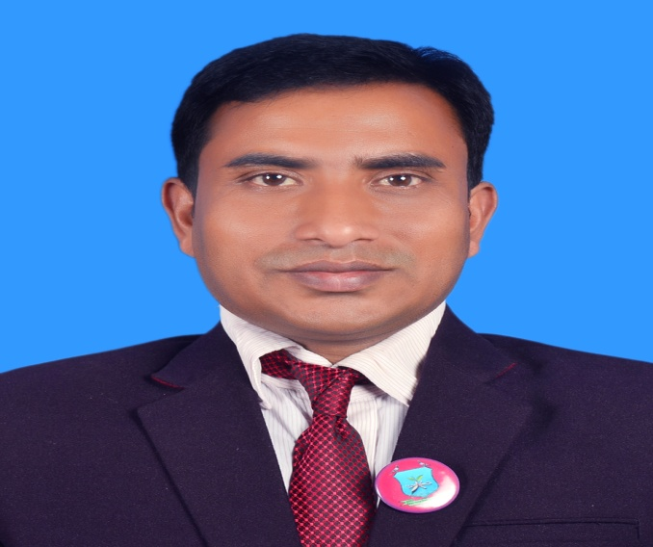
INTRODUCTION
Class : Three
Subject : English
Unit:34 ,Lesson:1-3.
Date:
Time:
Suranjit Talukder
( BA, B-Ed; MSS, M-Ed; C-in-Ed )
Assistant teacher
Voishber Govt. Primary School.
Sunamgonj Sadar , Sunamgonj.

Slide 3
CREATING EMOTION
Good morning , students.
Good morning , teacher.
How are you?
Fine . And you?
I’m also fine. But you are looking pale .(By showing a student)
Have you any problem?
No/Yes , Sir.
Let’s sing a song …

Slide 4
Every animal lives in his own environment. Fish lives in water. Birds live on tress. A lion lives in a den, a cow lives on a shed. But where do men live?
Men live in house.
What is called the house where men live in peace with father mother and children?
It is called the family.
Really! .
Today’s topic is “My Family ” .

Slide 5
LEARNING OUTCOMES
Students will be able to………
Enjoy and understand simple stories.
Ask and answer simple WH and Yes/No questions.
To read silently with understanding simple sentences , paragraphs and other texts.
write short and simple paragraph by answering a set of questions.

Slide 6
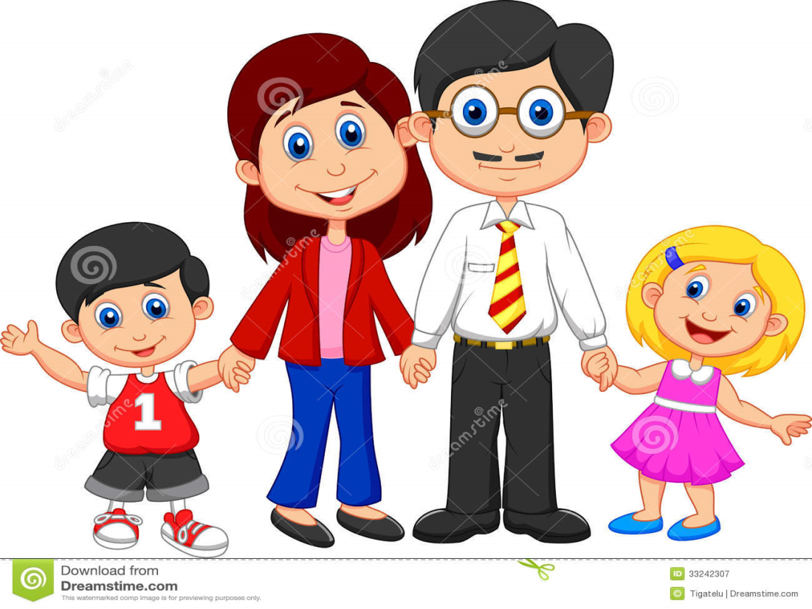
Please think about this picture and discuss in pairs.
What do you see in the picture?
A family members.

Slide 7
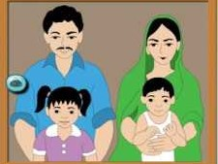
Please think about this picture and discuss in pairs.
Do you know whose family is it?
It’s Tisha’s family.

Slide 8
NEW WORDS MEANINGS
Banker : A person who works in a bank as an officer.

Slide 9
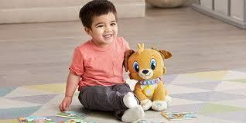
NEW WORDS MEANINGS
Boy : Son, A male child.
Father : Dad , Daddy.
Mother : Mammy.

Slide 10
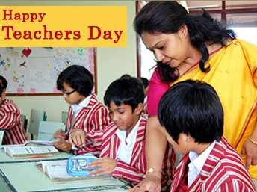
NEW WORDS MEANINGS
Teacher: A person who teaches in any educational institution.

Slide 11
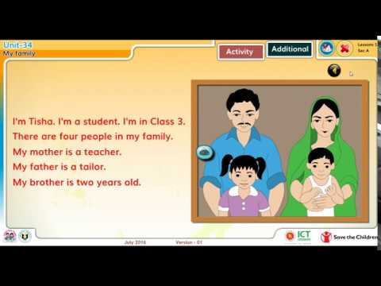
Listen to the text with me and put your finger under the line.

Slide 12
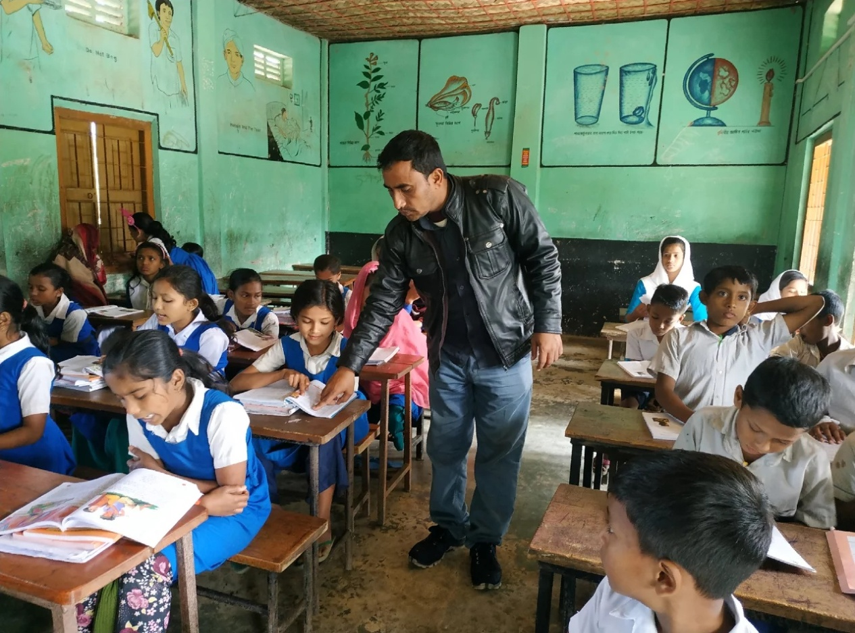
Now read loudly after me.

Slide 13
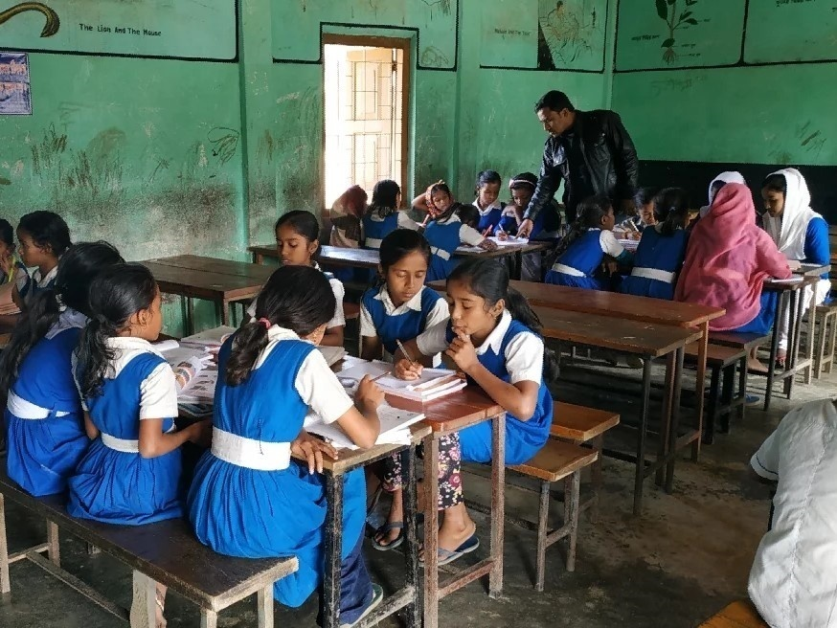
Now read the text in groups.

Slide 14
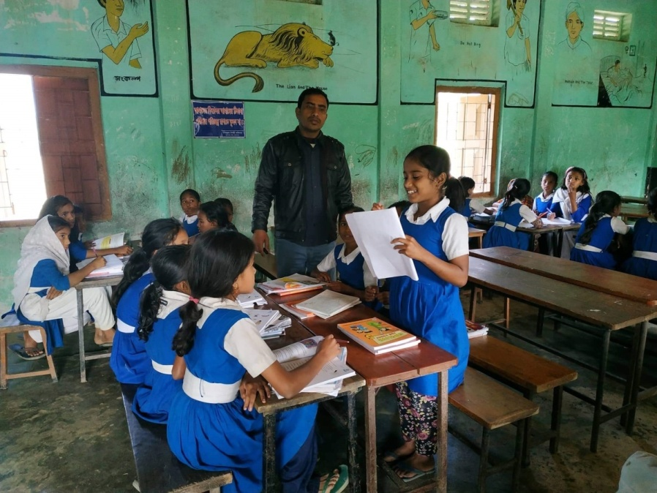
A student will be selected from every group to present their group work.

Slide 15
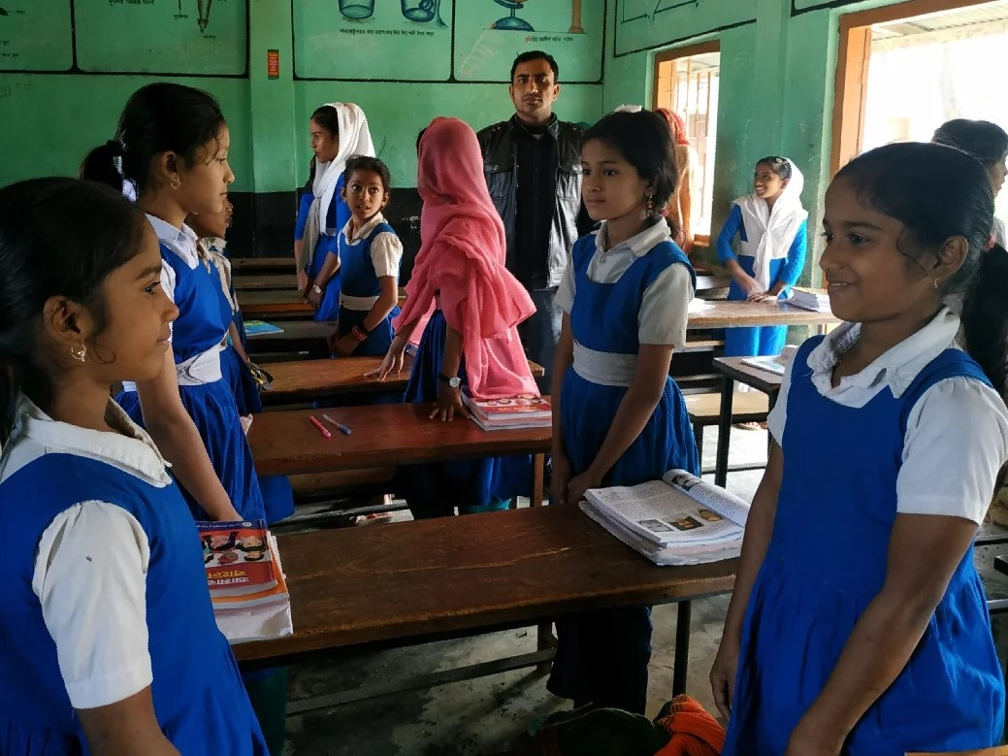
Pairwork.

Slide 16
Pairwork. Ask and answer.
1.What is the girl’s name?
2.What class is she in?
3.How many people are there in her family?
4.What does her mother do?
6.How old is her brother?

Slide 17
INDIVISUAL WORK
Fill in the blanks with the suitable word from the box. ( There are two extra words)
people | bank | teacher | two | three | banker | brother
1.Tisha is a student of class………
2.Tisha’s brother is …….years old.
3.A banker works in a …….
4.Tisha’s mother is a…………
5.There are four …….. in Tisha’s family.

Slide 18
Homework

Slide 19
Homework
Write a paragraph about “Your Family” by using the following questions:
What is your name?
What class are you in?
How many people are in your family?
What does your mother do?
What does your father do?
Do you have brothers or sisters?
How old are your brothers and sisters?

Slide 20
GOODBYE

