Slide 1
W
E
L
C
O
L
E

Slide 2
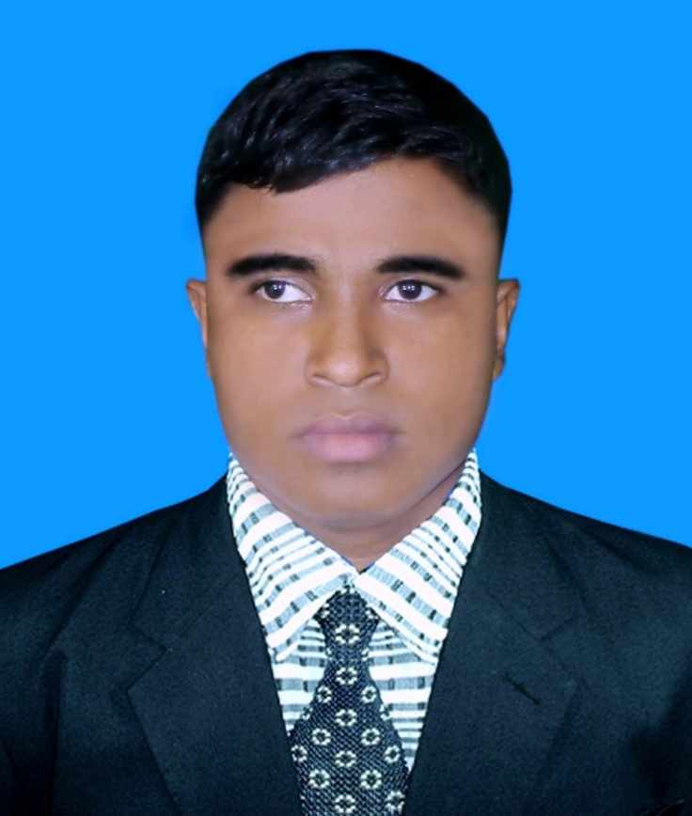
Identity A. Sukur Ali Khan Assistant Teacher (English)
Naldha Secondary School
Naldha,Fakirhat,Bagerhat.
Email : sukur360720@gmail.com Mobile no-01922360720
Class-Nine
English Second Paper

Slide 3
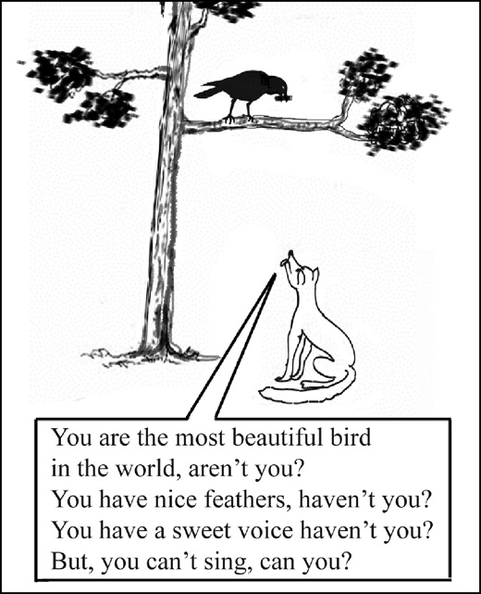
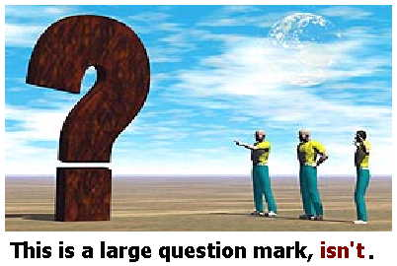

Slide 4
Read the Sentences Carefully
*I am a teacher. aren’t I?
*You are good students. aren’t you?
* Let’s go to study. shall we?
*Every mother loves her child. don’t they?
* He is not reading at this moment. is he?
What is the Sentences about?

Slide 6
By the end of the lesson You will be able to know-----
What the Tag Question is.
About auxiliary verb.
About the rules of Tag Question.
About the uses of Tag Question.

Slide 7
Question Tags
Subject
Pronoun
That dog is yours, isn’t it?
That dog isn’t yours, is it?
Auxiliary Verb
Auxiliary Verb
Subject
Pronoun
The question tag is formed by the auxiliary verb that matches the tense of the statement and the pronoun that matches the subject of the statement.

Slide 8
Question Tags
When the sentence is affirmative, the question tag is negative.
You work in a bank, don’t you?
Purba liked the film, didn’t she?
You don’t work in a bank, do you?
When the sentence is negative, the question tag is affirmative.
Purba didn’t like the film, did she?

Slide 10
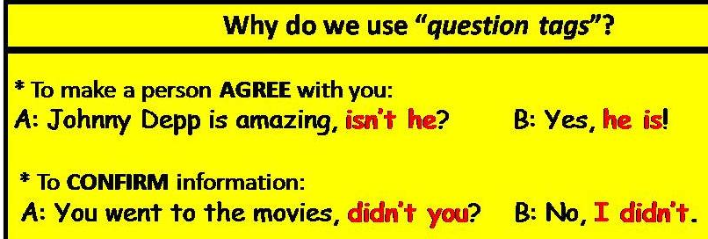

Slide 11
A Tag Question is the question asked by the speaker to conform the negative or affirmative statement during conversation. Through a Tag Question the speaker wants to have an answer in support of the statement.
If the statement is affirmative, the Question Tag is negative.
If the statement is negative, the Question Tag is affirmative.
Example:
They came here, didn’t they?
They did not work, did they?
Rules:
If the statement is affirmative, rule will be. Auxiliary verb+ n’t + Subject+?
If the statement is negative, rule will be. Auxiliary verb + Subject +?

Slide 12
In the Tag Question the auxiliary verb is very essential, so I will discus about auxiliary verb.
Do you know how many kinds of auxiliary verb? What are they?
Mainly there are two kinds of auxiliary verb. They are Primary& Modals.
Primary are three kinds. They are be, have& do.
Be verb am, is & are.
Have verb have, has & had.
Do verb do, does & did.
The primary auxiliary verbs change according to subject.
Example: I am a boy.
Modals auxiliary verbs are may, might, can, could, shall, should, will, would, must, ought to, need. have to,has to,had to,am to,is to,are to ,dare etc.
The modals auxiliary verbs will not change according to subject.
Example:
I can do the work.

Slide 13
In the Tag Question auxiliary verb always use contractions mood. So, I will show a chart about it.
Full Forms | Contractions | Full Forms | Contractions
am not are not is not was not were not do not does not did not have not has not had not | aren’t aren’t isn’t wasn’t weren’t don’t doesn’t didn’t haven’t hasn’t hadn’t | shall not will not should not would not may not might not can not could not ought not must not need not | shan’t won’t shouldn’t wouldn’t mayn’t mightn’t can’t couldn’t oughtn’t mustn’t needn’t
In this chart we have learnt that auxiliary verb will be always small letter.

Slide 14
In the Question Tag the subject will always be pronoun.
If the sentence has primary or modals auxiliary verb. The rule will be auxiliary verb + sub:+?
Example: I shall learnt it. shan’t I?
Rahim is a good student. isn’t he?
If the sentence has no auxiliary verb we will use do, does & did.
Example: I eat rice. don’t I?
He did not go to School yesterday. did he ?
Some words such as never, rarely, scarcely, seldom, few, little express negative meaning. If these words contain in a sentence. Tag Question will be positive.
Example: He is seldom found at home. is he?
I have a few friends. have I?

Slide 15
If the words such as nothing, anything, something, everything contain in a sentence, subject will be it.
Example: Nothing was done. was it?
Everything is our favour. isn’t it?
If the words such as everybody, anybody, somebody, everyone, someone, anyone, nobody, none etc contain in a sentence, subject will be they.
Example: Everybody hates a liar. don’t they?
Nobody went there. did they?
If the sentence is imperative Question Tag will be will you? Exceptional let’s. If the imperative sentence start let us the answer will be shall we?
Example: Open the door. will you?
Let us play cricket. shall we ?

Slide 16
Except we, all the plural subject will be they in the Question Tag.
Example: Birds can fly. can’t they?
Fishes can fly. can’t they?
Evaluation
Let’s do the work.
I found a little water in the jug.
Rahim could play football.
He killed a snake.
Let him do the work.
Make the above sentences Question Tag.
shall we ?
did I ?
couldn’t he ?
didn’t he ?
will you ?

Slide 17
Evaluation:
1. Peu and Lily are working, ____________?
2. Anwar had visited Barisal before, _________?
3. Elephants can’t fly, ______________?
4. We shouldn’t do this, ____________ ?
5. School starts at 8:25, _____________?
6. Samia will be in class, ___________ ?
7. You’ve got three cats, ____________?
8. Be careful, ______________?
9. Let’s write it again, _____________?
aren’t they
hadn’t he
should we
can they
doesn’t it
won’t she
have you
will you
shall we

Slide 18
Home work
Make the sentences below Question Tag.
Open the window.
He is in American.
Nothing was said.
You should help me.
Everybody wishes to be happy in life..
Let’s have a picnic.
Let him do the work.
He needs your help
I am innocent.
She hardly came here.

Slide 19
Class Over
. See you again.

