Slide 1
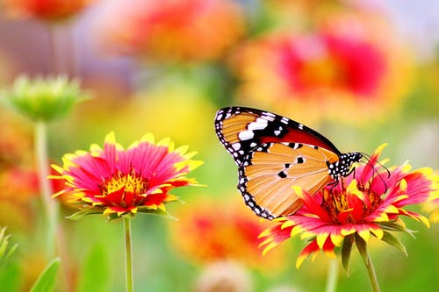
Welcome
everybody
Easy To Learn
powered by saju sir
Visit : www.sajusir34.blogspot.com

Slide 2
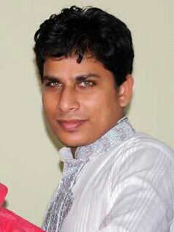
Teacher’s Information
Md Rabiul Mowla
Assistant Teacher
Govt. Primary School
Easy To Learn
powered by saju sir
Visit : www.sajusir34.blogspot.com

Slide 3
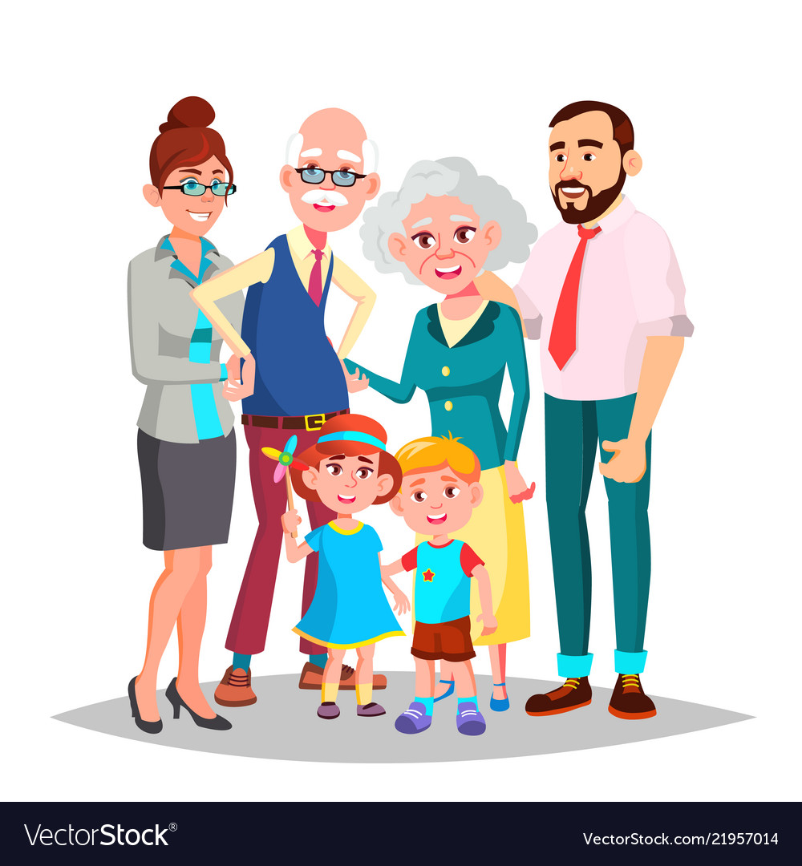
Can you see the picture ?
Who are they ?
Easy To Learn
powered by saju sir
Visit : www.sajusir34.blogspot.com

Slide 4
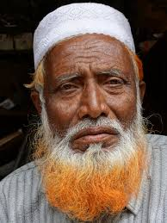
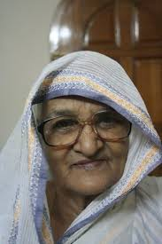
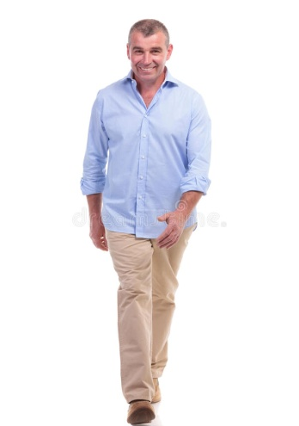
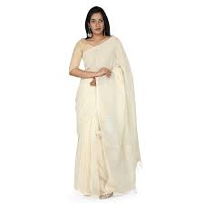
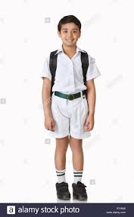
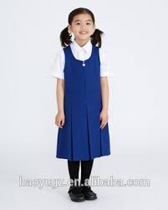
Grandfather
They are……
Grandmother
Father
Mother
Brother
Do you know what is the relation among them ?
Sister
Easy To Learn
powered by saju sir
Visit : www.sajusir34.blogspot.com

Slide 5
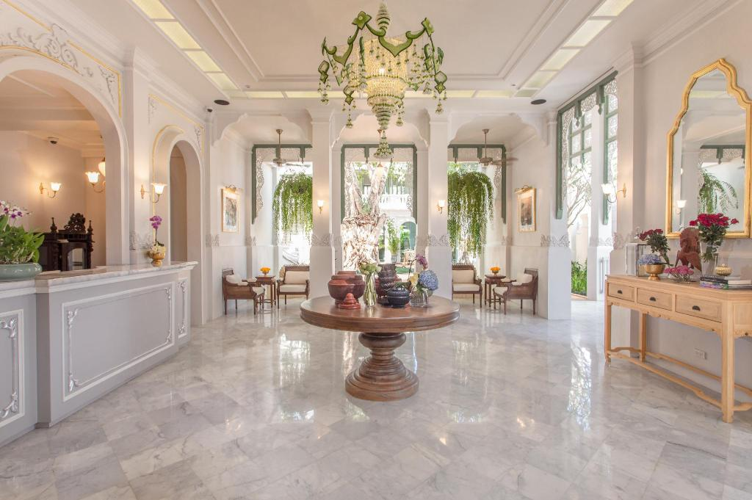
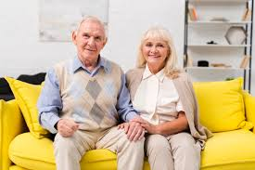
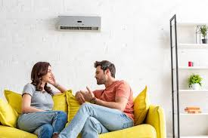
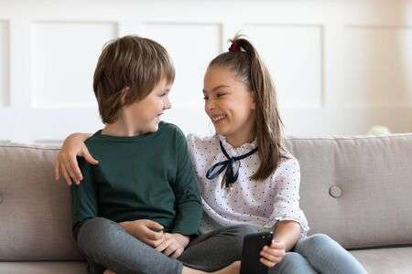
When grandparents , parents , brother and sister live together is called family.
Easy To Learn
powered by saju sir
Visit : www.sajusir34.blogspot.com

Slide 6
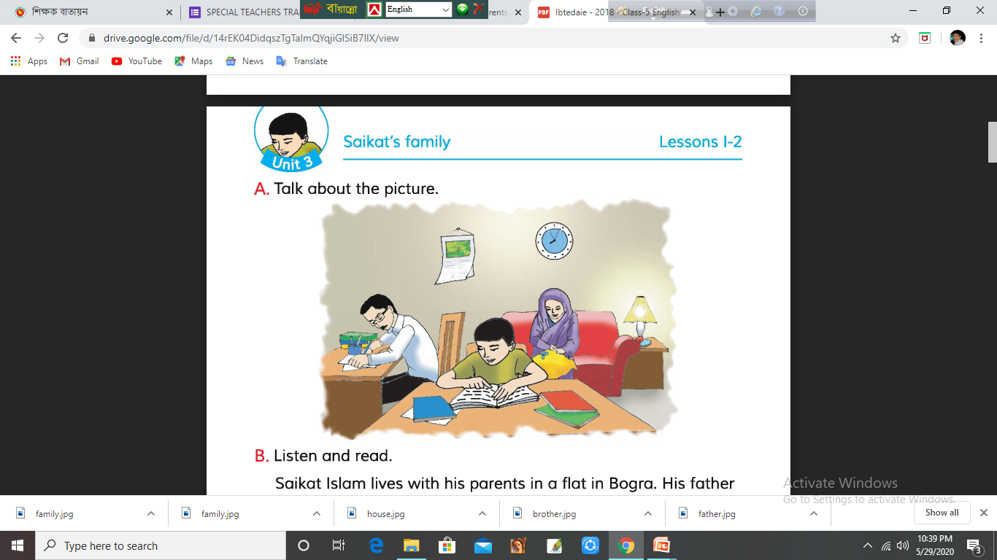
Today’s Lesson
Saikat’s Family
Unit-3
Lesson 1-2
Easy To Learn
powered by saju sir
Visit : www.sajusir34.blogspot.com

Slide 7
Vocabulary
New word | Meaning
Parents | পিতামাতা
Listen | শুনা
Music | সুর / গান
Housewife | গৃহিণী
Sew | সেলাই করা
Neighbours | প্রতিবেশি
Improve | উন্নতি
Watch | দেখা
Animal | প্রানি
Especially | বিশেষ করে
Easy To Learn
powered by saju sir
Visit : www.sajusir34.blogspot.com

Slide 8
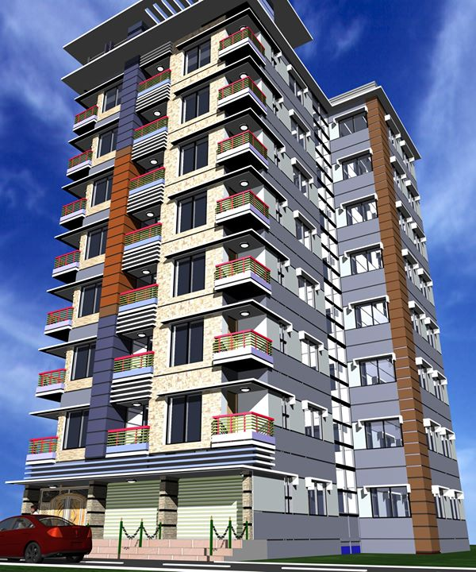
Now listen and read
Saikat Islam lives with his parents in a flat in Bogra.
Easy To Learn
powered by saju sir
Visit : www.sajusir34.blogspot.com

Slide 9
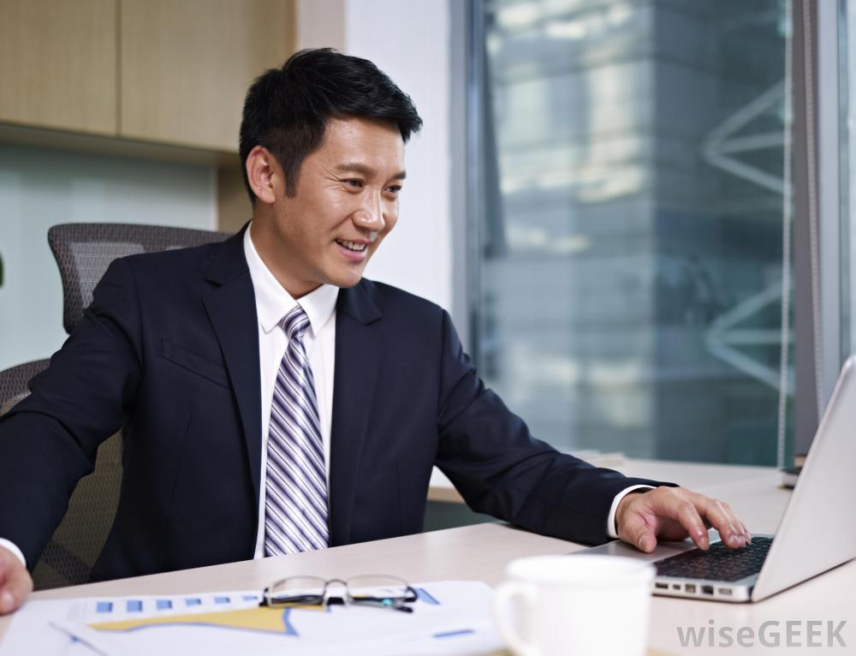
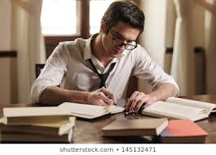
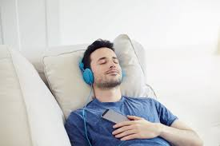
His father Mr. Rashidul Islam is a banker .
But in his free time Mr. Islam writes stories and listens to music .
Easy To Learn
powered by saju sir
Visit : www.sajusir34.blogspot.com

Slide 10
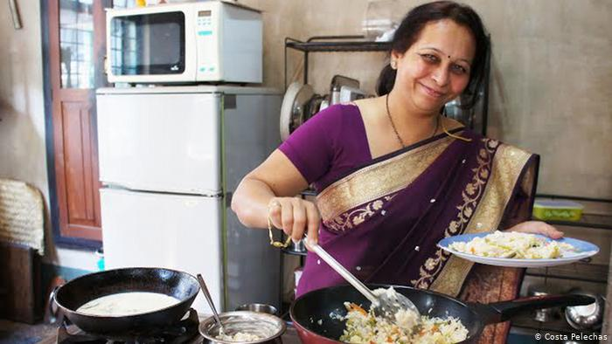
Saikat’s mother is Mrs. Monowara Islam. She is a housewife.
Easy To Learn
powered by saju sir
Visit : www.sajusir34.blogspot.com

Slide 11
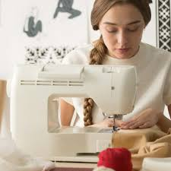

In her free time she enjoys sewing. She makes dresses.
She often gets orders from her friends and neighbours.
Easy To Learn
powered by saju sir
Visit : www.sajusir34.blogspot.com

Slide 12
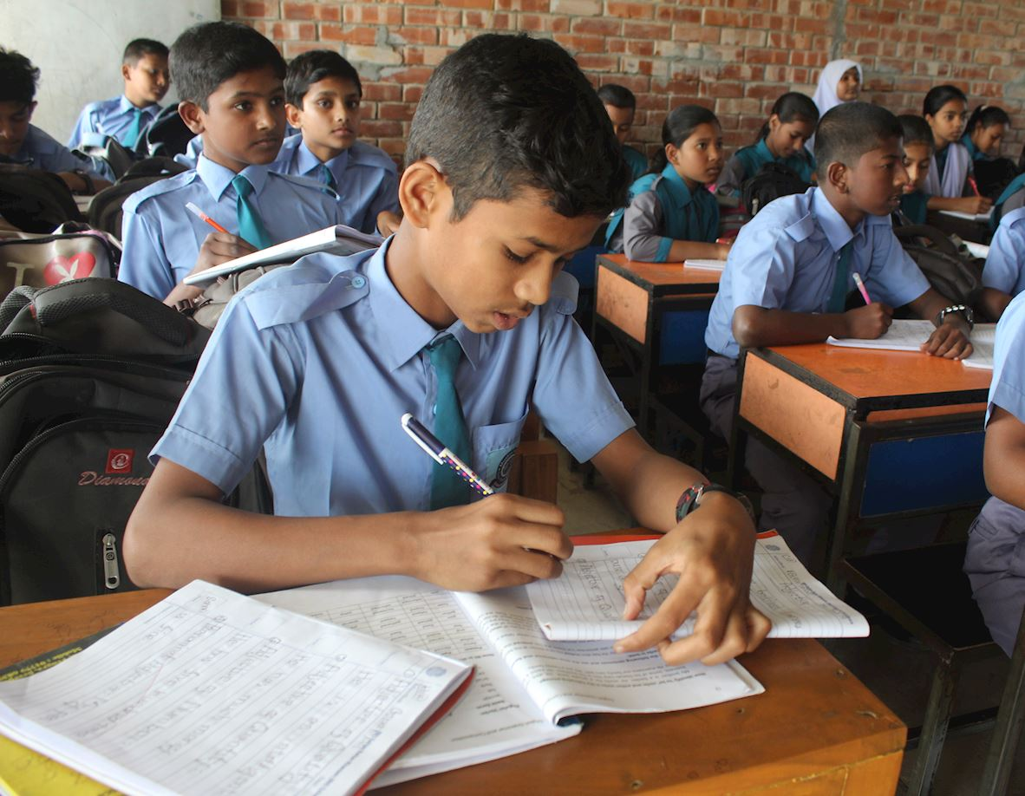
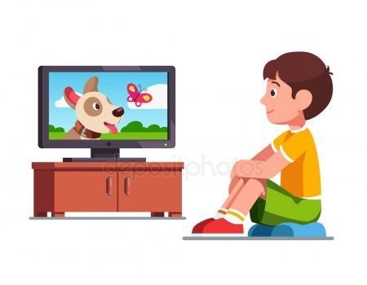
Saikat is in class 5. He is a good student.
He wants to improve his English, so he watches cartoons on TV everyday.
Easy To Learn
powered by saju sir
Visit : www.sajusir34.blogspot.com

Slide 13
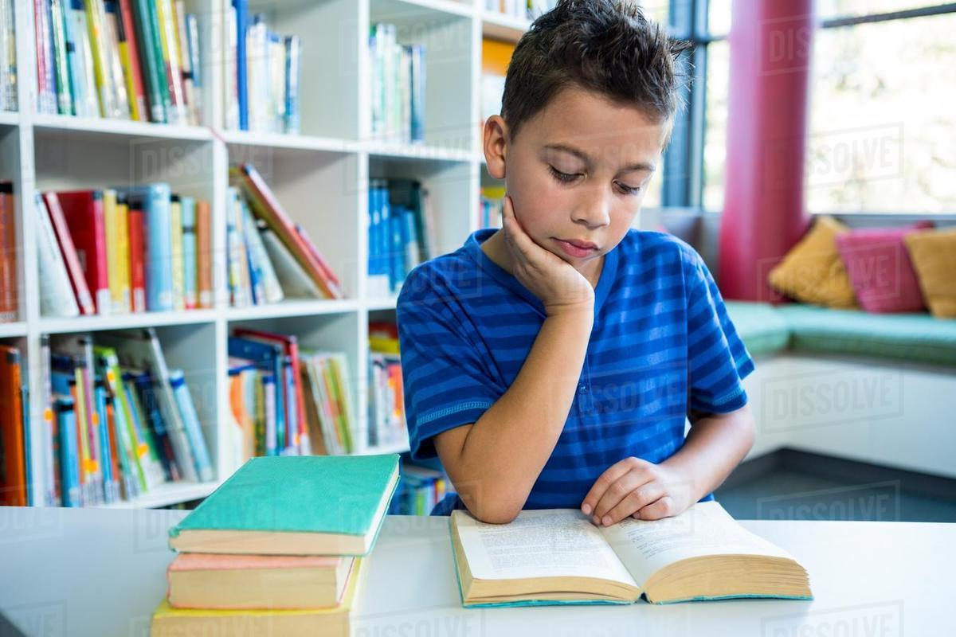
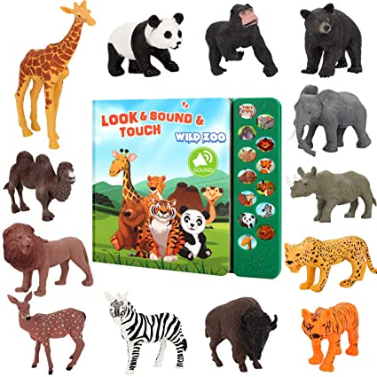
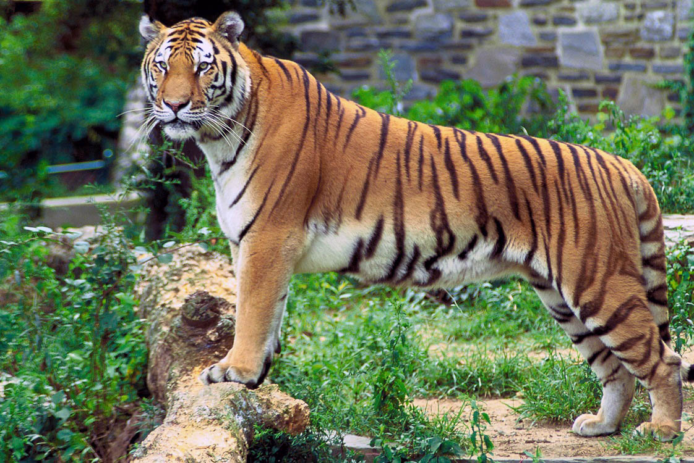
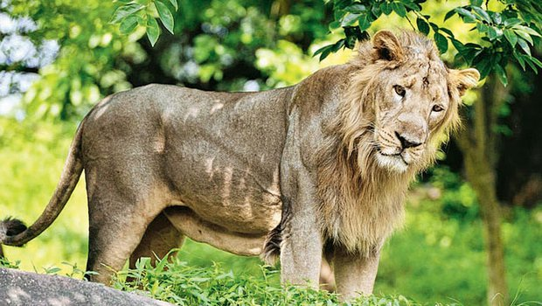
He also reads English books. He likes books about animals ,especially tigers and lions.
Easy To Learn
powered by saju sir
Visit : www.sajusir34.blogspot.com

Slide 14
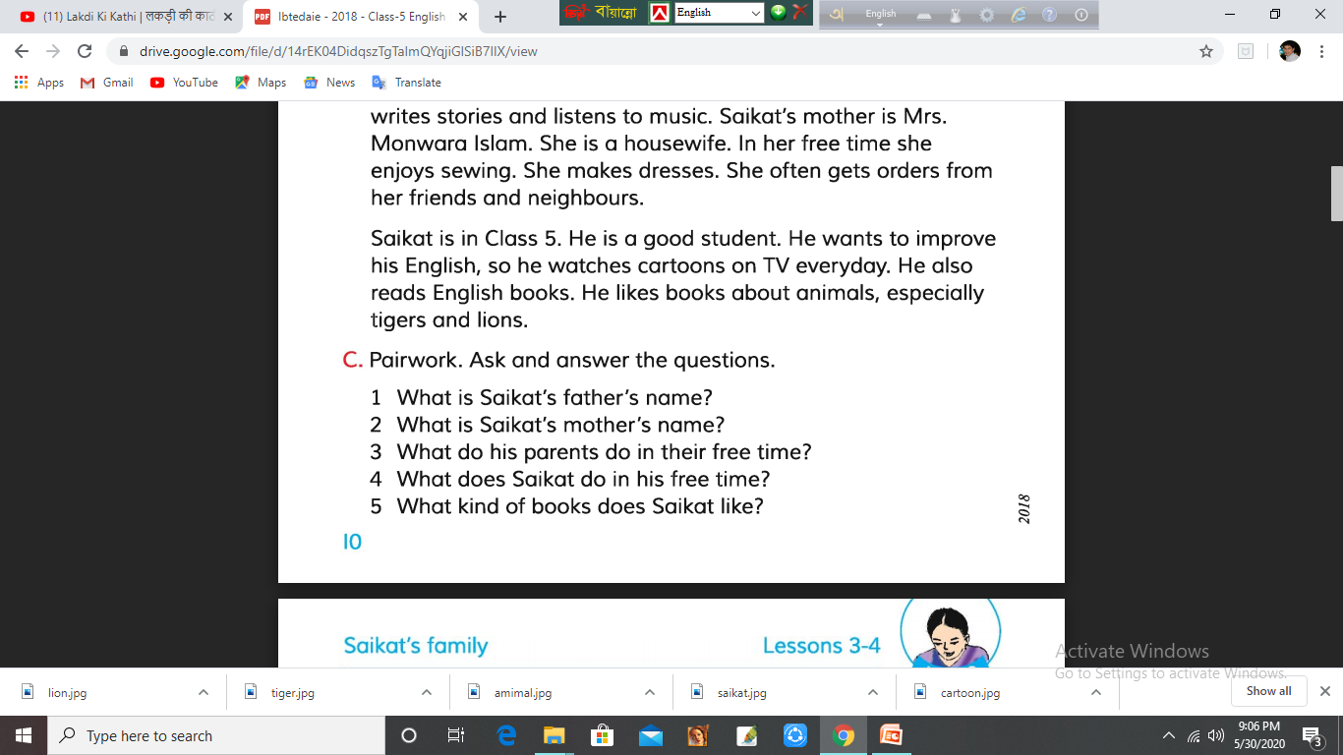
Pair Work
Easy To Learn
powered by saju sir
Visit : www.sajusir34.blogspot.com

Slide 15
Evaluation
Make the sentence complete with appropriate word.
Mr. Rashidul Islam is a ………
Saikat lives in ………………..
Saikat’s mother makes ………
Saikat reads in class …………
He likes book about …………
banker .
Bogra
dresses .
5 .
animal .
Easy To Learn
powered by saju sir
Visit : www.sajusir34.blogspot.com

Slide 16
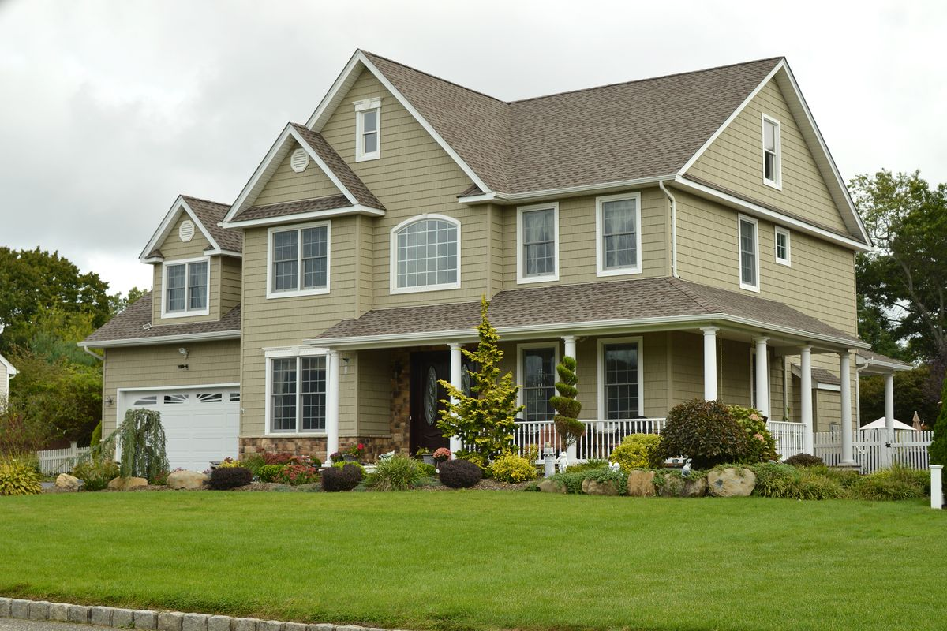
Home Work
Write a paragraph about your family.
Easy To Learn
powered by saju sir
Visit : www.sajusir34.blogspot.com

Slide 17
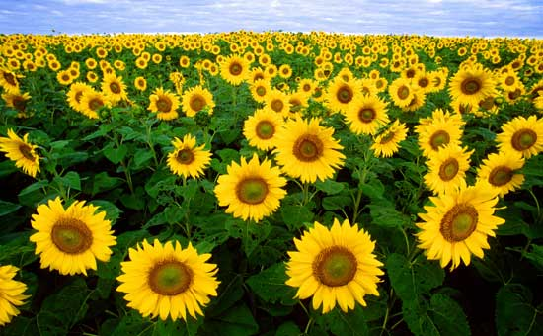
Thank you all
Easy To Learn
powered by saju sir
Visit : www.sajusir34.blogspot.com

