Slide 1
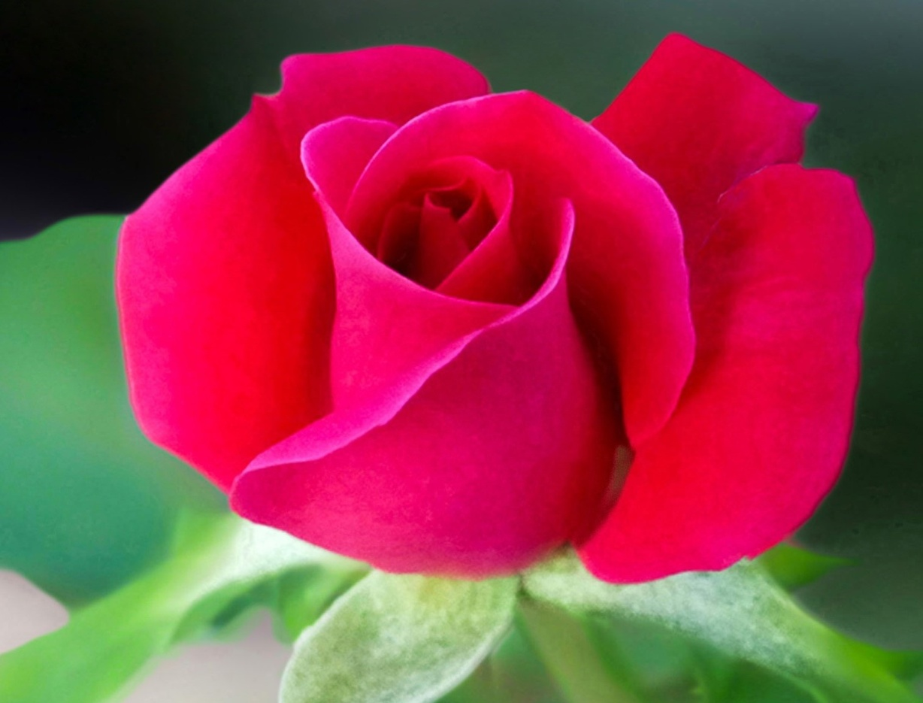
WELCOME

Slide 2
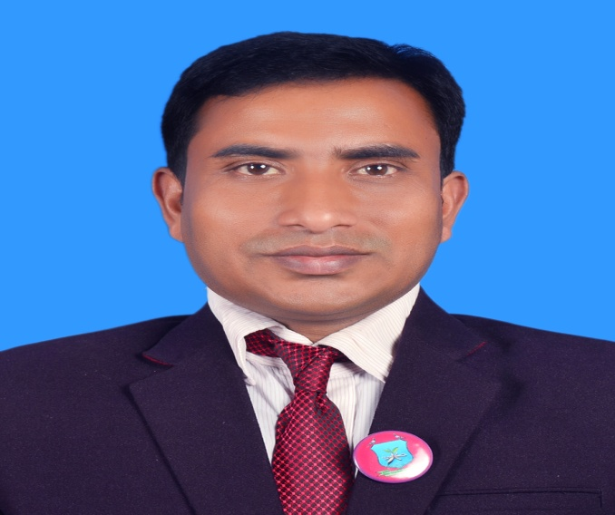
INTRODUCTION
Class : Three
Subject : English
Unit:23 , Lesson:4-6.
Date:
Time:
Suranjit Talukder
( BA, B-Ed; MSS, M-Ed; C-in-Ed )
Assistant teacher
Voishber Govt. Primary School.
Sunamgonj Sadar , Sunamgonj.

Slide 3
Today’s topic is “What do they do ” .

Slide 4
LEARNING OUTCOMES
Students will be able to………
recognize English sound differences in the context of words.
Repeat after the teacher and say words, phrases and sentences with proper sounds and stress.
To read silently with understanding simple sentences , paragraphs and other texts.

Slide 5
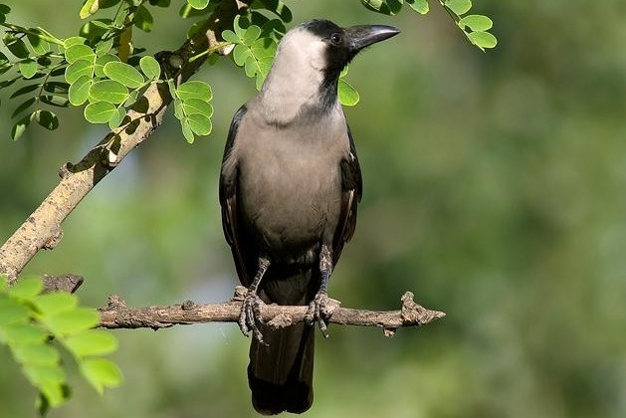
Please think about this picture and discuss in pairs.
What do you see in the picture?
A crow is sitting on a tree.

Slide 6
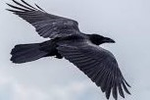
Please think about this picture and discuss in pairs.
What do you see in the picture?
A crow is flying in the sky.

Slide 7
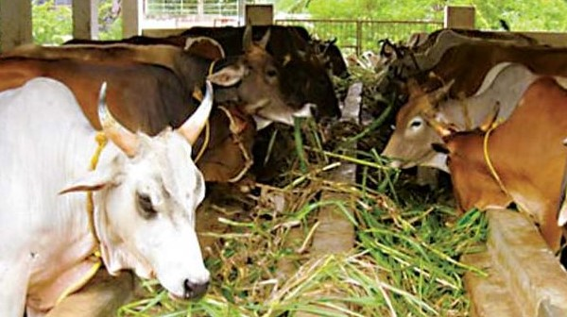
Please think about this picture and discuss in pairs.
What do you see in the picture?
The cows are in a shed.

Slide 8
NEW WORDS MEANINGS
Crow

Slide 9
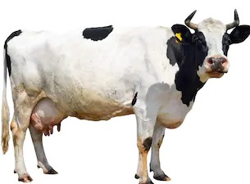
NEW WORDS MEANINGS
Cow

Slide 10
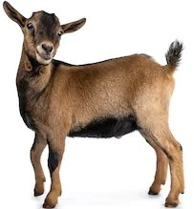
NEW WORDS MEANINGS
Goat

Slide 11
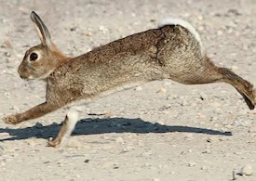
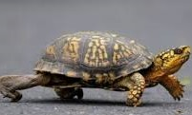
NEW WORDS MEANINGS
Quick (Hare)
Slow (Tortoise)

Slide 12
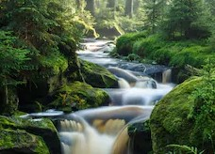
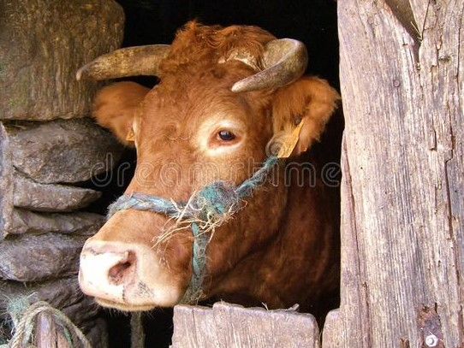
NEW WORDS MEANINGS
Stream
Shed

Slide 13
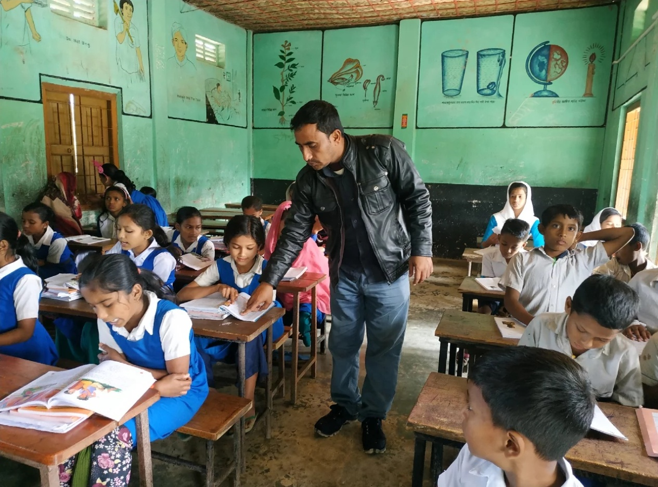
Listen to the text with me and put your finger under the line.
Now read loudly after me.

Slide 14
I’m a crow. I live in a tree.

Slide 15
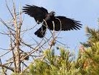
I get up early in the morning. I’m active all day.

Slide 16
I fly in the sky and look for food.

Slide 17
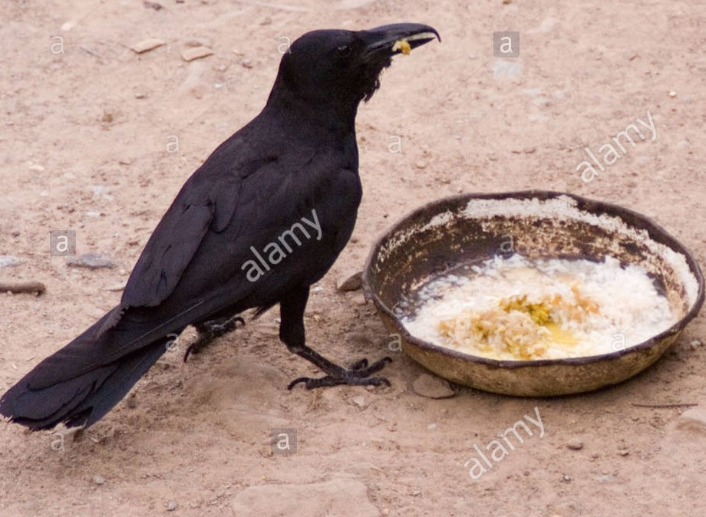
Sometimes I take food from people .
I’m very quick.

Slide 18
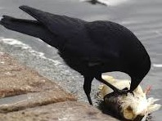
Sometimes I eat dirty things.

Slide 19
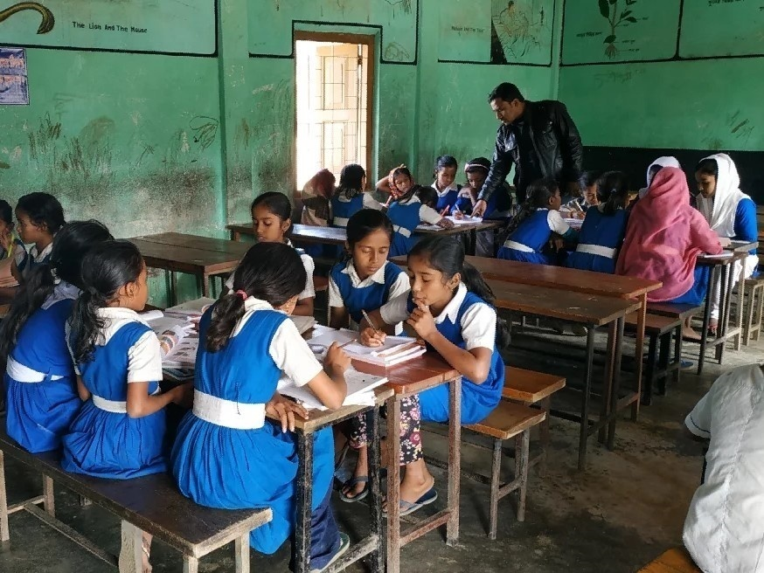
Now read the text in groups.

Slide 20
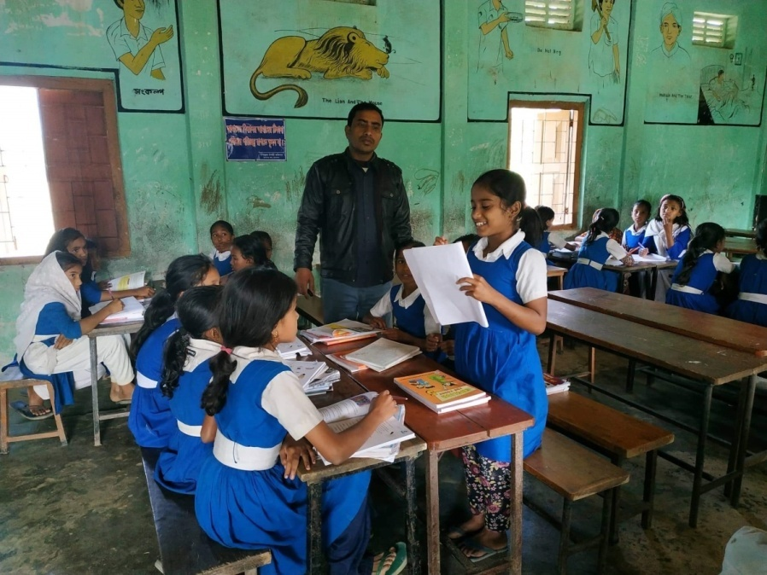
A student will be selected from every group to present their group work.

Slide 21
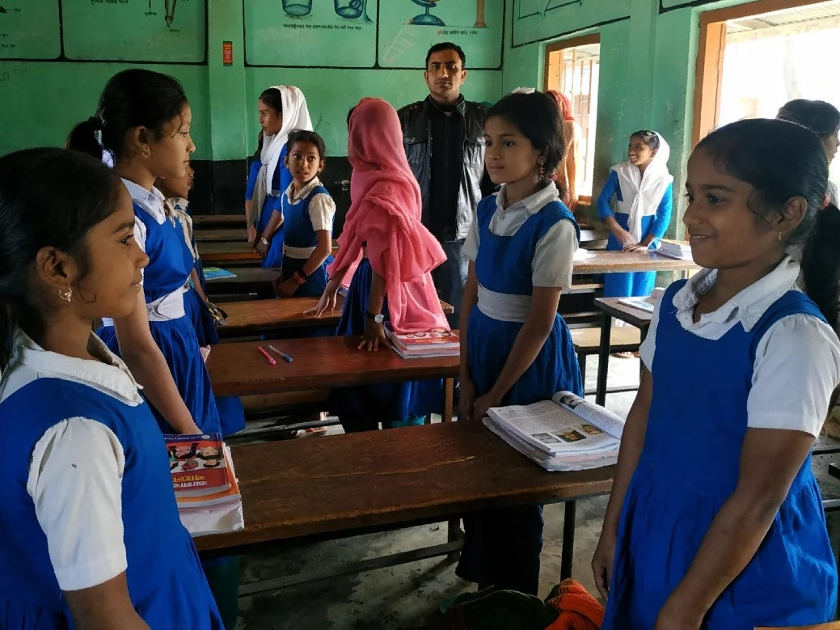
Pairwork.

Slide 22
Pairwork
Say True or False
1.The crow lives in a tree.
2.The crow gets up late in the morning.
3.The crow is lazy.
4.The crow takes food from people.
5. The crow doesn’t eat dirty things

Slide 23
INDIVISUAL WORK
Look at the picture. Circle the answers.
I’m a cow/goat. I live in a stream/ shed. I get up early/late. I am a slow/quick animal.

Slide 24
Homework
Write a short paragraph about
“A Crow” at least five sentences.

Slide 25
GOODBYE

