Slide 1
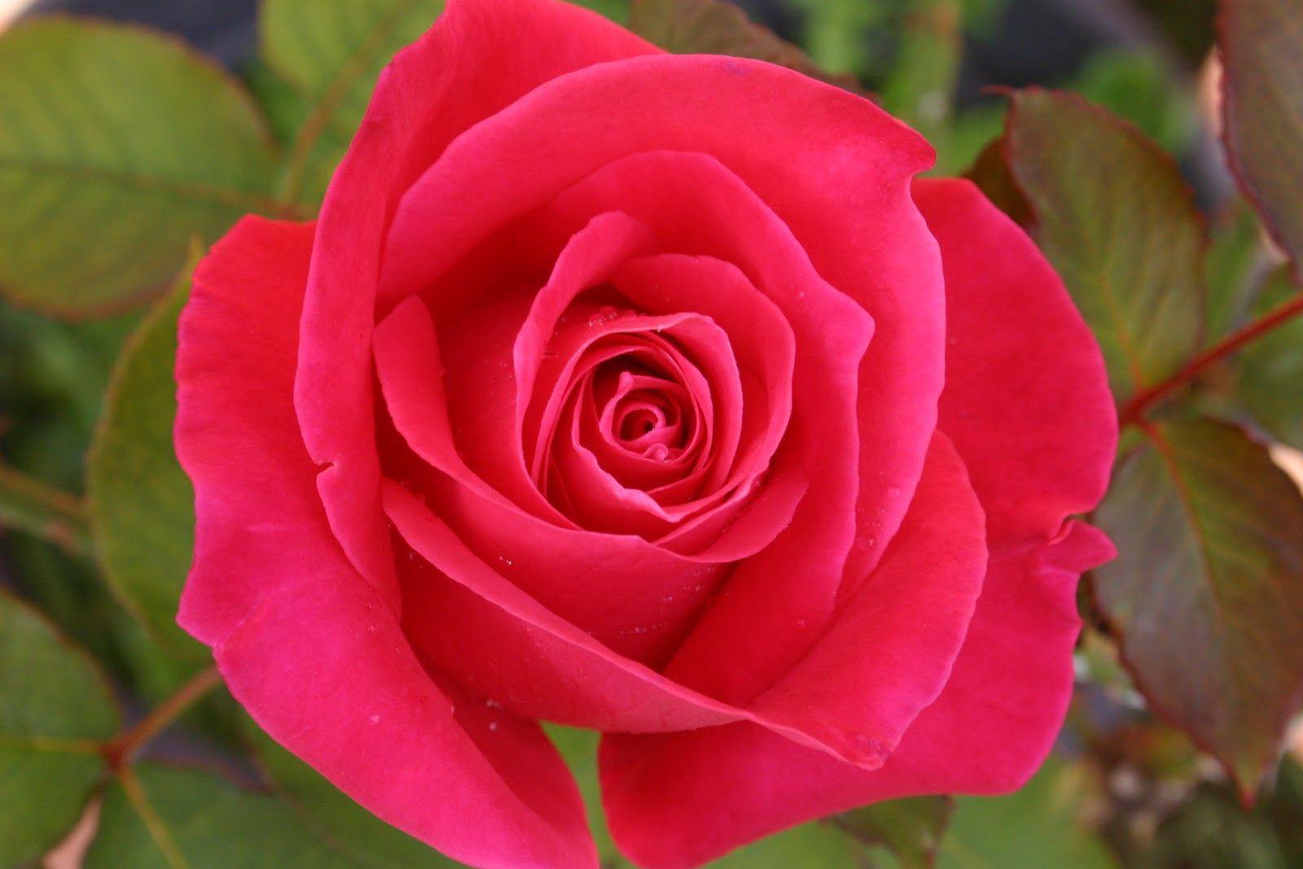
Welcome students

Slide 2
Teacher’s Introduce
Md. Nuruddin
Assistant teacher
Kasirgathi Govt.Primary school
Biswambarpur, Sunamganj.

Slide 3
Introducing Lesson
Class- Four
Subject-English
Title-S.M.Sultan
Unite-34
Part of the lesson-S.M.Sultan is a……Art Collage.
Time-35 minutes

Slide 4
Learning outcomes
The end of the lesson the students will be able to…
1.Read the selected part of the lesson correctly.
2.Recogenise the painting of S.M.Sultan.

Slide 5
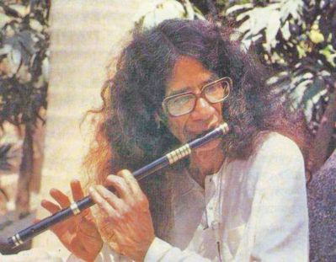
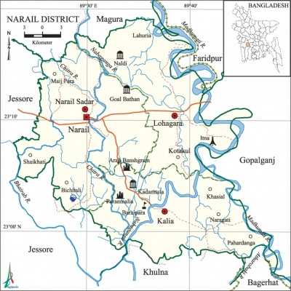
Let’s see some pictures
S.M.Sultan
Narail District

Slide 6
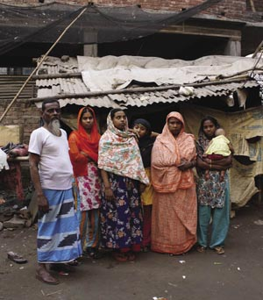
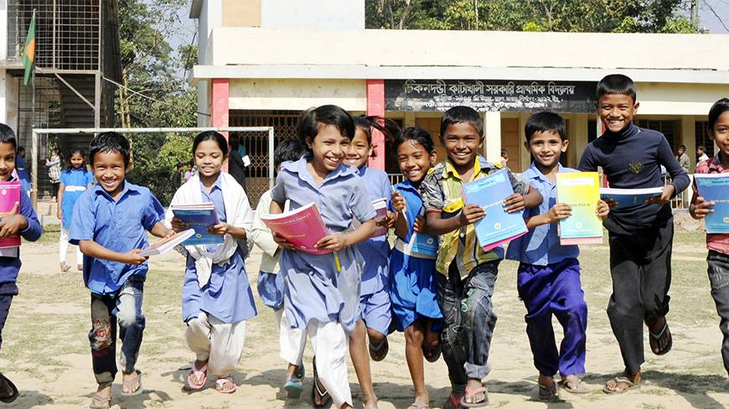
Poor family
Go to school five years

Slide 7
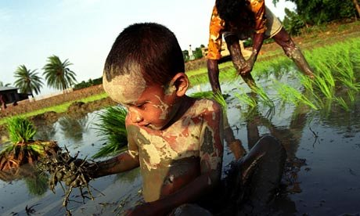
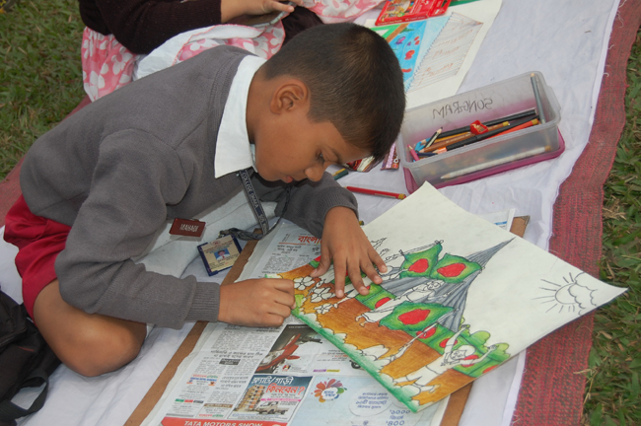
Work with his father
Love drawing

Slide 8
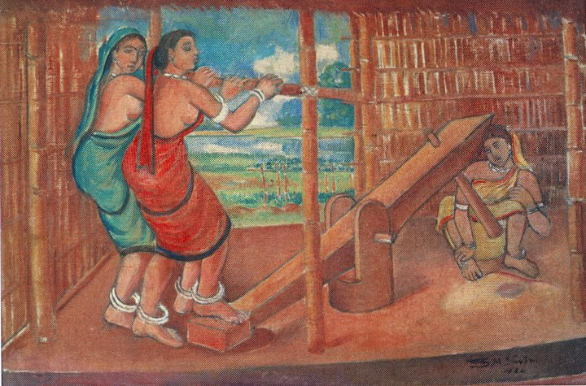
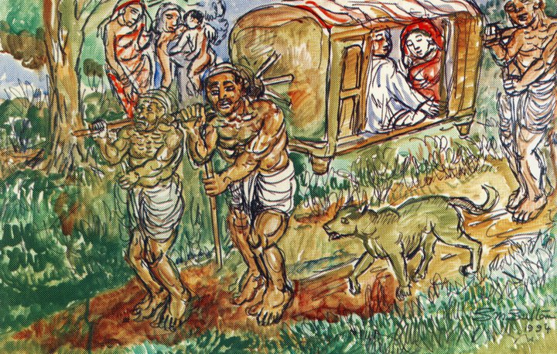
DHAN BHANA
PALKI

Slide 9
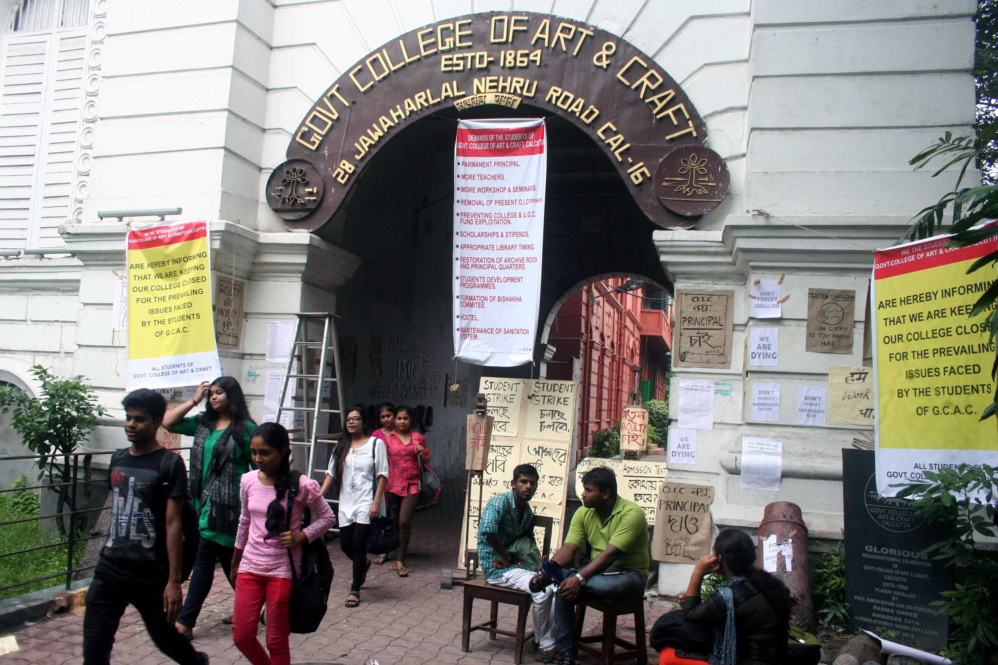
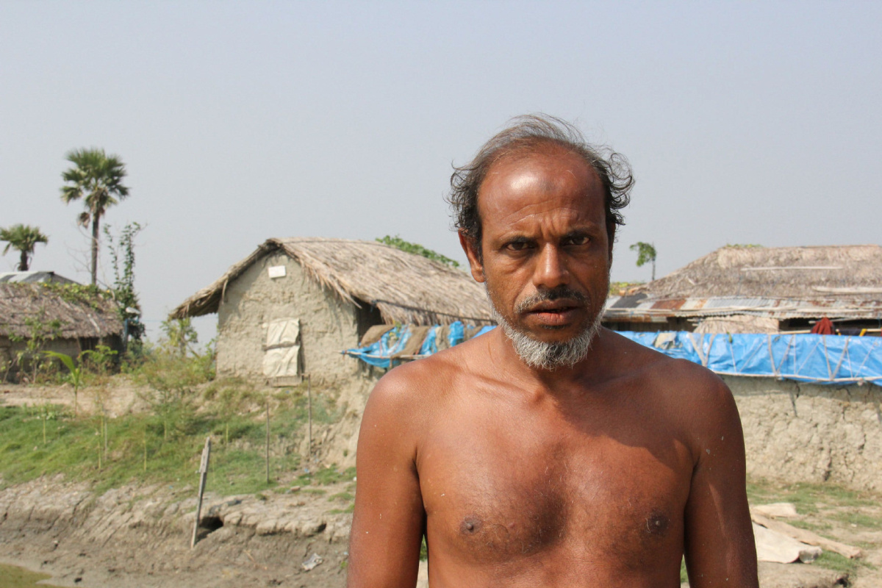
Kolkata
Poor father

Slide 10
Open your book at page no.68.
Discussing about S.M.Sultan and his painting.
Word meaning and spelling-------
Famous-বিখ্যাত।
Painter-চিত্রকর।
Country-দেশ।
With-সাথে।
Family-পরিবার।
Money-টাকা।

Slide 11
Dividing Three groups.
1st group name-CHITRA
2nd Group name-SULTAN MELA
3rd Group name-SULTAN BOAT
1st group -write 3 sentence about Sultan Art
2nd group -write 3 sentence about Sultan Mela.
3rd group -write 3 sentence about Sultan Boat.

Slide 12
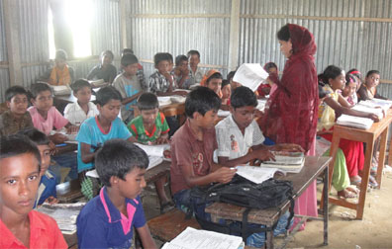
Reading silently

Slide 13
Fill in the gaps
1. S.M. Sultan was born in…………..
2. Sultan went to school for……………….
Short question
1.Where is the birth place of S.M. Sultan?
2.Where did he want to study?

Slide 14
Home work
Write 5 sentence about S.M. Sultan.

Slide 15
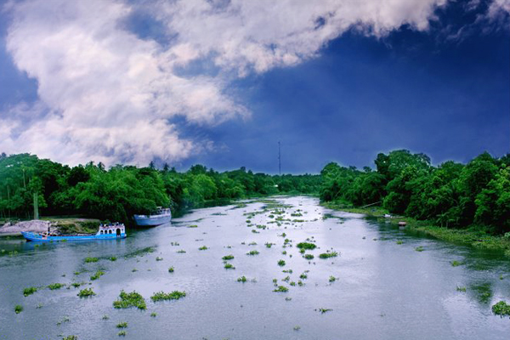
THANKS

