Slide 1
Welcome

Slide 2
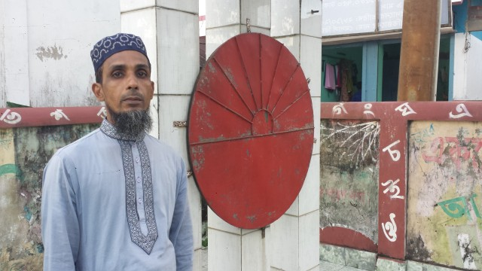
Introduction
Mohammod Helal Uddin
Assistant Teacher(English)
Wahid Siddek High School, Gurarai, Sadar, Moulvibazar
E-mail: helal.bd.mb@gmail.com
Class-Eight
Sub: English For Today
Unit : Tree
Lesson : 01 (Health)

Slide 3
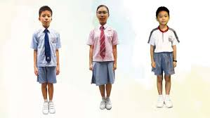
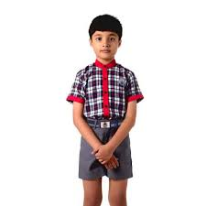
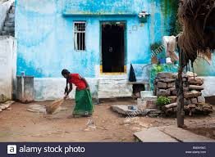
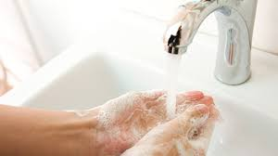
Look at the pictures then answer the questions in pair
Cleaning the house
Taking exercise
They are unhealthy
A healthy boy
Why is good health essential for us ?
Why is physical exercise necessary?
Washing hands

Slide 4
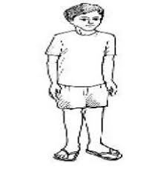
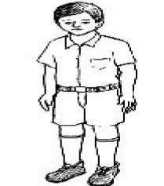
Look at the pictures and answer the questions
Which boy looks healthy ?
Which boy looks unhealthy ?
Can you guess why they are so ?

Slide 5
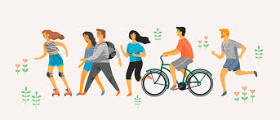
Our Today’s Lesson is……
Health

Slide 6
Learning Outcomes
End of this unit, The students will be able to……
Read and understand texts though silent reading
Ask and answer questions
Practice vocabulary
Write short paragraph

Slide 7
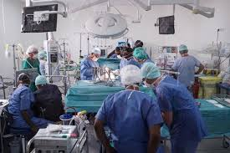
Vocabulary Practice
Disease
Illness, ailment
Thousands die of heart disease each year.

Slide 8
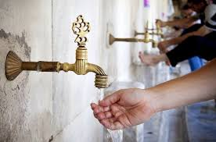
Essential
Vital, crucial
She knew the essential condition of the instruments.

Slide 9
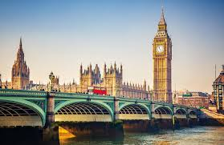
Concentrate
Focus, direct
There is a concentrate of wealth in the cities.

Slide 10
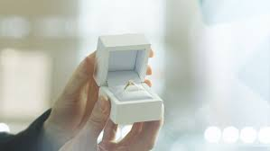
Possession
Ownership, asset
This ring was my mother’s most precious possession.

Slide 11
Read the texts then answer the questions
Health is the condition of our body and mind. It may be good or bad. Good health means healthy body free from disease. It is essential for everyone to lead a happy life. If we are not in good health, we concentrate on any activity in our life.
A proverb goes,” Health is Wealth.” It means health is equally valuable as gold or any other personal possession. We may have vast wealth and property, but if we are not healthy we cannot enjoy them.
To keep ourselves healthy, we have to certain things, we have to take a balanced diet. We must exercise regularly to keep our body fit for work.
There is an old saying :
“ Early to bed and early to rise
Makes a man healthy ,wealthy and wise”
So we should not late hours. We should go to bed early at night and rise early in the morning. Peace of mind is another condition for good health. So we must no worry over small things of life.

Slide 12
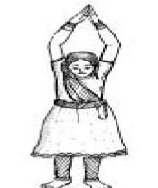
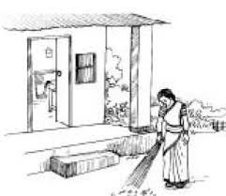
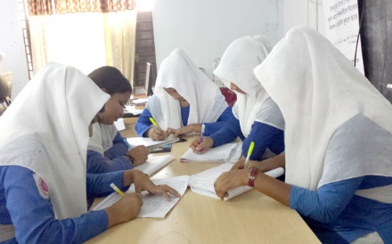
Answer the following questions in groups
What is the meaning of good health ?
What is the meaning of the phrase to keep late hours ?
What kinds of food do we need to eat ?

Slide 13
Evaluation
Choose the best answer from the alternatives.
Health means the condition of..
Our body b. our mind
c. Our body and mind d. our environment
02. We need to eat…
Rich food b. balanced food
c. Little food d. lot of food
03. The phrase “ to keep late hours ‘ means..
To go to bed late b. to wake up late in the morning
C . To do things late always d. to be late for the class.

Slide 14
Home Work
Write a short paragraph about Good health.

Slide 15
Thank You
Stay Home, Stay Safe

