Slide 1
WELCOME

Slide 2
Introduction & Lesson
Hosne Ara Basry
(Lecturer in English)
Bhaktiarpara Charpir Aulia Alim
Madrasah, Anowara, Ctg.
Cell no: 01816001006
Email:
hosnearaamir94638@gmail.com
Subject :
English first paper
English for Today
H.S.C/Alim
Duration:45m

Slide 5
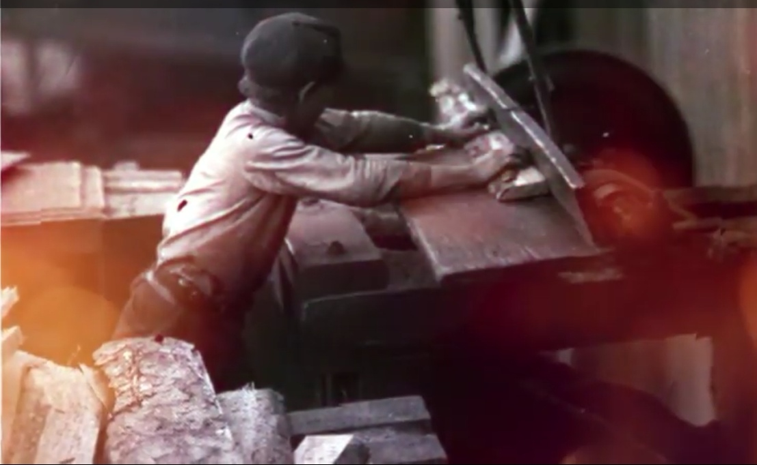

Slide 6
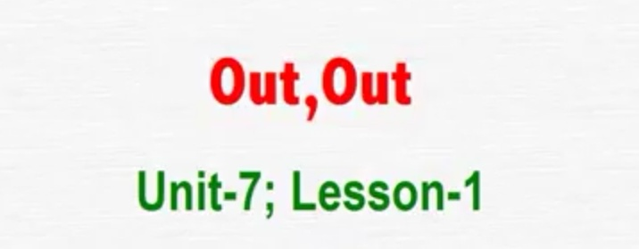
Today's Lesson-
Poem
Written by Robert Frost
po

Slide 7
Learning Outcomes
After the end of the lesson the students will be learn
about -
★The poet
★Word meaning
★The poem
★Critical analysis
★Summary

Slide 8
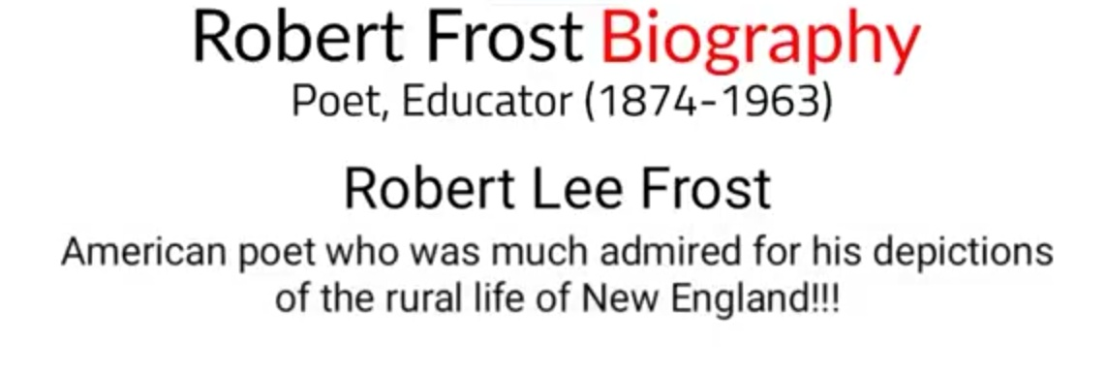

Slide 10
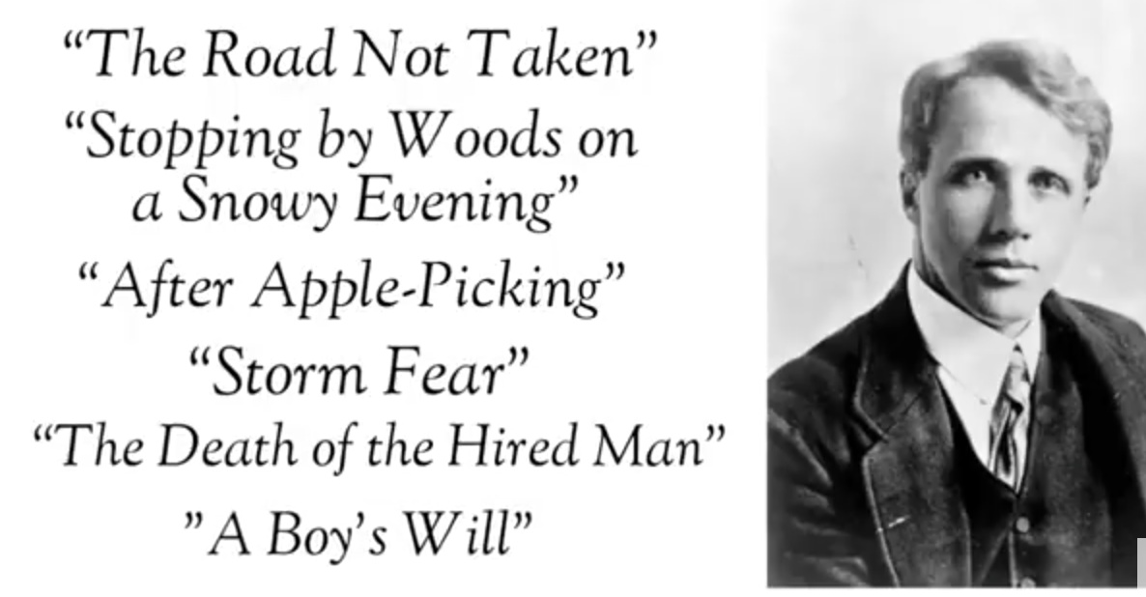

Slide 14
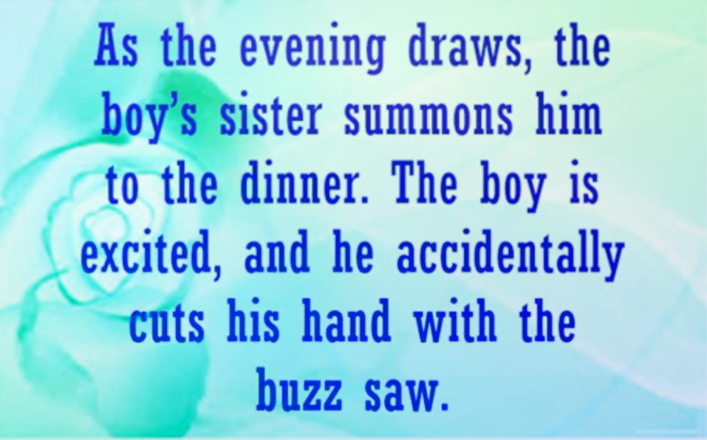

Slide 15
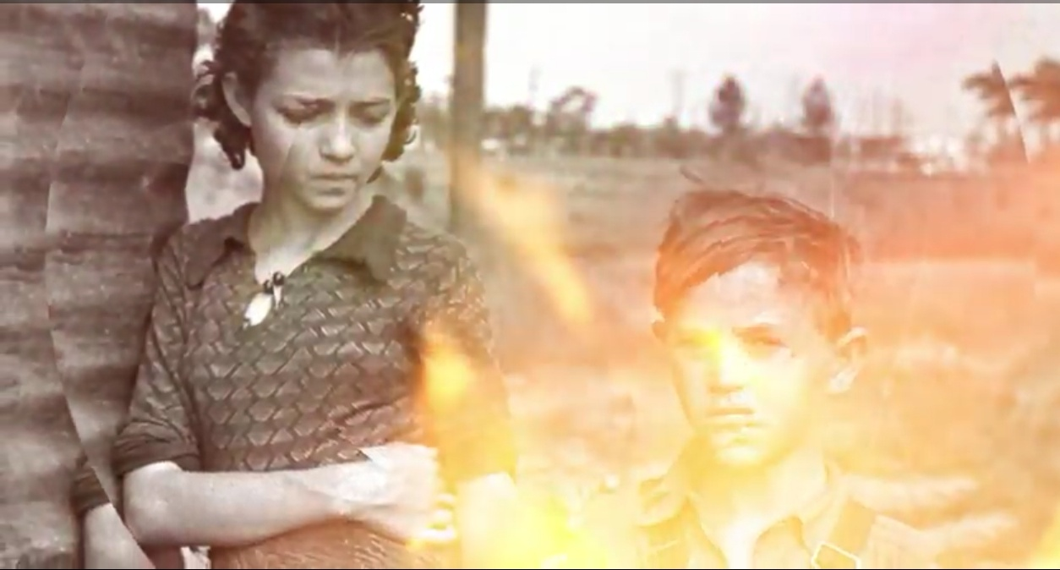

Slide 18
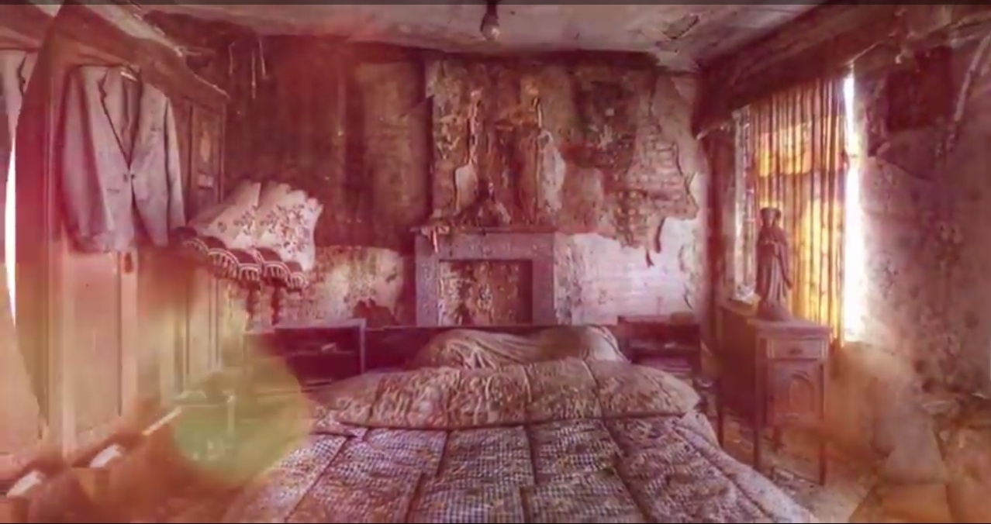

Slide 19
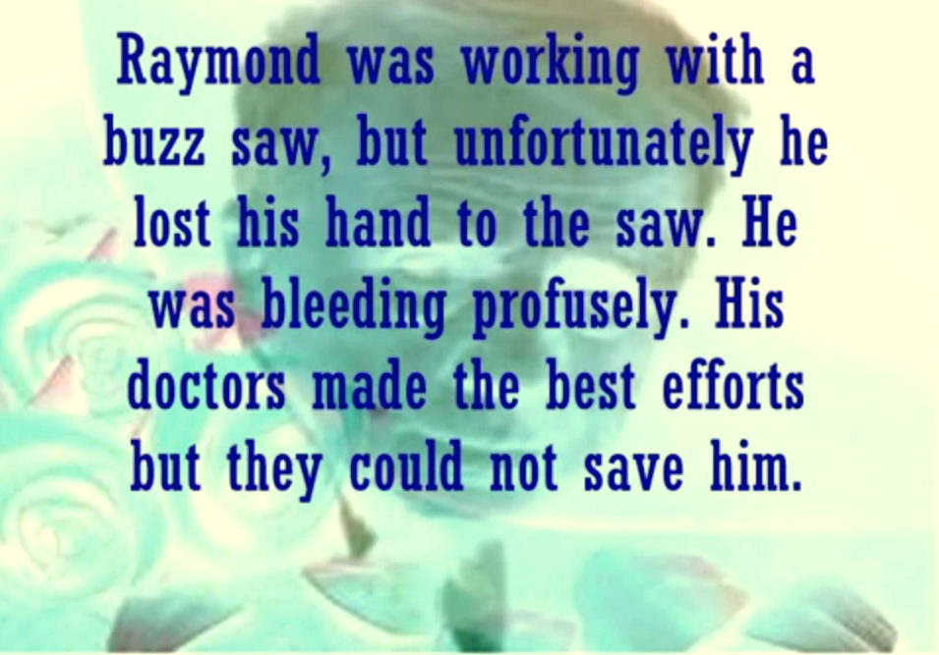
Summary

Slide 20
Group Work
★ Discuss about the child labour situation in
the world.
★ Write five senteces about the child labour.

Slide 21
Evaluation
★ How do employers treat child labourers?
★ What human rights do the employers violate?
★ What's the condition of the child labour in our
country?

Slide 22
Home Work
★Learn word meaning of the poem.
★Write a theme of the poem in your own words.

Slide 23
THANK YOU

