Slide 1
MY DEAR STUDENTS

Slide 2
Rahima begum academy. Allardarga Daulatpur,kushtia
TEACHER IDENTITY
Md. Raziul haque
Assistant teacher.
. MOB no-01740972512
. email-mdraziulhaque@gmail.com

Slide 3
Lesson declaration
He is too black_________________
What is this?
He is too black to love
What is this?
So today we will discuss about

Slide 4
LEARNING OUTCOMES
BY THE END OF THE LESSON
Students will be able to learn the completing rules.
Students will be able to complete the sentence.

Slide 5
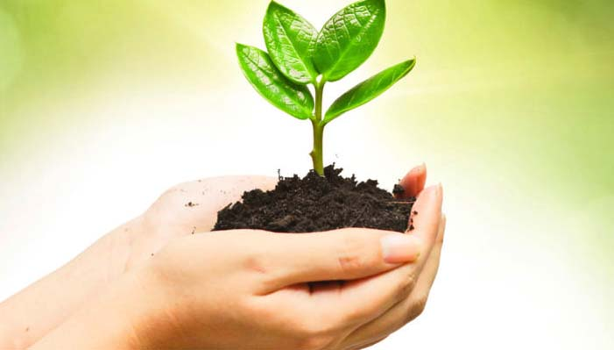
Completing sentence
Rule -06
It is time/high time
এখনই সময়
Structure
It is time/high time+
to +verb+obj
It is time
to plant trees.

Slide 6
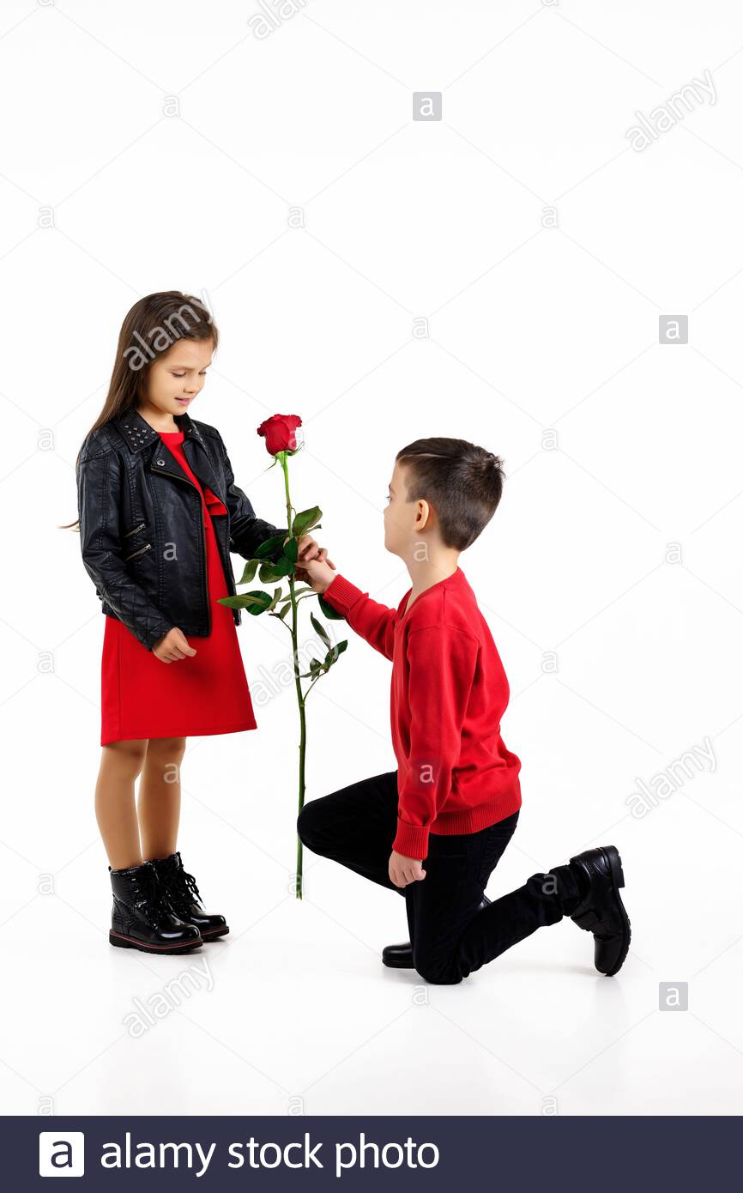
Let us practice the rule
It is time --------------
It is high time ---------

Slide 7
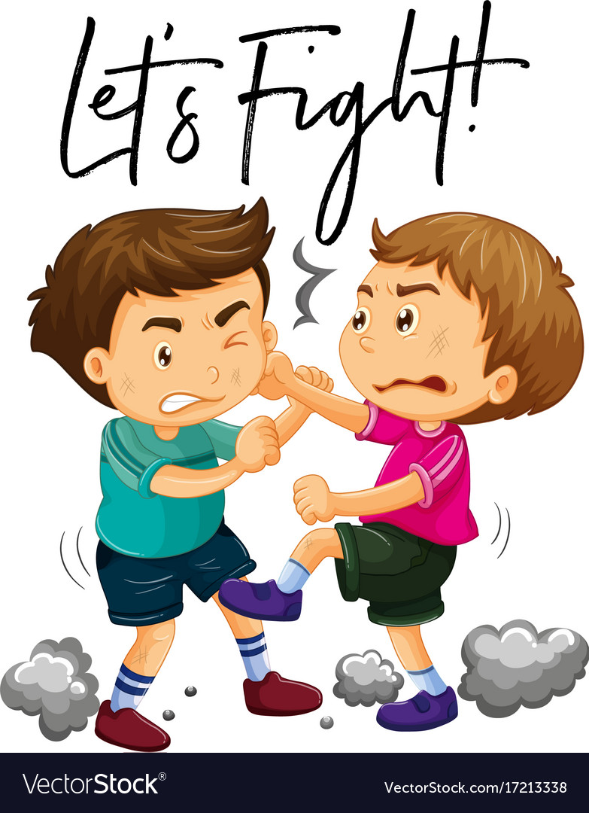
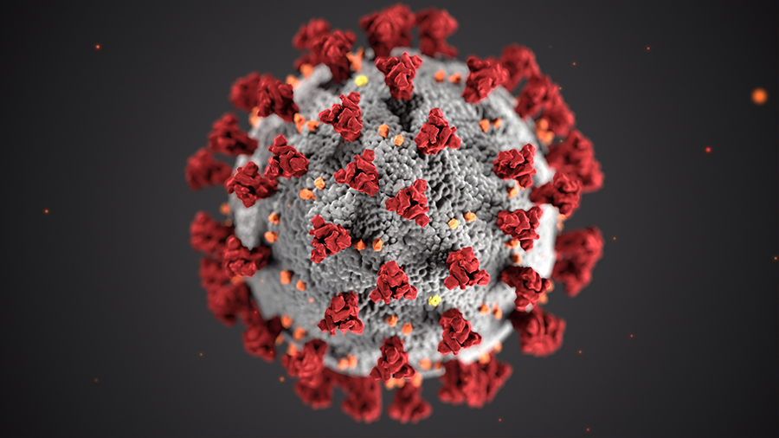
Completing sentence
Rule -07
It is time/high time+sub
এখনই সময়
Structure
It is time/high time+sub+
v₂+obj
It is time
to fight against corona virus.

Slide 8
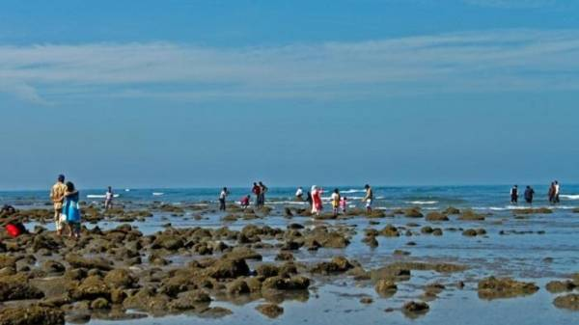
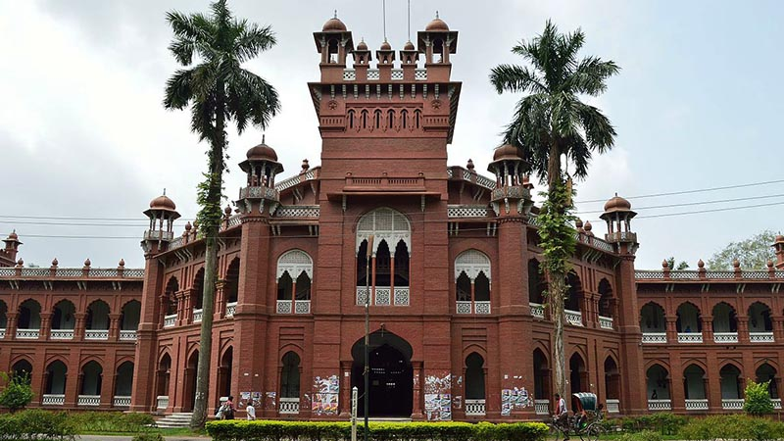
Let us practice the rule
It is time I --------------
It is high time we ---------

Slide 9
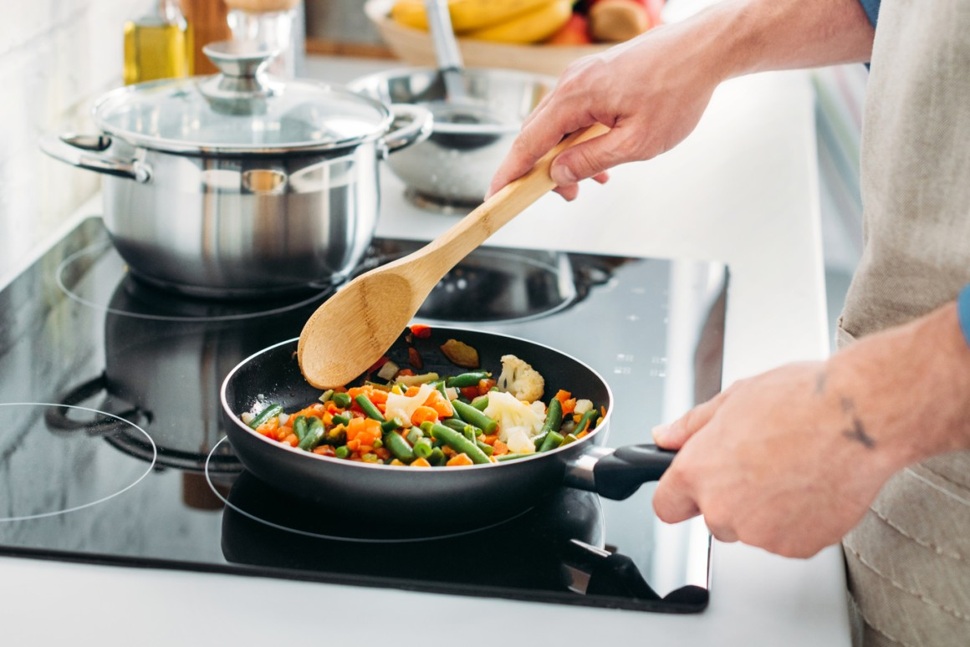
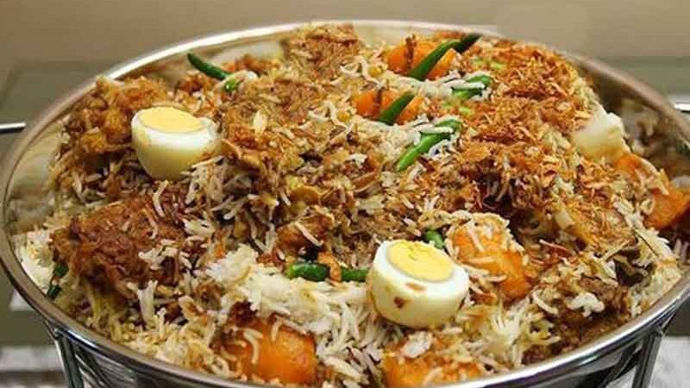
Completing sentence
Rule -08
Would you mind
মনে কর তুমি
Structure
Would you mind +
Verb+ing + obj+?
Would you mind
cooking biriany?

Slide 10
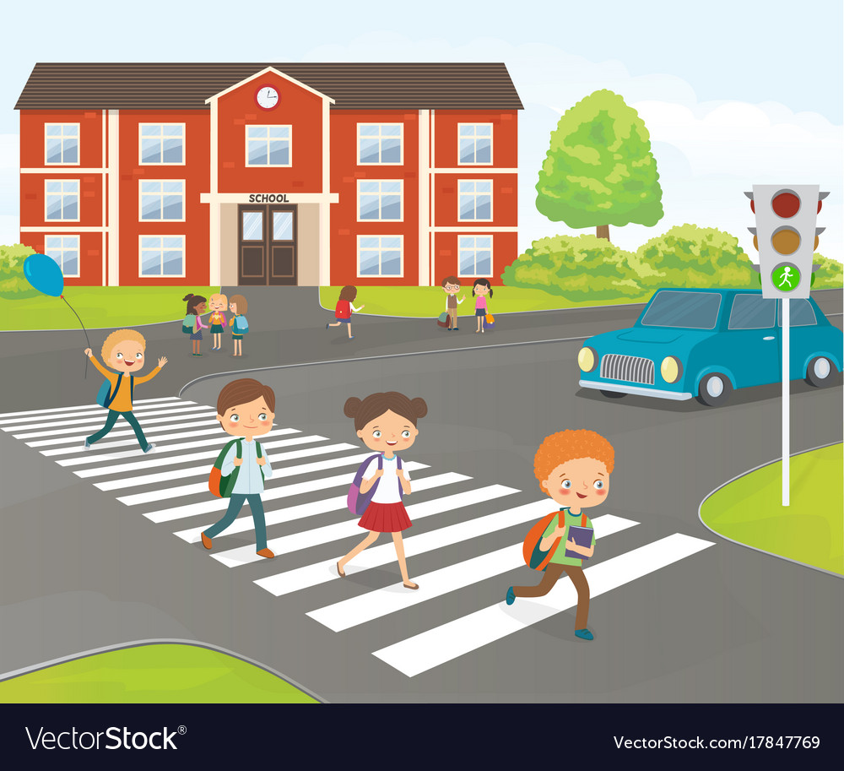
Let us practice the rule
Would you mind --------------
Would you mind ---------

Slide 11
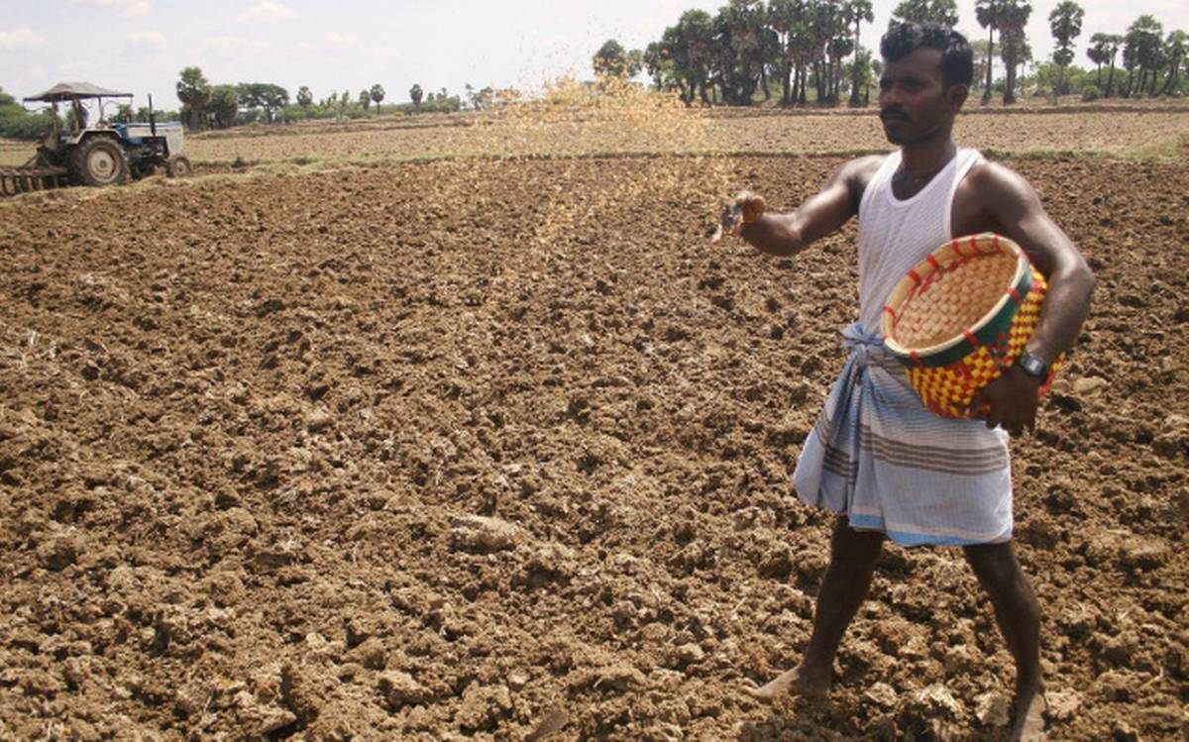
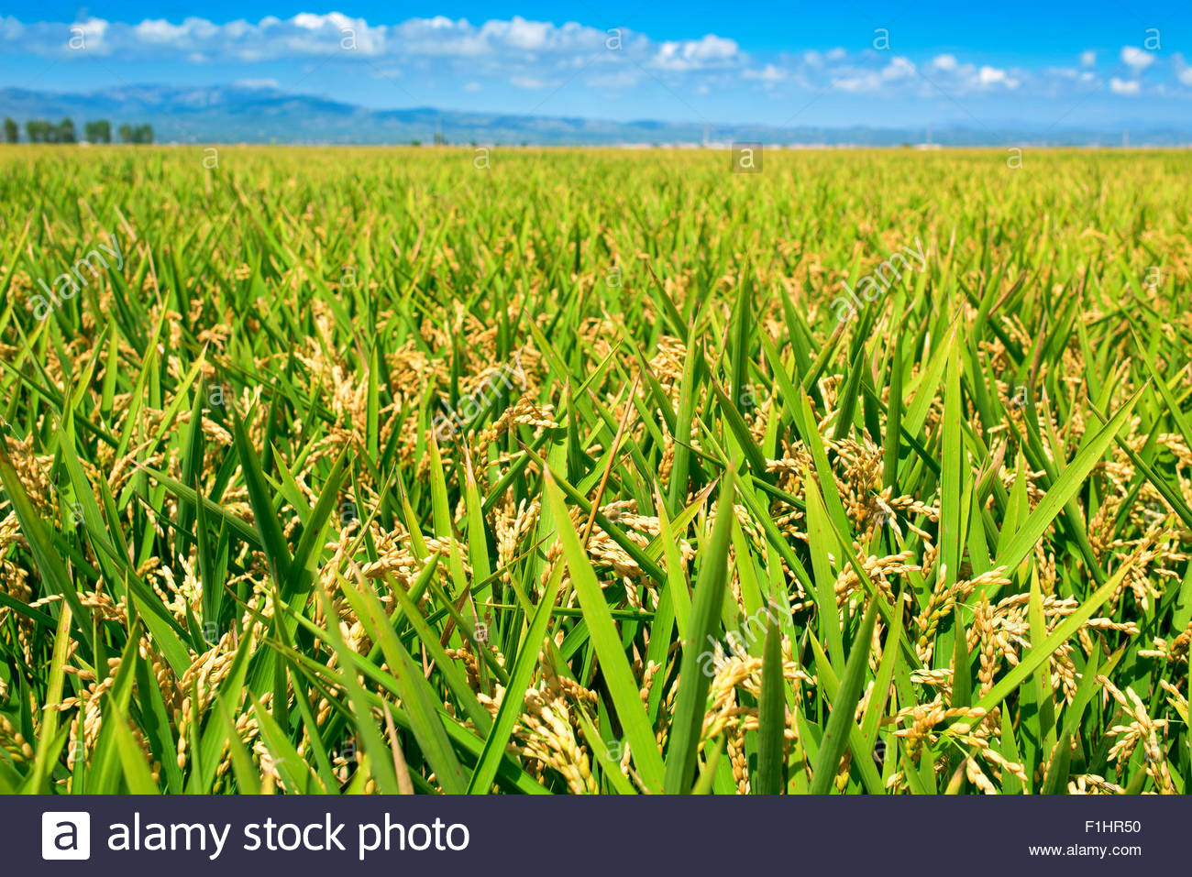
Completing sentence
Rule -09
Without +gerund
মাধ্যমে/দ্বারা
Structure
Without+verb+ing+obg+
Sub+m.a.v+ not+verb+obj
Without sowing seeds
We can not get harvest

Slide 12
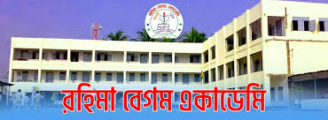
Let us practice the rule
Without going to school --------------
Without drinking pure water -------

Slide 13
Completing sentence
Rule -10
By +gerund
মাধ্যমে/দ্বারা
Structure
By +verb+ing+obg+
Sub+m.a.v+verb+obj
By sowing seeds
We can get harvest

Slide 14
Let us practice the rule
By going to school --------------
By drinking pure water -------

Slide 15
Home work
1. It is time ----------------
2. It is high time we --------------------------
3. Would you mind------------------
4. Without making a house-----------------------
5. By making a house---------------------------
To know more see part 3

