Slide 1
It’s my pleasure to welcome you.
Notes:
As this section of grammar needs extensive practice , teachers are requested to add anything extra as suits the class.

Slide 2
Nurul Aziz
Assistant Teacher
Krishnakumari City Corporation Girls’ High School,
Nandankanan, Chittagong
E mail : naziz13.na@gmail.com
Mobile : 01843773924
English Grammar and Composition
Class IX
Time : 45 Minutes
Date : 16/03/2020

Slide 3
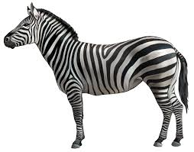
Dear students what do you mean by following sentences?
A lion is stronger than a zebra.
A zebra is not as strong as a lion.
They are degrees of comparison.

Slide 4
Our today’s lesson is..
Degrees of Comparison

Slide 5
Learning Outcomes
After the end of the lesson students will be able to
Tell about the types of degrees.
Change degrees without changing the meaning.
Use degrees correctly
Find out mistakes in sentences.

Slide 6
Degrees of Comparison
Comparison can be made using the three forms of the adjective.
Positive
Comparative
Superlative

Slide 7
Positive Degree
It is used when no comparison is made.
It is a tall building.
Apple is sweet to taste.
Mina is a nice girl.

Slide 8
Comparative Degree
It is used when two things (or two sets of things) are compared.
This building is taller than any other building.
Apple is sweeter than pear.
Mina is nicer than most other girls in class .

Slide 9
Superlative Degree
It is used when more than two things are compared.
This is the tallest building.
Apple is the sweetest fruit.
Mina is one of the nicest girls in the class.

Slide 10
Individual Work
Transform the following sentences as directed.
1.He is a good boy. (Comparative)
He is better than any other boy.
2. Dhaka is one of the most polluted cities. (Positive)
Very few cities are as polluted as Dhaka.
3. Canada is colder than Bangladesh. (Positive)
Bangladesh is not as cold as Canada.
4. No other country is as beautiful as Bangladesh (Com.)
Bangladesh is more beautiful than any other country.
5. Bashir is smarter than most other boys. (Sup)
Bashir is one of the smartest boys.
Notes:
For matching the answer , trigger animation has been used. Honourable teachers are requested to note this.

Slide 11
List of Degrees of Comparison By adding ‘er’ and ‘est’
POSITIVE | COMPARATIVE | SUPERLATIVE
bright | brighter | brightest
black | blacker | blackest
bold | bolder | boldest
clever | cleverer | cleverest
cold | colder | coldest
fast | faster | fastest
great | greater | greatest

Slide 12
List of Degrees of Comparison By adding ‘r and ‘st’
POSITIVE | COMPARATIVE | SUPERLATIVE
brave | braver | bravest
fine | finer | finest
large | larger | largest
nice | nicer | nicest
noble | nobler | noblest
pale | paler | palest
simple | simpler | simplest

Slide 13
List of Degrees of Comparison by deleting the final ‘y’ and adding ‘ier’ and ‘iest’
POSITIVE | COMPARATIVE | SUPERLATIVE
costly | costlier | costliest
dry | drier | driest
easy | easier | easiest
happy | happier | happiest
heavy | heavier | heaviest
lazy | lasier | lasiest

Slide 14
List of Degrees of Comparison by doubling the final consonants
POSITIVE | COMPARATIVE | SUPERLATIVE
big | bigger | biggest
dim | dimmer | dimmest
fat | fatter | fattest
hot | hotter | hottest
thin | thinner | thinnest

Slide 15
List of Degrees of Comparison by using more and most
POSITIVE | COMPARATIVE | SUPERLATIVE
active | more active | most active
attractive | more attractive | most attractive
beautiful | more beautiful | most beautiful
brilliant | more brilliant | most brilliant
careful | more careful | most careful
courageous | more courageous | most courageous
cunning | more cunning | most cunning
difficult | more difficult | most difficult

Slide 16
List of Degrees of Comparison Irregular Comparisons
POSITIVE | COMPARATIVE | SUPERLATIVE
bad | worse | worst
evil | worse | worst
good | better | best
ill | worse | worst
far | farther | farthest
well | better | best
late | later | latest
little | less | least

Slide 17
Changes in Degrees of Comparison
Here more than two persons or places or things are compared. Matchless comparisons are of this type:
Superlative | Comparative | Positive
Iron is the most useful of all metals. | Iron is more useful than any other metal. | No other metal is so useful as iron.
Tom is the cleverest of all boys in the class. | Tom is cleverer than any other boy in the class. | No other boy in the class is so clever as Tom.

Slide 18
Pair Work
Transform the following sentences as directed.
1. Very few boys are as courageous as Karim . (Comp.)
Karim is more courageous than most other boys.
2. No other beast is as cunning as the fox. (Super.)
The fox is the most cunning animal.
3. Bangladesh is a brave nation. (Comparative)
Bangladesh is braver than any other nation.
4. Salt is as important as sugar. (Comparative)
Sugar is not less important than salt.
5. Iron is harder than silver (Positive).
Silver is not as hard as iron.

Slide 19
Changes in Degrees of Comparison
Here more than two persons or places or things are compared. Generally this type is in plural form:
Superlative | Comparative | Positive
Iron is the most useful of all metals. | Iron is more useful than any other metal. | No other metal is so useful as iron.
Cheetah is one of the fastest animals. | Cheetah is faster than most other animals. | Very few animals are as fast as cheetah.

Slide 20
Changes in Degrees of Comparison
Here only two persons or places or things are compared. For this type, there is no superlative form:
Comparative | Positive
Paris is hotter than England. | England is not so hot as Paris.
The Blue Mountain Express runs faster than the Green Express. | The Green Express does not run so fast as the Blue Mountain Express.

Slide 21
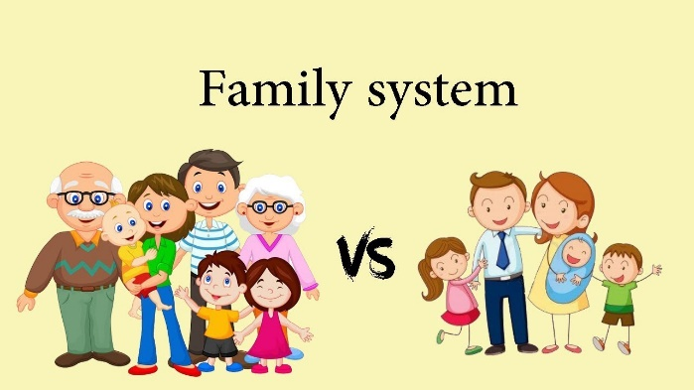
Comparisons and Contrasts
When we compare two objects, persons, qualities, degrees etc. that are some respects equal, we may use the comparison of equality.
This is formed by the use of as... adjective / adverb... As
Your family is as large as mine.

Slide 22
Comparisons and Contrasts
When we compare unequal subjects, we may use the comparative degree of the adjective or adverb with than
His new book is more interesting than his earlier books.

Slide 23
Comparisons and Contrasts
In some adverbial clauses of comparison both subject and verb are dropped.
He is more shy than (he is) unsocial.
Some people think more about their rights than (they do) about their duties.

Slide 24
Comparisons and Contrasts
Comparison and contrast are also expressed by the use of the...the...with comparatives.
The sooner you start, the sooner you’ll finish.
The more he read, the less he understood.

Slide 25
Group Work
Transform the following sentences as directed.
1. Bangladesh is a beautiful country.(Comparative)
Bangladesh is more beautiful than any other country.
2. Chattogram is the cleanest of all cities. (Comparative)
Chattogram is cleaner than all other cities.
3. No other all-rounder is as great as Shakib.(Sup.)
Shakib is the greatest all-rounder.
4. Samin is the most brilliant students in the class. (Pos.)
No other student in the class is as brilliant as Samin.
5. Gold is more brighter than any other metals.
No other metal is as bright as gold.

Slide 26
Evaluation
Transform the following sentences as directed.
1. Paris is hotter than England. (Positive)
England is not as hot as Paris.
2. Kamal is not less wise than Jamal. (Positive)
Kamal is as wise as Jamal.
3. Teaching is nobler than any other profession. (Sup.)
Teaching is the noblest profession.
4. Honesty is the best policy. (Positive)
No other policy is as good as honesty.
5. The Fizz is the best bowler in Bangladesh. (Comp.)
The Fizz is better than any other bowler in Bangladesh.

Slide 27
Home Work
Transform the following sentences as directed.
1. They Japanese are more industrious than most other nations. (Superlative)
2. Cox’s Bazar is the longest sea beach in the world. (Comparative)
3. He is not as bad as his friend. (Comparative)
4. Egg contains more protein than other food. (Positive)
5. Winter is the coldest season in Bangladesh.(Comparative)

Slide 28
Thank you for your attention.

