Slide 1
Welcome To English Class

Slide 2
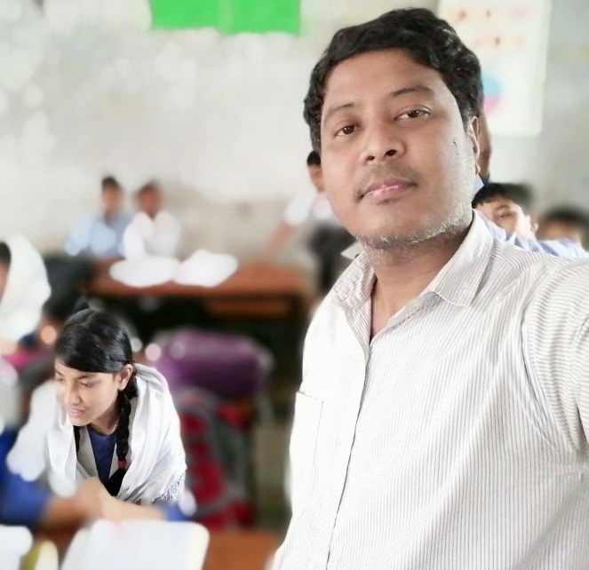
TEACHERS’ NAME & ID
Sumon Barua
Assist Teacher
Guzra shyamachara High School
P,K Sen Hat, Mogdai, Raozan Chattogram
E-mail:sumonbarua8626@gmail.com
Mobile: 0181564924

Slide 3
Introducing 0f Lesson
* Class –Nine * English 1st paper
* Unit – Three
* Lesson – Five * Duration – 50 m
* Title of the Lesson :26 March

Slide 4
Learning Outcome
After Ss, have studied this lesson they will be able to……
Talk about event and festivals .
Ask and answer questions and give opinions in a logical sequence.
Infer meaning from the context .
Describe the grammar point.

Slide 5
Dear Ss,Look at the picture.

Slide 7
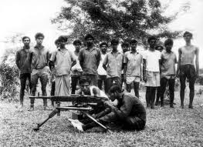

Slide 8
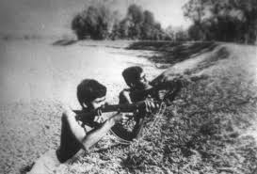

Slide 9
Dear Ss : Let’s Watch a lesson related video

Slide 10
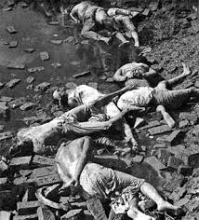

Slide 11
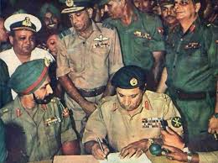

Slide 12
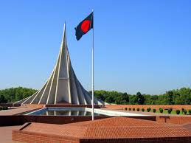
Lesson Announce
Independence Day

Slide 13
Silent Reading

Slide 14
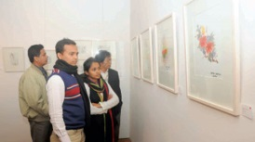
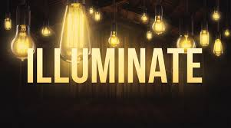
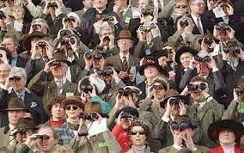
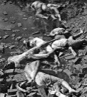
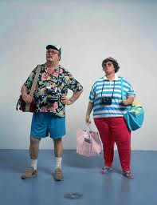
Word Meaning
Display –
Illuminate –
Spectator –
Martyr –
Foreigner -
To show something
To decorate building with bright light.
Many people who see something.
Who sacrificed his life for his country.
Immigrant.

Slide 15
Enthusiasm=প্রবল আগ্রহ Buzz, craze, trend,
Wreath=মালা গাঁথা , পাকানো,interlace,entwine
Procession=শোভাযাত্রা,parade
Spectacular=সাধারণের দৃষ্টি আকর্ষক attractive
Illuminated=উদ্ভাসিত, আলোকিত enlighted

Slide 16
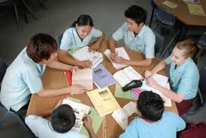
Answering Question
When Bangladesh became Independence?
What is the abbreviation the word VDP?
Where do our President and Prime Minister pay their homage?
How many people sacrifice their life in this war?
Where does build the National Memorial ?

Slide 17
Grammar
Grammar Point : Superlative Degree.
Example : The independent is the biggest state festival.
Structure :Sub. + verb + super. Form of adj.+ noun+ Extent.
Meaning : Super. Form of adj.
No other state festival is as big as the independent.( Positive)
The independent is bigger than any other festival. (comperative)

Slide 18
Pair Work
Independent Day
Freedom fighter
Sacrifice
Illuminate
Holiday
See the mind mapping and write a paragraph about Independence day of your own word.

Slide 19
Evaluation/ M.C.Q without option
Our biggest state festival is ………. ………………
The celebration of Day begins with ……………………………….
The National Mausoleum is at……………………
On Independence Day a national parade is held at …………………………………….
On this day all public building are adorned with …………………………………..

Slide 20
Evaluation answer
Independence Day.
gunshots .
Savar .
The national parade ground.
Colourfull light

Slide 21
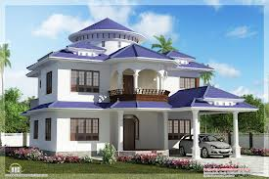
Home Work
Write , in a brief, how you celebrated this year’s Independent Day at your school.

Slide 22
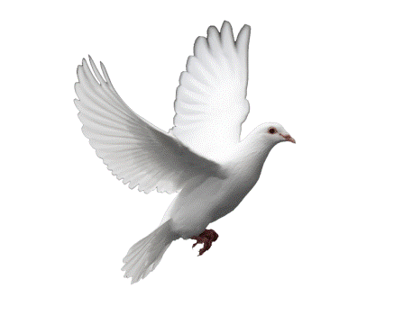
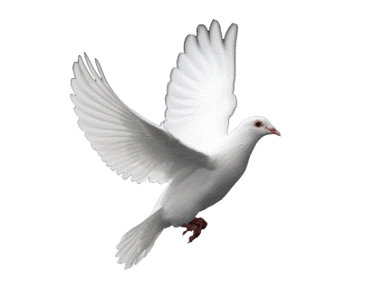
Thanks To All

