Slide 1
WELL COME TO ALL

Slide 2
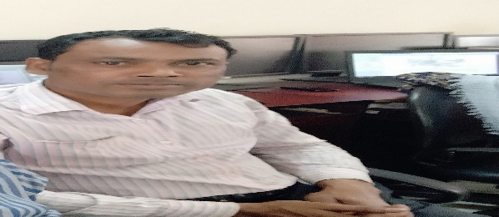
INDENTITY
TEACHER
SUBJECT
NAME:Ramjan Ali
Assistant Teacher
Majer gaon G.P.s
Companigonj,sylhet.Email:ramjanali9133@gmail.com
Mobail:01724354399
Class:five
Sub:English for today
Unit:09
Lesson: 1-2
Lesson Title:occupations.
Time:40 minite

Slide 3
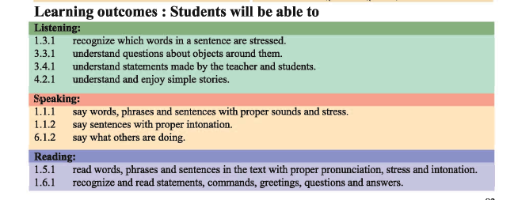

Slide 4
Warm up .
Good morning everybody.
How are you today?
Let’s sing the good morning song.

Slide 5
Pre knowledgebverification
What are the parts of a letter?
How many parts of a letter
What should we write in the beginning?

Slide 6
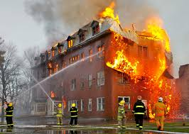
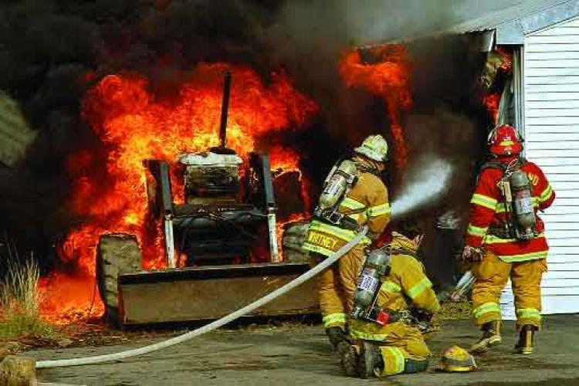
Look at these pictures and think about .what can you see in the picture?

Slide 7
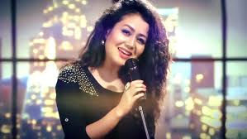
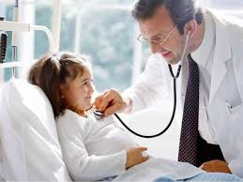
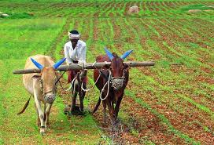
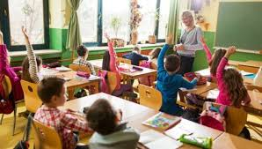
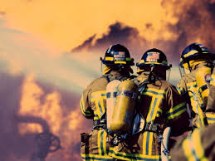
Look at these pictures and think about them
Singer
A person who song professionally.
Doctor
A person who treatment the patient.
Farmer
A person who grows crops.
Teacher
A person who teaches students.
firefighter
A person who puts out fire.

Slide 8
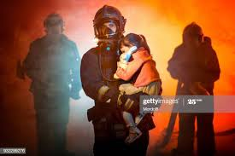
Today lesson occupations

Slide 9
Look at these pictures and think about .what can you see in the picture?s
A long time ago,When Raju was in class five 5 there was a fire in his scholl.

Slide 10
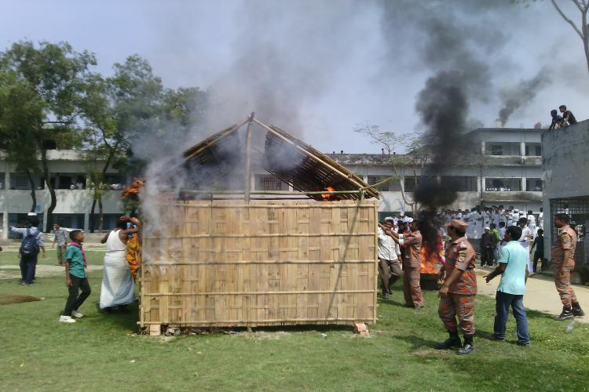
Look at these pictures and think about .what can you see in the picture?
Everyone was very afraid,but no one panicked.

Slide 11
Look at these pictures and think about .what can you see in the picture?
The teachers helped the students to leav the building quietly and safely.

Slide 12
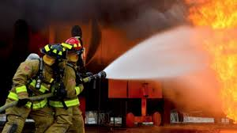
Look at these pictures and think about .what can you see in the picture?
Soon the firefighters came and put out the fire.Raju watched the firefighters frome the school yard.He thought about the fire and the firefighters for a long time.

Slide 13
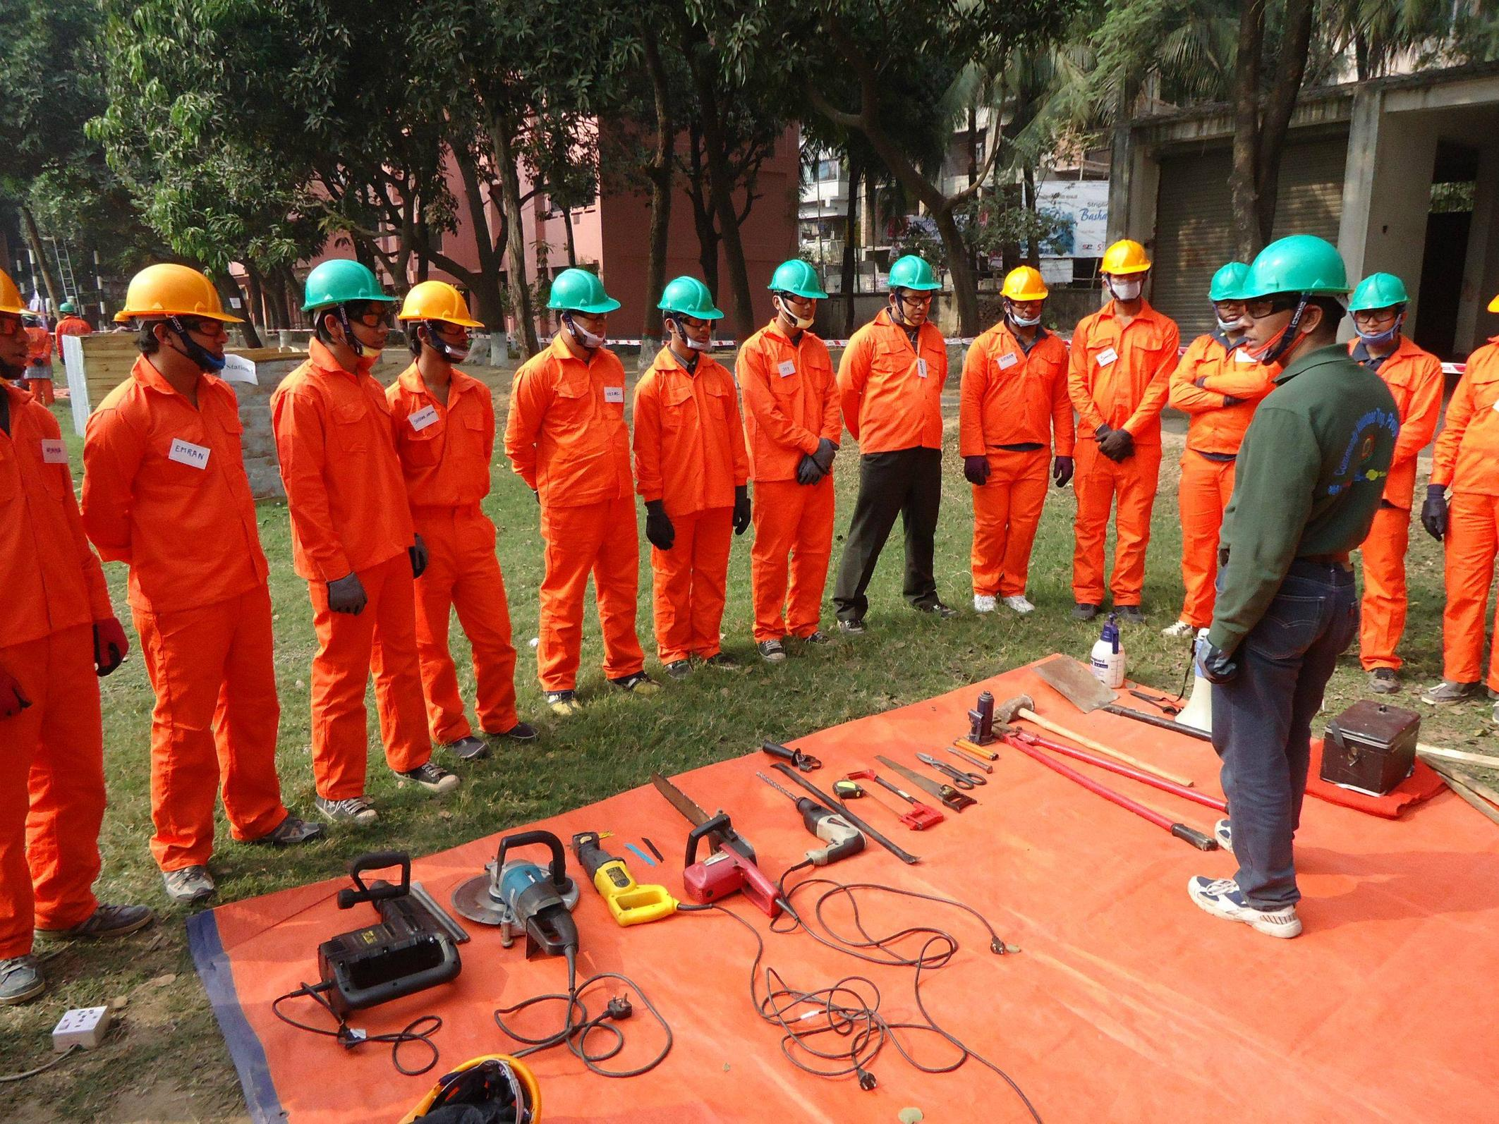
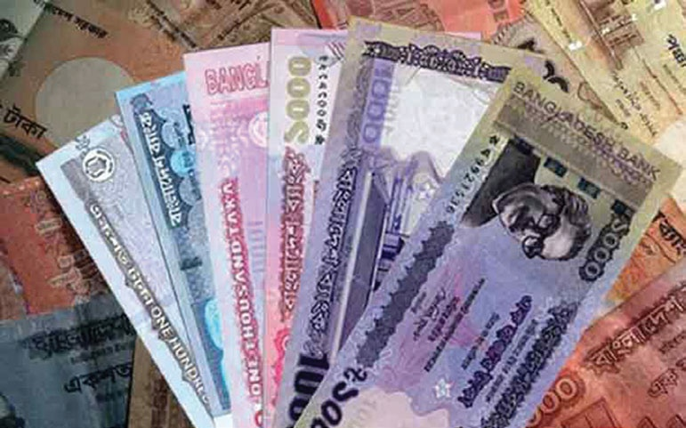
Look at these pictures and think about .what can you see in the picture?
After college,Raju joined a volunteer fire department.As a volunteer,he didn t get any money for his work.But Raju didn t mind.

Slide 14
Dear students open your E F T book at page No 34.Teacher loudly reading.

Slide 15
Students reading
Group work
Read the text silently and find out the answer
Q.1. Where did the fire take place?
Q.2. Who helps the students to leave
the building?
Q.3. Who put out fire?
Q.4. Who wacched the fire fighter from the school yeard?
Q.5.What Does a teacher do?
Q.6.What does a singer do?

Slide 16
Dear students now unknown word from the tex and try to similar word
Afraid – Frightened.
Safe – Out of danger.
Panic – Fear.
Quiet – Calm.
Volunteer – Unpaid worker.
Help – Shelter.
Firefighter – Who put out fire.
Department Section.

Slide 17
Individual work
Match the words in column A with their meaning in B
Column A
Column B
a) Afraid
i. who puts out fire
b) Safe
ii. calm
iii. frightened
c) Panic
iv. division
d) Quiet
v. be anxious
e) Firefighter
vi. unpaid worker
vii. free from danger

Slide 18
pair work
Write T for true or F for false.
1. There were a fire at Raju’s school when he was in class five.
2. The teachers left the students in the building during the fire.
3. Raju didn’t see the firefighters put out the fire at his school.
4. Raju always earns money for being a firefighter.
5. Raju also likes teaching.
6. Talking to student is part of Raju’s job.

Slide 19
Evalution
Every students, come in front of
by turns and read the text with
correct pronunciation.

Slide 20
Home work
Dear student’s
You will write the answers by the following questions.
Q.1. Who joined the fire department?
Q.2. When did Raju join as a volunteer firefighter?
Q.3. What does he talk about with the studets?

Slide 21
THANK YOU

