Slide 1
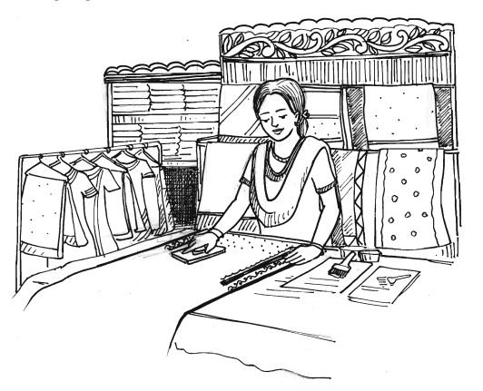
Welcome to the presentation

Slide 2
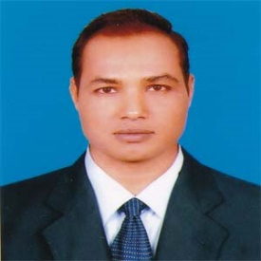
Introduction
Md. Mizanur Rahman
B.A. (Hons.), M.A. English, B. Ed.
Assistant Teacher
Police Lines School and College, Pabna.
Mobile no: 01737979719
Email:mizanplsc@gmail.com
Class : VIII
Subject : English 1st paper
Unit: Five (Making a difference)
Lesson: Three
Lesson Title : Ever beautiful Shamima
Time : 40 Minutes
Date : 08/05/2020

Slide 3
A. Look at the pictures and answer the following questions.
What do you see in the picture -1 ?

Slide 4
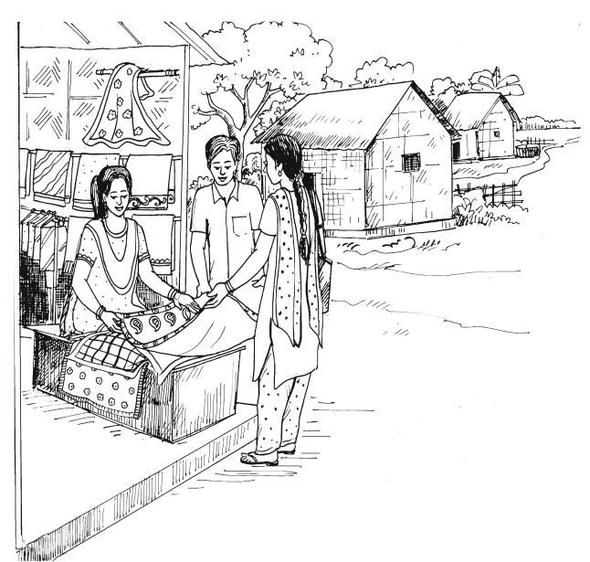
What do you see in the picture-2 ?

Slide 5
Today’s lesson
Ever beautiful Shamima

Slide 6
Learning Outcomes
At the end of the lesson, the students will be able to:
i. read and understand texts through silent reading.
ii. infer meaning from context.
iii. fill in the gaps and choose the correct answer.
iv. write about a successful person in his/ her society.

Slide 7
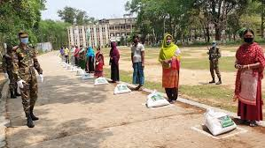
New Words Presentation
Ill-fated (adj)
Destined to doom or have bad luck.
Syn. unlucky.
Ant. lucky
Shamima vows to work with the ill-fated women.

Slide 8
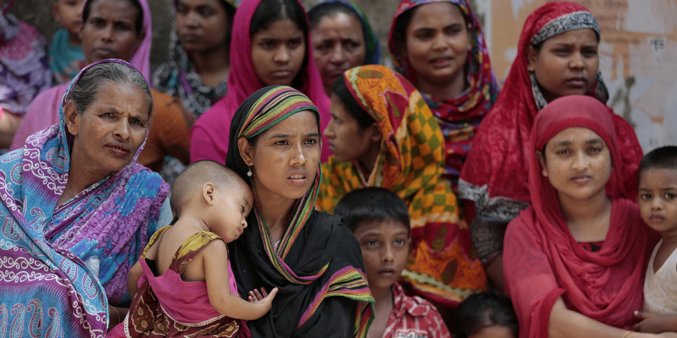
Misery (n)
Sadness and suffering
Syn. Suffering
Ant. happiness
Shamima’s misery started when she was married.

Slide 9
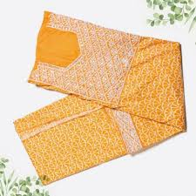
Unstitched (adj)
Without stitching something
Ant. stitched
They stitched the unstitched dresses.

Slide 10
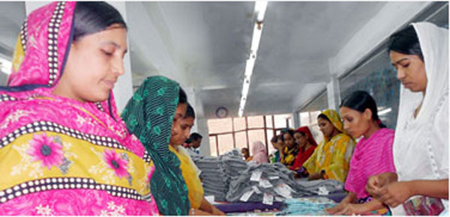
Product (n)
Something that someone makes or grow.
Syn. creation
Ant. reduction
She sells these products in her shop.

Slide 11
Design (v)
To draw or play something.
Syn. plan
She designs fabrics.

Slide 12
B. Read the text silently to understand the meaning of the lesson.
Read the text and answer questions 1 and 2.
Shamima’s misery started the day she was married. Her husband was a greedy person and he used to abuse her verbally and physically. Within a few months into her marriage she had to leave her husband Kamal Uddin Joardar.
Now Shamima vows to work with women, who are ill-fated like her. She has 43 female members in her organization working for her. She herself trains the members and them provides them with wok. She designs fabrics, makes block-print, brush –paint and hand –embroidered saris.

Slide 13
She also makes three-piece dresses for women and fatuas for men. She sells these products in her shop and supplies them outside.
Shamima has a dream now, a dream to do something for the helpless people. She wants them to feel useful. They can live with self-respect and dignity. With this in views, she goes out looking for such people. Shamima finished her story with a smile. Shamima has no complaints, no regrets, and no grudges. Her husband could destroy her outward beauty but not the beauty of her mind. All she wants to do is to bring a smile on the faces of those women who are unfortunate. Shamima wants to become a famous designer.

Slide 14
Individual Work
C. What do you understand by, “Her husband could destroy her outward beauty but not the beauty of her mind”?

Slide 15
Pair Work
D. True or false? If false , give the correct information.
Shamima’s husband destroyed her.
2. Shamim promised to stand beside the helpless women.
3. She has some trainers to train the women of her organisation.
Ans. False. Corr. Info. Shamima’s husband could destroy her outward beauty, but not the beauty of her mind.
Ans. True
Ans. False. Corr. Inf. Shamima herself trains the women in her organization.

Slide 16
Group work
E. Choose the best answer to each question from the alternatives given and write the corresponding number of the answers in your answer script:
What does the word ‘greedy’ mean?
Kind ii. Untidy iii. Covetous iv. Gracious
b. Grudge means----------
Objection ii. Envy iii. Hatred iv. complain
c. Shamima vows to work with ----- women.
Rich ii. Dishonest iii. Helpless iv. Restless

Slide 17
d. Her husband --- her dream.
i. Shattered ii. Liked
iii. Supported iv. Appreciated
e. Shamima is a woman of ---- nature.
Egoistic ii. Malignant
iii. Conceited iv. Benevolent
f. Vow means-----------.
Voyage ii. Voluntary
iii. Promise iv. Guarantee
g. Shamima’s conjugal life was ------------------.
Very happy ii. successful
iii. Futile iv. gorgeous

Slide 18
Evaluation
F. Read the following text and fill in the gaps with appropriate words to make a meaningful one.
Smile
Shamima finished her story with a (a) . She has no complains, no regrets, no (b) . Her husband could destroy her outward © but not the beauty of her (d) . All she wants to do is to bring a smile on the faces of those women who are (e) .
grudges
beauty
mind
unfortunate

Slide 19
Home Work
G. Find a person in your locality who has succeeded in the difficulties and write about her/ him.

Slide 20
Thanks to all
See you again in the next class

