Slide 1
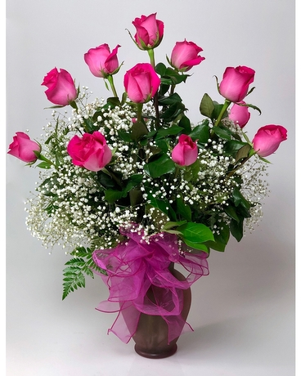
Welcome to all

Slide 2
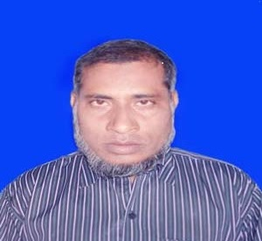
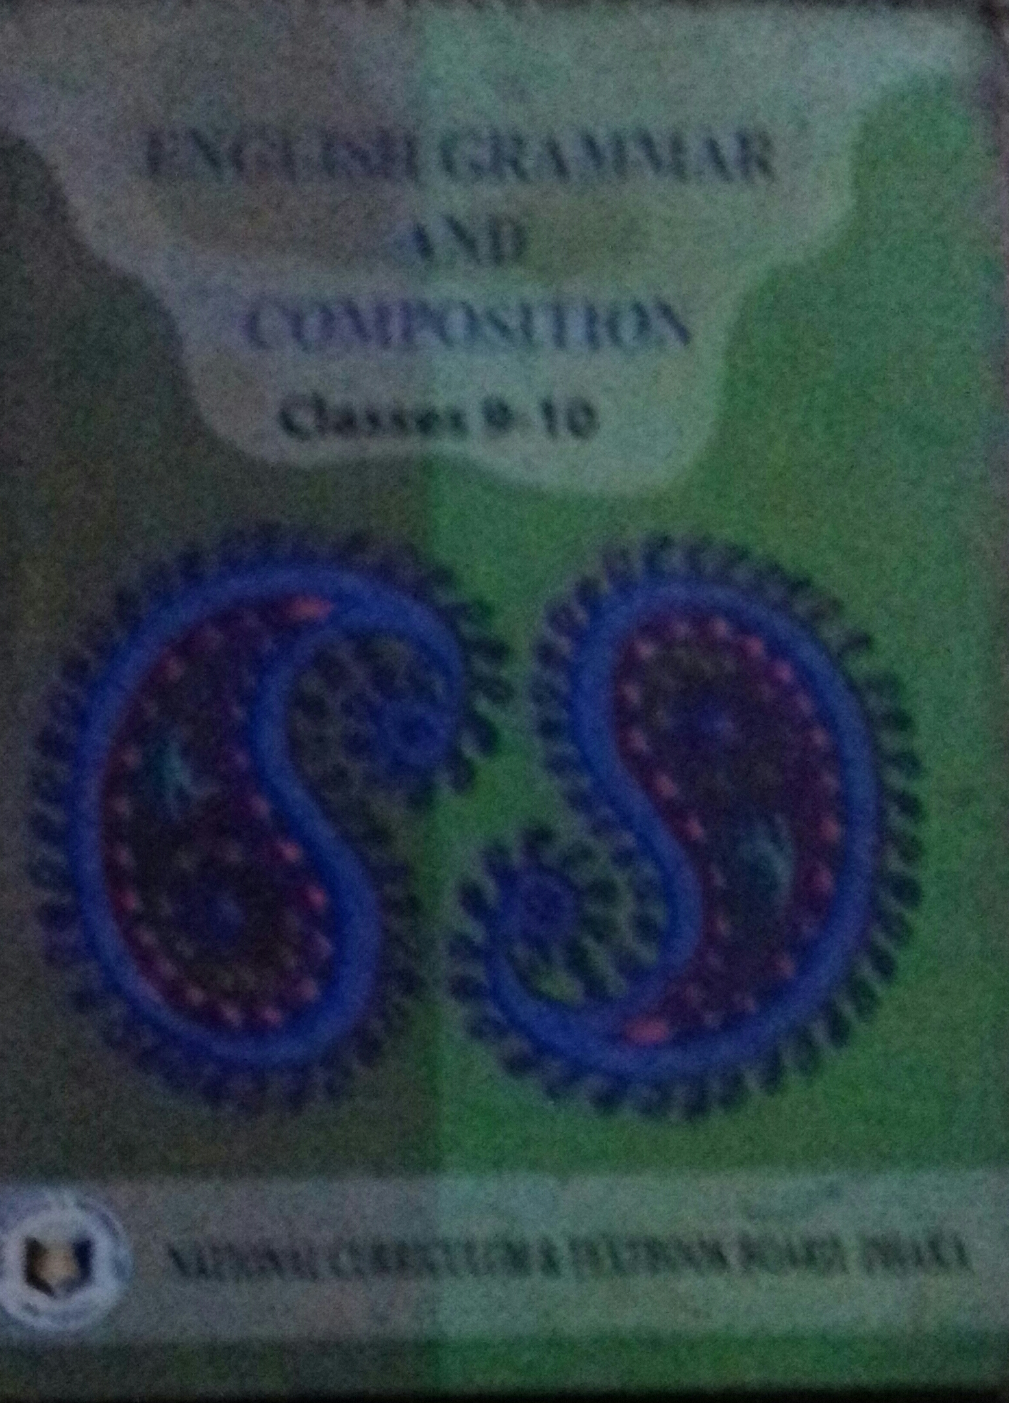
Introduction
Md. Nazrul Islam
Assistant Teacher
K.K.H.S.Porsha,Naogaon
Nazrul.kkhs@gmail.com
Class – Nine & Ten
Sub- English 2nd Paper
Title – Tag questions
Time – 45 minutes

Slide 3
Learning Outcomes
Student will be able to ---
*tell what is Tag questions.
*describe how to add Tag questions.
*use tag questions after the statements

Slide 4
Look at the Punctuation Marks beloww
?
What is the name of the Punctuation Mark ?
Note of interrogation or question mark.
When do we use it ?
To make questions.

Slide 5
Do you know How many kinds of questions?
Three Kinds
What are they?
* Yes /No question – Are you I’ll?
* Wh questions –What’s your name?
*Tag questions –It is fine,isn‘t it?

Slide 6
Todays our Topic is -----
Tag questions

Slide 7
Tag question is a kind of question which is added at the end of any statement / any command/any proposal /any request to be sure the listener is agree/disagree to the statemen/ command /proposal /request.
Examples
Today is Friday, isn’t it?
Please give me a pen, will you/won‘t you?
Let‘s go out, shall we/shan‘t we?

Slide 8
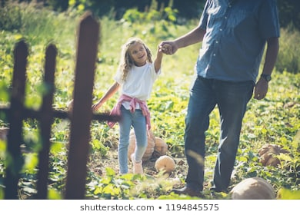
Let’s go out,
Shall we / shan‘t we?
If the statement / proposal start with let’s /let us tag question will be shall we? /shan‘t we?

Slide 9
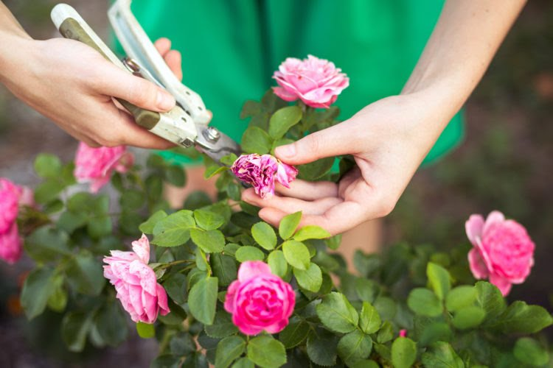
Let him pluck a flower,
will you? /won‘t you?
Let me thinking,
will you? /won‘t you?
If the statement /proposal starts with let me/him/her/them/ name tag question will be will you? Won’t you?

Slide 10
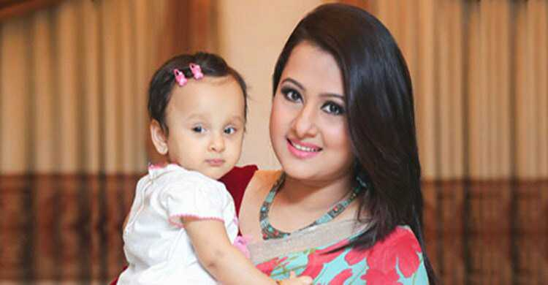
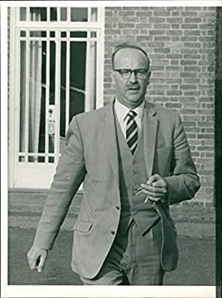
Every mother loves her child,
don’t they?
don’t they?
Somebody like him,
If the statement starts with every/some tag question will be don’t they? Didn’t they?

Slide 11
Nobody hates flowers,
do they?
If the statement starts with No tag question will be
do they? did they?

Slide 12
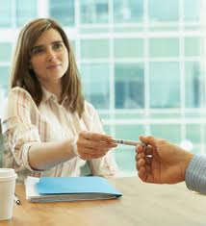
Sit down, please,
Will you? /won‘t you?
Please give me your pen,
Will you? /won‘t
you?

Slide 13
Go home,
Will you? /won‘t you?
If the statement starts with please/kindly /verb tag question will be will you ? / won‘t you?

Slide 14
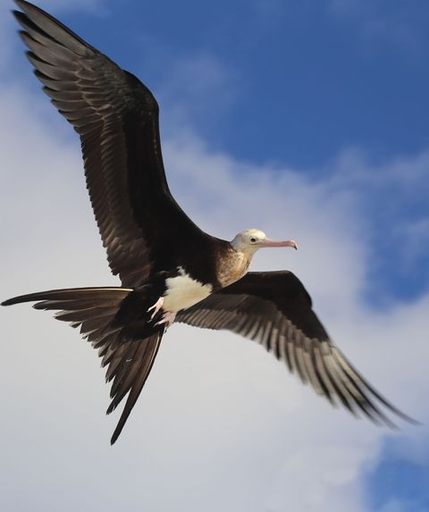
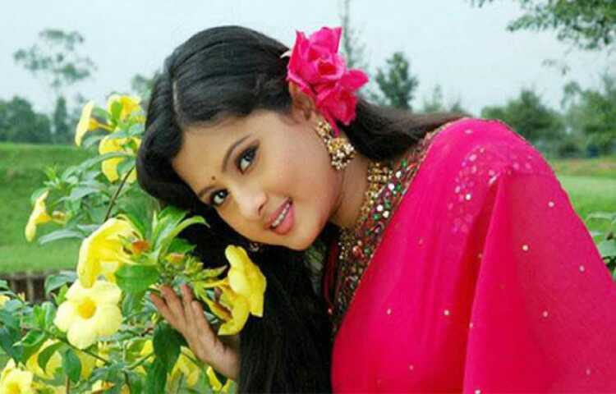
Birds can fly ,
can’t they?
Purnima is very beautiful,
isn’t she?

Slide 15
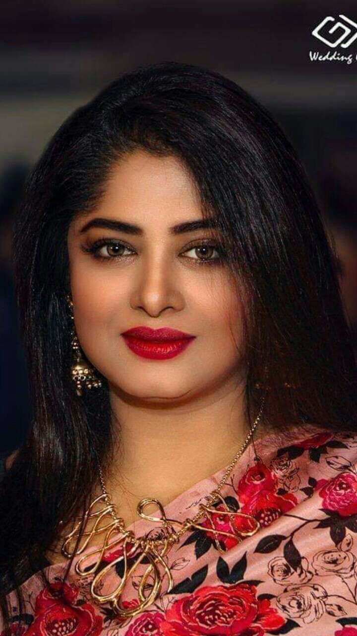
Mousumi is a famous actress,
isn’t she?
If there is any auxiliary verb in the sentence tag question will be auxiliary verb +(n’t)+pronoun of the subject ?
If the statement is affirmative, tag question must be negative,if the statement is negative tag question must be affirmative.

Slide 16
Negative words --- No ,Never, Not,hardly, scarcely, seldom, a little, a few .....

Slide 17
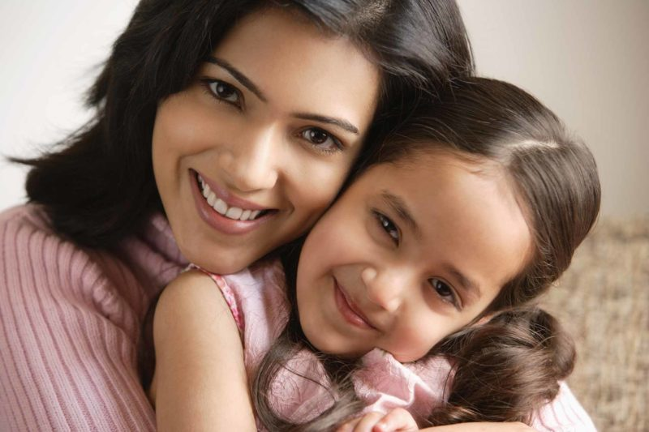
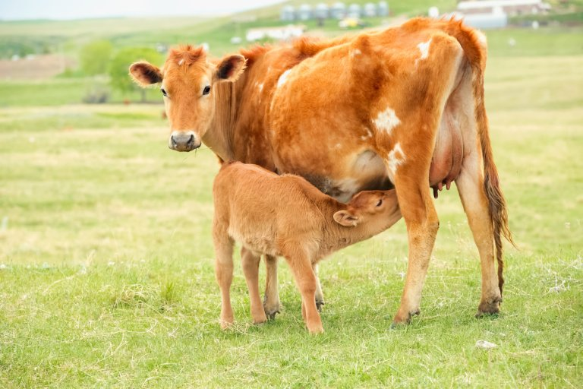
Mother loves her baby,
doesn”t she?
The cow lives on grass,
doesn”t she?/
doesn‘t it ?

Slide 18
Mecky went to school,
didn”t he?
If there is main/principal verb in the sentence tag questionwill be don’t/doesn‘t/didn‘t (according to verb)+pronoun of the subject .
If the statement is affirmative, tag question must be negative,if the statement is negative tag question must be affirmative.

Slide 19
Exception
I am a student, aren‘t I / ain’t I.
amn‘t = aren‘t /ain’t
willn‘t= won’t

Slide 20
Pair work
Add Tag questions
1.We are happy,..... ? 2. They‘ll go to India,....?
3.Babu isn‘t at home,....? 4. She likes to dance,.....?
5.It was Saturday,.....? 6.We aren’t going,.....?
7.He can’t draw,...? 8.He has never been to Paris,..?
9.Rafikul didn‘t play hockey,...? 10.She likes it,......?

Slide 21
Answers
1.Aren’t we?
2.won’n they?
3.is he?
4.doesn’t she?
5.wasn’t it?
6.are we?
7.can he?
8.Has he?
9.did he?
10.doesn’t she?

Slide 22
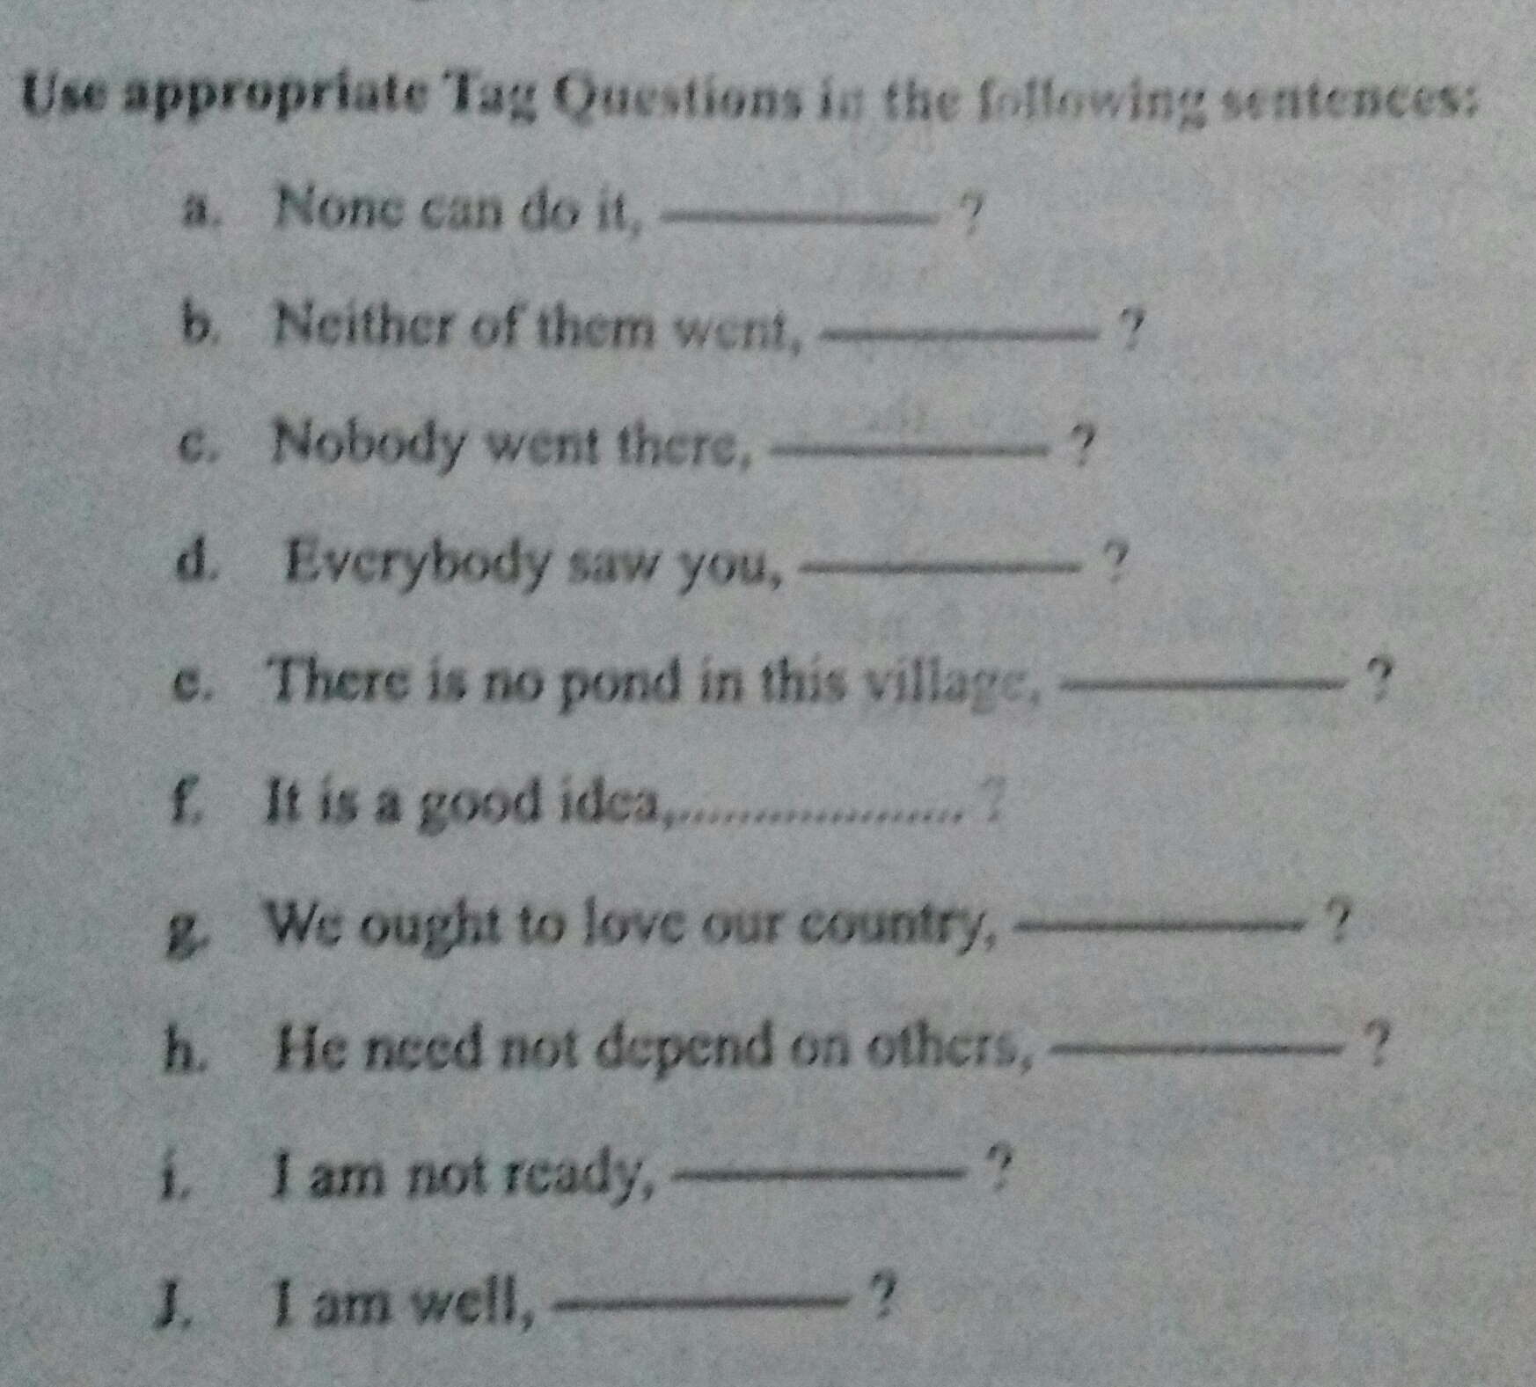
Home work

Slide 23
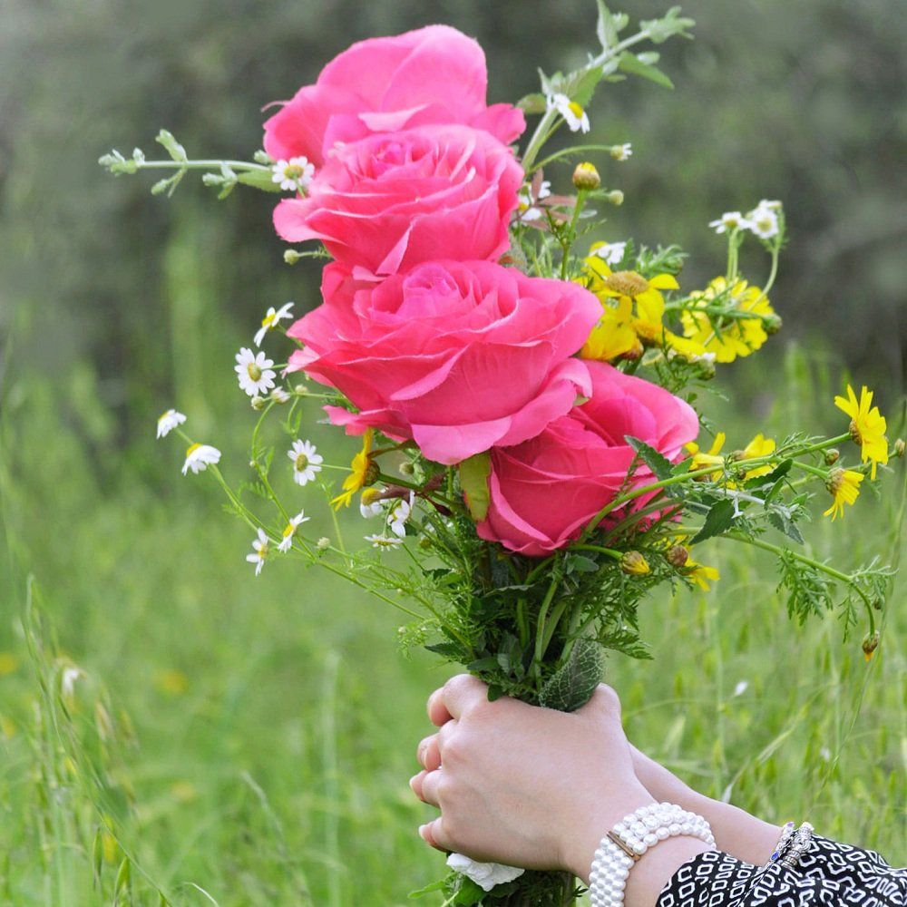
Thank you

