Slide 1


Slide 2

Welcome

Slide 3


Introduction
Swandip Banerjee
Assistant Teacher (English)
Pallimangal Secondary School
Sonadanga. Khulna.
Mobile: 01718503573
E-mail:swandipb1@gmail.com
Class: Nine/Ten
Subject: English 1st Paper
Time: 50 Minutes.

Slide 4
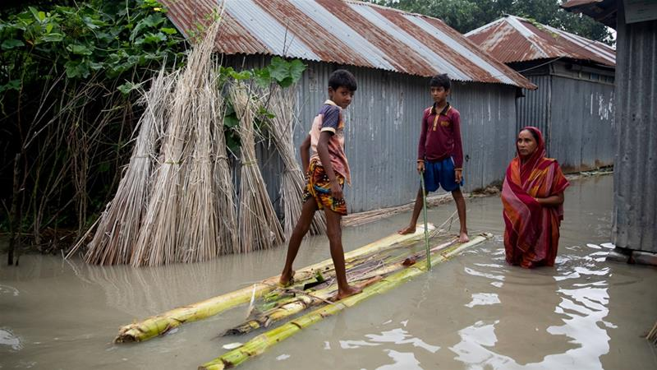
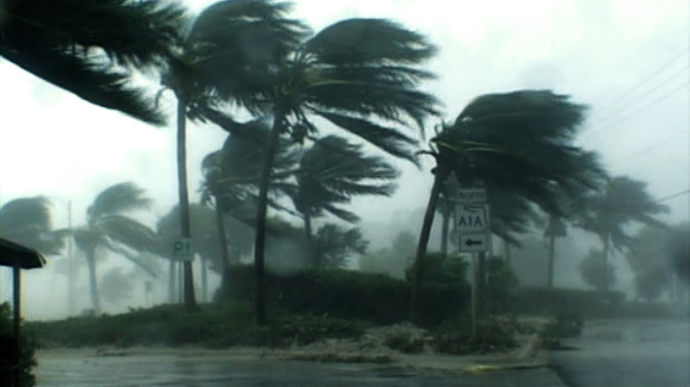
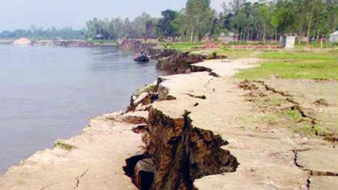
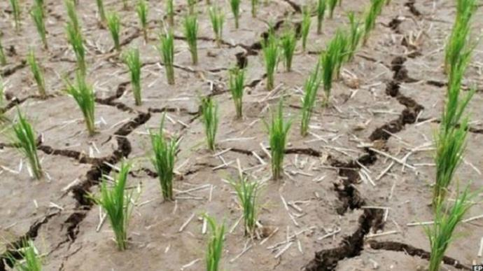
Look at the pictures.
Picture of natural disasters.
Notes:
Teacher can hide this slide.

Slide 5

Let’s watch a video
What is the video about?

Slide 6
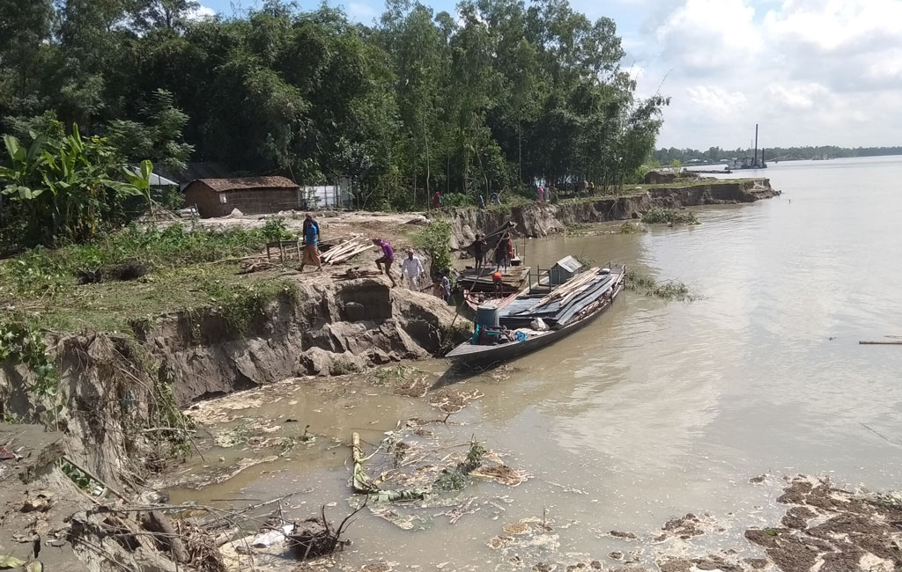
Today’s Lesson is……
The greed of the mighty rivers.
Unit: 5 Lesson: 1

Slide 7
Learning outcomes
After completing this lesson, students will be able….
to comprehend and summaries texts.
to ask and answer questions.
to write a paragraph.

Slide 8
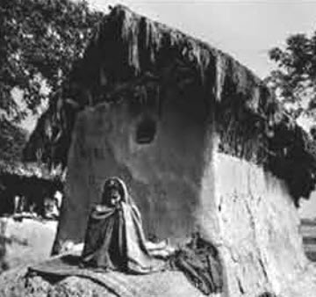
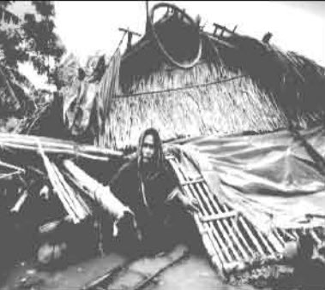
Look at the pictures and talk about it with your partner.
What is the picture about?
How do they look?
Are they victim of any natural disaster?
Notes:
First teacher will read the text, explain the text then ss will read the text loudly/silently later ss answer the ques orally/written.

Slide 9

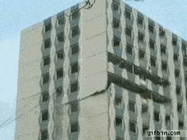
Vocabulary
Unsteady
Not firm or still
The flame of this candle is unsteady.
Demolish
destroy
Last earthquake demolished a lot of buildings.
Notes:
At first teacher will show the words then ask his/her students to tell the meaning and making sentences. If they fail teacher will show the picture again. For feedback click on meaning button.

Slide 10
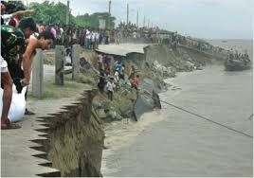
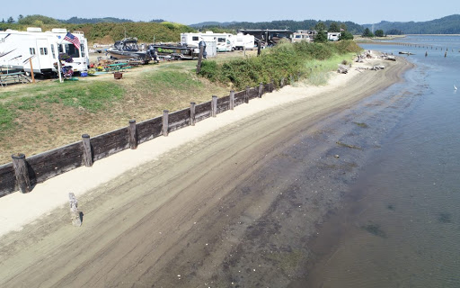
Vocabulary
Erosion
Corrosion/Decay
We have lost all our properties due to river erosion.
Embankment
A wall of earth or stone built to prevent a river flooding.
An embankment can save the people from flood.
Notes:
At first teacher will show the words then ask his/her students to tell the meaning and making sentences. If they fail teacher will show the picture again. For feedback click on meaning button.

Slide 11
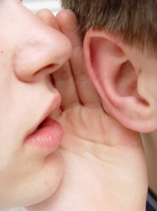
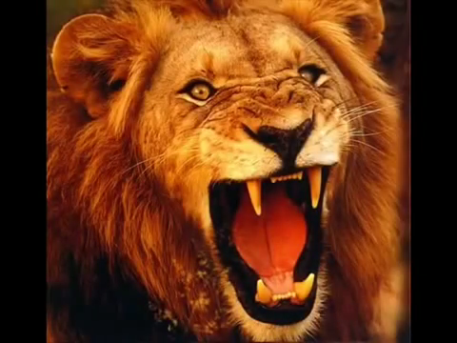
Vocabulary
Whisper
To speak very quietly near to ear.
The mother is whispering to her baby.
Roar
To make a loud deep harsh sound of rivers or wild animals.
The lion is roaring for hungry.
Notes:
At first teacher will show the words then ask his/her students to tell the meaning and making sentences. If they fail teacher will show the picture again. For feedback click on meaning button.

Slide 12
Read the following text and fill in the blanks in pairs.
GW
Meherjan lives in a slum on the Sirajgonj town protection embankment. Her polythene-roofed shelter looks like a cage. She is nearly 45 but looks more than he4 age. In front of her shelter, she is trying to make a fire to cook the day’s only meal .Her weak hands tremble as she adds some fallen leaver and straw to the fire. The whispering wind from the river Jamuna makes the fire unsteady. The dancing of the flames reminds Meherjan of the turmoil in her life.
Not long ago Meherjan had everything- a family, cultivable land and cattle. The erosion of the Jamuna consumed all her landed property gradually. It finally claimed her only shelter during the last monsoon. It took the river only a day to demolish Meher’s house, trees, vegetable garden and the bamboo bush. She had a happy family once. Over the years, she lost her husband and her family to diseases that cruel hunger and poverty brought to the family. Now, she is the only one left to live on with the loss and the pain. The greedy Jamuna has shattered her dreams and happiness.
There are thousand others waiting to share the same fate like Meherjan. Bangladesh is a land of rivers that affect its people. Erosion is a harsh reality for the people living along the river banks. During each monsoon many more villages are threatened by the roaring rivers like the Jamuna, the Padma and the Meghna. It is estimated that river makes at least 100,000 people homeless every year in Bangladesh. In fact, river erosion is one of the main dangers caused by climate change. If we can’t take prompt actions to adapt to climate change, there will be thousands of more Meherjans in our towns and villages every year.

Slide 13
Pair Work.
Complete the summery of Meherjan’s life with words/ phrases from the box.
Meherjan is a typical (1)…………… woman who lives in a slum. She lost her shelter and properties (2)………… the erosion of river Jamuna. She also lost her family. Her husband had died of disease caused by poverty and (3)……………………….Now, she is only a (4)………………… . Like Meherjan there are many people who have become the (5)………… of river erosion. River erosion is still posing (6) ………… to the lives and properties of thousands of people. People living (7) ………… rivers are most likely victims of river erosion. Each year about (8) ……………… people become homeless due to river erosion in Bangladesh. Meherjan’s life is just one (9) ………… of how climate change (10)………… the lives of thousands of people.
victims, affects, close to, slum dweller, homeless, threats, example, due to, shortage of food, one lac
homeless
due to
shortage of food
slum dweller
victims
threats
close to
one lakh
example
affects
Notes:
SS will get time 10 minu: T will try to elicit the ans: from ss if fail then T will give feedback.

Slide 14
Now, read the text ‘A’ again and answer the following questions.
Group work
Text
What does Meherjan use to make fire for cooking her meals?
What property did Meherjan lose due to river erosion?
What do you know about Meherjan’s family?
In which season does river erosion most likely occur?
Why is the phrase ‘greedy Jamina’ used to describe the river? What greed do you notice in the description?
Notes:
SS will get time 10 minu: T will try to elicit the ans: from ss if fail then T will give feedback.

Slide 15
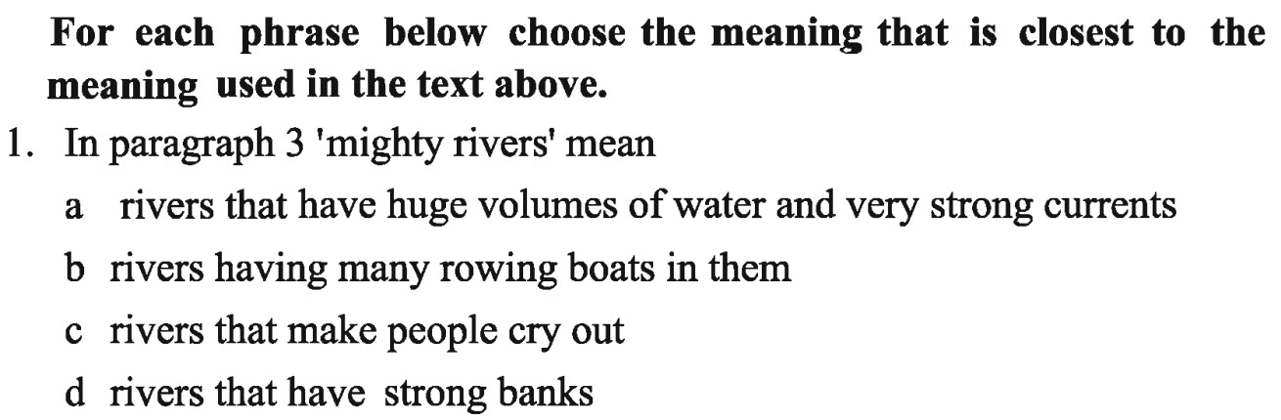

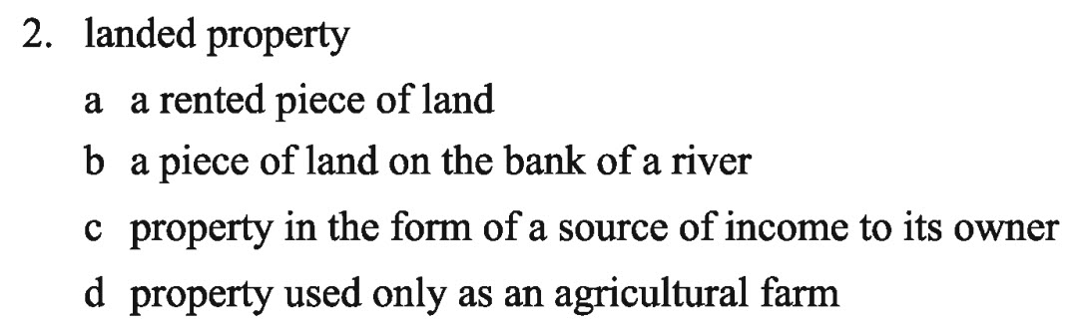
Evaluation.
Ans
Ans
Notes:
T will try to elicit the ans: from ss if fail then T will give feedback.

Slide 16
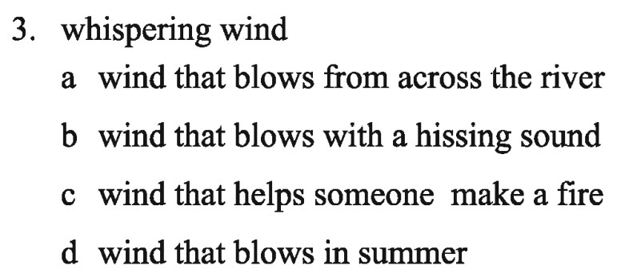
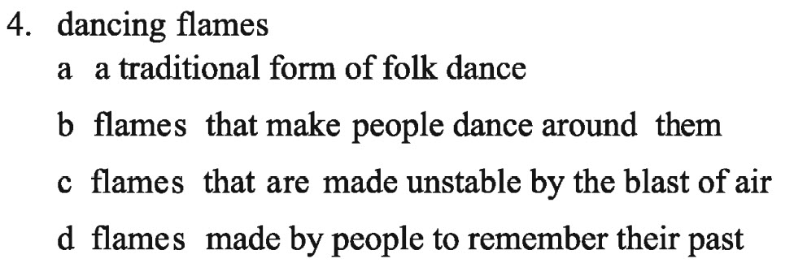
Evaluation.
Ans
Ans

Slide 17
Home Work
Write a paragraph on natural disaster of Bangladesh.

Slide 18

Thank you

