Slide 1
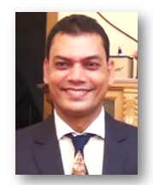
Welcome
Biplab Das
Assistant Teacher (M.S.S; M.Ed.)
Raozan R.R.A.C Govt. High School.
E-mail: biplabd80@yahoo.com
Class Six
English 1st Paper.
Time:50 Minutes, Date:09 May,2020

Slide 2
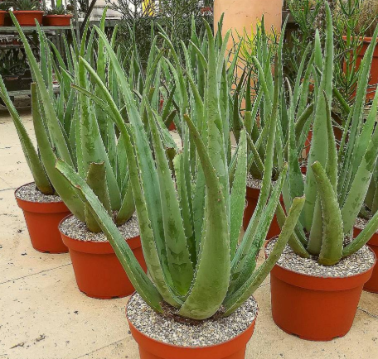
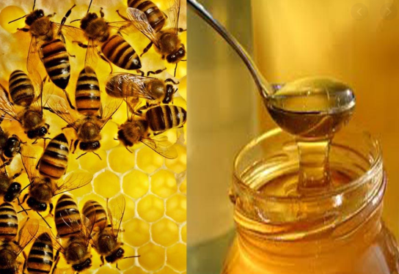
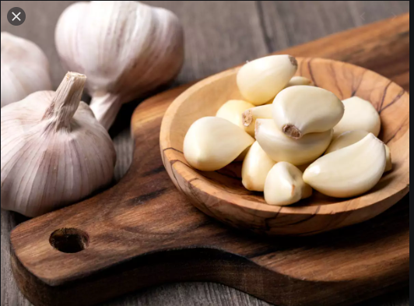
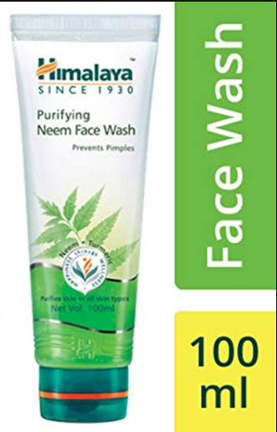
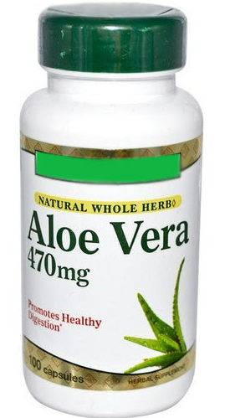
What do you see in the images? Why do we use them?

Slide 3
Today`s Lesson is…..
Remedies: Modern and Traditional
(Lesson: 10,Page: 33)

Slide 4
Learning Outcomes:
after completing the lesson students will be able to……
identity traditional remedies.
read and understand texts
ask and answer questions.
write a short paragraph.

Slide 5
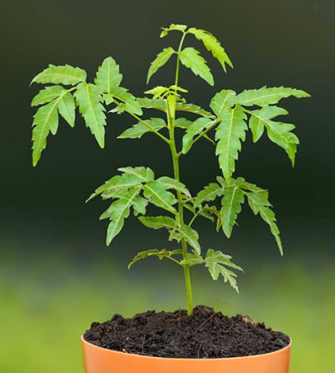
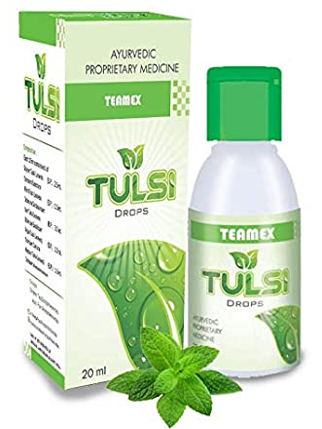
Some Key Words & Synonym
Natural
Usual
We can use natural cures to free from diseases.
Cures
Medicines
We can use natural cures to free from diseases.

Slide 6
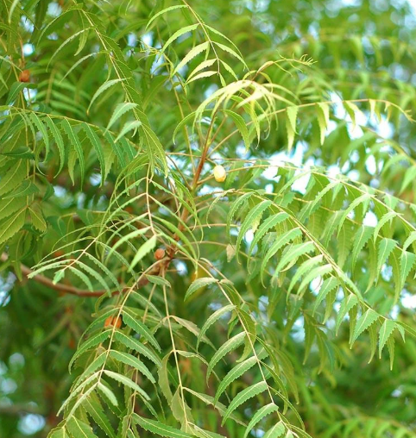
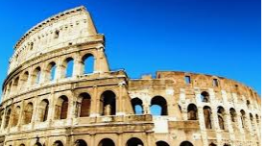
Some Key Words & Synonym
Herbs
Aromatic plant
We can use herbs to free from diseases.
Civilizations
Developments
Some old civilizations like India and China used herbs for treatment.

Slide 7
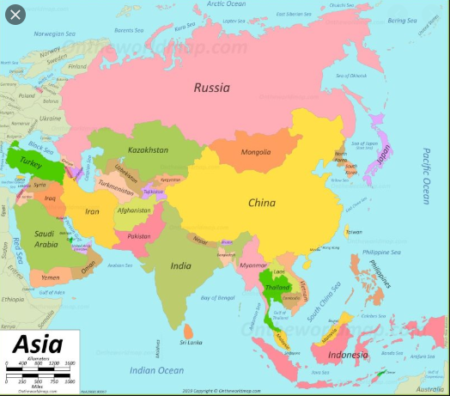
Do you know which countries were used herbal remedies in ancient times?
Herbal medicines were used in ancient civilizations like……
India
China
Greece
Egypt
Rome

Slide 8
Modern
Paracetamol
Savlon
Antacid
Ointment
Remedies:

Slide 9
Traditional
Aloe vera
Honey
Tulsi
Garlic
Neem
Marigold
Turmeric
Remedies:

Slide 10
Now we are go to learn about traditional remedies in details.

Slide 11
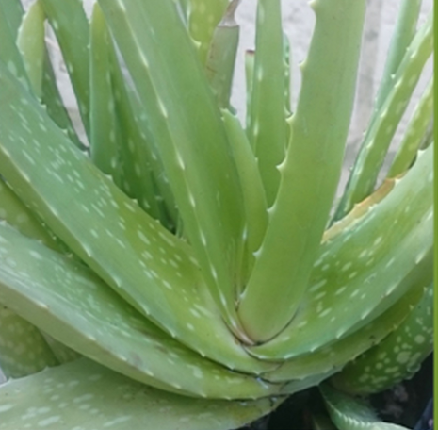
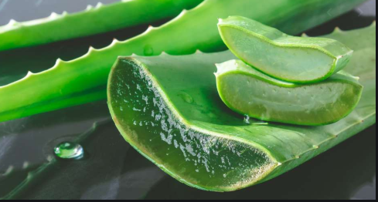
Aloe Vera:
Aloe Vere is used for a minor burn injury , a minor cut or wound.

Slide 12
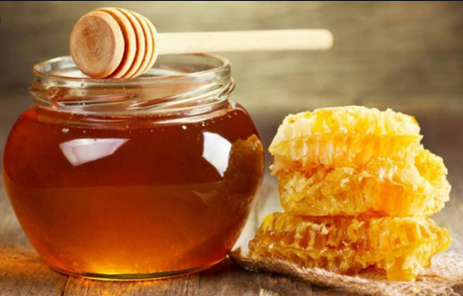
Honey:
If children have cold, honey and tulsi leave are used from remove it.

Slide 13
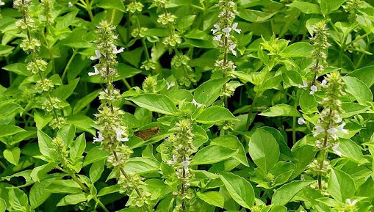
Tulsi leaves:
Tulsi leaves are used for children`s cold.

Slide 14
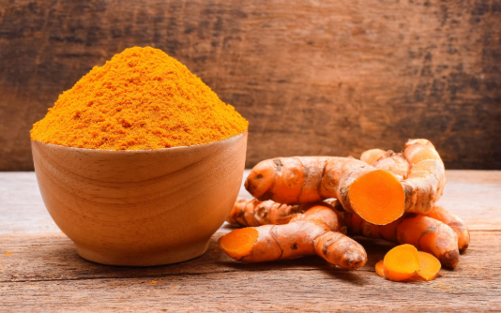
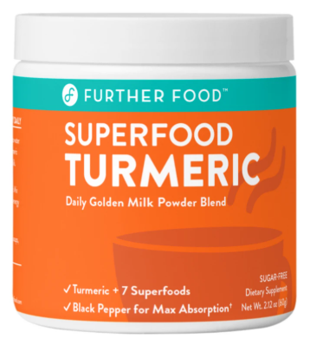
Turmeric:
Turmeric is sued for skin problems.

Slide 15
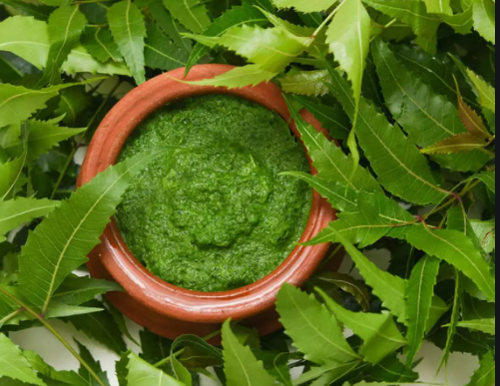
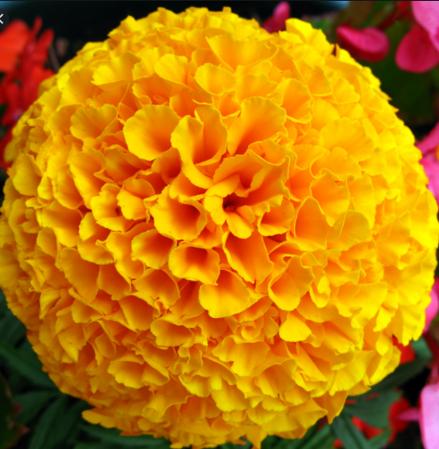
Neem/Marigold
are sued for skin problems.

Slide 16
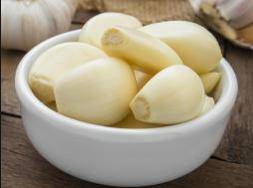
Garlic:
Garlic is sued for also skin problems.

Slide 17
Silent Reading
Read the text Silently.
(after silent reading you will be given group works)
Teacher will monitor and help the students.

Slide 18
Work in Pairs
Make 5 sentences by using following table
Column A | Column B | Column C
1. People around the world | A. are still in | i. to get.
2. Some ancient treatment systems | b. come down | ii. attitude to herbal remedies
3 Herbal treatments have | c. have no | iii. practice today.
4.Herbal remedies | d. are changing their | iv. side effects.
5.Most often they | e. are easy | v. through generations.

Slide 19
Match your answer. (Make sentences)
1.+b+ii
2.+a+iii
3.+b+v
4.+e+I
5.+c+iv

Slide 20
Watch the Video Link Attentively.
Click on Video link
About
Remedies.

Slide 21
Group Work
Answer the following questions in groups
Click on slide in presentation mode.
Rose
1. What are natural cures made of?
Lily
Click on slide in presentation mode.
2. Are herbal cures modern inventions ? Explain.
Tulip
3. Which civilizations are known for herbal treatments?
Click on slide in presentation mode.
Dalia
Click on slide in presentation mode.
4. What herbal cures are used for skin problems?

Slide 22
Write a Paragraph about Traditional Remedies.

Slide 23
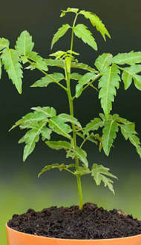
Thanks

