Slide 1
Introduction to HTML
copyright,
MD.MAMUNUR RASID
EMAIL, mdmamun480@gmail.com

Slide 2
Definitions

Slide 3
Definitions

Slide 4
HTML Document Structure
<html>
<head>
<title> NACTAR </title>
</head>
<body>
This is what is displayed.
</body>
</html>
Notes:
09/22/97
3
University of Minnesota Extension Service
Master Internet Volunteer Program
Provide information in an organized way
Chat Groups
Specialized information areas
Internet access

Slide 5
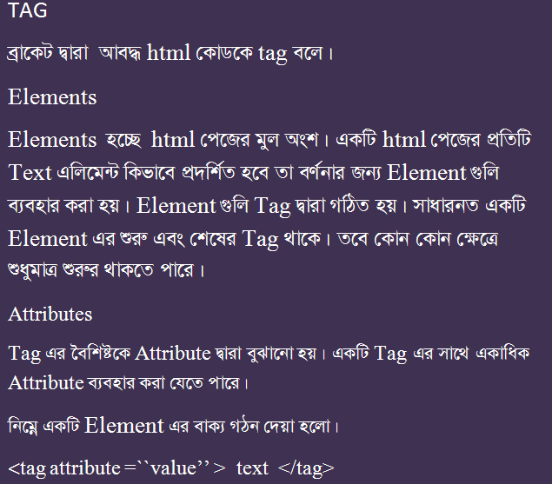
Tag, Element, Attribute

Slide 6
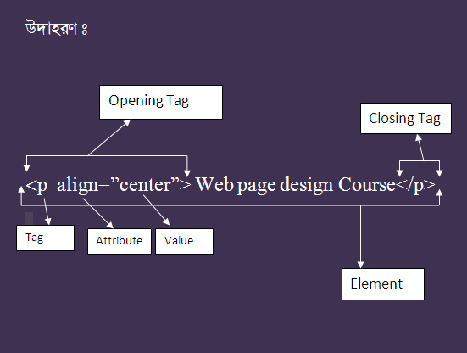
Tag, Element, Attribute

Slide 7
Creating Paragraph
Html Page
Output
<html>
<head>
<title> Text </title>
</head>
<body>
<p align =“center”> World wide web</P> <p> The world wide web is an Internet service, based on a common set of protocols.</P>
</body>
</html>
World wide web
The world wide web is an Internet service, based on a common set of protocols.
Notes:
09/22/97
3
University of Minnesota Extension Service
Master Internet Volunteer Program
Provide information in an organized way
Chat Groups
Specialized information areas
Internet access

Slide 8
Text Emphasis
<b> Text</b> : টেক্সট বোল্ড করার জন্য
<u> Text</u> : টেক্সট আন্ডারলাইন করার জন্য
<i> Text <i> : টেক্সট ইটালিক করার জন্য
<strong> Text </strong> : টেক্সট গাঢ় করার জন্য
<big> Text </b> : টেক্সট বড় করার জন্য
<small> small> : টেক্সট ছোট করার জন্য
Notes:
09/22/97
3
University of Minnesota Extension Service
Master Internet Volunteer Program
Provide information in an organized way
Chat Groups
Specialized information areas
Internet access

Slide 9
Text Emphasis
Html Page
Output
<html>
<head>
<title> Text </title>
</head>
<body>
<p align =“left”>Date : 25 June 2014</P> <p> The world wide web is an <b>Internet service</b>, based on a common <u>set of protocols.</u></P>
</body>
</html>
Date :25 June 2014
The world wide web is an Internet service, based on a common set of protocols.
Notes:
09/22/97
3
University of Minnesota Extension Service
Master Internet Volunteer Program
Provide information in an organized way
Chat Groups
Specialized information areas
Internet access

Slide 10
Choosing Text Editor
There are many different programs that you can use to create web documents.
HTML Editors enable users to create documents quickly and easily by pushing a few buttons. Instead of entering all of the HTML codes by hand.
These programs will generate the HTML Source Code for you.

Slide 11
Starting NotePad
NotePad is the standard text editor that comes with the microsoft windows operating system. To start NotePad in windows 9x or XP follow the steps bellow:
Click on the “Start” button located on your Windows task bar.
Click on “Programs” and then click on the directory menu labeled “Accessories”.
Locate the shortcut “NotePad” and click the shortcut once.

Slide 12
HTML Page Creation & Editing
In this chapter you will learn to create HTML
pages with a standard text editor.
Objectives
Upon completing this section, you should be able to
1. Choose a Text Editor.
2. Create a Basic Starting Document.
3. Understand and set Document Properties.
4. View Your Results in a Browser.

Slide 13
Headings, <Hx> </Hx>
Inside the BODY element, heading elements H1 through H6 are generally used for major divisions of the document. Headings are permitted to appear in any order, but you will obtain the best results when your documents are displayed in a browser if you follow these guidelines:
H1: should be used as the highest level of heading, H2 as the next highest, and so forth.
You should not skip heading levels: e.g., an H3 should not appear after an H1, unless there is an H2 between them.

Slide 14
Headings, <Hx> </Hx>
<HTML>
<HEAD>
<TITLE> Example Page</TITLE>
</HEAD>
<BODY>
<H1> Heading 1 </H1>
<H2> Heading 2 </H2>
<H3> Heading 3 </H3>
<H4> Heading 4 </H4>
<H5> Heading 5 </H5>
<H6> Heading 6 </H6>
</BODY>
</HTML>
Heading 1
Heading 2
Heading 3
Heading 4
Heading 5
Heading 6

Slide 15
Paragraphs, <P> </P>
Paragraphs allow you to add text to a document in such a way that it will automatically adjust the end of line to suite the window size of the browser in which it is being displayed. Each line of text will stretch the entire length of the window.

Slide 16
Paragraphs, <P> </P>
<HTML><HEAD>
<TITLE> Example Page</TITLE>
</HEAD>
<BODY></H1> Heading 1 </H1>
<P> Paragraph 1, ….</P>
<H2> Heading 2 </H2>
<P> Paragraph 2, ….</P>
<H3> Heading 3 </H3>
<P> Paragraph 3, ….</P>
<H4> Heading 4 </H4>
<P> Paragraph 4, ….</P>
<H5> Heading 5 </H5>
<P> Paragraph 5, ….</P>
<H6> Heading 6</H6>
<P> Paragraph 6, ….</P>
</BODY></HTML>
Heading 1
Paragraph 1,….
Heading 2
Paragraph 2,….
Heading 3
Paragraph 3,….
Heading 4
Paragraph 4,….
Heading 5
Paragraph 5,….
Heading 6
Paragraph 6,….

Slide 17
Character Formatting
In this chapter you will learn how to enhance your page with Bold, Italics, and other character formatting options.
Objectives
Upon completing this section, you should be able to
Change the color and size of your text.
Use Common Character Formatting Elements.
Align your text.
Add special characters.
Use other character formatting elements.

Slide 18
Alignment
Some elements have attributes for alignment (ALIGN) e.g. Headings, Paragraphs and Horizontal Rules.
The Three alignment values are : LEFT, RIGHT, CENTER.
<CENTER></CENTER> Will center elements.

Slide 19
Break, <BR>
Line breaks allow you to decide where the text will break on a line or continue to the end of the window.
A <BR> is an empty Element, meaning that it may contain attributes but it does not contain content.
The <BR> element does not have a closing tag.

Slide 20
Break, <BR>
<HTML>
<HEAD>
<TITLE> Example Page</TITLE>
</HEAD>
<BODY>
<H1> Heading 1 </H1>
<P>Paragraph 1, <BR>
Line 2 <BR> Line 3 <BR>….
</P>
</BODY>
</HTML>
Heading 1
Paragraph 1,….
Line 2
Line 3
….

Slide 21
Bold, Italic and other Character Formatting Elements
<FONT SIZE=“+2”> Two sizes bigger</FONT>
The size attribute can be set as an absolute value from 1 to 7 or as a relative value using the “+” or “-” sign. Normal text size is 3 (from -2 to +4).
<B> Bold </B>
<I> Italic </I>
<U> Underline </U>
Color = “#RRGGBB” The COLOR attribute of the FONT element. E.g., <FONT COLOR=“#RRGGBB”>this text has color</FONT>
<PRE> Preformatted </PRE> Text enclosed by PRE tags is displayed in a mono-spaced font. Spaces and line breaks are supported without additional elements or special characters.

Slide 22
Bold, Italic and other Character Formatting Elements
<EM> Emphasis </EM> Browsers usually display this as italics.
<STRONG> STRONG </STRONG> Browsers display this as bold.
<TT> TELETYPE </TT> Text is displayed in a mono-spaced font. A typewriter text, e.g. fixed-width font.
<CITE> Citation </CITE> represents a document citation (italics). For titles of books, films, etc. Typically displayed in italics. (A Beginner's Guide to HTML)

Slide 23
Bold, Italic and other Character Formatting Elements
<P> <FONT SIZE=“+1”> One Size Larger </FONT> - Normal –
<FONT SIZE=“-1”> One Size Smaller </FONT> <BR>
<B> Bold</B> - <I> italics</I> - <U> Underlined </U> -
<FONT COLOR=“#FF0000”> Colored </FONT> <BR>
<EM> Emphasized</EM> - <STRONG> Strong </STRONG> - <TT> Tele Type </TT> <BR>
One Size Larger - Normal – One Size Smaller Bold - italics - Underlined - Colored Emphasized - Strong - Tele Type

Slide 24
Alignment
<DIV ALIGN=“value”></DIV> Represents a division in the document and can contain most other element type. The alignment attribute of the DIV element is well supported.
<TABLE></TABLE> Inside a TABLE, alignment can be set for each individual cell.

Slide 25
Color Codes
Colors are set using “RGB” color codes, which are, represented as hexadecimal values. Each 2-digit section of the code represents the amount, in sequence, of red, green or blue that forms the color. For example, a RGB value with 00 as the first two digits has no red in the color.

Slide 26
Main Colours

Slide 27
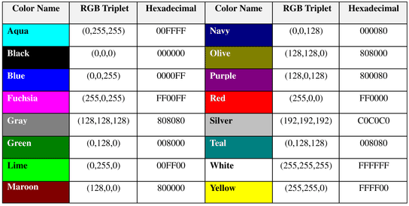
16 Basic Colors

Slide 28
Color Codes
WHITE
BLACK
RED
GREEN
BLUE
MAGENTA
CYAN
YELLOW
AQUAMARINE
BAKER’S CHOCOLATE
VIOLET
BRASS
COPPER
PINK
ORANGE
#FFFFFF
#000000
#FF0000
#00FF00
#0000FF
#FF00FF
#00FFFF
#FFFF00
#70DB93
#5C3317
#9F5F9F
#B5A642
#B87333
#FF6EC7
#FF7F00

Slide 29
Color Codes
If you require more information about color values, there is an excellent site entitled “VGDesign’s Interactive Color Cube” that displays the background color code when you put your cursor over a small color sample. The Web address is :
http://www.vgdesign.com/color.html

Slide 30
The Body Element
The BODY element of a web page is an important element in regards to the page’s appearance. Here are the attributes of the BODY tag to control all the levels:
TEXT="#RRGGBB" to change the color of all the text on the page (full page text color.)
This element contains information about the page’s background color, the background image, as well as the text and link colors.

Slide 31
Background Color
It is very common to see web pages with their background color set to white or some other colors.
To set your document’s background color, you need to edit the <BODY> element by adding the BGCOLOR attribute. The following example will display a document with a white background color:
<BODY BGCOLOR=“#FFFFFF”></BODY>

Slide 32
TEXT Color
The TEXT attribute is used to control the color of all the normal text in the document. The default color for text is black. The TEXT attribute would be added as follows:
<BODY BGCOLOR=“#FFFFFF” TEXT=“#FF0000”></BODY>
In this example the document’s page
color is white and the text would be red.

Slide 33
LINK, VLINK, and ALINK
These attributes control the colors of the different link states:
1. LINK – initial appearance – default = Blue.
2. VLINK – visited link – default = Purple.
3. ALINK –active link being clicked–default= Yellow.
The Format for setting these attributes is:
<BODY BGCOLOR=“#FFFFFF” TEXT=“#FF0000” LINK=“#0000FF”
VLINK=“#FF00FF”
ALINK=“FFFF00”> </BODY>

Slide 34
Using Image Background
The BODY element also gives you ability of setting an image as the document’s background.
An example of a background image’s HTML code is as follows:
<BODY BACKGROUND=“hi.gif” BGCOLOR=“#FFFFFF”></BODY>

Slide 35
Horizontal Rule, <HR>
The <HR> element causes the browser to display a horizontal line (rule) in your document.
<HR> does not use a closing tag, </HR>.

Slide 36
Horizontal Rule, <HR>
Attribute
Description
Default Value
SIZE
Height of the rule in pixels
2 pixels
WIDTH
Width of the rule in pixels or percentage of screen width
100%
NOSHADE
Draw the rule with a flat look instead of a 3D look
Not set
(3D look)
ALIGN
Aligns the line (Left, Center, Right)
Center
COLOR
Sets a color for the rule (IE 3.0 or later)
Not set

Slide 37
Horizontal Rule, <HR>
<HTML>
<HEAD>
<TITLE> Example Page</TITLE>
</HEAD>
<BODY>
<H1> Heading 1 </H1>
<P>Paragraph 1, <BR>
Line 2 <BR>
<HR>Line 3 <BR>
</P>
</BODY>
</HTML>
Heading 1
Paragraph 1,….
Line 2
___________________________
Line 3

Slide 38
Lists
In this chapter you will learn how to create a variety of lists.
Objectives
Upon completing this section, you should be able to
Create an unordered list.
Create an ordered list.
Create a defined list.
Nest Lists.

Slide 39
List Elements
HTML supplies several list elements. Most list elements are composed of one or more <LI> (List Item) elements.
UL : Unordered List. Items in this list start with a list mark such as a bullet. Browsers will usually change the list mark in nested lists.
<UL>
<LI> List item …</LI>
<LI> List item …</LI>
</UL>
List item …
List item …

Slide 40
List Elements
You have the choice of three bullet types: disc(default), circle, square.
These are controlled in Netscape Navigator by the “TYPE” attribute for the <UL> element.
<UL TYPE=“square”>
<LI> List item …</LI>
<LI> List item …</LI>
<LI> List item …</LI>
</UL>
List item …
List item …
List item …

Slide 41
List Elements
OL: Ordered List. Items in this list are numbered automatically by the browser.
<OL>
<LI> List item …</LI>
<LI> List item …</LI>
<LI> List item …</LI>
</OL>
List item …
List item …
List item
You have the choice of setting the TYPE Attribute to one of five numbering styles.

Slide 42
List Elements
TYPE
Numbering
Styles
1
Arabic numbers
1,2,3, ……
a
Lower alpha
a, b, c, ……
A
Upper alpha
A, B, C, ……
i
Lower roman
i, ii, iii, ……
I
Upper roman
I, II, III, ……

Slide 43
List Elements
You can specify a starting number for an ordered list.
<OL TYPE =“i”>
<LI> List item …</LI>
<LI> List item …</LI>
</OL>
<P> text ….</P>
<OL TYPE=“i” START=“3”>
<LI> List item …</LI>
</OL>

Slide 44
List Elements
List item …
List item …
Text ….
List item …

Slide 45
List Elements
DL: Definition List. This kind of list is different from the others. Each item in a DL consists of one or more Definition Terms (DT elements), followed by one or more Definition Description (DD elements).
<DL>
<DT> HTML </DT>
<DD> Hyper Text Markup Language </DD>
<DT> DOG </DT>
<DD> A human’s best friend!</DD>
</DL>
HTML
Hyper Text Markup Language
DOG
A human’s best friend!

Slide 46
Images
In this chapter you will learn about images and how to place images in your pages.
Objectives
Upon completing this section, you should be able to
Add images to your pages.

Slide 47
Images
<IMG>This element defines a graphic image on the page.
Image File (SRC:source): This value will be a URL (location of the image) E.g. http://www.domain.com/dir/file.ext or /dir/file.txt.
Alternate Text (ALT): This is a text field that describes an image or acts as a label. It is displayed when they position the cursor over a graphic image.
Alignment (ALIGN): This allows you to align the image on your page.

Slide 48
Images
Width (WIDTH): is the width of the image in pixels.
Height (HEIGHT): is the height of the image in pixels.
Border (BORDER): is for a border around the image, specified in pixels.
HSPACE: is for Horizontal Space on both sides of the image specified in pixels. A setting of 5 will put 5 pixels of invisible space on both sides of the image.
VSPACE: is for Vertical Space on top and bottom of the image specified in pixels. A setting of 5 will put 5 pixels of invisible space above and bellow the image.

Slide 49
Some Examples on images
1) <IMG SRC=“jordan.gif“ border=4>
2) <IMG SRC=" jordan.gif" width="60" height="60">
3) <IMG SRC=“jordan.gif" ALT="This is a text that goes with the image">
4) <IMG SRC=" jordan.gif “ Hspace="30" Vspace="10" border=20>
5) < IMG SRC =" jordan.gif“ align="left">
blast blast blast blast blast

Slide 50
Anchors, URLs and Image Maps
In this chapter you will learn about Uniform Resource Locator, and how to add them as Anchor or Links inside your web pages.
Objectives
Upon completing this section, you should be able to
Insert links into documents.
Define Link Types.
Define URL.
List some commonly used URLs.
Plan an Image Map.

Slide 51
HOW TO MAKE A LINK
1) The tags used to produce links are the <A>
and </A>. The <A> tells where the link should start and
the </A> indicates where the link ends. Everything between
these two will work as a link.
2) The example below shows how to make the word
Here work as a link to yahoo.
Click <A HREF="http://www.yahoo.com">here</A> to
go to yahoo.

Slide 52
Image Maps
Image maps are images, usually in gif format that have been divided into regions; clicking in a region of the image cause the web surfer to be connected to a new URL. Image maps are graphical form of creating links between pages.
There are two type of image maps:
Client side and server side
Both types of image maps involve a listing of co-ordinates
that define the mapping regions and which URLs those
coordinates are associated with. This is known as the map
file.

Slide 53
Tables
In this chapter you will learn that tables have many uses in
HTML.
Objectives:
Upon completing this section, you should be able to:
Insert a table.
Explain a table’s attributes.
Edit a table.
Add a table header.

Slide 54
Tables
The <TABLE></TABLE> element has four sub-elements:
Table Row<TR></TR>.
Table Header <TH></TH>.
Table Data <TD></TD>.
Caption <CAPTION></CAPTION>.
The table row elements usually contain table header elements or table data elements.

Slide 55
Tables
<table border=“1”>
<tr>
<th> Column 1 header </th>
<th> Column 2 header </th>
</tr>
<tr>
<td> Row1, Col1 </td>
<td> Row1, Col2 </td>
</tr>
<tr>
<td> Row2, Col1 </td>
<td> Row2, Col2 </td>
</tr>
</table>

Slide 56
Tables
Column 1 Header
Column 2 Header
Row1, Col1
Row1, Col2
Row2, Col1
Row2, Col2

Slide 57
Tables Attributes
BGColor: Some browsers support background colors in a table.
Width: you can specify the table width as an absolute number of pixels or a percentage of the document width. You can set the width for the table cells as well.
Border: You can choose a numerical value for the border width, which specifies the border in pixels.
CellSpacing: Cell Spacing represents the space between cells and is specified in pixels.

Slide 58
Table Attributes
CellPadding: Cell Padding is the space between the cell border and the cell contents and is specified in pixels.
Align: tables can have left, right, or center alignment.
Background: Background Image, will be titled in IE3.0 and above.
BorderColor, BorderColorDark.

Slide 59
Table Caption
A table caption allows you to specify a line of text that will appear centered above or bellow the table.
<TABLE BORDER=1 CELLPADDING=2>
<CAPTION ALIGN=“BOTTOM”> Label For My Table </CAPTION>
The Caption element has one attribute ALIGN that can be either TOP (Above the table) or BOTTOM (below the table).

Slide 60
Table Header
Table Data cells are represented by the TD element. Cells can also be TH (Table Header) elements which results in the contents of the table header cells appearing centered and in bold text.

Slide 61
Table Data and Table Header Attributes
Colspan: Specifies how many cell columns of the table this cell should span.
Rowspan: Specifies how many cell rows of the table this cell should span.
Align: cell data can have left, right, or center alignment.
Valign: cell data can have top, middle, or bottom alignment.
Width: you can specify the width as an absolute number of pixels or a percentage of the document width.
Height: You can specify the height as an absolute number of pixels or a percentage of the document height.

Slide 62
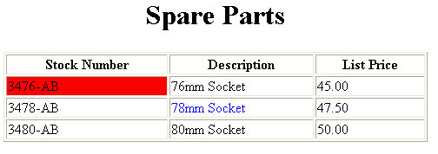
Basic Table Code
<TABLE BORDER=1 width=50%>
<CAPTION> <h1>Spare Parts <h1> </Caption>
<TR><TH>Stock Number</TH><TH>Description</TH><TH>List Price</TH></TR>
<TR><TD bgcolor=red>3476-AB</TD><TD>76mm Socket</TD><TD>45.00</TD></TR>
<TR><TD >3478-AB</TD><TD><font color=blue>78mm Socket</font> </TD><TD>47.50</TD></TR>
<TR><TD>3480-AB</TD><TD>80mm Socket</TD><TD>50.00</TD></TR>
</TABLE>

Slide 63
Table Data and Table Header Attributes
<Table border=1 cellpadding =2>
<tr> <th> Column 1 Header</th> <th> Column 2 Header</th> </tr>
<tr> <td colspan=2> Row 1 Col 1</td> </tr>
<tr> <td rowspan=2>Row 2 Col 1</td>
<td> Row 2 Col2</td> </tr>
<tr> <td> Row 3 Col2</td> </tr>
</table>

Slide 64
Table Data and Table Header Attributes
Column 1 Header
Column 2 Header
Row 1 Col 1
Row 2 Col 1
Row 2 Col 2
Row 3 Col 2

Slide 65
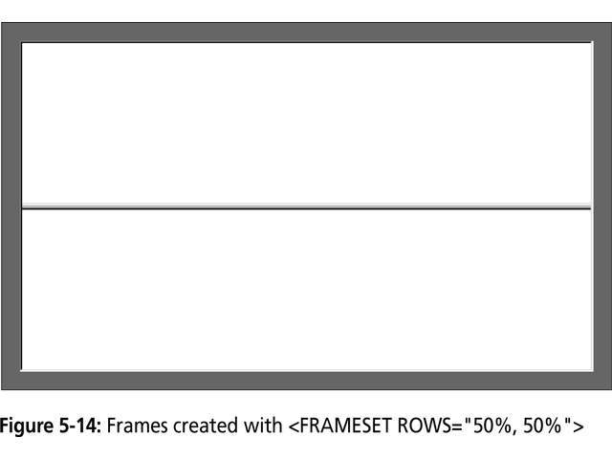

Slide 66
Forms
Forms add the ability to web pages to not only provide the person viewing the document with dynamic information but also to obtain information from the person viewing it, and process the information.
Objectives:
Upon completing this section, you should be able to
Create a FORM.
Add elements to a FORM.
Define CGI (Common Gateway Interface).
Describe the purpose of a CGI Application.
Specify an action for the FORM.
Forms work in all browsers.
Forms are Platform Independent.

Slide 67
Forms
To insert a form we use the <FORM></FORM> tags. The rest of the form elements must be inserted in between the form tags.
<HTML> <HEAD>
<TITLE> Sample Form</TITLE>
</HEAD>
<BODY BGCOLOR=“FFFFFF”>
<FORM ACTION = http://www.xnu.com/formtest.asp>
<P> First Name: <INPUT TYPE=“TEXT” NAME=“fname” MAXLENGTH=“50”> </P>
<P> <INPUT TYPE=“SUBMIT” NAME=“fsubmit1” VALUE=“Send Info”> </P>
</FORM>
</BODY> </HTML>

Slide 68
<FORM> element attributes
ACTION: is the URL of the CGI (Common Gateway Interface) program that is going to accept the data from the form, process it, and send a response back to the browser.
METHOD: GET (default) or POST specifies which HTTP method will be used to send the form’s contents to the web server. The CGI application should be written to accept the data from either method.
NAME: is a form name used by VBScript or
JavaScripts.
TARGET: is the target frame where the response page will show up.

Slide 69
Form Elements
Form elements have properties: Text boxes, Password boxes, Checkboxes, Option(Radio) buttons, Submit, Reset, File, Hidden and Image.
The properties are specified in the TYPE Attribute of the HTML element <INPUT></INPUT>.

Slide 70
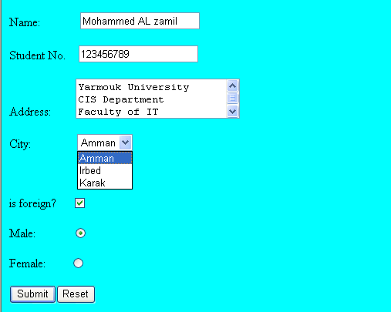
Sami Ali
Al al-Bayt University

Slide 71
Form Elements
<INPUT> Element’s Properties
TYPE= Type of INPUT entry field.
NAME = Variable name passed to CGI application
VALUE= The data associated with the variable
name to be passed to the CGI application
CHECKED= Button/box checked
SIZE= Number of visible characters in text field
MAXLENGHT= Maximum number of characters
accepted.

Slide 72
Text Box
Text boxes: Used to provide input fields for text, phone numbers, dates, etc.
<INPUT TYPE= " TEXT " >
Browser will display
Textboxes use the following attributes:
TYPE: text.
SIZE: determines the size of the textbox in characters. Default=20 characters.
MAXLENGHT : determines the maximum number of characters that the field will accept.
NAME: is the name of the variable to be sent to the CGI application.
VALUE: will display its contents as the default value.

Slide 73
Example on Text Box
<TITLE>Form_Text_Type</TITLE>
</HEAD> <BODY>
<h1> <font color=blue>Please enter the following bioData</font></h1>
<FORM name="fome1" Method= " get " Action= " URL " >
First Name: <INPUT TYPE="TEXT" NAME="FName"
SIZE="15" MAXLENGTH="25"><BR>
Last Name: <INPUT TYPE="TEXT" NAME="LName"
SIZE="15" MAXLENGTH="25"><BR>
Nationality: <INPUT TYPE="TEXT" NAME="Country"
SIZE="25" MAXLENGTH="25"><BR>
The Phone Number: <INPUT TYPE="TEXT" NAME="Phone"
SIZE="15" MAXLENGTH="12"><BR>
</FORM> </BODY> </HTML>

Slide 74
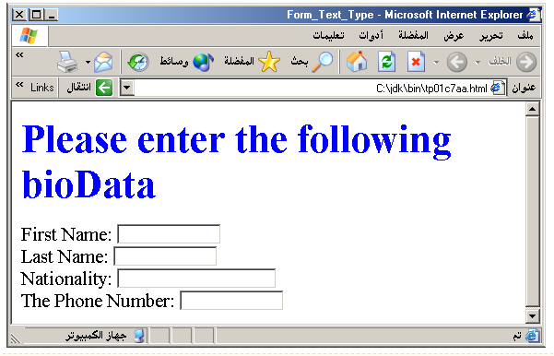
Output

Slide 75
Password
Password: Used to allow entry of passwords.
<INPUT TYPE= " PASSWORD " >
Browser will display
Text typed in a password box is starred out in the browser
display.
Password boxes use the following attributes:
TYPE: password.
SIZE: determines the size of the textbox in characters.
MAXLENGHT: determines the maximum size of the password in characters.
NAME: is the name of the variable to be sent to the CGI application.
VALUE: is usually blank.

Slide 76
Example on Password Box
<HTML><HEAD>
<TITLE>Form_Password_Type</TITLE></HEAD>
<BODY>
<h1> <font color=red>To Access, Please
enter:</font></h1>
<FORM name="fome2" Action="url" method="get">
User Name: <INPUT TYPE="TEXT" Name="FName"
SIZE="15" MAXLENGTH="25"><BR>
Password: <INPUT TYPE="PASSWORD"
NAME="PWord" value="" SIZE="15”
MAXLENGTH="25"><BR>
</FORM></BODY> </HTML>

Slide 77
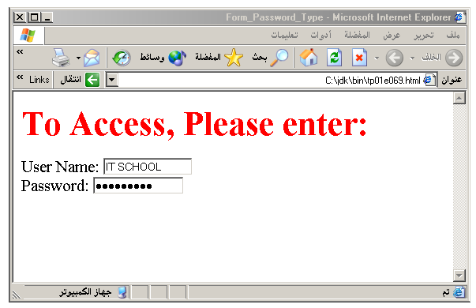
Output

Slide 78
Hidden
Hidden: Used to send data to the CGI application that you don’t want the web surfer to see, change or have to enter but is necessary for the application to process the form correctly.
<INPUT TYPE=“HIDDEN”>
Nothing is displayed in the browser.
Hidden inputs have the following attributes:
TYPE: hidden.
NAME: is the name of the variable to be sent to the CGI application.
VALUE: is usually set a value expected by the CGI application.

Slide 79
Check Box
Check Box: Check boxes allow the users to select more than one option.
<INPUT TYPE=“CHECKBOX”>
Browser will display
Checkboxes have the following attributes:
TYPE: checkbox.
CHECKED: is blank or CHECKED as the initial
status.
NAME: is the name of the variable to be sent to the
CGI application.
VALUE: is usually set to a value.

Slide 80
<HTML> <HEAD><TITLE>CheckBoxType</TITLE> </HEAD>
<BODY>
<h1> <font color=green>Please check one of the following</font></h1>
<FORM name="fome3" Action="url" method="get">
<font color=red> Select Country: </font><BR>
jordan:<INPUT TYPE="CheckBox" Name="country" CHECKED><BR>
Yemen<INPUT TYPE="CheckBox" Name="country"><BR>
Qatar:<INPUT TYPE="CheckBox" Name="country"><BR> <BR>
<font color=blue>Select Language:</font><BR>
Arabic:<INPUT TYPE="CheckBox" Name="language" CHECKED><BR> English:<INPUT TYPE="CheckBox" Name="language"><BR>
French:<INPUT TYPE="CheckBox" Name="language"> <BR></FORM> </BODY></HTML>

Slide 81
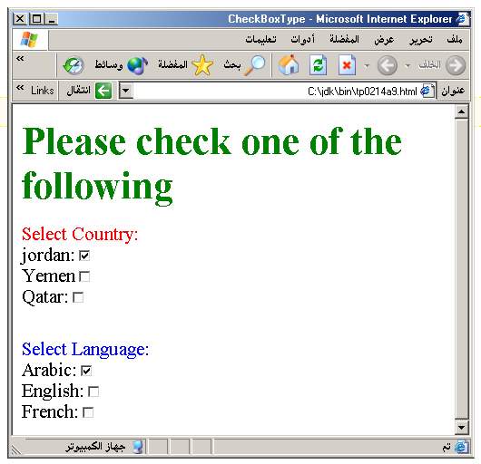
Output

Slide 82
Radio Button
Radio Button: Radio buttons allow the users to select
only one option.
<INPUT TYPE=“RADIO”>
Browser will display
Radio buttons have the following attributes:
TYPE: radio.
CHECKED: is blank or CHECKED as the initial
status. Only one radio button can be
checked
NAME: is the name of the variable to be sent to the
CGI application.
VALUE: usually has a set value.

Slide 83
<HTML> <HEAD><TITLE>CheckBoxType</TITLE> </HEAD>
<BODY>
<h1> <font color=green>Please check one of the following</font></h1>
<FORM name="fome3" Action="url" method="get">
<font color=red> Select Country: </font><BR>
jordan:<INPUT TYPE= "RADIO" Name="country" CHECKED><BR>
Yemen<INPUT TYPE="RADIO " Name="country"><BR>
Qatar:<INPUT TYPE="RADIO" Name="country"><BR> <BR>
<font color=blue>Select Language:</font><BR>
Arabic:<INPUT TYPE="RADIO" Name="language" CHECKED><BR> English:<INPUT TYPE=" RADIO " Name="language"><BR>
French:<INPUT TYPE=" RADIO " Name="language"> <BR></FORM> </BODY></HTML>

Slide 84
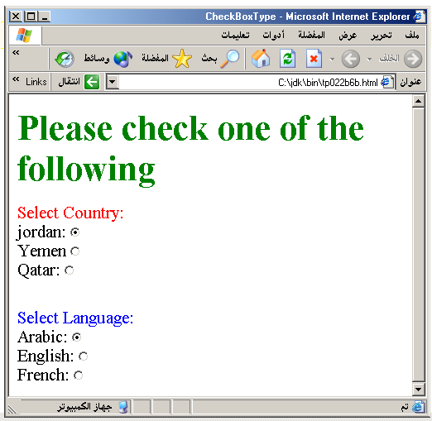

Slide 85
<HTML><HEAD>
<TITLE>RADIOBox</TITLE> </HEAD>
<BODY>
Form #1:
<FORM>
<INPUT TYPE="radio" NAME="choice" VALUE="one"> Yes.
<INPUT TYPE="radio" NAME="choice" VALUE="two"> No.
</FORM>
<HR color=red size="10" >
Form #2:
<FORM>
<INPUT TYPE="radio" NAME="choice" VALUE="three" CHECKED> Yes.
<INPUT TYPE="radio" NAME="choice" VALUE="four"> No.
</FORM>
</BODY></HTML>

Slide 86
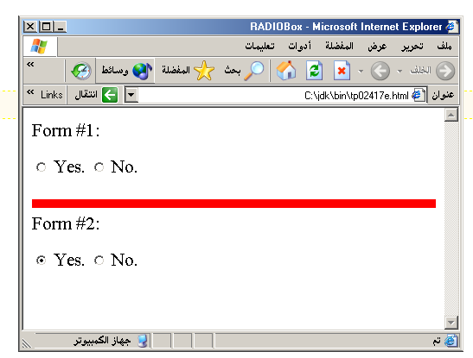
Output

Slide 87
Push Button
Push Button: This element would be used with
JavaScript to cause an action to take place.
<INPUT TYPE=“BUTTON”>
Browser will display
Push Button has the following attributes:
TYPE: button.
NAME: is the name of the button to be used
in scripting.
VALUE: determines the text label on the button.

Slide 88
<DIV align=center><BR><BR>
<FORM>
<FONT Color=red>
<h1>Press Here to see a baby crying:<BR>
<INPUT TYPE="button" VALUE="PressMe"><BR><BR>
<FONT Color=blue>
Click Here to see a baby shouting:<BR>
<INPUT TYPE="button" VALUE="ClickMe" > <BR><BR>
<FONT Color=green>
Hit Here to see a baby eating:<BR>
<INPUT TYPE="button" VALUE="HitME" > <BR><BR>
<FONT Color=yellow>
</FORM></DIV>

Slide 89
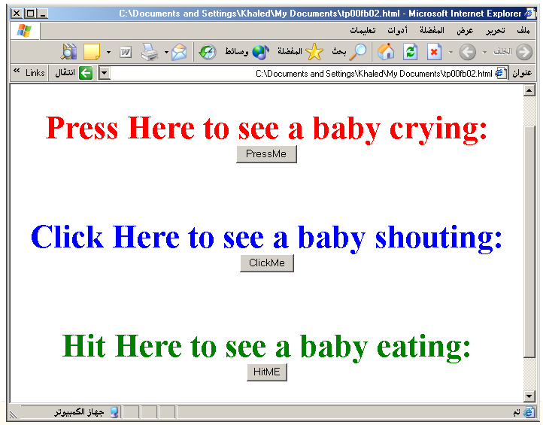

Slide 90
Submit Button
Submit: Every set of Form tags requires a Submit button. This is the element causes the browser to send the names and values of the other elements to the CGI Application specified by the ACTION attribute of the FORM element.
<INPUT TYPE=“SUBMIT”>
The browser will display
Submit has the following attributes:
TYPE: submit.
NAME: value used by the CGI script for processing.
VALUE: determines the text label on the button, usually Submit Query.

Slide 91
<FORM Action="URL" method="get">
First Name: <INPUT TYPE="TEXT" Size=25 name="firstName"><BR>
Family Name: <INPUT TYPE="TEXT" Size=25 name="LastName"><BR>
<BR>
<FONT Color=red>
Press Here to submit the data:<BR>
<INPUT TYPE="submit" VALUE="SubmitData " >
</FORM>

Slide 92
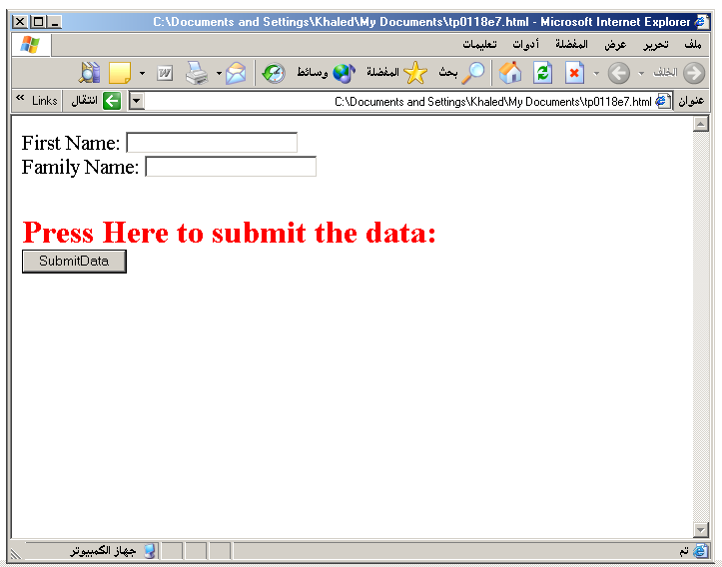

Slide 93
Reset Button
Reset: It is a good idea to include one of these for each form where users are entering data. It allows the surfer to clear all the input in the form.
<INPUT TYPE=“RESET”>
Browser will display
Reset buttons have the following attributes:
TYPE: reset.
VALUE: determines the text label on the button, usually Reset.

Slide 94
<FORM Action="URL" method="get">
First Name: <INPUT TYPE="TEXT" Size=25 name="firstName"> <BR>
Family Name: <INPUT TYPE="TEXT" Size=25 name="LastName"><BR>
<BR>
<FONT Color = red>
<STRONG><font size=5>Press Here to submit the data:</font></STRONG><BR>
<INPUT TYPE="submit" VALUE="SubmitData">
<INPUT TYPE="RESET" VALUE="Reset">
</FORM>

Slide 95
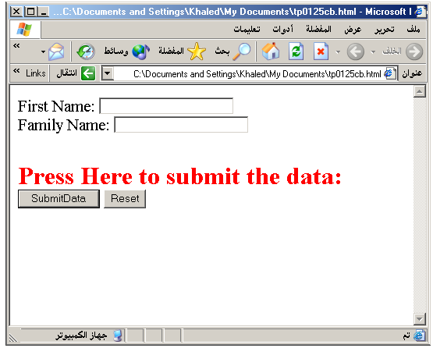

Slide 96
Image Submit Button
Image Submit Button: Allows you to substitute an image for the standard submit button.
<INPUT TYPE=“IMAGE” SRC=“jordan.gif”>
Image submit button has the following attributes:
TYPE: Image.
NAME: is the name of the button to be used in scripting.
SRC: URL of the Image file.

Slide 97
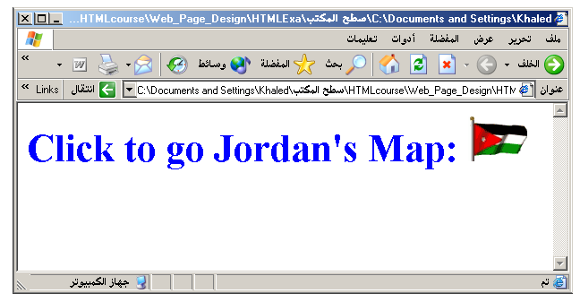
<form> <H1><font color=blue> Click to go Jordan’s Map: <INPUT TYPE="IMAGE" SRC="jordan.gif"> </form>

Slide 98
File
File Upload: You can use a file upload to allow surfers to upload files to your web server.
<INPUT TYPE=“FILE”>
Browser will display
File Upload has the following attributes:
TYPE: file.
SIZE: is the size of the text box in characters.
NAME: is the name of the variable to be sent to the
CGI application.
MAXLENGHT: is the maximum size of the input in the
textbox in characters.

Slide 99
<BODY bgcolor=lightblue>
<form>
<H3><font color=forestgreen>
Please attach your file here to for uploading to
My <font color =red>SERVER...<BR>
<INPUT TYPE="File" name="myFile" size="30">
<INPUT TYPE="Submit" value="SubmitFile">
</form>
</BODY>

Slide 100
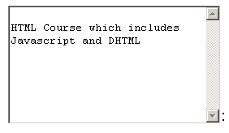
Other Elements used in Forms
<TEXTAREA></TEXTAREA>: is an element that allows for free form text entry.
Browser will display
Textarea has the following attributes:
NAME: is the name of the variable to be sent to the CGI application.
ROWS: the number of rows to the textbox.
COLS: the number of columns to the textbox.

Slide 101
<BODY bgcolor=lightblue>
<form>
<TEXTAREA COLS=40 ROWS=20 Name="comments" >
From observing the apathy of those
about me during flag raising I
concluded that patriotism if not
actually on the decline is at least
in a state of dormancy.
Written by Khaled Al-Fagih
</TEXTAREA>:
</form>
</BODY>

Slide 102
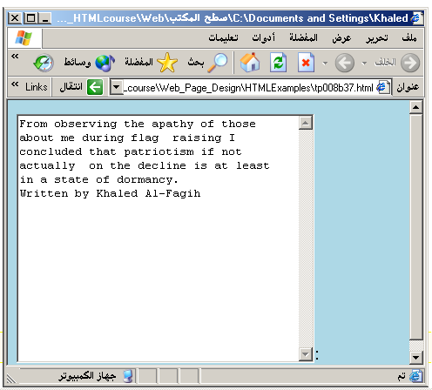

Slide 104
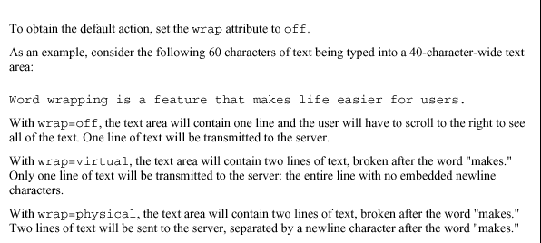

Slide 105
Other Elements used in Forms
The two following examples are <SELECT></SELECT> elements, where the attributes are set differently.
The Select elements attributes are:
NAME: is the name of the variable to be sent to the CGI application.
SIZE: this sets the number of visible choices.
MULTIPLE: the presence of this attribute signifies that the user can make multiple selections. By default only one selection is allowed.

Slide 106
<BODY bgcolor=lightblue>
<form>
Select the cities you have visited:
<SELECT name=“list” size=5>
<option> London</option>
<option> Tokyo</option>
<option> Paris</option>
<option> New York</option>
<option> LA</option>
<option> KL</option>
</SELECT>
</form>
</BODY>

Slide 107
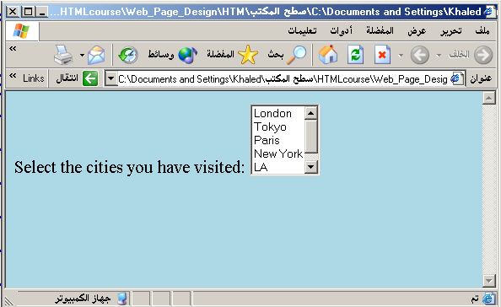

Slide 108
Other Elements used in Forms
Drop Down List:
Name: is the name of the variable to be sent to the CGI application.
Size: 1.

Slide 109
Other Elements used in Forms
List Box:
Name: is the name of the variable to be sent to the CGI application.
SIZE: is greater than one.

Slide 110
Other Elements used in Forms
Option
The list items are added to the <SELECT> element by inserting <OPTION></OPTION> elements.
The Option Element’s attributes are:
SELECTED: When this attribute is present, the option is selected when the document is initially loaded. It is an error for more than one option to be selected.
VALUE: Specifies the value the variable named in the select element.

Slide 111
</HEAD>
<BODY>
<h2><font color=blue>What type of Computer do you have?</font><h2>
<FORM>
<SELECT NAME="ComputerType" size=4>
<OPTION value="IBM" SELECTED> IBM</OPTION>
<OPTION value="INTEL"> INTEL</OPTION>
<OPTION value=" Apple"> Apple</OPTION>
<OPTION value="Compaq"> Compaq</OPTION>
</SELECT>
</FORM></BODY></HTML>

Slide 112
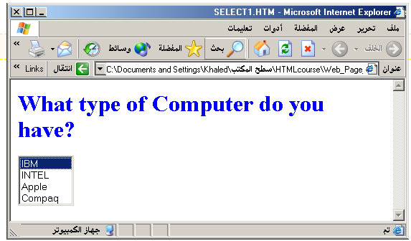

Slide 113
<HEAD> <TITLE>SELECT with Mutiple </TITLE> </HEAD>
<BODY>
<h2><font color=blue>What type of Computer do you have?</font><h2>
<FORM>
<SELECT NAME="ComputerType" size=5 multiple>
<OPTION value="IBM" > IBM</OPTION>
<OPTION value="INTEL"> INTEL</OPTION>
<OPTION value=" Apple"> Apple</OPTION>
<OPTION value="Compaq" SELECTED> Compaq</OPTION>
<OPTION value=" other"> Other</OPTION>
</SELECT>
</FORM></BODY></HTML>

Slide 114
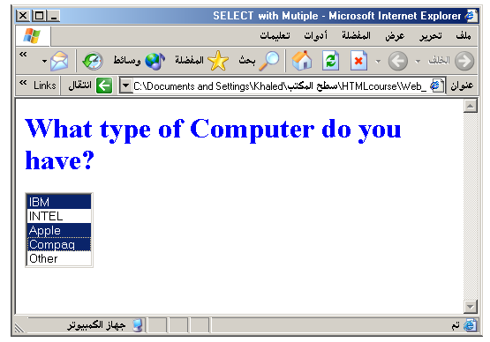

Slide 115
