Slide 1
WELCOME
Md. Alamgir Hossain(ass: teacher ict) Rahimapur Fazil Madrasha, Patnitala,Naogaon. Mob: 01723626108

Slide 2
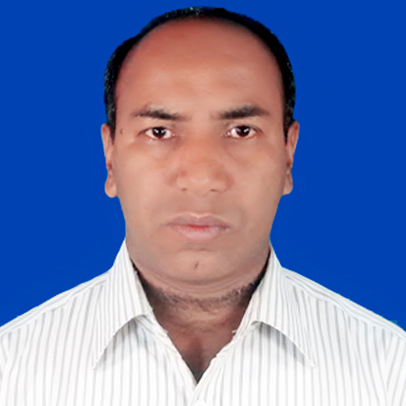
Presented by
Md. Alamgir Hossain
(ICT Teacher)
Rahimapur Fazil Madrasah, Patnitala, Naogaon.
Cell : 01723-626108
E-mail : alamgirchz@gmail.com
Date – 28/10/2020
Md. Alamgir Hossain(ass: teacher ict) Rahimapur Fazil Madrasha, Patnitala,Naogaon. Mob: 01723626108

Slide 3
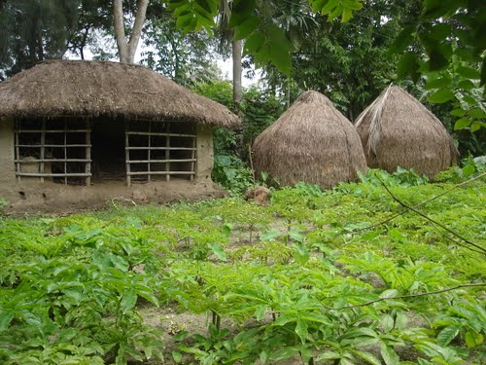
The boy lives this hut.
Subject
1
Verb
2
Object 3
This hut is lived by the boy
Verb
2
Subject
3
Object
3
Md. Alamgir Hossain(ass: teacher ict) Rahimapur Fazil Madrasha, Patnitala,Naogaon. Mob: 01723626108

Slide 4
Lesson Identity
VOICE
Class Six,Seven, Eight,Nine, Ten.
Md. Alamgir Hossain(ass: teacher ict) Rahimapur Fazil Madrasha, Patnitala,Naogaon. Mob: 01723626108

Slide 5
Learning outcomes
identify the definition of the Voice
identify the classification of voice
identify the structures of active and passive voice
change voice from active to passive
Md. Alamgir Hossain(ass: teacher ict) Rahimapur Fazil Madrasha, Patnitala,Naogaon. Mob: 01723626108

Slide 6
Imperative sentence এর voice
Rule (1):
(i) শুধু মাত্র মূল verb দিয়ে শুরু হয় এমন active voice কে passive voice এ রুপান্তর করার নিয়ম-
Structure:
Let + object এর subject + be + verb এর past participle form
যেমন :-
Active: Close the door.
Passive:
Let
the door
be
closed.
Active: Shut the windrow.
Passive:
Let
the windrow
be
shut.
Md. Alamgir Hossain(ass: teacher ict) Rahimapur Fazil Madrasha, Patnitala,Naogaon. Mob: 01723626108

Slide 7
(ii) Do not + P.v দিয়ে শুরু হয় এমন active voice কে passive voice এ রুপান্তর করার নিয়ম-
Structure:
Let not + object এর subject + be + verb এর past participle form
যেমন :-
Active: Do not close the door.
Passive:
Let not
the door
be
closed.
Active: Do not shut the window.
Passive:
Let not
the windrow
be
shut.
Md. Alamgir Hossain(ass: teacher ict) Rahimapur Fazil Madrasha, Patnitala,Naogaon. Mob: 01723626108

Slide 8
(iii) Never + P.V যুক্ত active voice কে passive voice এ রুপান্তর করার নিয়ম-
Structure:
Let not + object এর subject + ever be + verb এর past participle form
যেমন :-
Active: Never tell a lie.
Passive:
Let not
a lie
ever be
told.
Active: Never do this.
Passive:
Let not
this
ever be
done.
Md. Alamgir Hossain(ass: teacher ict) Rahimapur Fazil Madrasha, Patnitala,Naogaon. Mob: 01723626108

Slide 9
(2) Let এর পর যদি কোন ব্যক্তিবাচক object (me, us, you, them, him, her) থাকে এবং তা যদি Imperative sentence হয়, তাহলে active voice কে passive voice এ রুপান্তর করার নিয়ম-
Structure:
Let + শেষের object এর subject + be + verb এর past participle form + by + উক্ত ব্যক্তিবাচক object.
যেমন :-
Active: Let me play football.
Passive:
Let
the football
be
played
by
me.
Active: Let us sing a song.
Passive:
Let
a song
be
sung
by
us.
Md. Alamgir Hossain(ass: teacher ict) Rahimapur Fazil Madrasha, Patnitala,Naogaon. Mob: 01723626108

Slide 10
(3) মূল verb এর পর যদি কোন ব্যক্তিবাচক object (me, us, you, them, him, her) থাকে এবং তা যদি Imperative sentence হয়, তাহলে active voice কে passive voice এ রুপান্তর করার নিয়ম-
Structure:
Let + শেষের object টি বসবে + be + verb এর past participle form + for + উক্ত ব্যক্তিবাচক object.
যেমন :-
Active : Buy me a shirt.
Passive:
Let
be
a shirt
bought
for
me.
Active: Give me a glass of water.
Passive:
Let
a glass of water
be
given
for
me.
Md. Alamgir Hossain(ass: teacher ict) Rahimapur Fazil Madrasha, Patnitala,Naogaon. Mob: 01723626108

Slide 11
Individual work
learn English.
make a team.
sing a song .
buy a book.
do the work.
Md. Alamgir Hossain(ass: teacher ict) Rahimapur Fazil Madrasha, Patnitala,Naogaon. Mob: 01723626108

Slide 12
Evaluation:
CHANGE THE FOLLOWING SENTENCES IN PASSIVE VOICE
write a letter
cook food.
help karim.
Make a garden.
Md. Alamgir Hossain(ass: teacher ict) Rahimapur Fazil Madrasha, Patnitala,Naogaon. Mob: 01723626108

Slide 13
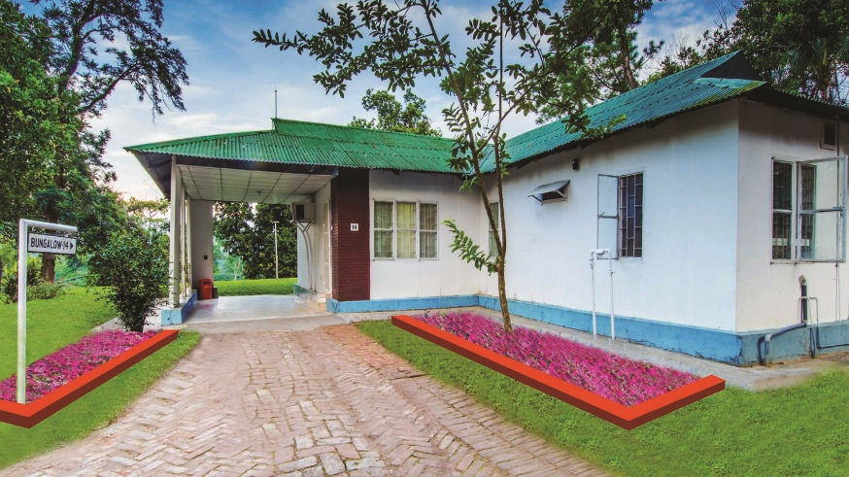
Home Task
(a) type a letter.
(b) play football.
(c) read the book...
Md. Alamgir Hossain(ass: teacher ict) Rahimapur Fazil Madrasha, Patnitala,Naogaon. Mob: 01723626108

Slide 14
বিদায়
Md. Alamgir Hossain(ass: teacher ict) Rahimapur Fazil Madrasha, Patnitala,Naogaon. Mob: 01723626108

