Slide 1
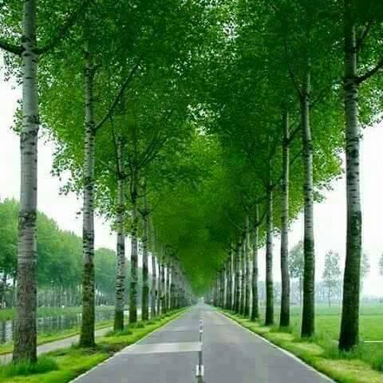
Wellcome to my English class.

Slide 2
Good morning students
How are you doing today ?

Slide 3
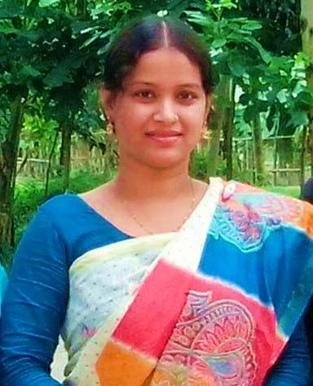
Teacher’identy
Kamrunnaher
Assistant teacher
Sreerampor purbopara govt.prymary school.
Raipura-Narsingdi

Slide 4
Lesson’s identy
Class: Four
Subject : English
Unit : 1 About me
Lesson 1-2 (B)

Slide 5
Learning outcomes-
Listening
1.1.1 Recognize sound differences in the context words.
1.4.1 recognize and use intonation petters for Wh or yes no questions,greetings and statements.
3.1.1 Understand questions asked by the teacher and students .
3.4.1 Understand statements made by the teacher and students
Speaking
3.1.1 ask and answer Wh questions

Slide 6
Everybody stand up. Now we will sing the greeting song hello hello….start

Slide 7
What is this ?
This is our
‘ English for Today’ Textbook
Say the name 5 times

Slide 8
Hello! dear students.
My name is Kamrunnaher.
I am your English teacher

Slide 9
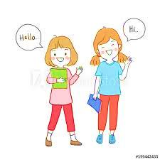
Now come here 2 students
Now start your introducing use Name , age , class , school
At first you will start hello ! I am …..

Slide 10
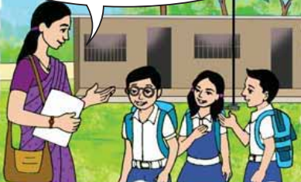
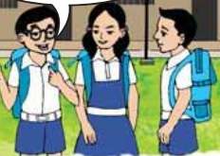
What do you understand to see these picture?
Teacher say somethings with her students.
A boy say something with his friends.

Slide 11
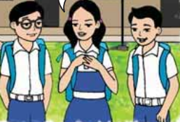
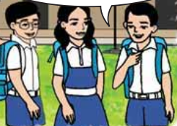
What do you understand to see these picture?
A girl say something with her friends.
A boy say something with his friends.

Slide 12
Now we will listen a audio very cearfully

Slide 13
Do you remember ,what we have to say when introducing someone ?
When introducing yourself, you have to mention your name, age, in which class you are studing in the school, where are you live, from.

Slide 14
We have to use when we want to know introduce any student
What is your name ?
How old are you ?
What is your school’s name ?
What class are you in ?
Where are you from?
Where do you live ?
We will practice these question

Slide 15
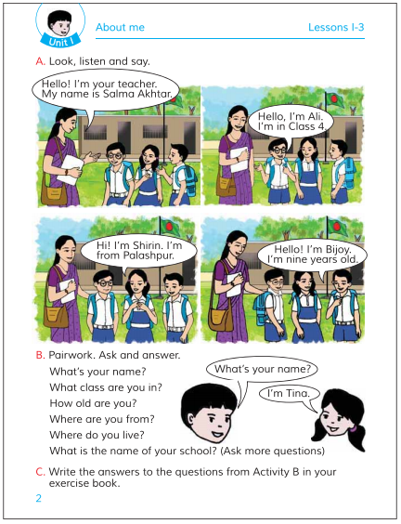
Open your English book at page no 2
Now I will ask you activity B and you will answer me

Slide 16
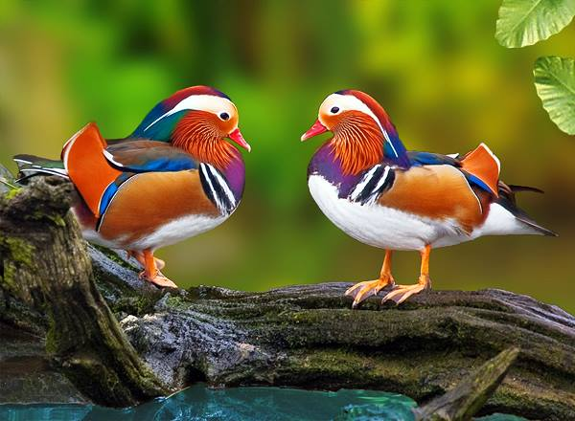
Pair work
Now you will practice between 2 students about activity B’s questions of your book.

Slide 17
Now I introduce myself
I am Kamrunnaher.
I am 34 years old.
I am your English teacher.
I work in a primary school.

Slide 18
Group work
First we will be divided into five groups
Now you will give our introduce with chain drill activity.
We will introduce ourself one by one from the first one

Slide 19
One day one word
Introduce –
পরিচয়
Now I will introduce myself

Slide 20
Home work
Write 10 sentence about yourself.

Slide 21
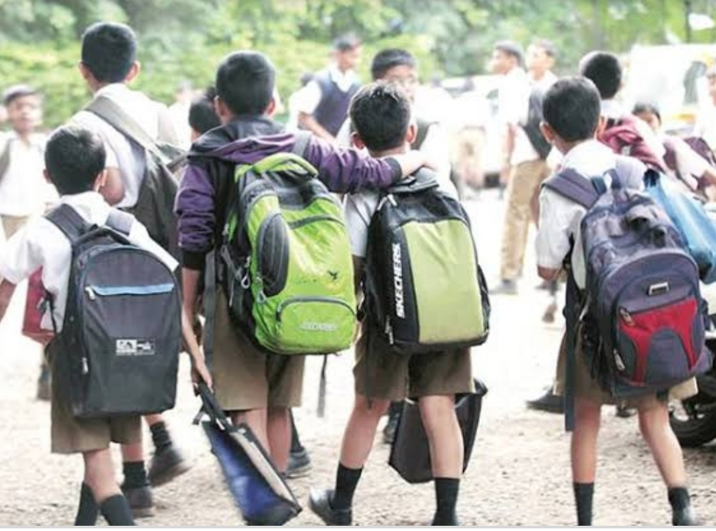
Thank you, that’s all for today
Goodbye, see you tomorrow.

