Slide 1
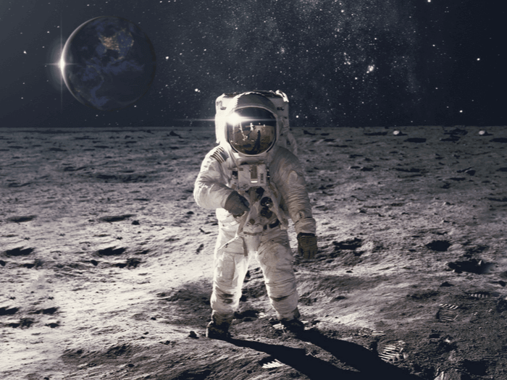
Welcome to the English Class

Slide 2
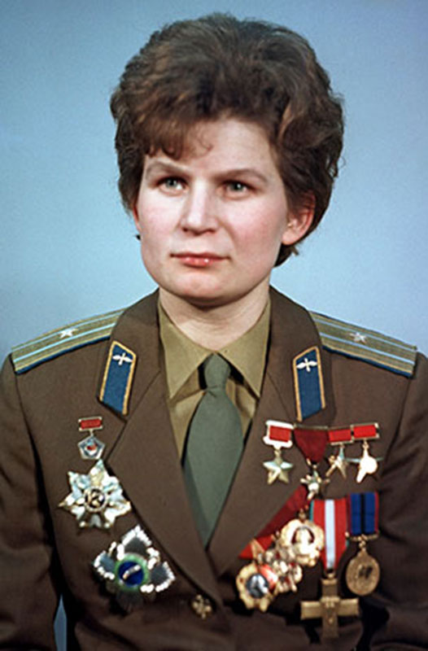
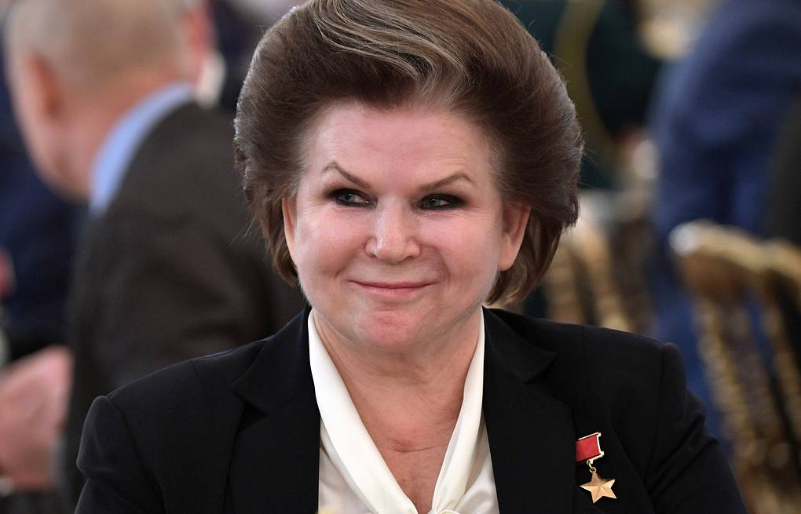
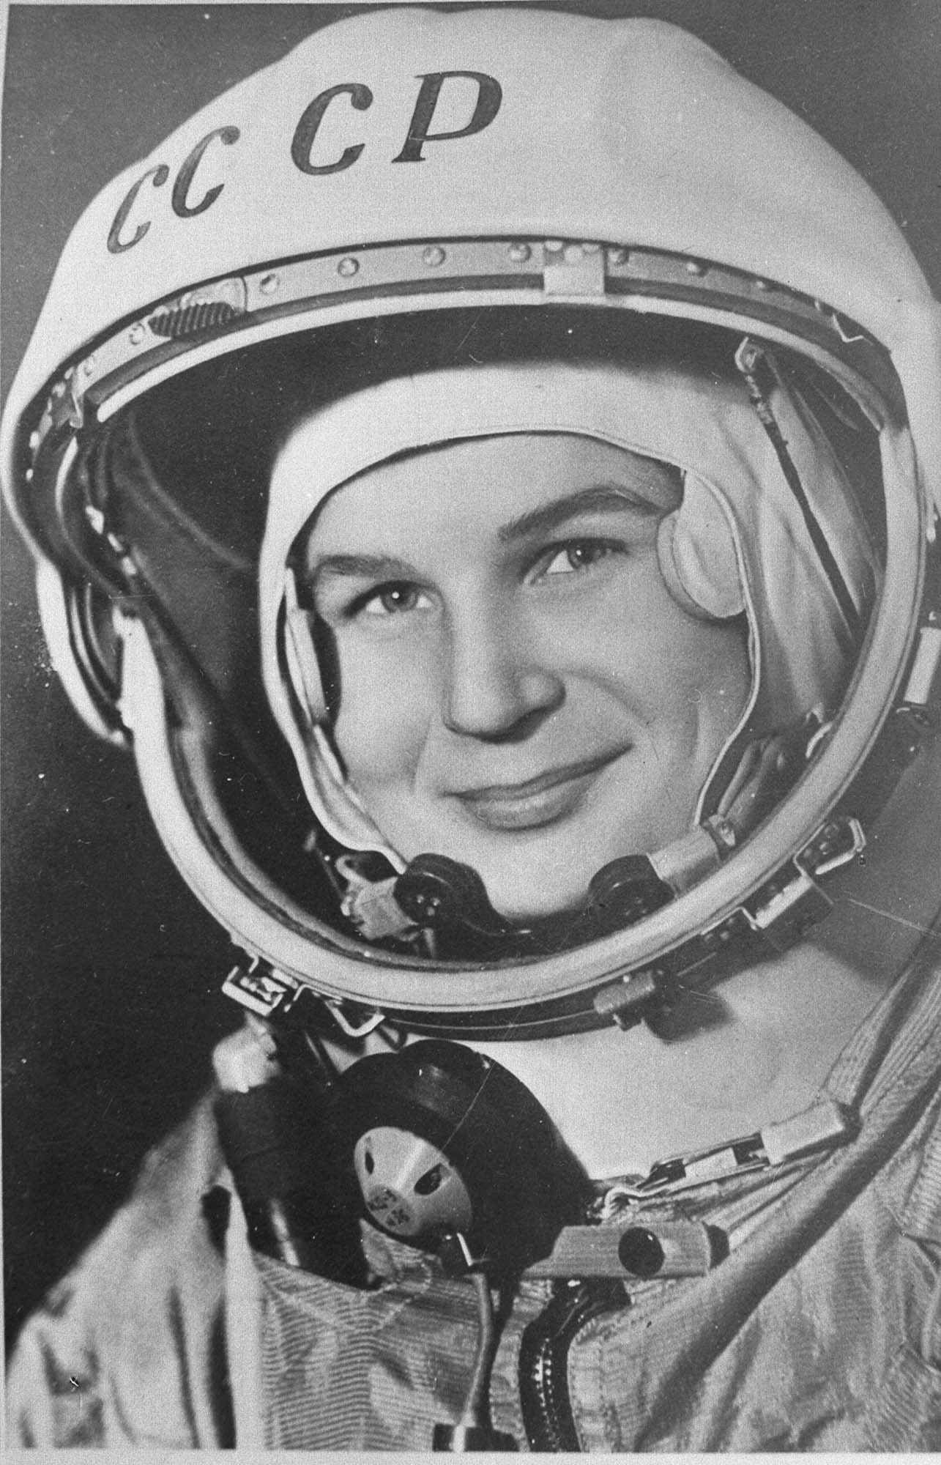
Whom do you see in the pictures?

Slide 3
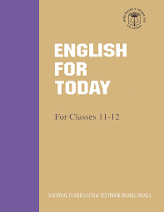
Identity
English 1st Paper
Class : 11-12
Unit : 1
Lesson : 3
Time : 50min
Parvin Akter
Lecturer, English
Rampur Ideal Alim Madrasah
Kamranga, Sadar, Chandpur
Cell: 01718295712
E-mail: parvinakter1335@gmail.com

Slide 4
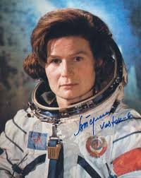
Today our topic is
“Valentina Tereshkova”
Two Women
Unit : 1
Lesson : 3
Time :50 mins.

Slide 5
Learning Outcomes
By the end of the lesson students will be able to -
Tell about Valentina Tereshkova
Read and understand the text
Say some new words.
Ask and answer the questions.
Write summary.

Slide 6
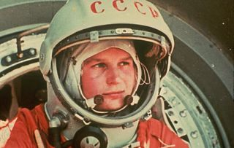
Let’s know about Valentina Tereshkova
Birth of Valentina Tereshkova
Valentina was born in the village Maslennikovo , Tutayevsky District, in Central Russia on March 06, 1937 .

Slide 7
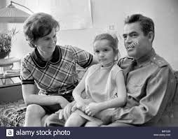
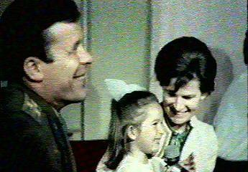
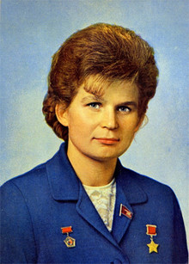
Parents of Valentina Tereshkova
Valentina’s father was a tractor Driver & her mother worked in a textile plant .

Slide 8
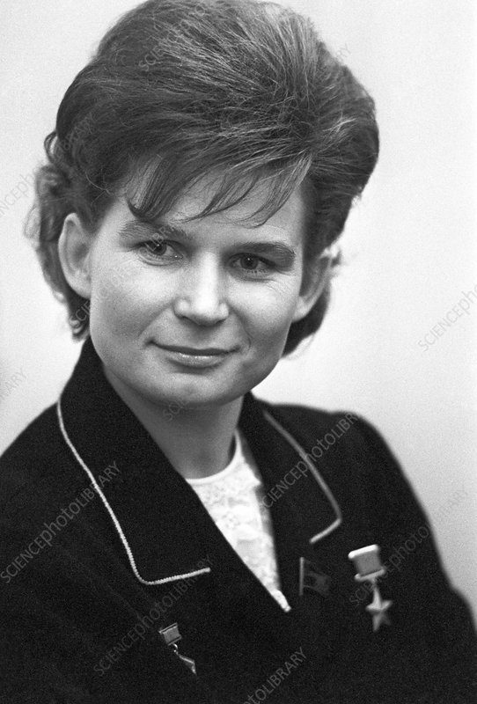
Education of Valentina Tereshkova
Valentina started her education in 1945 at the age of eight .

Slide 9
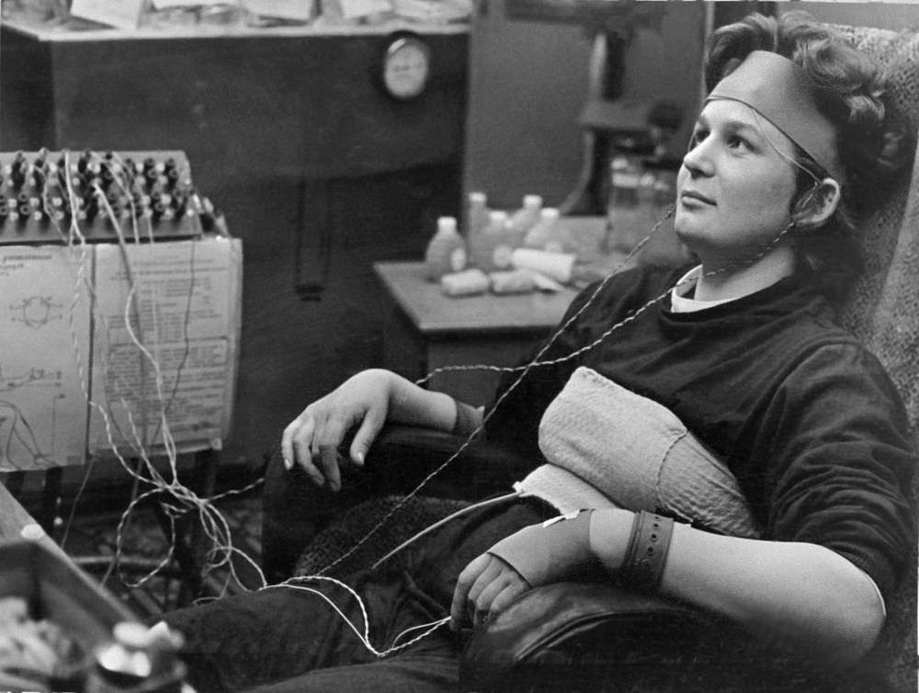
Distance Learning of Valentina Tereshkova
Valentina left school in 1953 & continued her education through distance learning .

Slide 10
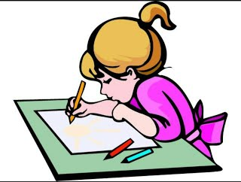
Individual Work
Write five sentences about Valentina Tereshkova.

Slide 11
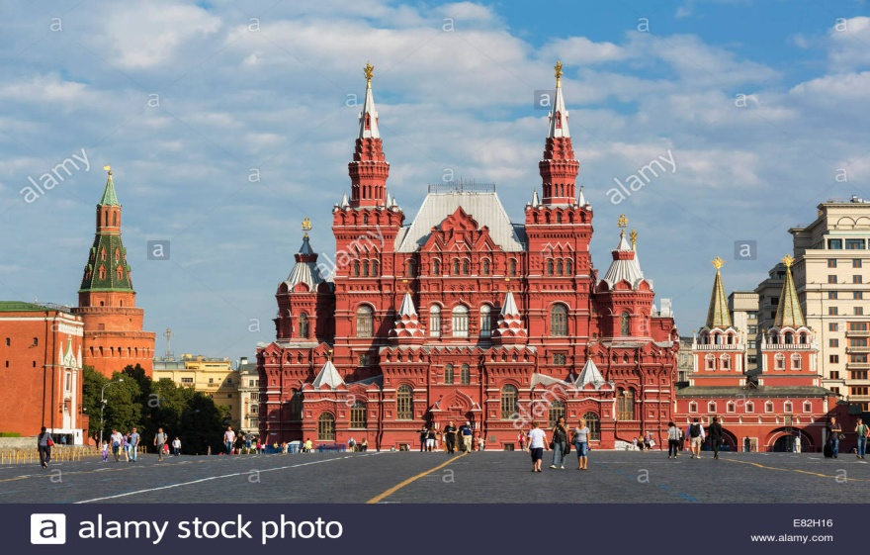
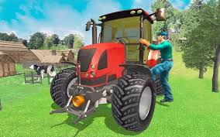
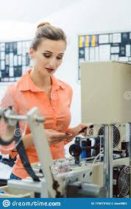
Read the text….
Valentina Tereshkova (born on 6 March 1937)
Valentina Tereshkova was born in the village Maselennikovo, Tutayevsky District, in Central Russia.
Tereshkova’s father was a tractor driver and her mother worked in a textile plant.

Slide 12
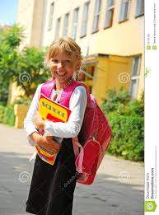
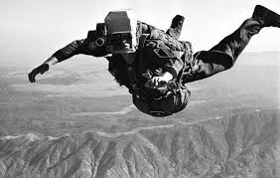
Tereshkova began school in 1945 at the age of eight, but left school in 1953 and continued her education through distance learning.
She became interested in parachuting from young age and trained in skydiving at the local Aeroclub, making her first jump at age 22 on 21 May 1959.

Slide 13
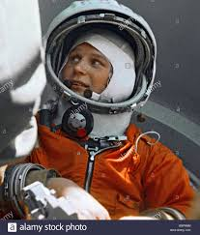
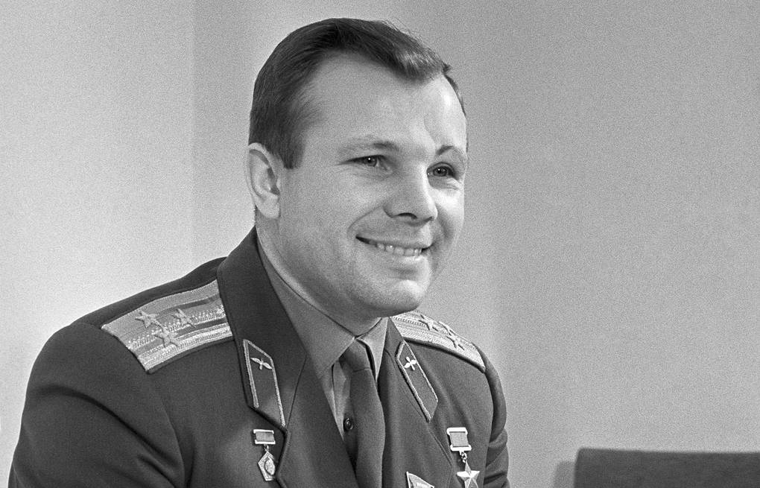
At that time she was employed as a textile worker in a local factory. It was her expertise in skydiving that led to her selection as a cosmonaut.
After the flight of Yuri Gagarin (the first human being to travel to outer space in 1961), the Soviet Union decided to send a woman in space.

Slide 14
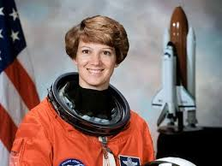
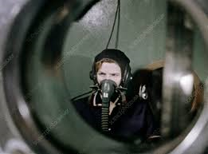
On 16 February 1962, “proletaria” Valentina Tereshkova was selected for this project from among more than four hundred applicants.
Tereshkova had to undergo a series of training that includes weightless flights, isolation tests, centrifuge tests, rocket theory, spacecraft engineering, 120 parachute jumps and pilot training in MiG- 15UTI jet fighters.

Slide 15
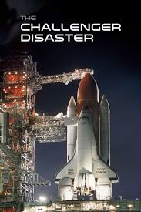
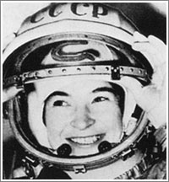
Since the successful launch of the Vostok -5 on 14 June 1963, Tereshkova began preparing for her own flight.
On the morning of June 1963, Tereshkova and her back- up cosmonaut Solovyova were dressed in Space- suits and taken to the space shuttle launch pad by a bus.

Slide 16
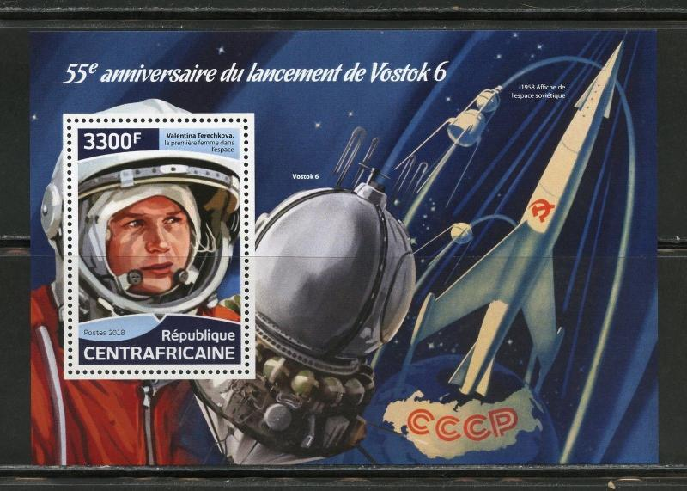
After completing her communication and life support checks, she was sealed inside Vostok 6. Finishing a two- hour countdown, Vostok 6 launched faultlessly.
Although Tereshkova experienced nausea and physical discomfort for much of the flight, she orbited the earth 48 times and sent almost three days in space.

Slide 17
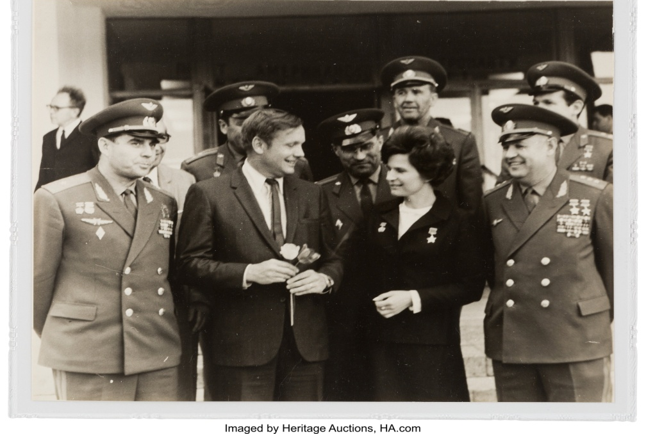
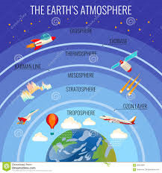
With a single flight, she logged more flight time than the combined times of all American astronauts who have flown before that date.
Tereshkova also maintained a flight log and took photographs of the horizon, which were later used to identify aerosol layers within the atmosphere.

Slide 18
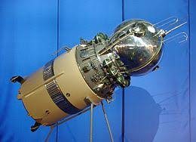
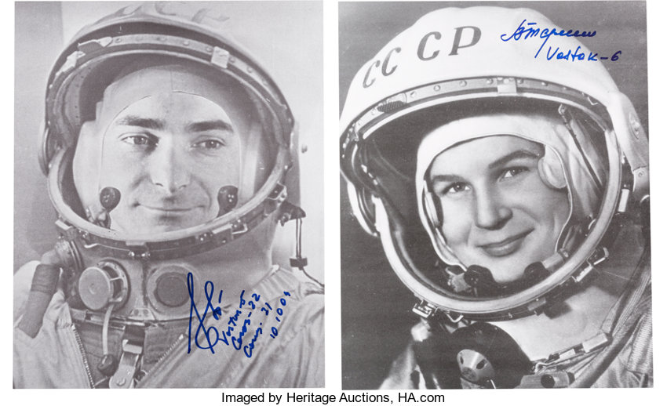
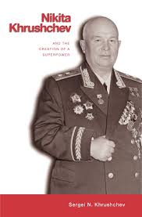
Vostok -6 was the final Vostok flight and was launched two days after Vostok -5, which carried Valary Bykovsy into a similar orbit for five days, landing three hours after Tereshkova.
The two vessels approached each other within 5 kilometers at one point, and from space Tereshkova communicated with Bikovsky and the Soviet Leader Khrushchev by radio.

Slide 19
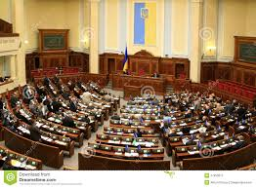
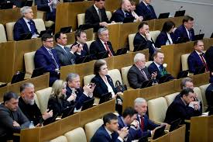
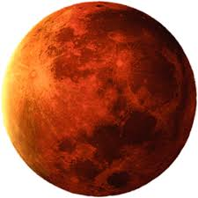
Much later, in 1997 Tereshkova earned a doctorate in Engineering from Zhukovsky Air Force Academy. Afterwards she turned to politics. During the Soviet regime she became one of the presidium members of the Supreme Soviet
Now this living legend is a member in the lower house of the Russian legislature. On her 70th birthday when she was invited by the Russian Prime Minister Vladimir Putin, she expressed her desire to fly to Mars, even if for a one- way trip.

Slide 20
Vocabulary
Word
meaning
Example
The sport of jumping from an aircraft .
Skydiving (n):
Valentina Tereshkova trained skydiving.
Tina wants to be a cosmonaut.
Cosmonaut
A person who is trained to travel in a spacecraft.
Valentina Tereshkova was a proletarian girl.
Proletarian (adj):
A person who has no wealth

Slide 21
Isolation (n)
the process of separating.
Now he is in an isolation.
A machine with a rapidly rotating container
She had taken centrifuge tests.
Centrifuge
A vehicle used for travelling in space.
She launched in the spacecraft.
Spacecraft
Tereshkova became interested in parachuting from a young age.
Parachuting
To jump from an aircraft using a parachute.

Slide 22
5 minutes
Pair Work
Make a flow chart finding out the historical importance of the mentioned years in the text. First one has been done.
6 March, 1937, birth of Valentina Tereshkova
2
3
4
5
6

Slide 23
Let’s check our answers
1
6 March, 1937, birth of Valentina Tereshkova
2
Went to school in 1945
3
Left school in 1953
4
First jump on 21 May in 1959
5
First journey in space in 1962.
6
Earned doctorate degree in 1977.

Slide 24
Group Work
Time: 4 minutes
Make 3 groups and distribute these 6 questions in these groups
Answer the questions.
What led to the selection of Tereshkova as a cosmonaut?
What can you say about trainings Tereshkova took?
Who was the first human being to fly to outer space?
Where and when was Tereshkova born?
Briefly discuss Tereshkova’s experience in Vostok-6?
What did she express on her 70th birthday?

Slide 25
Evaluation
Fill in the blanks
Tereshkova is (a) ____ first woman (b)_____fly in space. (c) ____ on completing distance learning she took training in (d) ______ that relates to (e)_______. (f) _____ the Soviet Union had taken the decision to send a woman in space, she was selected for this project. So, (g) _______ Tereshkova had a chance to (h) ______ . Still today she is very (i) ______as she wants to (j)________ Mars.
Match the answers
(a) the , (b) to, (c) Just, (d) skydiving, (e) parachuting, (f) After, (g) proletariat ,( h) grasp, (i) daring, ( j) conquer

Slide 26
Home Work
Write summary of above text in 50 words.

Slide 27
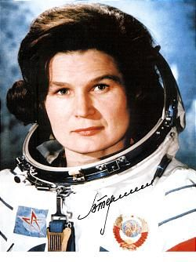
Thanks to all

