Slide 2
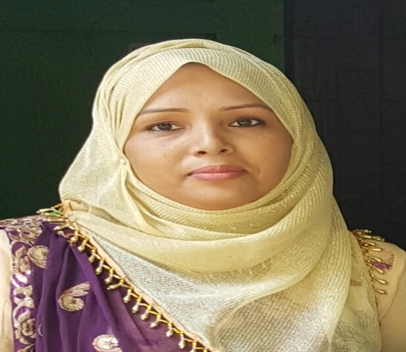
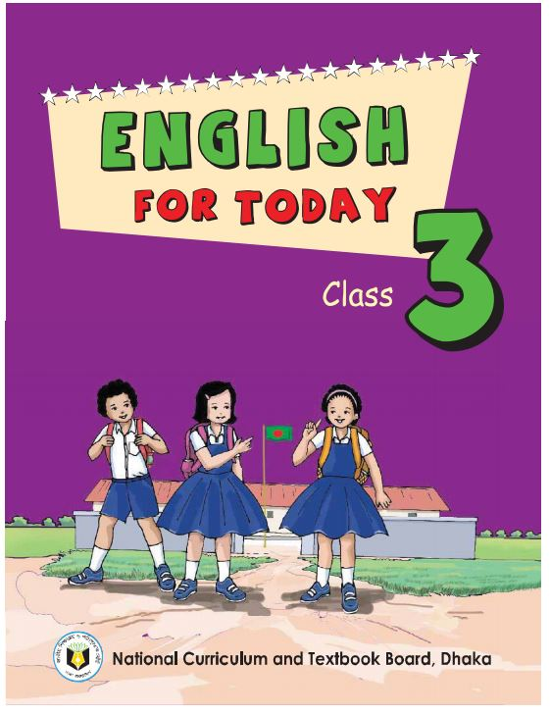
Identity
ACHIA BEGUM
Head Teacher
Uttarsur K.C. Govt. Primary School
Sreemangal , Moulvibazar.
English For Today
Class-Three

Slide 3
Let’s enjoy a video…

Slide 4
Learning outcomes: Students will be able to-
Reading:
7.1.1 recognize punctuation marks and read accrdingly.
Writing:
5.1.1 use full stop.
5.1.2 use comma.
5.1.3 use question mark.
6.1.1 use capital letters for sentence beginnings.
6.1.2 use capital letters for proper nouns.

Slide 5
Today’s lesson
Punctuation and capital letters
Unit:32
Lessons:1-2
Activity:A,B

Slide 6
0pen your English book at pg:64.
What do you see in the picture?

Slide 7
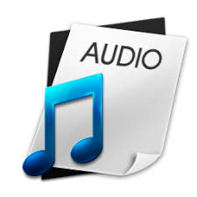
Listen to the audio carefully.
Open your book and put your finger under the line.

Slide 8
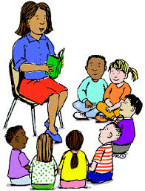
Maliha is Bangladeshi. She comes from Dhaka. Dhaka is the capital of Bangladesh. Maliha lives near the Buriganga River. The river is very big. In June, July and August, there is a lot of rain in Bangladesh.

Slide 9
Pair work
Every pair will read. Teacher will try to see the reading of each pair. Everyone has to make sure to read.

Slide 10
Find the words with capital letters in Activity A. Underline them.
Maliha is Bangladeshi. She comes from Dhaka. Dhaka is the capital of Bangladesh. Maliha lives near the Buriganga River. The river is very big. In June, July and August, there is a lot of rain in Bangladesh.
The first letter of the sentence has to be written with capital letter.

Slide 11
When writing, we use capital letters in some cases.
Country’s name is always written with capital letter.
Bangladesh
India
Nepal

Slide 12
When writing, we use capital letters in some cases.
City’s name is always written with capital letter.
Dhaka
Sylhet
Hobigonj

Slide 13
When writing, we use capital letters in some cases.
People’s name is always written with capital letter.
Maliha
Moury
Komol
Radif

Slide 14
When writing, we use capital letters in some cases.
River’s name is always written with capital letter.
Buriganga
Surma
Kusiara

Slide 15
When writing, we use capital letters in some cases.
Month’s name is always written with capital letter.
June
July
August

Slide 16
When writing, we use capital letters in some cases.
Week’s name is always written with capital letter.
Saturday
Sunday
Monday

Slide 17
When writing, we use capital letters in some cases.
Always write with a capital letter to address someone.
He
She
It

Slide 18
Evaluation
Correct and write the sentences in your note book individually.
1.maliha is bangladeshi
2. she comes from dhaka
3.dhaka is the capital of bangladesh
4. maliha lives near the buriganga river
5.the river is very big

Slide 19
You have to practice activity C at your home.

Slide 20
That’s all for today.

