Slide 1
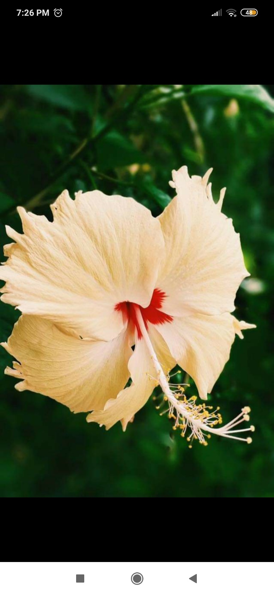
Welcome to my online class.

Slide 2
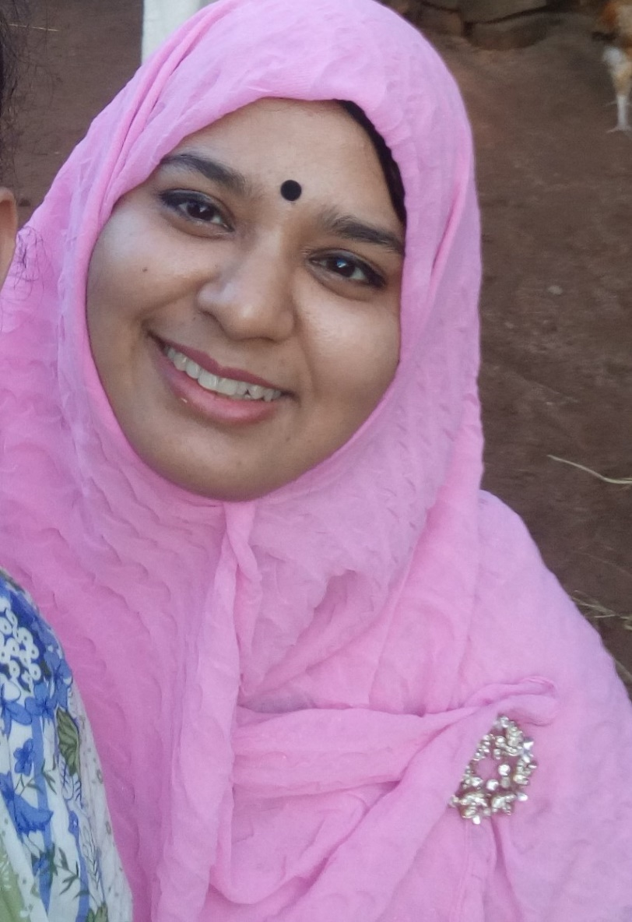
Introduction of teacher.
Syeda Nusrat Sarmin
Assistant Teacher
Ayjuddin GPS
Faridpur Sadar, Faridpur

Slide 3
Introduction of the lesson.
Class: Five
Subject: English
Unit:22
Lesson: 5-6
Activity: F&G,
Page: 88

Slide 4
Learning outcomes
By the end of the lesson the students will be able to
Listening:
3.4.1 understand statements made by the teacher and students.
Reading:
1.7.1 read paragraphs, dialogues, stories, letters and other texts.
5.1.4 read silently with understanding personal letters and other texts materials.
Writing:
3.1.1 write words, phrases and sentences using non-cursive capital letters.
3.1.2 write words, phrases and sentences using non-cursive small letters.
8.1.1 make sentences using words and phrases given in the textbook.

Slide 5
Teaching aids :
Word cards
Poster paper
Slide
CD drive/ audio

Slide 7
No, it’s not.
We have to complete the form.
What do you see in the picture?
Look at the picture.
Is it complete?
It’s a form.

Slide 8
Our today’s lesson is
Completing forms
Unit: 22, Lesson: 3-6, Activity: A,B&C;
Page: 87 & 88

Slide 9
New Words
Promise (v)
Promise – অঙ্গীকার করা/ প্রতিজ্ঞা করা
Promise – Vow; to say that you will certainly do something

Slide 10
New Words
Return (v)
Return – ফিরে আসা/ ফেরত দেওয়া
Return – Give back

Slide 11
New Words
Signature (n)
Signature – দস্তখত
Signature – Initial; one’s name written in one’s own way.

Slide 13
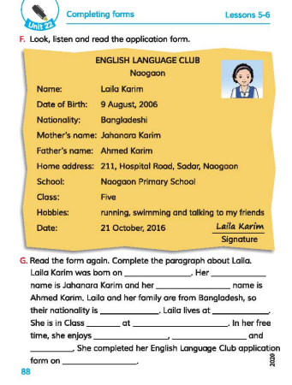

Slide 16
9 August, 2006.
mother’s
father’s
Bangladeshi.
Naogaon
5 (five)
Naogaon Primary School
running
swimming
talking to her friends
21 October, 2020

Slide 17
Evaluation
Write ‘True’ for correct statement or ‘False’ for incorrect statement.
Laila is fond of chess.
Laila dislikes to run in the park.
Bithi likes swimming.
Bithi is not a talkative person.
False
False
False
True

Slide 18
Home Work
Write 10 sentences about
your hobbies.

Slide 19
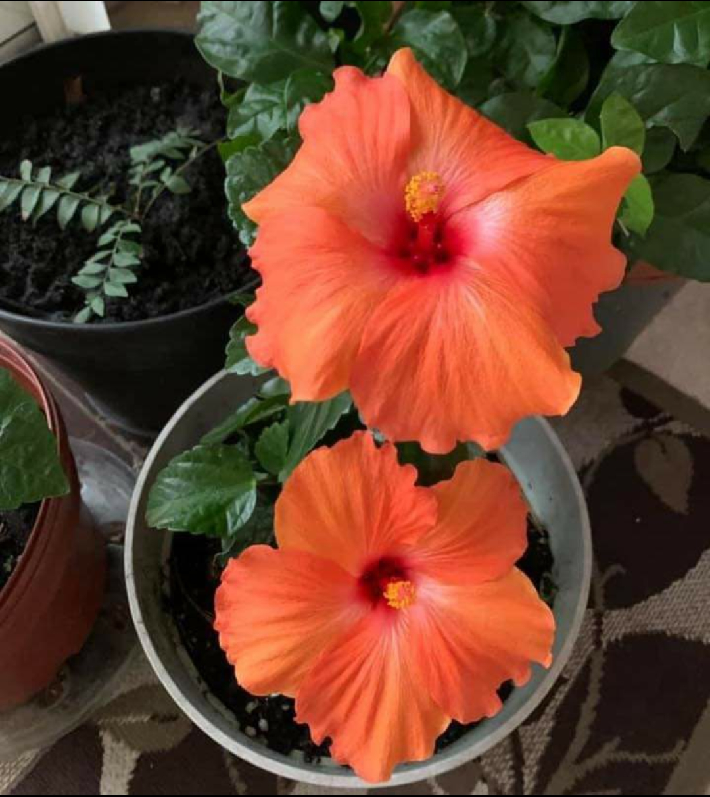
Be Happy.
Good bye, dear students.

