Slide 1
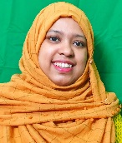
W
E
L
C
O
M
E
Mahia
Rahman
Assistant Teacher
English
Silam P.L High School
B.A Hons
M.A (English)

Slide 3
