Slide 1
Good Morning

Slide 2
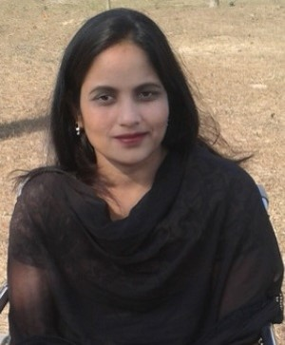
Teacher’s Identitification
Most. Aklima Khatun
Assistent Teacher (English)
Raipur Govt. Primary School
Raipur, Gangni, Meherpur
Phone No: 01735897201
E-mail:aklimameherpur2012@gmail.com

Slide 3
Lesson Identity
Class : Five
Subject : English
Unit : 01
Lesson : 6 -7
Lesson Tittle : Hello !
Page no : 5

Slide 4
Let’s “ Greeting song”

Slide 5
Lesson title
Hello!!

Slide 6
Learning Outcomes:
Students will be able to -
Listenig :
Understand quistions about family and friends of students .
Speaking :
Ask and answer Wh questions.
Reading :
Read paragraphs , dialogues stories , letters and other texts .

Slide 7
Recape discuss class......
Where are Sima and Tamal ?
Who is the new person in the Club ?
Why does Sima want meet the new person ?

Slide 8
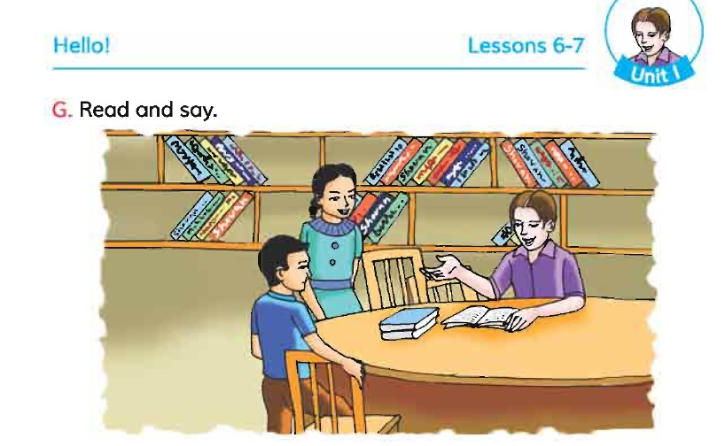
Discuss about the picture ........

Slide 9
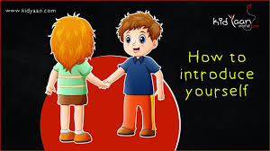
New words
Friend
বন্ধু
Rohim is my best friend .

Slide 10
Sit down
বসা
Sima , please sit down .

Slide 11
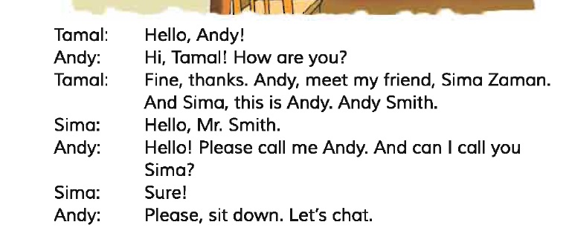
Read from the book

Slide 12
Indivitual Work :
Tamal introduces him as Andy and then he say’s ‘ Andy Smith’.

Slide 13
Pair Work :
Acting the dialogues 2 partner.

Slide 14
Group Work :
Group ‘A’
Dialogues practise
Sima Andy and tamal.

Slide 15
Evaluation :
( a ) How do you introduces your friend ?
Answer : Meet my friend........
( b ) How to tell someone to address you?
Answer : Please call me .........

Slide 16
Home Task :
Write a short composition on “ Introduce a friend”.
[ Write at least five sentences to the topic.
Remember to use capital letters,punctuation ,
correct spelling and sentence structure .

Slide 17
One day One word:
meet - সাক্ষাত করা ।

Slide 18
Thank you everybody
Stay home , Stay safe .

