Slide 1
Online Class
of
W
E
L
C
O
M
E
Idilpur Govt. Pilot High School

Slide 2
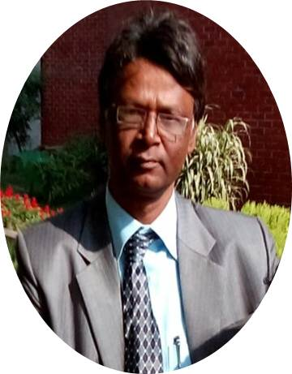
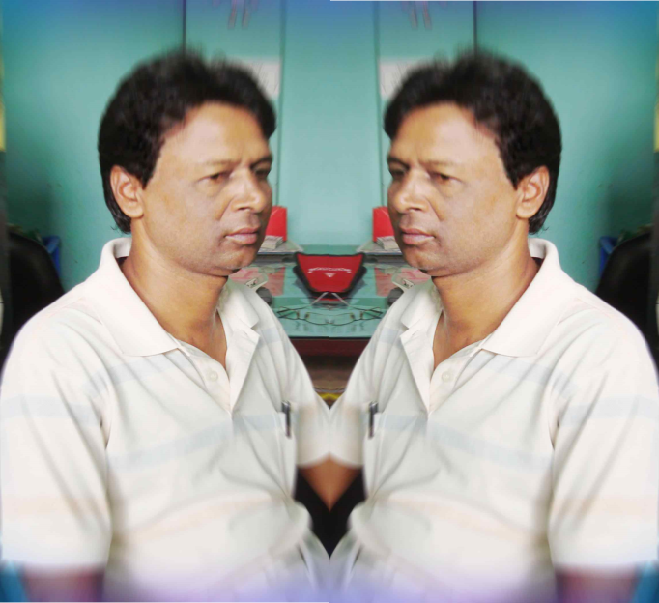
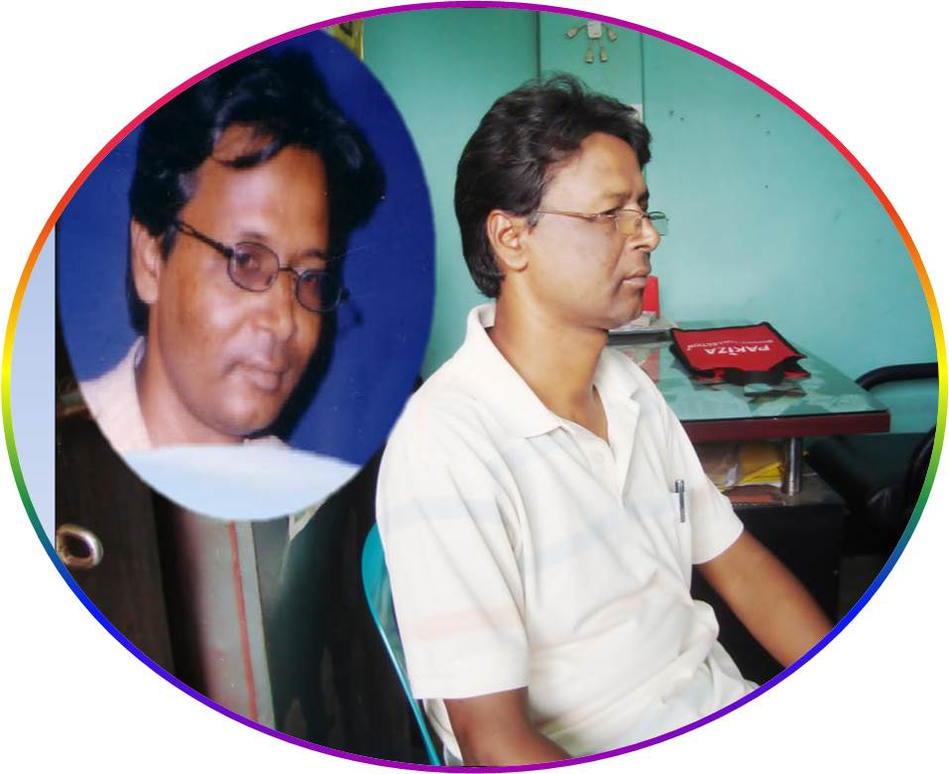
Presented By
Muhammad Emdad Hossain
Head Teacher
Idilpur Govt. Pilot High School
Class:Nine and Ten
English 2nd paper
Grammar

Slide 3
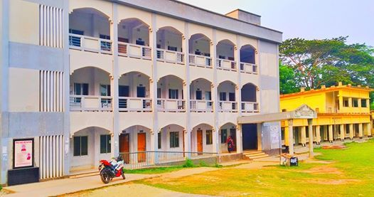
Idilpur is the place
where
Idilpur Pilot Govt. High School is situated.
Look at the slide.
What do you mean ?

Slide 4
Habib came here
and
Labib went there.
He is poor
but
he is a bright student.
Look at these sentences.
Work hard
or
You will fail to shine.
This is the pen
which
I lost yesterday.
I Know
that
he is well.

Slide 5
Clauses
Guess it ……….
What kind of topic can we discuss today?

Slide 6
Learning Outcomes
By the end of the lesson the students will be able to ____
i. learn what a clause is.
ii. identify the clauses of a sentences.
iii. learn the uses of sentences having different clauses.

Slide 7
Let’s introduce with conjunctions at a glance.
Conjunctions
Co-ordinate
Sub-ordinate
and, but, or, still, yet, than, as well as, both..and, not only..but also, either..or, neither….nor, so, as a result, consequently, etc.
that, who, whom, whose, which, what, where, when, why, while, how, as, since, because, for, lest, so that, if, unless, though, although, till, until, etc.

Slide 8
The name of the founder of Bangladesh
It is not a sentence . It is a phrase. Because it has no subject &verb.
is Bangabandhu Sheikh Mujibur Rahman.
It is a sentence. Because it has a subject & a verb.
He declared the independence of Bangladesh.
It is also sentences.
Because it has a subject and a predicate.

Slide 9
1. The name of the founder of Bangladesh
SUBJECT
is Bangabandhu Sheikh Mujibur Rahman
PREDICATE
So it is a principal clause.
who
declared the independence of Bangladesh.
2. He
SUBJECT
PREDICATE
There are two sentences in this slide.
So it is a sub-ordinate clause.
Now it is a large sentence.

Slide 10
They are the teachers of Idilpur Pilot Govt. High School
and
This is a clause . Because it has a subject & a predicate and is a part of a large sentence.
CONJUNCTION
SUBJECT
they
PREDICATE
They
This is also a clause . Because it has a subject & a predicate and is a part of a large sentence.
offer flowers at the feet of memorial on 21st February.
SUBJECT
PREDICATE
Now, it is a large sentence.
They are the teachers of Idilpur Pilot Govt. High School and they offer flowers at the feet of memorial on 21st February.

Slide 11
Now you can say…
What is clause ?
A clause means a part of a large sentence which has a subject and predicate of its own.

Slide 12
Test Yourselves.
As the teachers of this school are very friendly,
There are 18 teachers in this school
Boys and girls students study together here
They go to school together
The teachers of this school are very friendly.
Sub-ordinate Clause
About 2000 students study in this school
Sub-ordinate Clause
Sub-ordinate Clause
Principal Clause
Sub-ordinate Clause
Principal Clause
Principal Clause
we are proud to read in this school.
We know
It is a government school
Principal Clause
and
and
and
Complex Sentence
because it is a co-educational institution.
they play with another in the school ground.
We are proud to read in this school.
as the govt. of BD has recently declared it as a govt. school.
Principal Clause
most of them are very meritorious.
that Idilpur Pilot Govt. High School is one of the best schools in Shariatpur.
Principal Clause
Principal Clause
Principal Clause
they are highly educated.
Principal Clause
The teachers of this school are very friendly
Principal Clause
and so we are proud to read in this school.
Compound Sentence
Complex Sentence
Compound Sentence
Complex Sentence
Complex Sentence
Compound Sentence
Simple Sentence
Compound Sentence

Slide 13
Now write a paragraph about the Headmaster of your school by using conjunctions and indicate the clauses.

Slide 14
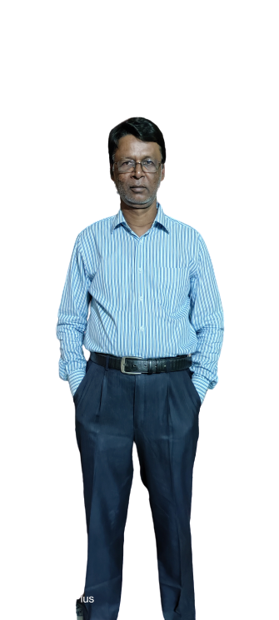
Thank You Very Much.

