Slide 1
Welcome to my English class

Slide 2
How are you doing today ?

Slide 3
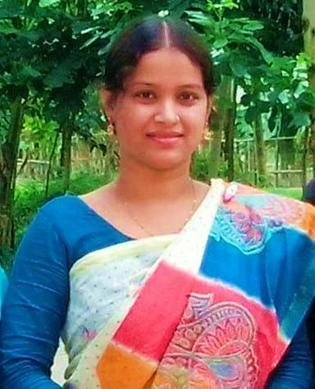
Teacher’identy
Kamrunnaher
Assistant teacher
Sreerampor purbopara govt.prymary school.
Raipura-Narsingdi

Slide 4
Lesson’s identy
Class: Four
Subject : English
Unit : 1 About me
Lesson 1-2 (C)

Slide 5
Learning outcomes-
Listening
1.1.1 Recognize sound differences in the context words.
1.4.1 recognize and use intonation patters for Wh andYes/ no questions,greetings and statements.
Speaking
1.1.1 Repeat after the teacher and say words,phrases and sentences with proper sounds , stress an intonation.
2.1.1 Change greetings and farewells.
Reading
1.4.1 Read words,pharses and sentences in the text.
1.5.1 Read words,pharses and sentences in the text with proper pronunciation,strees and intonation.

Slide 6
Hello! dear students.
My name is Kamrunnaher.
I am your English teacher

Slide 7
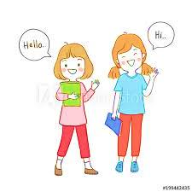
Do you remember ,what we have to say when introducing someone ?
Come here Mitu and Ritu do the activity.

Slide 8
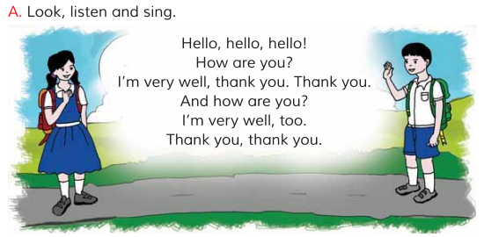
What do you understand to see the picture ?
They are greetings.

Slide 9
Now we will listen a audio very cearfully
Everyone sing with audio again and again

Slide 10
Grouo work
Now you will practice in group.

Slide 11
Now open your English book page no 3
Today we will learn this greetings song.
Everyone repeat after me again and again.

Slide 12
Pair work
Now you will practice among pair work.

Slide 13
One day one word
practice –
অনুশীলন
I am practicing again and again

Slide 14
Home work
You will practice to sing the song .

Slide 15
Thank you, that’s all for today
See you tomorrow.

