Slide 1

WELCOME

Slide 2

Teacher’s introduction
Md: Abdullah Al Mamun
Assistant Teacher,
Dhormodoho Govt. Primary School,
Birol,Dinajpur.

Slide 3

Lesson Introduction:
Class: Three
Subject: English For Today
Unit: 2
Lesson : 1-3
Lesson Name: Introducing a teacher.

Slide 4
Learning Outcomes
Listening:
3.1.1-Understand simple questions about students,family and Friends.
3.3.1: Understand statements.
Reading:
Read simple sentences with propernumciation and sress.

Slide 5
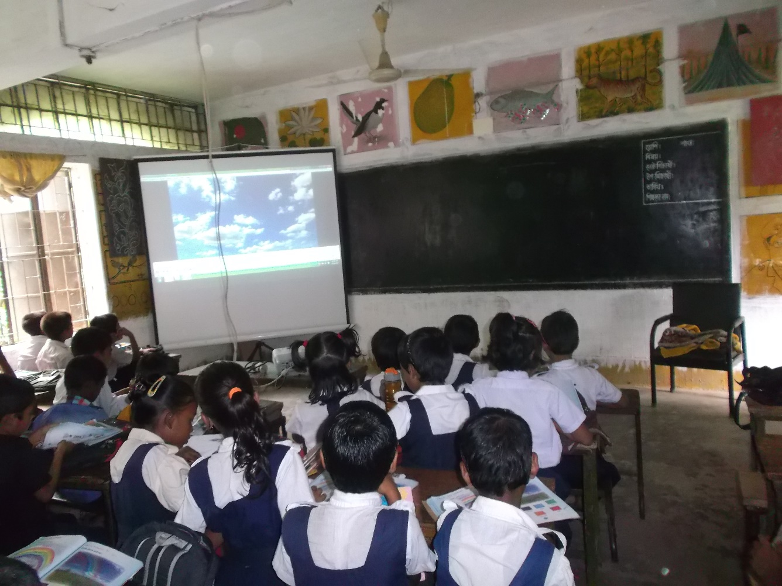
What’s this?
This is a classroom.

Slide 6
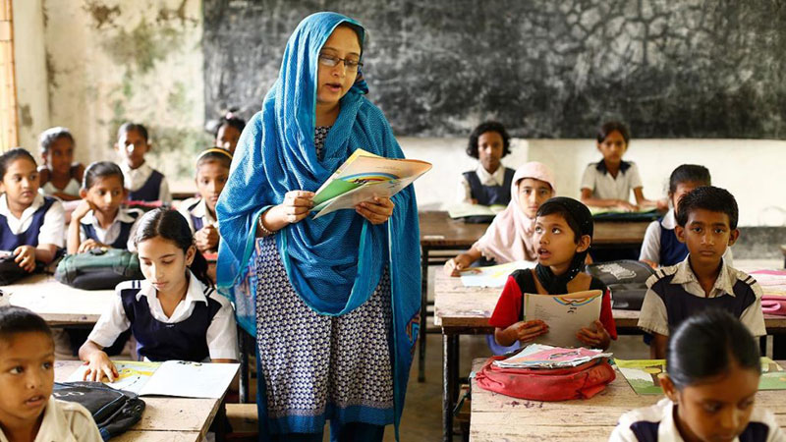
What do you see in the picture?
Do you know her?

Slide 7
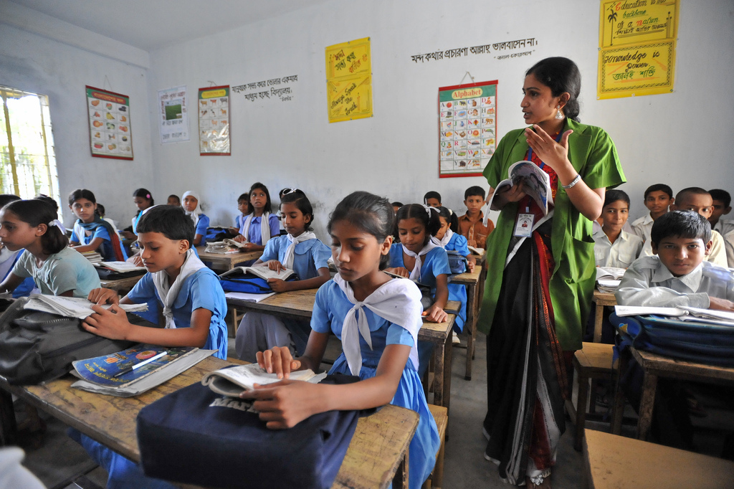
Who teaches in the classroom?
.

Slide 8
New words
Year
বছর
Old
বয়স
Work
কাজ

Slide 9
This is Mahbub Alam.
He’s 30 years old.

Slide 10
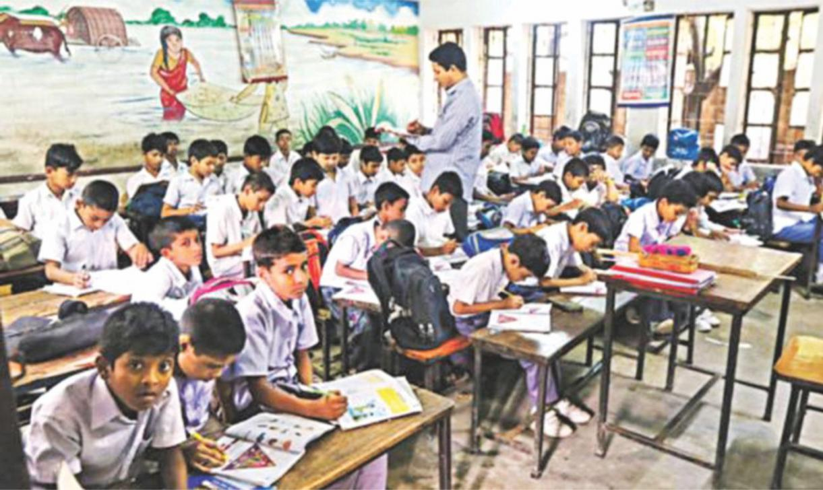
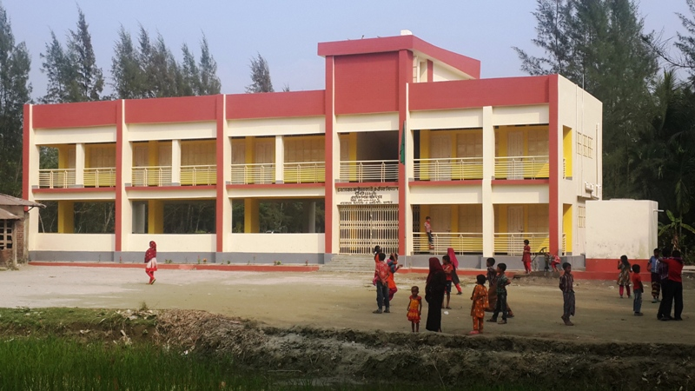
He’s an English teacher.
He works in a primary school of Narail.

Slide 11
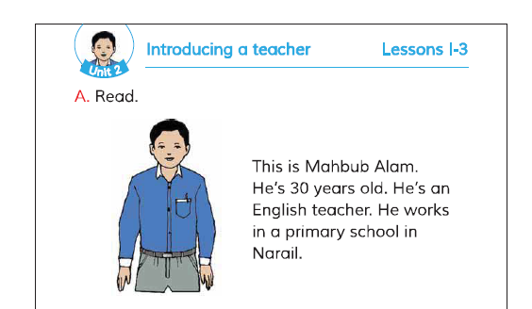
Open your book at page no. 4 and read silently with me.

Slide 12
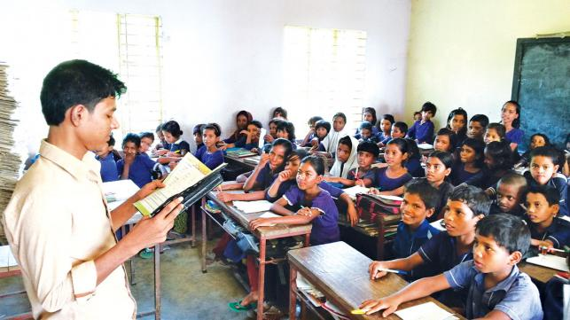
Teacher’s Model reading

Slide 13
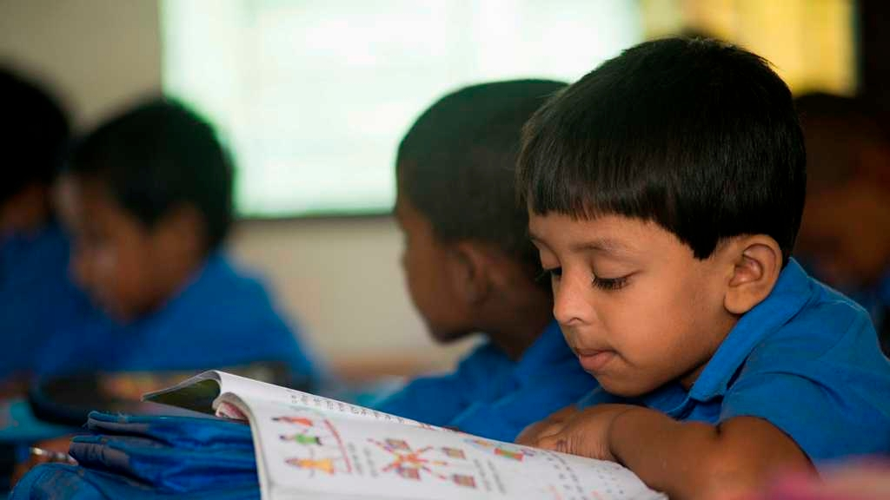
Students Reading
WCW
Read the passage loudly.

Slide 14
Read the passage alone.
I.W

Slide 15
Fill in the blanks
WCW
1. This is ________ Alam.
2. He’s 30_______ old.
3. ___ works in a ________ school
4. He is an _______ teacher.

Slide 16
SGW
Write the answer with your group.
Group 1
Group 2
1. How old is the teacher?
1. Where does he work?
2. What does he do?
2. What’s the name of the teacher?

Slide 17
Think about your favorite teacher.
Then answer the question and write a paragraph.
1. What’s the name of your teacher?
2. How old is he/she?
3. What does he/she do

Slide 18
.
Home Works
Write a short paragraph about yourself

Slide 19

See you again .
Thank you .

