Slide 1
Assalamualaikum Warahmatullahi Wabarakatuhu

Slide 2
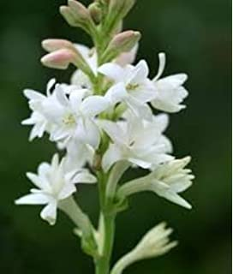
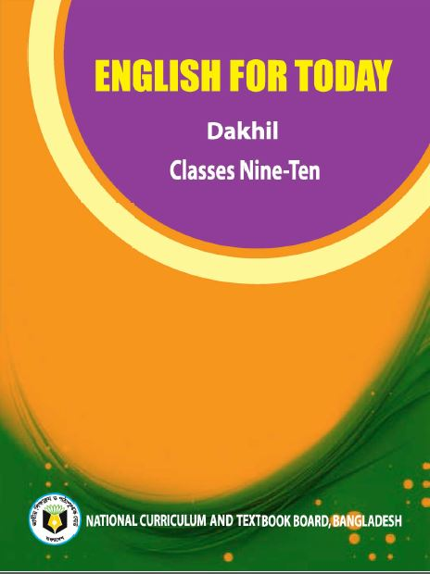
Teacher’s Identity Name: Muhammad Al Amin Assistant Teacher (English) Kathora Mohammadia Balika Dakhil Madrasah, Gazipur Sadar Mobile: 01726313606 Email: alamin1980059@gmail.com
Lesson Identity
Class: Dakhil Nine
Subject : English first Paper
Unit-3, Lesson-5 (Page: 36-38)

Slide 3
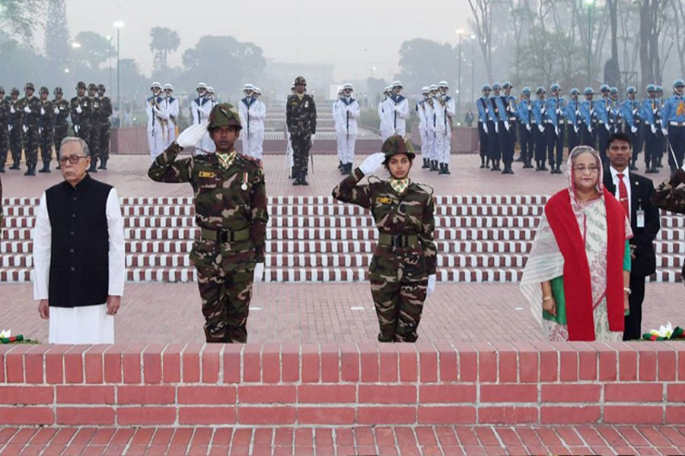

Slide 4
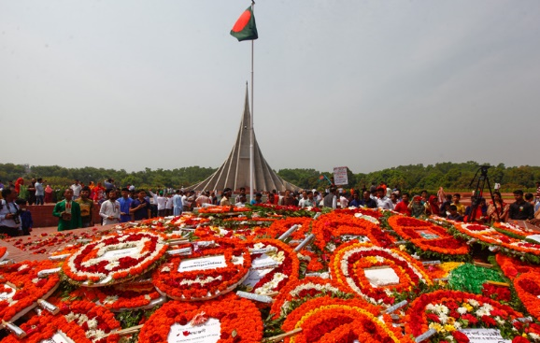

Slide 5
Learning Outcomes
After reading this lesson the students will be able to
learn the biggest festival of the country.
learn about Independence Day.
learn where the National Mausoleum situated.
learn how does the begin.
Know where is the Parade held on 26 March and who took part in the Parade.

Slide 7
Vocabulary:
Independence = freedom
Enthusiasm = zeal; eagerness
Gun-shot = firing up
pay homage to = show respect
Sacrifice = giving up
Spectator = viewer
Organize = arrange
Festival = celebration
Fervour = a strong feeling of excitement
Diplomat = ambassador
Highlight = uphold
Heroic = brave
Parade = showing march past
Display = exhibition
Illuminate = to decorate a building with bright light

Slide 8
Lesson Gist
26 March, our Independence Day, is the biggest state festival. The day begins with 31 gunshots. People from all walks of life come there with rallies and processions. Early in the morning the President and the Prime Minister on behalf of the the nation place floral wreaths at the National Mausoleum at Savar. The country also witness a smartly dressed parade of defence forces, border guards, police, ansars and the VDP (Village Defence Party) at the National Parade Ground near the National Parliament.

Slide 9
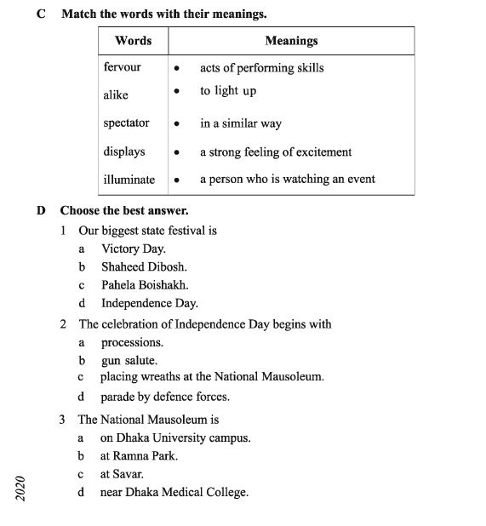

Slide 11
Questions
What is the biggest festival of the state?
What does Bangla Academy hold?
How are the public buildings illuminated?
Where is the Nation Mausoleum?
Who place floral wreaths at it on behalf of the nation? when?

Slide 12
Thank You All

