Slide 1
WELCOME

Slide 2
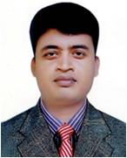
INTRODUCTION
MD.SARUWAR HOSEN
M.S.S, B.ED.
SENIOR TEACHER(ENGLISH)
AGRANI HIGH SCHOOL CHUNARUGHAT
HABIGANJ
saruwarhosen@gmail.com
Cell-01712-861616
Class-VIII
English 2nd Paper

Slide 3
1.Runa sang a song.
2. I like him very much.
What is the parts of speech of the words in the circles?
Verb

Slide 4
Our today’s topic
Right forms of verbs
Part-2

Slide 5
Learning Outcomes
After this lesson the students will be able to...
write the sentences using right forms of verbs.
fill the gaps with right forms of verbs (with clues).

Slide 6
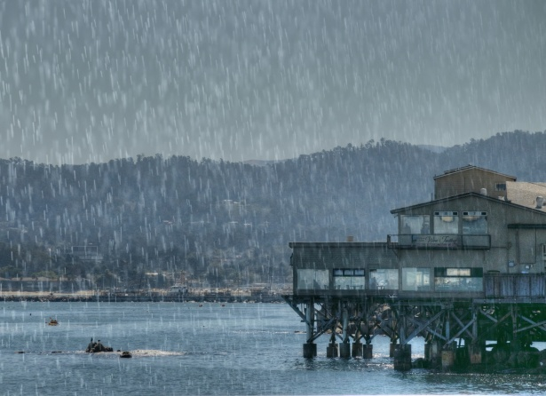
# If in the sentence there is for/since+ time the
sentence will be Present Perfect Continuous Tense.
It has been raining for three hours.

Slide 7
# If in the sentence there is once/ago/long ago/last night/ last week/last year/yesterday , the sentence will be Past Indefinite tense.
Once there lived a greedy farmer.

Slide 8
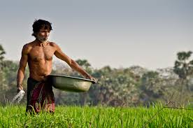
# If in the sentence there is has/have/had ,the verb of the sentence will be past participle.
He has done the work. s

Slide 9
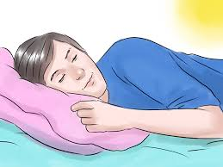
# If in the sentence there is had better, had rather,would rather,would rather,let,must,need,dare , the verb of the sentence will be present form.
You had better take rest..

Slide 10
# If in the past tense there is word ‘before’ between
two clauses, the sentence structure will be-
The clause(Past Perfect)+ before +The clause (Past Indefinite).
We had reached the school before the bell rang.
# If in the past tense there is word ‘after’ between two clauses, the sentence structure will be-
The clause(Past Indefinite)+after +The clause (Past Perfect).
Runa went to bed after she had finished their study.

Slide 11
INDIVIDUAL WORK
Fill the gaps using right verbs.
It (rain) for five hours.
He (come) home last night.
Orna has (break) the glass.
4.You had better (to leave) the place

Slide 12
Work
1.We (read) for an hours.
2.They (come) home last year.
3.Sworna has (buy) the glass.
4.You had better (to go) home.
5. We had reached the station before the train left.

Slide 13
Thanks all

