Slide 2
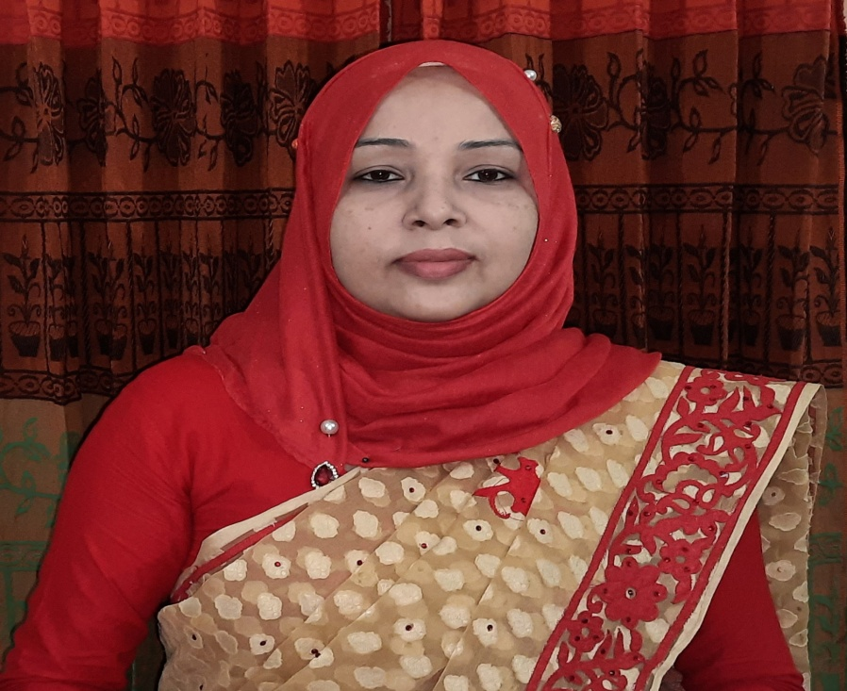
Identity
Achia Begum
Head Teacher
Uttarsur k.c Govt’ Primary School
Sreemangal,Moulvibazar.

Slide 3
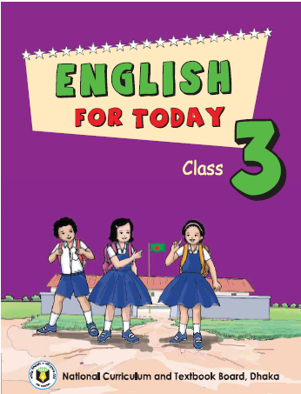
Identity
English For Today
Class:Three

Slide 4
Let’s enjoy a video…

Slide 5
Learning outcomes
Students’ will be able to :
4.3.1 enjoy and understand simple stories.
3.1.1 ask and answer Wh questions
5.1.1 read simple paragraphs.
8.1.3 write sentences from the textbook or model.
10.1.1 write short and simple paragraphs by answering a set of questions.

Slide 6
Title decleration
My family
Unit:34
Lesson:1-3
Todays Lesson: “I’m……years old”.

Slide 7
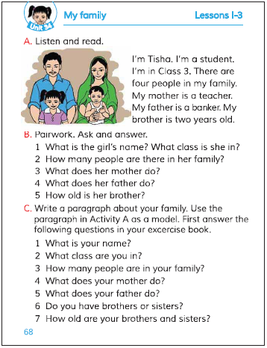
Open your book at page 68

Slide 8
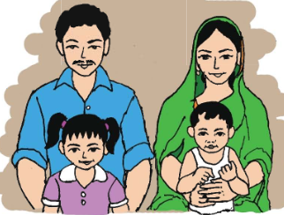
Dear ss, think what will be the picture?
2/3 students will answer.

Slide 9
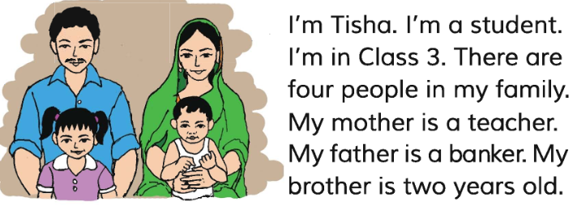
Listen to the audio carefully.
Open your book and Put your finger under the line.

Slide 10
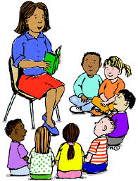
Teachers loud reading……
Students repeat after teacher. And they will put their finger under the line.

Slide 11
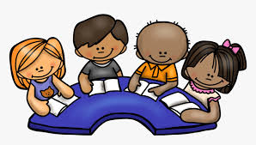
Group reading
Read in groups. One student will read
by turn and others will listen. Help him/
her .Do it in turn.

Slide 12
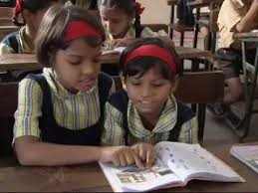
Pair work
Answer the following questions.
1.What is the girl’s name?
2.What class is she in?
3.How many people are there in her family?
4.What does her mother do?
5.What does her father do?
6.How old is her brother?

Slide 13
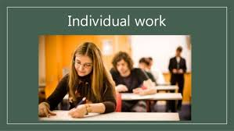
Fill in the blanks.
Tisha is a ………. .
She is …..class 3.
c. There are ……..members in Tisha’s family.
d. Tisha’s mother is a…………
e. Her father is a………….

Slide 14
Write 3 sentences about your family.

Slide 15
Thank you

